Slide 1
Towards a
Natural User Interface
Kai-Fu Lee
Corporate Vice President
Natural Interactive Services Division
Microsoft Corporation
Notes:
Vision of the future of user interface.
But illustrated with real products that pave the roadmap towards this user interface.

Slide 2
Talk Outline
The NUI revolution
  The vision.
  The ingredients and technologies.
5 challenges to getting NUI started
10 steps to overcome challenges
Conclusion

Slide 3



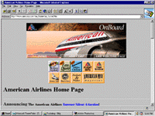
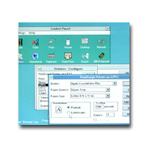
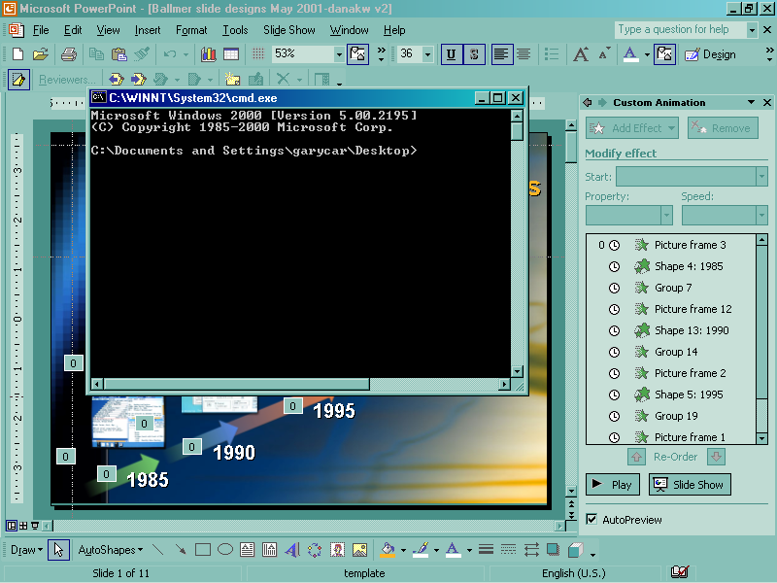
User Interface Evolution
Graphical
User Interface
Search Engines
Hyperlinks
Multiple Windows
Menus
Command line
1995
Internet
1985
1990
PC
GUI
Notes:
Revolutions in computing & UI have been mutually reinforcing….
Example: bitmap graphics & mouse + windows.
Power of the PC enabled bitmap graphics, which gave rise to a better UI.
Browser + internet & hyperlink + search engine.
Power of the UI of hyperlinking otherwise unconnected content turned into the Internet and the rich content that we now cannot live without.

Slide 4
User Interface Evolution
Graphical User Interface
GUI Technology
Direct manipulation
  Mouse / keyboard input
  Mouse input mapped to Windows, menus, etc.
  Keyboard input (search) mapped to text index
GUI Interaction
User is the expert and knows
  What functions exist
  Where to go
  What to click (and in what order)
  What to type
Enables
Notes:
GUI, which is embodied by the used of mouse+menus+multiple windows, was an incredibly important step in UI. The success of the Macintosh and Windows created standard platforms to develop applications in cost-effective, consistent, and easy-to-use ways.
GUI UI provides the user with a direct link between their actions (inputs) and the effect of those actions. Users learn what actions cause what effects, and plan their own solution.
So for users who have learned and become an expert, they love GUI. But you do have to become an expert to get the full advantage.
For example, if you want to find a recipe for Kung Pao chicken, you need to find what web sites have recipes, then navigate in that web site to find if it has that recipe.
Or if you want to change your proxy server in IE, you need to know to open tools → Internet Options → Connections → LAN Settings.
GUI is great for experts who know exactly what they are doing.

Slide 5








User Interface Evolution
Natural
User Interface
Personal Assistant
Multimodal (speech, ink…)
Graphical
User Interface
Natural Language
Search Engines
Hyperlinks
Multiple Windows
Menus
2005
Any place,
Any time,
Any device
Command line
2000
1995
XML
Web Services
Internet
1985
1990
PC
GUI
Notes:
New changes are coming
Explosive web content – including the invisible web.
Complex web services – providing new capabilities for users to buy what they want, when they want, at the price they want; reach people and be notified of important events.
Any device – Need to be made available any time any where & can be used by any body. The power of these services will make computing useful to every citizen of this planet.
Recall that GUI is great for expert users, these changes present serious challenges to GUI:
There will be so much web content and web services, that nobody can be an expert at everything.
GUI works great on a screen with mouse and keyboard, but many of these devices have small or no screen, and no keyboard.
We want an interface that is so easy to use, that every citizen of this planet can learn & use it.
To deliver on the dream of making web-based content and services available to the masses, we need a new UI paradigm that allows people to easily, naturally, and expressively describe what they want, as easily as they interact with other people.

Slide 6
NUI – “Do What I Mean” UI
Users naturally articulate what they mean, on any device, to any application or web service, and have their intention interpreted and executed accurately.
Why NUI?
  Expressive.
  Natural.
  Scalable.

Slide 7


Natural User Interface
Motivated by human-human interaction
Interacting with a Librarian
“Information about Chicago”
“Chicago the city, college or music group?”
“City”
“History or travel information?”
“Travel”
“Who knows about traveling to Chicago?”
Books, magazines, other libraries…
Present choices
Notes:
The UI we need must have
Preciseness to find from explosive content & services.
Richness to express much more complex concepts.
Scalable -- works on any device, and easy to learn/use/remember by anybody.
In this talk, I will talk about the move towards what we call NUI.
-- The use of natural human language in UI to computers.
Let’s think about how we interact with other people when we want to find something… when we go to the library… we might have an interaction like this:
Go through the dialog example here.
Hear speech
Understand Intent
“Broker” to Dewey catalog + new arrivals + magazines + other libraries or librarians
What is really great about this kind of a natural interface is that the library user is NOT an expert, and does NOT have to know where to find information, or the “language” needed to get the information, or how to pick among a sea of information.
The librarian is a HELPFUL ASSISTANT, to whom you delegate what you want done, not the steps of how to do it.

Slide 8
Natural User Interface (NUI)
NUI Technology
NUI Technology
Hear what you say
Typed, spoken, written
User asks naturally
“Find information about Chicago”
User says / types:
“Information about Chicago”
“I want to travel to Chicago”
“Book my flight to Chicago using Expedia”
NUI Interaction
Enables
Text
2. Know what you mean
Analyze text
Consider context
Clarify using dialog
3. Do what you want
Broker and execute by
finding content / services
Notes:
So our goal is to teach the computer to be more librarian-like, and assistant-like.
What technologies do we need to make this vision possible?
There are three sets of technologies:
First hear what you said.
Second understand what you mean.
Third, do what you want.
The librarian analog is going from the sentence “information about Chicago” to figuring out that “you want to travel to Chicago”, and then providing the solution “to book a flight through Expedia travel service”.

Slide 9
NUI: Hear What You Say
NUI Technology
Hear what you say
Typed, spoken, written
User says / types:
“Information about Chicago”
“I want to travel to Chicago”
“Book my flight to Chicago using Expedia”
NUI Interaction
Enables
Text
2. Know what you mean
Analyze text
Consider context
Clarify using dialog
3. Do what you want
Broker and execute by
finding content / services
Notes:
In the rest of my talk, I will talk about each of these three technology components.
First – how does the librarian interact with you?
It’s using human language, because that is how people prefer to interact. This is mostly speech, but also you might send an email to a librarian, or fill out a form using handwriting. So the central thing is not speech, but the use of human language.

Slide 10
Hear What You Say
Human language : “Invented” for interaction
  “[Language is] a biological adaptation to communicate information… One of nature’s engineering marvels”
  – Steven Pinker
  “Vision evolved from the need to survive; speech evolved from the need to communicate”
  – Michael Dertouzos.
Speech is central…
  … but also typing, handwriting, gestures…
  Best form depends on:
    Habit / skills (typing to PCs)
    Form factor (speaking to phones)
    Situation (writing at meetings)
  Eventually, multimodal
Notes:
Let’s think about the first step in “talking” to a librarian… we don’t use GUI, we use human language.
We learn it as we grow up. It is “natural” and has no learning curve.
It is more expressive – you can say many things that are hard to use GUI to express (example: if-then, for-all, when, etc.).
How would you express “send flowers to mom on her birthday” in GUI?
Or “If I get an important call, page me, but don’t bother me from 1PM to 4PM”?
Human language evolved from the need to communicate / interact (human vision evolved from the need to survive).
So pure human language is a good way to input to the librarian’s brain (this is just input; there is no understanding yet). And as input…
We might think speech is the only way. In fact, it is the most natural way, but speech recognition makes errors, and also there are reasons why other medium work better in many situations…
Typing is still faster because ASR is not perfect (for word processing).
But for some languages (Chinese/Japanese), typing is slow and speech input is faster.
But speech makes a lot of sense on mobile devices, phones and PDAs, that do not have a keyboard.
On the other hand, social reasons make speech input infeasible in meetings and open spaces.
Eventually, you want to take into account multiple modalities at one time, just like in a library you might point at a picture and ask a question.

Slide 11
NUI: Know What You Mean
NUI Technology
Hear what you said
Typed, spoken, written
NUI Interaction
User says / types:
“Information about Chicago”
“I want to travel to Chicago”
“Book my flight to Chicago using Expedia”
Enables
Text
2. Know what you mean
Analyze text
Consider context
Clarify using dialog
3. Do what you want
Broker and execute by
finding content / services
Notes:
Once the “hearing” part of the librarian hears “words”, these words should be sent to the “brain” of the librarian for “understanding”.
How does a librarian understand you?
Know the English language, apply domain knowledge, knowledge of you (5-year old & 30-year old asking the same question may mean different things), statistics (what things people ask a lot vs. not), etc.
If still unclear, talk to you to clarify.

Slide 12
Know What You Mean – by combining:
Syntax (rules of the human’s language)
  Nouns, verbs, etc. and how they combine
    “Book about a trip to Chicago” vs. “Book a trip to Chicago”
  Normalize linguistic variations .
Semantics
  Meaning of the words
    Book means reserve a ticket; requires from-city, to-city, etc.
Context (additional hints)
  Domain knowledge :
    No train from Hawaii to Chicago
  Statistics : Book as a noun > Book as a verb
    “Book Chicago”
  Personal Preferences :
    Where you live, your calendar, how you pay…
  Model of time, urgency, presence
Dialog (resolving ambiguity & determine intent)
    “Buy a book or book travel?”
    “What date would you like to travel?”
Notes:
Know what I mean is the brain that takes all the inputs, words broken, syntax, semantics, utterances, context, and figures out the person’s intent.
To understand what you said, the librarian brings to bear a lot of knowledge, including:
Syntax of the language – understanding nouns / verbs… similar to diagramming a sentence in high school… “Book” means very different things as nouns and verbs.
Semantics – Book is not just a verb, but it specifically means reserving a ticket, which requires additional other fields.
Other hints – context, common sense, statistics / frequency, personal preference / knowledge. Who the asker is, who the answerer is, where they are, what they are doing at the time, the time of year, etc. All of that plays an implicit but vitally important role in answering a query. “Turkey” before Thanksgiving, and “Turkey” after Turkey earthquake are likely to mean different things.
If after parsing the sentence, and taking into account other hints, what the user said is still ambiguous or incomplete, then you could engage in a dialog to clarify any such part.
It may also be worth noting that the same is true in the real world--how many times have you asked a human a question and they said they didn't know, or said they did but it turned out they were mistaken, and you have to figure out who to ask? “I want to check in” to a hotel clerk, and “I want two chicken” to a butcher.
Use the librarian / Chicago example to illustrate these.
Knows where you live & how you pay (for delivery of goods).
Knows your preferences (travel by plane or bus).
Knows your relationships (who’s your boss, wife, etc.).
Knows what is important to you (email prioritization).
Can give high-level commands almost impossible using GUI.
“Page me if my mother calls”
Can pro-actively find things for you, not just delegate-and-do.
Keeps your data secure.

Slide 13
NUI: Do What You Want
NUI Technology
Hear what you said
Typed, spoken, written
User says / types:
“Information about Chicago”
“I want to travel to Chicago”
“Book my flight to Chicago using Expedia”
NUI Interaction
Enables
Text
2. Know what you mean
Analyze text
Consider context
Clarify using dialog
3. Do what you want
Broker and execute by
finding content / services
Notes:
Once the librarian understands your request, she needs to do two things:
First she has a mental model (Dewey Catalog) that maps your intent to a particular section(s) of the library.
Second she thinks about all the sections of the library that your query might match (magazine, books).
Then she might sometimes give you an answer for your question, sometimes point you in the right direction (with a list of books), or hand you a phone number.

Slide 14
Do What You Want
(by brokering & combining)
No system can know everything.
Broker intent to experts:
  Take user intent and determine
    “Who are the possible experts for this intent?”
  Each expert (web service) registers what it knows
    Encarta knows about history, geography, …
    Expedia knows about travel (to various places…)
    Amazon knows about books, book reviews…
Combine all experts’ answers,
  Content (like a search) – Find history of Chicago.
  Action (like a service) – Buy a ticket to Chicago.
Notes:
Similarly, we will want web services to “register” themselves the way that the books are “registered” in the Dewey Catalog.
For example, Encarta, Expedia, Amazon….
If that happens, once the computer understands your intent, it just “brokers” to web services that may know about what you want.
These services give their best shot at the answer for the intended question.
We will now need to look at these answers, which may be:
Content discovery → Find … example = finding “American Civil War”
Also service discovery → Do … example = “Book a trip to Chicago”.
If there is one good answer, just do it. Otherwise, let users choose (just like search engines today).

Slide 15
NUI Will Enable…
Find the Bill Gates book on future
When is the Britney Spears concert?
How do I replace my printer cartridge?
Buy the Gladiator DVD for less than $15
Send flowers to mom on her birthday
Continue working on my annual report
Notes:
Bill Gates book – figures out what book it is (The Road Ahead).
Concert – Over time:
1) Find concert schedule.
2) Synchronize with your schedule, and propose to buy.
Printer cartridge – Federate to HP printer, because it knows I have HP.
Librarian analogy : find manuals (which are books).
Buy DVD – not only broker to DVD-sale site, but if none found,
can pro-actively look for this as an agent.
Send flowers – Knows who mom is, where she lives, how I want to pay,
what flowers she likes, when to have it delivered, etc.
Continue working on my biz plan – Brings up right apps (notion of
apps go away). Load data from local disk (financial plan),
Intranet (last year’s sales numbers), and Internet (IDC
projections the industry).
Boundaries will disappear between apps and web services.
Between content (search) and action (do).
Between local, Intranet, and Internet.

Slide 16
Challenges to NUI
Technology limitations
User reluctance
Unproven business value
High development effort
More than UI – infrastructure needed
So, how do we make NUI work?
→ 10 evolutionary steps.
Notes:
Technology limitations – NUI technologies (speech, NLP) are getting better, but it’s important to realize that we are a long way off and there is no silver bullet. Speech recognition still makes at least an order of magnitude more errors than people. With natural language understanding, the technology is so far from human capabilities, that I do not even know how to measure the gap. Finally, the implied “universality” of NUI is problematic – while systems for constrained domains have been demonstrated, combining domains will make the problem much more complex, and result in reduced performance. Given all the technology challenges, we cannot have a strategy that requires technology breakthroughs; we need a strategy that can succeed in spite of the brittleness of today’s technology.
End-users acceptance – How can NUI successfully “compete” with GUI – GUI is very mature, and can do many things well, particularly for people who have become accustomed to its predictable nature. To get people to use natural language to communicate with their PCs, NUI must offer something that can’t be done with GUI. Furthermore, for the users who have become accustomed to GUI, the loss of control and at times unpredictable nature of a NUI system will be a barrier for adoption. In addition, we know that end-users are resistant to change. Finally, today, users do not feel comfortable speaking or typing long sentences to a computer. People may be comfortable typing to a search engine, but they are very terse (1-2 words typically), which makes sophisticated NL technologies useless. It will take a long and deliberate plan to get end-users to adapt to a new interface style. Revolutionary changes are likely to fail, unless they are accompanied by technology breakthroughs.
Unproven business value – Since NUI is a platform play, there has to be clear business value to businesses, for them to embrace a new platform. There needs to be self-evident ROI that NUI offers over existing interfaces for web services, web sites, or any business that we choose to target. How will the services offered to the end-users bring end-user benefit as a result of using our platform? And how does that translate into business value to the businesses? How do we explain the NUI concept and package the NUI product to appeal to them?
High developer effort – Authoring for NL and speech is notoriously difficult. Laborious effort is often needed to author for each domain. Current products are flawed in this respect because they: (1) requires specialized skills, (2) has a high initial adoption cost, and (3) provides insufficient benefit for the cost incurred. Furthermore, authoring currently is repeated for multiple applications within a corporation – site search, customer service, exposure to search engine, speech applications, etc. An authoring tool that works out-of-the-box, is easy to improve, spans multiple functions/domains/modalities, and preserves the authoring investment is critical to the successful adoption of this platform. Yet such a tool remains elusive.

Slide 17
Challenges to NUI
Technology limitations
User reluctance
Unproven business value
High development effort
More than UI – infrastructure needed
Notes:
Technology limitations – NUI technologies (speech, NLP) are getting better, but it’s important to realize that we are a long way off and there is no silver bullet. Speech recognition still makes at least an order of magnitude more errors than people. With natural language understanding, the technology is so far from human capabilities, that I do not even know how to measure the gap. Finally, the implied “universality” of NUI is problematic – while systems for constrained domains have been demonstrated, combining domains will make the problem much more complex, and result in reduced performance. Given all the technology challenges, we cannot have a strategy that requires technology breakthroughs; we need a strategy that can succeed in spite of the brittleness of today’s technology.
End-users acceptance – How can NUI successfully “compete” with GUI – GUI is very mature, and can do many things well, particularly for people who have become accustomed to its predictable nature. To get people to use natural language to communicate with their PCs, NUI must offer something that can’t be done with GUI. Furthermore, for the users who have become accustomed to GUI, the loss of control and at times unpredictable nature of a NUI system will be a barrier for adoption. In addition, we know that end-users are resistant to change. Finally, today, users do not feel comfortable speaking or typing long sentences to a computer. People may be comfortable typing to a search engine, but they are very terse (1-2 words typically), which makes sophisticated NL technologies useless. It will take a long and deliberate plan to get end-users to adapt to a new interface style. Revolutionary changes are likely to fail, unless they are accompanied by technology breakthroughs.
Unproven business value – Since NUI is a platform play, there has to be clear business value to businesses, for them to embrace a new platform. There needs to be self-evident ROI that NUI offers over existing interfaces for web services, web sites, or any business that we choose to target. How will the services offered to the end-users bring end-user benefit as a result of using our platform? And how does that translate into business value to the businesses? How do we explain the NUI concept and package the NUI product to appeal to them?
High developer effort – Authoring for NL and speech is notoriously difficult. Laborious effort is often needed to author for each domain. Current products are flawed in this respect because they: (1) requires specialized skills, (2) has a high initial adoption cost, and (3) provides insufficient benefit for the cost incurred. Furthermore, authoring currently is repeated for multiple applications within a corporation – site search, customer service, exposure to search engine, speech applications, etc. An authoring tool that works out-of-the-box, is easy to improve, spans multiple functions/domains/modalities, and preserves the authoring investment is critical to the successful adoption of this platform. Yet such a tool remains elusive.

Slide 18
1. Change the world, one domain at a time
General understanding is hard.
Domain knowledge can:
  Reduce linguistic ambiguity: proceeds, IRA…
  Reduce semantic ambiguity: I want to check in.
  Can get benefit even for “very big domains”
Use of contextual cues helps further.
Domain Constraints
Explicit Input
Context = implicit input
“Reasoning
Engine”
Notes:
Open-ended language understanding and task execution is extremely hard. This is one of the principle things learned from the Majel experience – many challenges are caused in the problem complexity and UI because Texas itself is really several applications – multi-applications require solutions for routing, higher-accuracy reasoning engine, as well as UI that provides hints about context.
In fact, the simpler the constraint, the better – for example, that the user is looking at a folder with just photos, or that the user is on the support section of a website.
Context = georelevence.
Domains can get pretty big (MSN Search).

Slide 19
2. Don’t try to solve all the problems at once….
Integrated search (documents, schema, database)
Re-usable domain and general language libraries
Q&A for databases (e.g., stored procedures)
Authoring tool that learns from user behavior
Modeling of context / domain knowledge
Planning, web services composition
Help and commands (slot filling)
Basic NL / disambiguation dialog
One model for speech and NL
General Q&A over documents
Handle complex sentences
Multi-domain reasoning
General Context Model
Natural dialogs
Probably Solvable Now Long-Term Research Problems

Slide 20
3. Be religious about solution, but be pragmatic about technology
Don’t fall in love with one technology!
Take whatever technology works.
If there are several approaches,
  Take the simplest!
  Rule of 80-20 could be 99-1 for hi-tech!
Combine them if that helps.

Slide 21
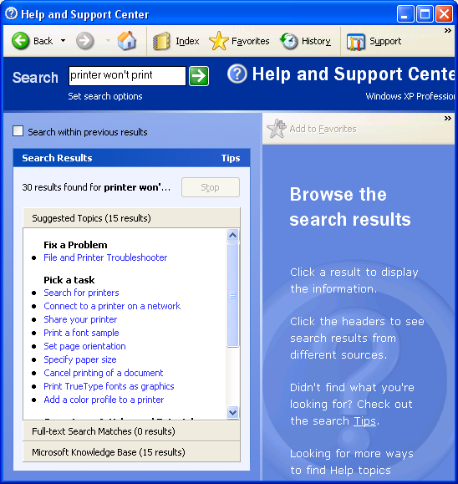
4. Use UI to hide technology imperfections.
Push the intelligence-required problems back to the human.
Request-and-choose UI
  Natural (in search).
  Top N precision, not top 1 precision.
Other UI tricks….
Notes:
Use UI to hide technology imperfections. For example, give users choices, or ask for disambiguation, rather than relying on imperfect technology to determine user intent with nearly perfect accuracy. If NUI looks and feels like a search engine, it is a lot easier than introducing a new user interface element that suggests that we can accept any command and just do it and get it right. We call this search UI request-and-choose (RAC). RAC means the user enters an NL input, and a list of choices are displayed back. The “AI problem” of understanding user intent is then passed back to the user to choose among the choices. Don’t under-estimate the power of this – the difficulty of understanding user input (and filling out all intended slots with 95% accuracy) is orders of magnitude harder than giving the user the correct answer somewhere within the result page (with slots not necessarily filled out) 95% of the time. And users are telling us that they find this kind RAC-based UI not only acceptable, but satisfying. This may seem trivial, but it is likely to be the single most important thing that makes imperfect technology work acceptably.
Use UI to hide tech problems – Microsoft phone system?

Slide 22
Challenges to NUI
Technology limitations
User reluctance
Unproven business value
High development effort
More than UI – infrastructure needed
Notes:
Technology limitations – NUI technologies (speech, NLP) are getting better, but it’s important to realize that we are a long way off and there is no silver bullet. Speech recognition still makes at least an order of magnitude more errors than people. With natural language understanding, the technology is so far from human capabilities, that I do not even know how to measure the gap. Finally, the implied “universality” of NUI is problematic – while systems for constrained domains have been demonstrated, combining domains will make the problem much more complex, and result in reduced performance. Given all the technology challenges, we cannot have a strategy that requires technology breakthroughs; we need a strategy that can succeed in spite of the brittleness of today’s technology.
End-users acceptance – How can NUI successfully “compete” with GUI – GUI is very mature, and can do many things well, particularly for people who have become accustomed to its predictable nature. To get people to use natural language to communicate with their PCs, NUI must offer something that can’t be done with GUI. Furthermore, for the users who have become accustomed to GUI, the loss of control and at times unpredictable nature of a NUI system will be a barrier for adoption. In addition, we know that end-users are resistant to change. Finally, today, users do not feel comfortable speaking or typing long sentences to a computer. People may be comfortable typing to a search engine, but they are very terse (1-2 words typically), which makes sophisticated NL technologies useless. It will take a long and deliberate plan to get end-users to adapt to a new interface style. Revolutionary changes are likely to fail, unless they are accompanied by technology breakthroughs.
Unproven business value – Since NUI is a platform play, there has to be clear business value to businesses, for them to embrace a new platform. There needs to be self-evident ROI that NUI offers over existing interfaces for web services, web sites, or any business that we choose to target. How will the services offered to the end-users bring end-user benefit as a result of using our platform? And how does that translate into business value to the businesses? How do we explain the NUI concept and package the NUI product to appeal to them?
High developer effort – Authoring for NL and speech is notoriously difficult. Laborious effort is often needed to author for each domain. Current products are flawed in this respect because they: (1) requires specialized skills, (2) has a high initial adoption cost, and (3) provides insufficient benefit for the cost incurred. Furthermore, authoring currently is repeated for multiple applications within a corporation – site search, customer service, exposure to search engine, speech applications, etc. An authoring tool that works out-of-the-box, is easy to improve, spans multiple functions/domains/modalities, and preserves the authoring investment is critical to the successful adoption of this platform. Yet such a tool remains elusive.

Slide 23
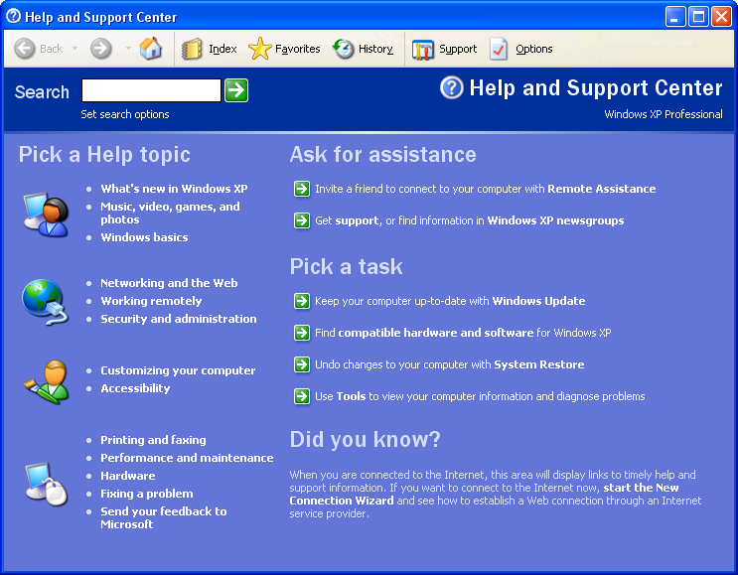
5. NUI complements and extends GUI
It’s all about discoverability.
  If it fits in one screen, GUI works great.
Always want to combine GUI and NUI.
  Search & browse is a good example
Notes:
Where GUI exists, NUI’s focus is to complement it, and to take over where GUI leaves off. We strongly believe that NUI is not a GUI replacement, but must be developed to complement GUI. GUI is a direct interface that exposes the widgets needed to accomplish tasks. GUI works well when the number of “features” can fit on a screen and be browsed. But the features are growing in number and in complexity. The solution is GUI+NUI – GUI continues to do its job, and NUI is used for finding the tasks that are too numerous to fit on the screen, or too complex that requires natural language to express. NUI-suitable tasks include finding an archived email, searching for a webview task in Windows, searching for information on a website and on the Internet, finding help in an application, or executing a command within an application. This principle also suggests that GUI and NUI should be more tightly integrated – using GUI to provide context and constraint for NUI; using this context, user input, and history to help surface the most common tasks through GUI, etc.
Context trick applies to GUI too – such as the proposed photo tasks.

Slide 24
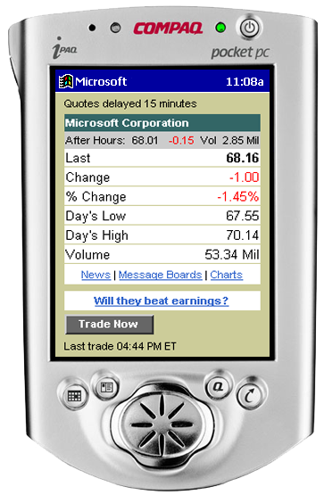
NUI extends GUI… even for small devices
When the screen is there, use it!
Example: SALT for multimodal and telephony-only
One authoring tool for all devices.
Extend presentation layer developers already know (e.g., html, xhtml).

Slide 25
6. NUI should start with user’s comfort zone
Don’t try to add revolutionary UI elements, and make users learn.
Instead, find out where users type/speak, and start there.
  Speaking : telephone (routing).
  Typing : search engine (finding).
  Handwriting : annotation.
Accommodate the user first; then expand naturally from there.
  Telephone → PDA → PC.
  Search → navigation → help → command.
Notes:
start with UI elements that people naturally “talk” or “type” to. We must start with UIs that people naturally use today – the telephone (for speech) and the search box (for typing). If we can deliver good speech recognition for the telephone, we can then extend to screen phones, smart phones, PDAs, tablet PCs, and then PCs. If we can deliver good searching for websites and the Internet, we can then extend into navigation, help, commands, question-answering for Windows, Office, MSN, and any application. We will start from the accepted UI elements today, and grow into the revolutionary experience of the future.
Steve Capps story.

Slide 26
Challenges to NUI
Technology limitations
User reluctance
Unproven business value
High development effort
More than UI – infrastructure needed
Notes:
Technology limitations – NUI technologies (speech, NLP) are getting better, but it’s important to realize that we are a long way off and there is no silver bullet. Speech recognition still makes at least an order of magnitude more errors than people. With natural language understanding, the technology is so far from human capabilities, that I do not even know how to measure the gap. Finally, the implied “universality” of NUI is problematic – while systems for constrained domains have been demonstrated, combining domains will make the problem much more complex, and result in reduced performance. Given all the technology challenges, we cannot have a strategy that requires technology breakthroughs; we need a strategy that can succeed in spite of the brittleness of today’s technology.
End-users acceptance – How can NUI successfully “compete” with GUI – GUI is very mature, and can do many things well, particularly for people who have become accustomed to its predictable nature. To get people to use natural language to communicate with their PCs, NUI must offer something that can’t be done with GUI. Furthermore, for the users who have become accustomed to GUI, the loss of control and at times unpredictable nature of a NUI system will be a barrier for adoption. In addition, we know that end-users are resistant to change. Finally, today, users do not feel comfortable speaking or typing long sentences to a computer. People may be comfortable typing to a search engine, but they are very terse (1-2 words typically), which makes sophisticated NL technologies useless. It will take a long and deliberate plan to get end-users to adapt to a new interface style. Revolutionary changes are likely to fail, unless they are accompanied by technology breakthroughs.
Unproven business value – Since NUI is a platform play, there has to be clear business value to businesses, for them to embrace a new platform. There needs to be self-evident ROI that NUI offers over existing interfaces for web services, web sites, or any business that we choose to target. How will the services offered to the end-users bring end-user benefit as a result of using our platform? And how does that translate into business value to the businesses? How do we explain the NUI concept and package the NUI product to appeal to them?
High developer effort – Authoring for NL and speech is notoriously difficult. Laborious effort is often needed to author for each domain. Current products are flawed in this respect because they: (1) requires specialized skills, (2) has a high initial adoption cost, and (3) provides insufficient benefit for the cost incurred. Furthermore, authoring currently is repeated for multiple applications within a corporation – site search, customer service, exposure to search engine, speech applications, etc. An authoring tool that works out-of-the-box, is easy to improve, spans multiple functions/domains/modalities, and preserves the authoring investment is critical to the successful adoption of this platform. Yet such a tool remains elusive.

Slide 27
7. NUI needs early adopters with real economic motivation
Cool demos or checkbox items will not lead to adoption.
Find an early adopter with the economic inventive or end-user pain.
  Speech recognition for call centers, mobile devices, automobiles.
  NL translation for manuals.
  Smart search for CRM, self-help, e-commerce.
Use early adopters to improve technology and tools.
  Then look for adjacent markets.

Slide 28
Challenges to NUI
Technology limitations
User reluctance
Unproven business value
High development effort
More than UI – infrastructure needed
Notes:
Technology limitations – NUI technologies (speech, NLP) are getting better, but it’s important to realize that we are a long way off and there is no silver bullet. Speech recognition still makes at least an order of magnitude more errors than people. With natural language understanding, the technology is so far from human capabilities, that I do not even know how to measure the gap. Finally, the implied “universality” of NUI is problematic – while systems for constrained domains have been demonstrated, combining domains will make the problem much more complex, and result in reduced performance. Given all the technology challenges, we cannot have a strategy that requires technology breakthroughs; we need a strategy that can succeed in spite of the brittleness of today’s technology.
End-users acceptance – How can NUI successfully “compete” with GUI – GUI is very mature, and can do many things well, particularly for people who have become accustomed to its predictable nature. To get people to use natural language to communicate with their PCs, NUI must offer something that can’t be done with GUI. Furthermore, for the users who have become accustomed to GUI, the loss of control and at times unpredictable nature of a NUI system will be a barrier for adoption. In addition, we know that end-users are resistant to change. Finally, today, users do not feel comfortable speaking or typing long sentences to a computer. People may be comfortable typing to a search engine, but they are very terse (1-2 words typically), which makes sophisticated NL technologies useless. It will take a long and deliberate plan to get end-users to adapt to a new interface style. Revolutionary changes are likely to fail, unless they are accompanied by technology breakthroughs.
Unproven business value – Since NUI is a platform play, there has to be clear business value to businesses, for them to embrace a new platform. There needs to be self-evident ROI that NUI offers over existing interfaces for web services, web sites, or any business that we choose to target. How will the services offered to the end-users bring end-user benefit as a result of using our platform? And how does that translate into business value to the businesses? How do we explain the NUI concept and package the NUI product to appeal to them?
High developer effort – Authoring for NL and speech is notoriously difficult. Laborious effort is often needed to author for each domain. Current products are flawed in this respect because they: (1) requires specialized skills, (2) has a high initial adoption cost, and (3) provides insufficient benefit for the cost incurred. Furthermore, authoring currently is repeated for multiple applications within a corporation – site search, customer service, exposure to search engine, speech applications, etc. An authoring tool that works out-of-the-box, is easy to improve, spans multiple functions/domains/modalities, and preserves the authoring investment is critical to the successful adoption of this platform. Yet such a tool remains elusive.

Slide 29
8. NUI Need Unified Authoring Tools
The most important enabler of NUI is great authoring tools.
  Same concept needed for speech, search, commands, help, or Q&A.
Bridge the gap between “problem statement” and “solution statement”:
  “I want something that pays interest and maybe appreciate a little, but not too risky” – problem statement (the way user thinks)
  Investment Articles > Bonds > Zero Coupons > Tutorial– solution statement (the way author thinks)
Organize “problems” with user log mining/analysis.
Organize “solutions” with re-usable data:
  Common types (date, time, synonyms…)
  Linguistic objects (synonyms, morphology, linguistic normalization modules…)
  Domain objects (e.g., financial terms…)
  Organized ontology? Need to avoid Cyc problems.
Notes:
Develop technologies that work out-of-the-box with little to no authoring, and improve with authoring. It’s OK if in the short-term, much of this tool is built from “low-tech”; however, our product must be extensible when deeper technologies are proven. Technology is the most sustainable competitive advantages for Microsoft.
Find ways to make developer and user investments in NUI as easily reusable as existing paradigms for cutting and pasting of text or code. We should reduce the cost of authoring by providing pre-authored re-usable libraries and content.
Tool business not usually considered good business, but someone has to do it!

Slide 30
Challenges to NUI
Technology limitations
User reluctance
Unproven business value
High development effort
More than UI – infrastructure needed
Notes:
Technology limitations – NUI technologies (speech, NLP) are getting better, but it’s important to realize that we are a long way off and there is no silver bullet. Speech recognition still makes at least an order of magnitude more errors than people. With natural language understanding, the technology is so far from human capabilities, that I do not even know how to measure the gap. Finally, the implied “universality” of NUI is problematic – while systems for constrained domains have been demonstrated, combining domains will make the problem much more complex, and result in reduced performance. Given all the technology challenges, we cannot have a strategy that requires technology breakthroughs; we need a strategy that can succeed in spite of the brittleness of today’s technology.
End-users acceptance – How can NUI successfully “compete” with GUI – GUI is very mature, and can do many things well, particularly for people who have become accustomed to its predictable nature. To get people to use natural language to communicate with their PCs, NUI must offer something that can’t be done with GUI. Furthermore, for the users who have become accustomed to GUI, the loss of control and at times unpredictable nature of a NUI system will be a barrier for adoption. In addition, we know that end-users are resistant to change. Finally, today, users do not feel comfortable speaking or typing long sentences to a computer. People may be comfortable typing to a search engine, but they are very terse (1-2 words typically), which makes sophisticated NL technologies useless. It will take a long and deliberate plan to get end-users to adapt to a new interface style. Revolutionary changes are likely to fail, unless they are accompanied by technology breakthroughs.
Unproven business value – Since NUI is a platform play, there has to be clear business value to businesses, for them to embrace a new platform. There needs to be self-evident ROI that NUI offers over existing interfaces for web services, web sites, or any business that we choose to target. How will the services offered to the end-users bring end-user benefit as a result of using our platform? And how does that translate into business value to the businesses? How do we explain the NUI concept and package the NUI product to appeal to them?
High developer effort – Authoring for NL and speech is notoriously difficult. Laborious effort is often needed to author for each domain. Current products are flawed in this respect because they: (1) requires specialized skills, (2) has a high initial adoption cost, and (3) provides insufficient benefit for the cost incurred. Furthermore, authoring currently is repeated for multiple applications within a corporation – site search, customer service, exposure to search engine, speech applications, etc. An authoring tool that works out-of-the-box, is easy to improve, spans multiple functions/domains/modalities, and preserves the authoring investment is critical to the successful adoption of this platform. Yet such a tool remains elusive.

Slide 31
9. NUI Needs Structure.
Unstructured document search
  Text → Text.
User
Web Service
Intended Task
Available Tasks
Loss
Results
Loss
Text
Text
Search Engine
(Site Search or
Internet Search)
Loss

Slide 32
Fortunately, structure is happening!
Structure allows for:
  Slot filling, understanding.
Structure is definitely coming!
  Databases, XML, SOAP, WSDL….
Need ways to map
unstructured to structured.
  Meta-data tagging.
Structured Data
Unstructured Data

Slide 33
10. NUI needs infrastructure beyond structure
Web services : infrastructure for
  Service discovery, task completion, and task composition.
The Semantic Web.
  NUI is the ideal human interface to the semantic web.
Notes:
Take the example of “send flowers to mom”. To do this, the role of .NET web services is to provide a distributed service architecture for defining, registering, discovering, and executing specifically defined tasks (e.g., payment, security, identity, user preferences…). The NUI platform’s role is to match an NL input against a set of tasks offered by web services, aggregate the results, and then interact with the user to arrive at the proper sequence of web services that fulfill the user’s intent.

Slide 34
Conclusion
NUI is the next big UI revolution.
NUI is hard; full of challenges.
NUI will arrive in an evolutionary manner.
  Pragmatic technology selection.
  Use UI to hide imperfection and connect to GUI.
  Find early adopters with business need.
  Structure, web services, semantic web are needed!
NUI will be nothing less than a revolution.

Slide 35
Microsoft Vision
Empower people through great software, any time, any place, and on any device
... naturally …
… eventually delivering the computer that hears what you say, knows what you mean, and does what you want
Notes:
From Microsoft Vision to delivering on future goal of MSR.
Key point is getting computers to converse using our language, rather than the other way around.

Slide 36

© 2001 Microsoft Corporation. All rights reserved.
Notes:
BACKUP:
A lot of hard work remains to make this vision a reality:
Speech recognition has to get a lot better
Noise robustness, particularly.
Natural language understanding
How to go beyond syntax to semantics, and combine statistics with rules.
Platform / application architecture that enables developers to build services based on this.
Help architecture – to change the way people get help.
Authoring tools – are key to making this possible.
Web services that self describe (Xml is a big part of enabling this)
Task hierarchies / concept spaces.
Coming up with a shared model of concept spaces, and a shared model of development.
Find early adopters.
XML, Store, file system, etc.
How to find what you want using NL

