Slide 1
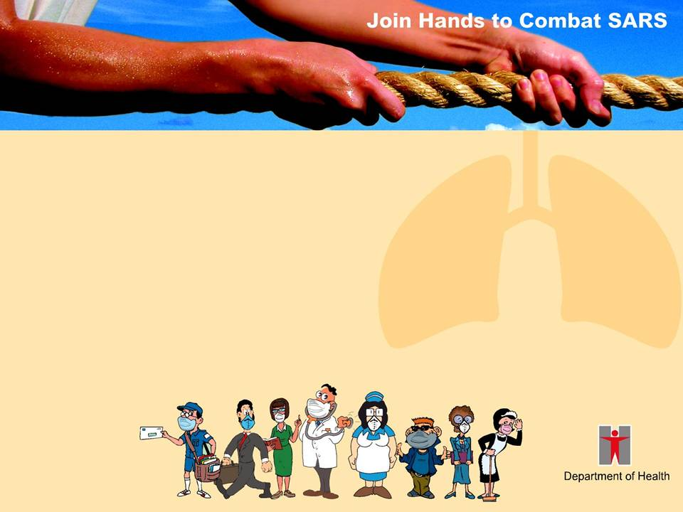
Prevention of Severe Acute Respiratory Syndrome (SARS)
Department of Health,
Government of the HKSAR

Slide 2

Background
There have been reports of “SARS” from different parts of the world since March 2003.
In Hong Kong, a number of health care workers and other people have also been affected by the disease.
SARS has been added to the schedule of infectious diseases under the Quarantine and Prevention of Disease Ordinance which empowers DH to implement control measures more effectively.

Slide 3
Background
The WHO removed Hong Kong from the list of areas with recent local transmission of SARS on 23 June 2003
However, we must remain vigilant and take necessary measures as required

Slide 4
What is Pneumonia?
Pneumonia is an inflammation or infection of the lungs that affects the lungs’ normal function.
It can be classified into “Classical Pneumonia” and “Atypical Pneumonia”.

Slide 5

What is Classical Pneumonia?
Classical Pneumonia is caused by bacteria such as streptococcus. Symptoms include:
  Fever
  Chest pain
  Cough
  Purulent sputum
  Symptoms are usually severe with an early onset.

Slide 6
What is Atypical Pneumonia?
The Atypical Pneumonia in this outbreak is also known as “Severe Acute Respiratory Syndrome” (SARS).
It is found to be caused by coronavirus.

Slide 7
What is Severe Acute Respiratory Syndrome (SARS)?
Symptoms include:
  High fever (of 38 degrees Celsius or above)
  Cough
  Chills
  Shortness of breath or difficulty in breathing
  Myalgia and malaise
  Headache
  Diarrhea
  Chest X-ray shows changes compatible with pneumonia

Slide 8
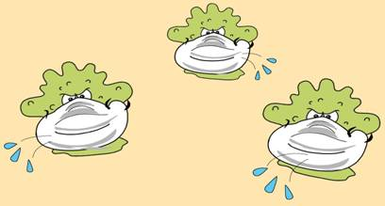
How is SARS Transmitted?
The virus causing SARS is transmitted:
By droplets; or
Through direct contact with secretions of an infected person.

Slide 9
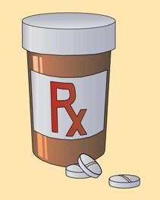
Treatment
With early detection, the disease can be treated with medication.

Slide 10

Prevention
Maintain good personal hygiene
Wear a mask properly
Keep the environment clean and hygienic
Ensure good ventilation
Adopt a healthy lifestyle

Slide 11
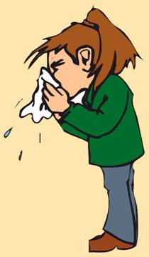
Maintain Good Personal Hygiene
Cover your mouth and nose when sneezing or coughing.
Use a tissue paper to hold your spit, then dispose of the soiled tissue paper into a covered bin.
Wash hands with liquid soap.
Use serving spoons and serving
chopsticks at mealtimes.
Wash hair and shower daily.

Slide 12
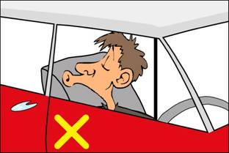
Maintain Good Personal Hygiene
Avoid touching your eyes, nose
and mouth.
Do not share towels.
Do not spit or litter.
Use a vomit bag to hold vomitus on public transport.
Consult the doctor promptly and stop going to work or school if you develop symptoms of respiratory tract infections or if you have a fever.

Slide 13
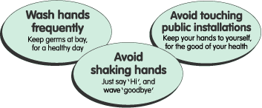
Your Health is in Your Hands
Wash your hands:
Before touching your eyes,
mouth and nose;
Before putting on a mask or after taking it off;
Before preparing food or eating;
After contact with infected persons;
After sneezing or coughing;
Tips: Wash hands properly

Slide 14
Your Health is in Your Hands
Wash your hands:
After going to the toilet;
After handling nappies, faeces or articles soiled with respiratory secretions;
After touching public installations such as railings, door handles, lift buttons and public telephones; and
After arriving at office or home.
Tips: Wash hands properly

Slide 15
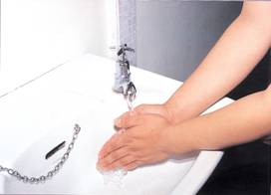
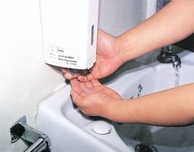
Proper Hand Washing
Wash hands under running tap water.
Add liquid soap.

Slide 16
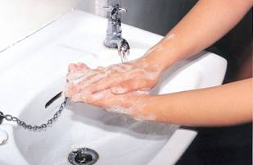
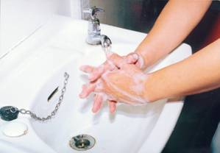
Proper Hand Washing
Work up lather with your hands.
Spend at least 10 seconds to rub your hands,
including all sides of the nails.

Slide 17
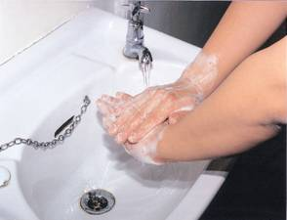
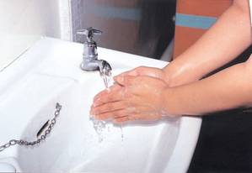
Proper Hand Washing
Don’t forget to rub the palm and back of the hands. Don’t rinse with water when rubbing.
When you have finished rubbing, rinse hands thoroughly with water.

Slide 18
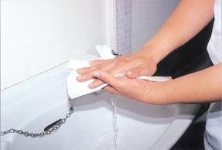
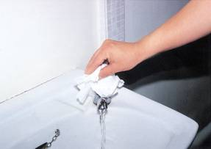
Proper Hand Washing
Dry hands with a clean personal towel or disposable paper towel.
Wrap the tap in a disposable towel, or
Rinse the tap thoroughly with water before turning it off.

Slide 19
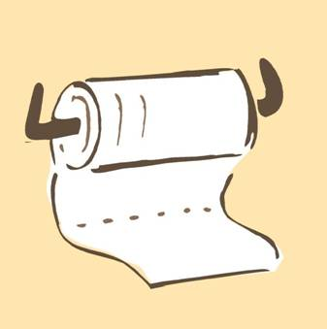
Proper Hand Washing
Remember:
Do not share towels or
tissue papers.
Discard disposable towels
properly.
Store personal towels properly. Change and wash them thoroughly every day.

Slide 20
The Following People Should Wear a Mask:
People with symptoms of
respiratory illness
Carers of patients with
respiratory illness
Health care workers in clinical settings
Household contacts of confirmed or suspected SARS patients
People visiting hospitals or clinics

Slide 21
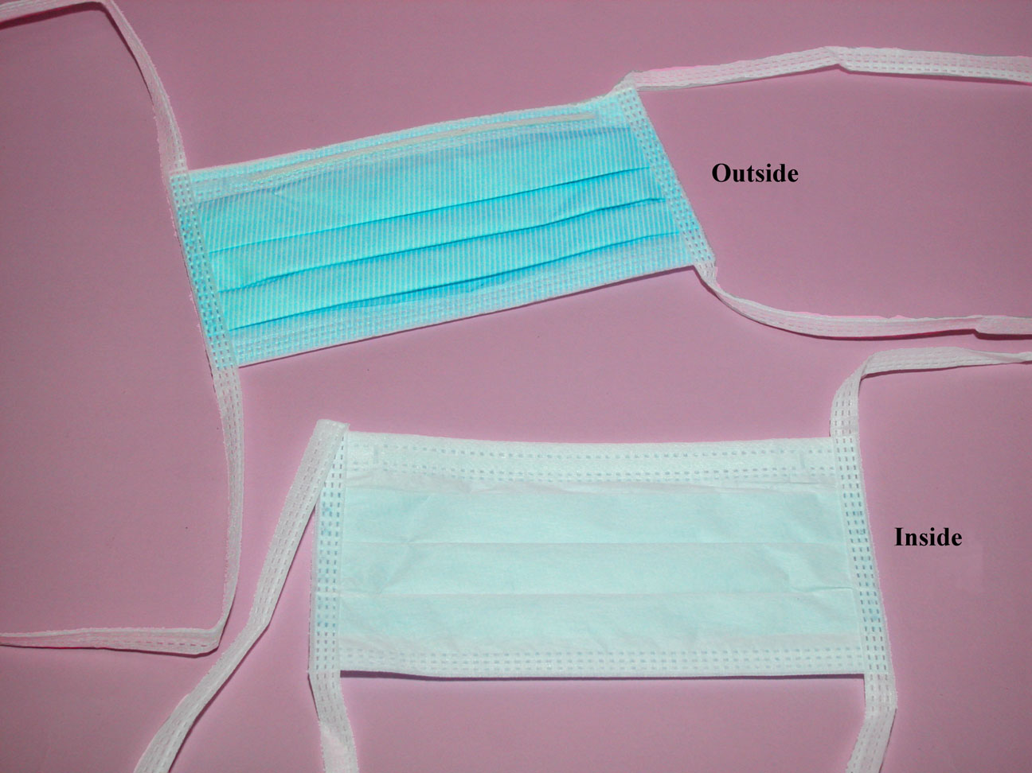
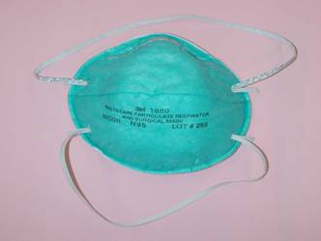
Which Type of Mask
Is Effective against SARS?
Ordinary surgical masks and N95 masks
can both help prevent SARS.
Surgical Mask
N95 Mask

Slide 22
Identify Different Parts of a Mask
Follow the instructions on the packet carefully, if available.
The coloured side of the mask should face outwards, and the edge with a metallic wire upwards.
Wash hands with liquid soap before putting on a mask.

Slide 23
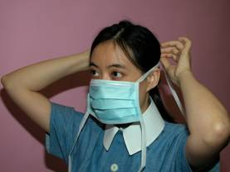
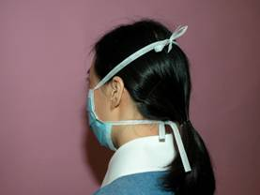
Proper Procedures of Wearing a Mask
Tie the upper 2 strings above the ears.
Tie all the strings properly to keep the mask in place.

Slide 24
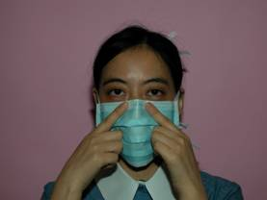
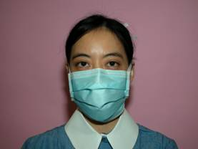
Proper Procedures of Wearing a Mask
The mask should fit snugly over the face. The metallic wire part of the mask should be fixed securely over the bridge of the nose.
The mask should fully cover the mouth, nose and chin to prevent leakage.

Slide 25
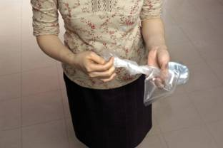
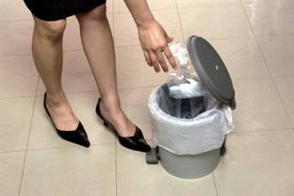
Points to Note about Wearing a Mask
Avoid touching the mask after putting it on. If you have to touch it, wash hands before and after doing so.
Wash hands before taking off the mask, and discard it properly.
Put the dirtied mask into a plastic or paper bag and tie the bag properly.
Then dispose of it into a covered bin.
Replace the mask immediately
if it is damaged or soiled.

Slide 26
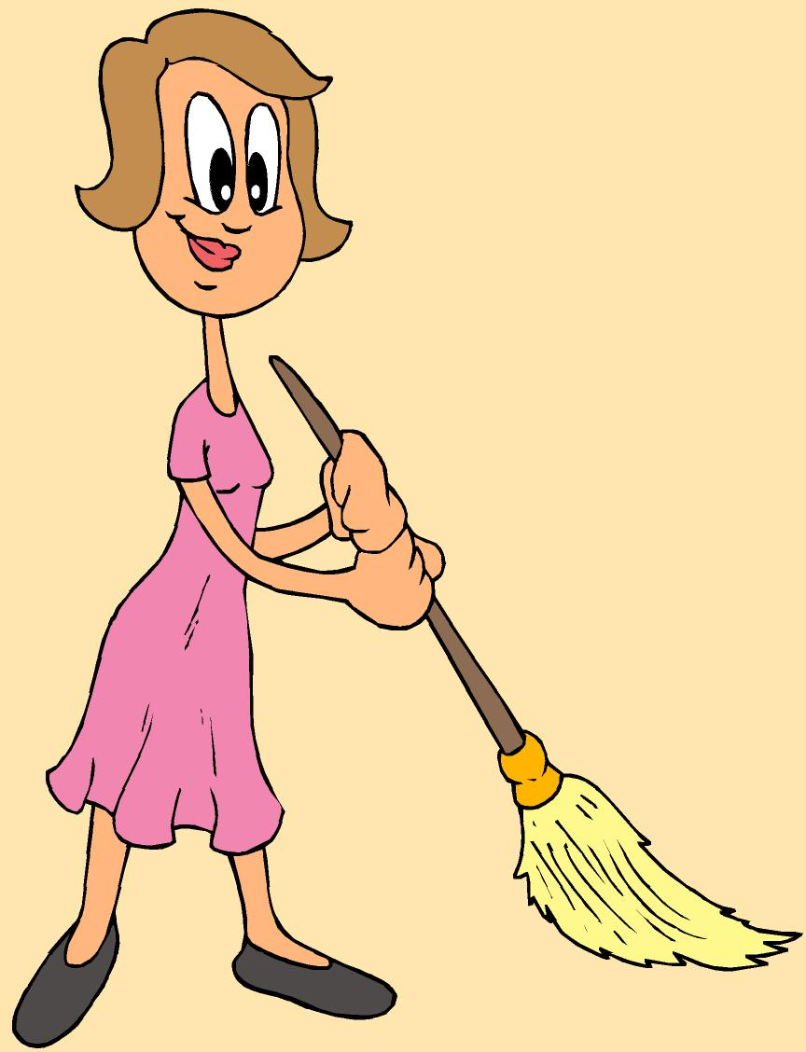
Keep the Environment Clean and Hygienic
Cleaning and Disinfection Procedures:
Get all cleaning tools ready, including household bleach, buckets, towels, mops, masks and gloves.
Put on a pair of gloves and a mask before you
start cleaning.
Clean and disinfect with a proper disinfectant.
Wash hands with liquid soap afterwards.
Tips:
Clean the home every day. Change bedding and clothing regularly.
Dispose of refuse into a covered bin.

Slide 27
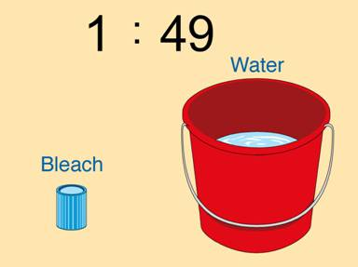
Choose a Proper Disinfectant
1:49 diluted household bleach solution
(mixing 1 part of bleach with
49 parts of water)
Suitable for:
Close contacts of SARS patients
in household cleaning;
Residents of buildings with SARS patients in first-time household cleaning;
Surfaces or articles contaminated with
respiratory secretions or vomitus.

Slide 28
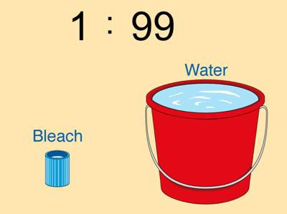
Choose a Proper Disinfectant
1:99 diluted household bleach solution
(mixing 1 part of bleach with
99 parts of water)
Suitable for: general cleaning
70% alcohol
Suitable for: wiping metallic surfaces

Slide 29
Cleaning and Disinfection
For washable items:
Examples: Bedding, curtains, dust filters of air-conditioners, floor mats and dustbins.
Procedures: Soak in diluted household bleach for 30 minutes, then rinse with water.
For non-washable items:
Examples: Telephone handsets, speakerphones of intercom system, door handles, light switches and furniture.
Procedures: Wipe with a towel soaked in diluted household bleach solution. Then, wipe with a wet towel and wipe dry.

Slide 30
Cleaning and Disinfection
The floor
Procedures:
- Sweep the floor clean before mopping.
- Soak a mop in diluted household
bleach solution and mop the floor.
- Finally, clean with water and wipe dry.
Walls
Procedures: Wipe with a towel soaked in diluted household bleach solution. Then, wipe with a wet towel and wipe dry.

Slide 31
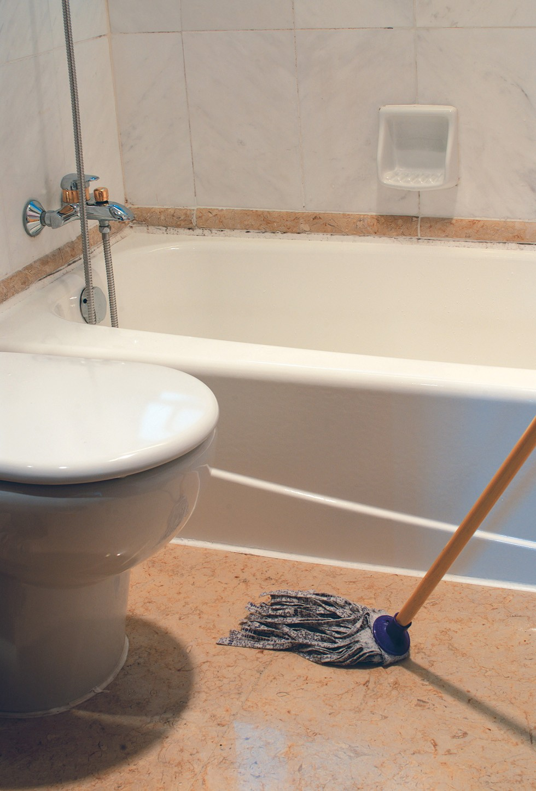
Keep the Toilet Clean and Hygienic
Pay attention to proper functioning of toilets and drains.
Clean toilet facilities at least once a day with diluted household bleach solution.

Slide 32
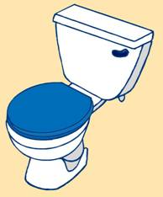
Keep the Toilet Clean and Hygienic
Flush the toilet properly:
  Before flushing, lower the toilet lid to prevent contaminated water from splashing out.
  When flushing has stopped, raise the lid.
  Wipe the lid, seat and rim with diluted bleach solution. Rinse with water and wipe dry.
  Pour a teaspoon of diluted bleach solution into the toilet bowl.
  Finally, wash hands thoroughly with liquid soap.

Slide 33
Disinfect Floor Drain Outlets
To prevent insects and air from entering toilet through the drain outlets.
Clean floor drain outlets at least once a week.
To ensure the air trap is not dry, pour about half a litre of water down the drain outlet.
Then, pour a teaspoonful of diluted household bleach solution down the drain.
After 5 minutes, pour clean water down the drain.

Slide 34
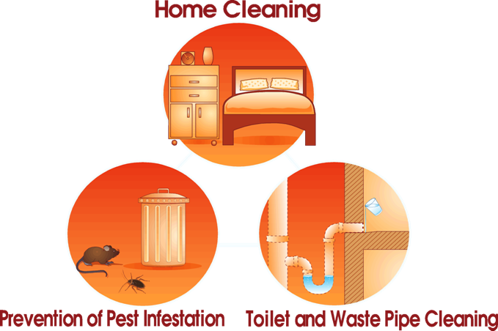
Prevention of Pest Infestation

Slide 35
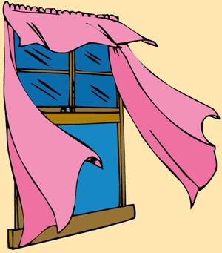
Ensure Good Ventilation
Keep all windows open at all times.
Ensure frequent air exchange for mechanically ventilated facilities.
Wash dust filters of air-conditioning systems frequently.
When traveling on public transport, open the windows whenever possible.

Slide 36


Adopt a Healthy Lifestyle
A balanced diet
Regular exercise
Adequate rest
Reduce stress
Avoid smoking or alcohol consumption

Slide 37
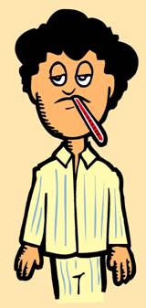
If Feeling Unwell…
Consult the doctor promptly if you develop symptoms of respiratory tract infections or if you have a fever.
Parents should not send sick children to school or nursery.
Patients who have respiratory illness should wear a mask to prevent spread of infection.
SARS patients should be hospitalized for medical treatment. The chance of recovery is better if it is detected and treated early.

Slide 38
What should be done if a family member is Infected or Suspected to be Infected?
The Department of Health will issue guidelines to close contacts of SARS patients or suspected SARS patients. They will be required to undergo home confinement for monitoring for 10 days, during which they should:
  Wear a mask for 10 days;
  Avoid close contact with family members or other people; and
  Maintain good personal hygiene.

Slide 39
What should be done if a family member is Infected or Suspected to be Infected?
Keep the home clean and hygienic. Disinfect the home with a solution of 1:49 diluted household bleach daily.
Maintain proper functioning and cleanliness of toilets and drains.
Watch out for symptoms. Consult the doctor immediately if feeling unwell.
Stop going to work or school.
During the home confinement period, health teams from the Department of Health will visit the persons affected to conduct medical checks.

Slide 40
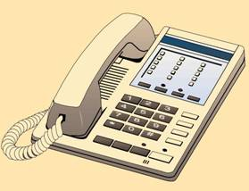
To Know More
The Department of Health’s hotline:
187 2222
24-hour health education hotline
of the Department of Health’s
Central Health Education Unit:
2833 0111
The Department of Health’s website:
www.dh.gov.hk

Slide 41
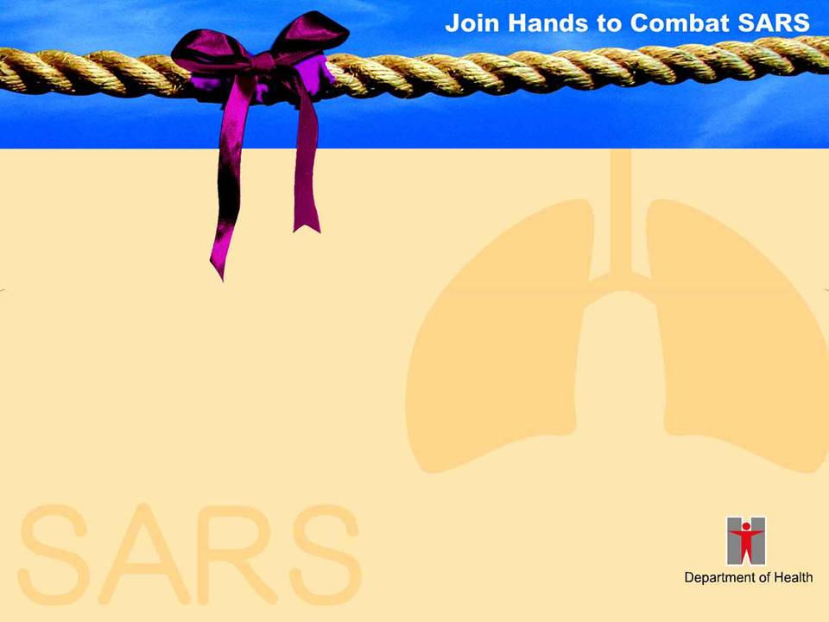
Prevention of Severe Acute Respiratory Syndrome (SARS)
Department of Health,
Government of the HKSAR

