Slide 1
User Interface in the Digital Decade
Kai-Fu Lee
Corporate Vice President
Microsoft Corporation
Notes:
Slide Deck Outline
Introduction – Tools Precede the Phenomenon
XML Web services phenom– Show how tools preceding a computing industry phenomenon is a trend we’ve seen throughout history. Now, we’re in the midst of the most important and comprehensive phenomenon the industry has ever witnessed: XML Web services.
Extraordinary .NET Momentum – Microsoft is leading the industry in this phenomenon as evidenced by the massive momentum behind .NET
Visual Studio .NET customer adoption
Analyst quotes on Microsoft .NET
Demos showing MS leadership and customer/partner support as well as adoption of WebServices within an outside of the firewall
VS .NETinnovation drives XML Web services and nextGen computing– Like tools that have preceded past industry phenomena, Visual Studio .NET is the tool that will drive the proliferation of XML Web services.
Productivity, performance, extensibility, customer adoption of VS .NET all illustrate that it is the best tool for driving the XML Web services phenomenon
Microsoft’s competitive edge = multi-language platform
(6 demos and 2 videos: Each demo is 5 mins with the exception of the Iron Developer demo which is 10 minutes)
2 Iron Developer Video Introduce the ‘contest/parody’ we are conducting
3 L’Oreal Video Webservices make it easy for partners to do biz with L’Oreal
3 Autodesk Video .NET innovates with multiple language support and super performance
5 Autodesk demo .NET innovates with multiple language support and super performance
5 Merryl Lynch demo Webservices within the firewall, .NET/VS is innovative
5 Rational demo Visual Studio innovation, ideal enterprise platform
5 SQL/BizTalk demo Visual Studio innovation – tight platform innovation. ‘Dance with the platform’
5 Multi-Language demo Visual Studio .NET innovation – supporting the languages of the world
5 Highschool kids demo Visual Studio innovation – power and appoachability, engineers of the next gen
8 Iron Developer demo Visual Studio innovation – RAD, productivity, mobility

Slide 2



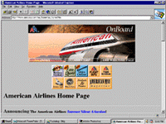
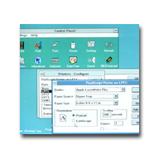
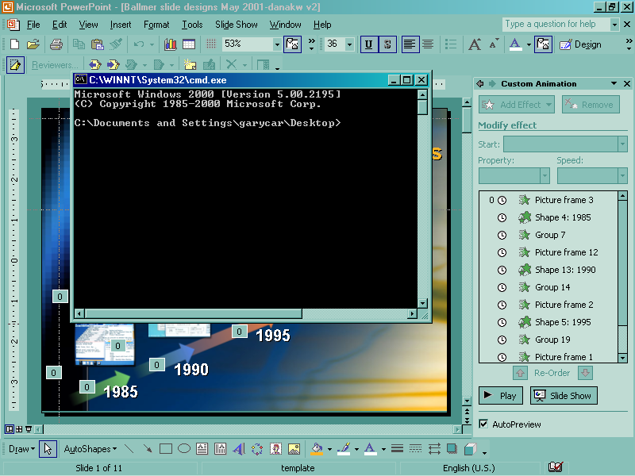
User Interface Evolution
Graphical
User Interface
Search Engines
Hyperlinks
Multiple Windows
Menus
Command line
1995
Internet
1985
1990
PC
GUI
Notes:
Revolutions in computing & UI have been mutually reinforcing….
Example: bitmap graphics & mouse + windows.
Power of the PC enabled bitmap graphics, which gave rise to a better UI.
Browser + internet & hyperlink + search engine.
Power of the UI of hyperlinking otherwise unconnected content turned into the Internet and the rich content that we now cannot live without.

Slide 3
Graphical User Interface
What you see is what you get
Technology Advances
  Bitmap display.
  Mouse.
  HTTP / HTML.
GUI
Interaction
  Low learning curve.
  Great for frequent actions.
  Difficult for rich domains
Enables
Notes:
GUI, which is embodied by the used of mouse+menus+multiple windows, was an incredibly important step in UI. The success of the Macintosh and Windows created standard platforms to develop applications in cost-effective, consistent, and easy-to-use ways.
GUI UI provides the user with a direct link between their actions (inputs) and the effect of those actions. Users learn what actions cause what effects, and plan their own solution.
So for users who have learned and become an expert, they love GUI. But you do have to become an expert to get the full advantage.
For example, if you want to find a recipe for Kung Pao chicken, you need to find what web sites have recipes, then navigate in that web site to find if it has that recipe.
Or if you want to change your proxy server in IE, you need to know to open tools → Internet Options → Connections → LAN Settings.
GUI is great for experts who know exactly what they are doing.

Slide 4








User Interface Evolution
Natural
User Interface
Personal Assistant
Multimodal (speech, ink…)
Graphical
User Interface
Natural Language
Search Engines
Hyperlinks
Multiple Windows
Menus
Digital Decade
XML
Web Services
Smart devices
Command line
1995
Internet
1985
1990
PC
GUI
Notes:
New changes are coming
Explosive web content – including the invisible web.
Complex web services – providing new capabilities for users to buy what they want, when they want, at the price they want; reach people and be notified of important events.
Any device – Need to be made available any time any where & can be used by any body. The power of these services will make computing useful to every citizen of this planet.
Recall that GUI is great for expert users, these changes present serious challenges to GUI:
There will be so much web content and web services, that nobody can be an expert at everything.
GUI works great on a screen with mouse and keyboard, but many of these devices have small or no screen, and no keyboard.
We want an interface that is so easy to use, that every citizen of this planet can learn & use it.
To deliver on the dream of making web-based content and services available to the masses, we need a new UI paradigm that allows people to easily, naturally, and expressively describe what they want, as easily as they interact with other people.

Slide 5
Natural User Interface
Do what I mean
Technology Advances
  Smart devices.
  XML.
  Web services.
NUI
Interaction
  Natural.
  Scalable.
  Expressive.
Enables
“A transforming capability [that allows] you to speak to your computer and it will understand what you're saying in context.”
        -- Gordon Moore, 2002
Notes:
GUI, which is embodied by the used of mouse+menus+multiple windows, was an incredibly important step in UI. The success of the Macintosh and Windows created standard platforms to develop applications in cost-effective, consistent, and easy-to-use ways.
GUI UI provides the user with a direct link between their actions (inputs) and the effect of those actions. Users learn what actions cause what effects, and plan their own solution.
So for users who have learned and become an expert, they love GUI. But you do have to become an expert to get the full advantage.
For example, if you want to find a recipe for Kung Pao chicken, you need to find what web sites have recipes, then navigate in that web site to find if it has that recipe.
Or if you want to change your proxy server in IE, you need to know to open tools → Internet Options → Connections → LAN Settings.
GUI is great for experts who know exactly what they are doing.

Slide 6


Super-Moore’s Law
Enable human-level speech recognition (SR):
  Leveraging Moore’s Law + more data + research.
  Predictable 10% error reduction or more per year.
  Human-level performance possible in 10-20 years.
Also enable natural language, Bayesian learning….
Tasks | SR error rate | Human error rate | SR-Human Gap
Free style transcription | 30% | 4% | 19 years
Alphabet letters | 5% | 1% | 15 years
Read newspaper transcription | 3% | 0.9% | 11 years

Slide 7
Microsoft’s Practical NUI Plan
Start with natural entry points:
  Speech for telephony.
  Typing for search and help.
Provide simple, evolutionary UI for end-users.
  Users will perceive NUI as “better search”.
  Search/help needs to complement GUI.
Build on .NET:
  Visual Studio for development.
  .NET frameworks, XML, web services.

Slide 8
A Roadmap Towards NUI Vision
TTS SR Dialog
Telephony speech
Multi-Modal
Delegation & Pro-Active
Text only
Federation Agents Planning
Search Help Tasks Q&A

Slide 9
A Roadmap Towards NUI Vision
  Buy 100 shares of Microsoft.
TTS SR Dialog
Telephony speech
Multi-Modal
Delegation & Pro-Active
Text only
Federation Agents Planning
Search Help Tasks Q&A

Slide 10
A Roadmap Towards NUI Vision
  Buy Microsoft stock.
TTS SR Dialog
Telephony speech
Multi-Modal
Delegation & Pro-Active
Text only
Federation Agents Planning
Search Help Tasks Q&A

Slide 11
Smart Devices Needs NUI (speech)
High
Tablet
PC
PC
Tablet
PC
Internet
TV
Internet
TV
PDA
Screen
Phone
Ease
of GUI
(screen/
Pointer)
PDA
Screen
Phone
Car
Phone
Car
Low
High
Ease of text input (keyboard/pen)

Slide 12
A Roadmap for Speech
Dictation
High
Tablet
PC
PC
Internet
TV
PDA
Screen
Phone
Ease
of GUI
(screen/
Pointer)
Multimodal
Command/Control
Car
Phone
Speech-Only
Telephony
Low
High
Ease of text input (keyboard/pen)

Slide 13
Speech Demonstrations
.NET Speech Platform for Telephony
  Support telephony speech from web application.
    Reduces cost of phone call from $2 to $0.10.
  Uses .NET Framework and Visual Studio.
  Supports multimodal UI using SALT.
  Beta in June; RC in October.
Tablet PC Speech
  Speech dictations is faster than handwriting.
  Supports multimodal UI.

Slide 14
A Roadmap Towards NUI Vision
TTS SR Dialog
Telephony speech
Multi-Modal
Delegation & Pro-Active
Text only
Federation Agents Planning
Search Help Tasks Q&A
  Find email from John about the budget.

Slide 15
A Roadmap Towards NUI Vision
TTS SR Dialog
Telephony speech
Multi-Modal
Delegation & Pro-Active
Text only
Federation Agents Planning
Search Help Tasks Q&A
  My printer is stuck.

Slide 16
A Roadmap Towards NUI Vision
TTS SR Dialog
Telephony speech
Multi-Modal
Delegation & Pro-Active
Text only
Federation Agents Planning
Search Help Tasks Q&A
  Print 10,000 copies in Kinko’s Beijing.

Slide 17
A Roadmap Towards NUI Vision
TTS SR Dialog
Telephony speech
Multi-Modal
Delegation & Pro-Active
Text only
Federation Agents Planning
Search Help Tasks Q&A
  What time does Bill Gates’ talk end?

Slide 18
A Roadmap Towards NUI Vision
TTS SR Dialog
Telephony speech
Multi-Modal
Delegation & Pro-Active
Text only
Federation Agents Planning
Search Help Tasks Q&A
  Send flowers to my wife on her birthday

Slide 19
A Roadmap Towards NUI Vision
TTS SR Dialog
Telephony speech
Multi-Modal
Delegation & Pro-Active
Text only
Federation Agents Planning
Search Help Tasks Q&A
  Hold all calls unless it’s urgent.

Slide 20
A Roadmap Towards NUI Vision
TTS SR Dialog
Telephony speech
Multi-Modal
Delegation & Pro-Active
Text only
Federation Agents Planning
Search Help Tasks Q&A
  I want to plan a vacation to Europe.

Slide 21
Structured Storage needs NUI
Find email from John about the Budget | SELECT DocumentName FROM LocalFileSystem, LocalMailSystem, LocalDocuments WHERE Author contains “John” and Subject contains LSP_Expand(“Budget”) ORDER BY ModifiedDate, CreateDate
My printer is stuck | SELECT DocumentName FROMLocalFileSystem, LocalHardware, HardwareVendorSupport WHERE Vendor=‘HP’ and Model=‘DeskJet 550” and Body contains LSP_Expand(“jam”) ORDERED BY Context, LearnedBehavior.
Show me the new Dell notebook | SELECT DocumentName FROM WebSearch, UserHeuristics WHERE Vendor=‘Dell’ and Category=‘laptops’ and Age<60
Make the letters on my screen bigger | SELECT TaskNames FROM LocalTasks, OSTasks, USerHeuristics WHERE Name contains ‘Video Resolution’ ORDER by Context, LearnedBehavior
Play Britney | SELECT MediaName FROM LocalFileSystem, WebMediaProviders WHERE Name contains ‘Britney’ OR Name contains ‘Spears’ ORDER BY CurrentDirectoryBias, LearnedBehavior, Name, Context

Slide 22
Natural language demonstrations
Smart search & help.
  Users don’t know where to go or what to type.
  Companies don’t know what’s on users’ minds.
  We want to close that gap.
Q&A for “any question”.
  Unstructured → structured tool is needed.
  Combines statistical and natural language.

Slide 23
Conclusion
Natural UI is needed for the Digital Decade:
  Scalable, natural UI for smart devices.
  Retrieval of information from structured storage.
  UI to connected web services.
Natural UI will arrive as an evolution:
  Telephony speech, search, help are the first applications.
But in 10 years, Natural UI will be viewed as the largest revolution since Graphical UI.

Slide 24

© 2001 Microsoft Corporation. All rights reserved.
Notes:
BACKUP:
A lot of hard work remains to make this vision a reality:
Speech recognition has to get a lot better
Noise robustness, particularly.
Natural language understanding
How to go beyond syntax to semantics, and combine statistics with rules.
Platform / application architecture that enables developers to build services based on this.
Help architecture – to change the way people get help.
Authoring tools – are key to making this possible.
Web services that self describe (Xml is a big part of enabling this)
Task hierarchies / concept spaces.
Coming up with a shared model of concept spaces, and a shared model of development.
Find early adopters.
XML, Store, file system, etc.
How to find what you want using NL

