Slide 1
Opportunities & Challenges for Multinationals in China:
Learning from the Microsoft Experience
Kai-Fu Lee
Corporate Vice President
Microsoft Corporation

Slide 2
Talk Outline
China Opportunity
6 Ingredients to Success in China
Microsoft’s Presence in China
  Early struggles
  Recent successes
Conclusion

Slide 3
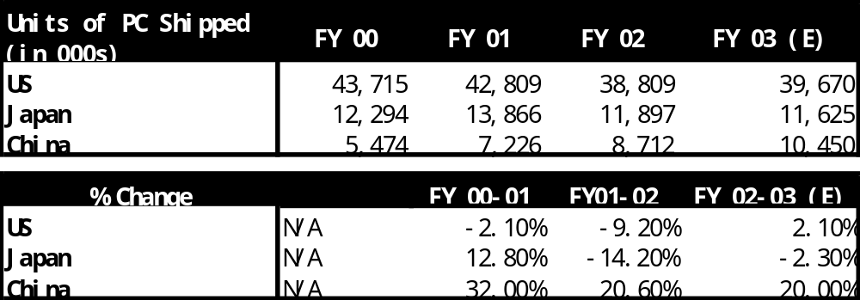
China Opportunity
Huge growing market
“The single most important thing to happen in our lifetime will be the emergence of China.”
– John Thornton, former President of Goldman Sachs
Now a Professor at Tsinghua University
  GDP growth 9% per year since 1978.
  Consumers saving $1 trillion per year.
  2002: China became #1 mobile phone market.
  2004: China will become #2 PC market.
  Next 5 Years: Software & services CAGR = 50%!

Slide 4
China Opportunity
World’s Largest Labor Force
“Through skillful control of residency, China’s 900 million rural residents will gradually move to cities and take jobs in manufacturing or information processing, perhaps at 20-30 million per year. This could give China a sustainable supply of low-cost labor for the next 20-30 years.”
– Kenichi Ohmae, The China Impact.
Traditional industries
  Many cities with good infrastructure
  People inflow from rural to cities
  Excellent process & know-how in manufacturing
Knowledge economy
  150,000 computer graduates / year
  Great emphasis on education
  But IT & software significantly lag India

Slide 5
Market Opportunity is Lucrative
Volkswagen
  40% market share in China
Motorola
  20% of global revenue comes from China
Kodak
  In 4 years, China went from 17th to 2nd
Intel
  $4+ billion revenue in China
L’Oreal
  “Imagine, 1.3 billion lips!”
  - Lindsay Owen-Jones, CEO, L’Oreal.

Slide 6
6 Ingredients to Success in China
Challenges & Successful Formula
Build strong government relationships
Play by China’s market rules
Make a long-term commitment
The local economy is the top priority
Nurture local people
Build trust, not PR

Slide 7
Build Strong Government Relationships
“It cannot be overstated the importance of accommodating
the government."
— John Stuttard, the New Silk Road.
Unique power of government
Relationships required at all levels
The spirit of the law matters more
China's culture is built on trust, relationships, mutual respect.
The concept of "face" is very important.
Avoid sensitivities and find every opportunity to make China look good
Negotiations are bottom-up and informal.

Slide 8
Play by China’s Market Rules
“We take pride in viewing ourselves as a very local company in China’”
– Mike Zafirobski, COO Motorola
Expect to respect “Chinese market”
The government for their own reasons what rules to apply and who they would like to do business with.
While they value global standard practices, they still expect MNCs to adapt to local rules.
Market conditions change rapidly and often irrationally due to an immature market economy.

Slide 9
Make a Long-Term Commitment
“China has discovered its leverage. They now say ‘If you want market access, give us technlogy’”
– Erfei Liu, Chairman of Merrill Lynch China
Contribute First and Benefit Later : Entitlement from power of market
MNCs must have long-term commitment.
  JV, investment, training, local partnership, technology & know-how transfer
Friends may be given great opportunities

Slide 10
Local Economy is the Top Priority
“Don’t think Chinese companies deserve to lose to foreign companies when foreign companies have a better product. It is different that a foreigner is making money and not a Chinese. The downfall of Chinese companies will come back to hurt all citizens of China”
– Professor Tan Haoqiang, IT Influential in China
Local companies are always preferred
MNCs expected to help nurture local economy in exchange for access to the China market (need to move up the value chain)
Bonus: help local company build export business
China often ignores international standards and attempts to build China standards
IP Protection is weak
Laws to protect local companies

Slide 11
Nurture Local Employees
“My boss asked me how to expand the IBM business in China. I answered first we had to grow the local people”
– Wilson Wong, first Chief Representative, IBM China
China prefers MNCs that develop local talent to make them more competitive internationally.
Local talent is high potential, but inexperienced
Send overqualified, senior leaders who intend to repatriate

Slide 12
Build Trust, not PR
Corporate image requires much more than PR.
  Good citizen in China helping local companies
  Single message (like China’s own) = unified org.
“Boasting PR” is very negative in Chinese culture
  Low-profile & humility is much better
Public media is immature, powerful, manipulated
  While positive PR may not help a company’s image, negative PR can damage a company’s image.

Slide 13


Microsoft In China
Commercial Sales &
Marketing
1992: Setup Beijing Office
1995: Setup Microsoft China Ltd
1996: Setup Shanghai & Guangzhou Offices
2003: 300 employees
MSR Asia
1998: established
2003: 150 researchers + 200 interns
Global Technical Engineering Center
1998: established
2004: 300 employees
MS IT Innovation Center/R&D/ATC
2004: 300 employees
Joint Ventures
2004: 2 corporations established

Slide 14
Microsoft Lowlights in China
Mistakes on “respect” & “commitment”
Government procurement law
Piracy & anti-Piracy measures
“Good enough” software
Management turnover
Center of media attention
Several strong but persuasive critics

Slide 15
Microsoft’s Recent Successes
Build strong government relationships
Play by China’s market rules
Make a long-term commitment
The local economy is the top priority
Nurture local people
Build trust, not PR

Slide 16


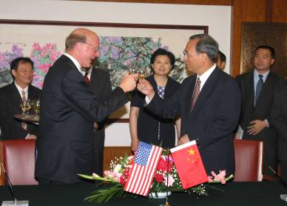
Build Strong Government Relationships
Steve Ballmer signs “Great Wall” collaboration with the Ministry of Education
REDMOND, Wash. -- June 27, 2002
Microsoft and China Announce
Government Security Program
Agreement
Beijing, China, Feb. 28, 2003
Microsoft shares Windows Source : Microsoft and China Ministry of Security Officially Opens Joint Information Security Technology Lab
Beijing, China, July 7, 2003

Slide 17



Play by China’s Market Rules
Two joint ventures
Support training center
Partner with local companies to comply with Government Procurement Law
MSR Annual Conference largest in China.
Partner plans: free end-to-end support, channels, MVP Asia Summit

Slide 18

Make a Long-Term Commitment
Microsoft Research helps Chinese universities
  Research funding, scholarships, internships.
  Articles & courses by Microsoft researchers on own initiative.
Address digital divide
  Technical job training: thousands of unemployed workers
  5 million RMB donation to help handicapped Chinese learning
Donations
  Project hope – schools, infrastructures, networking.
  SARS – donations (company and employees) to China

Slide 19

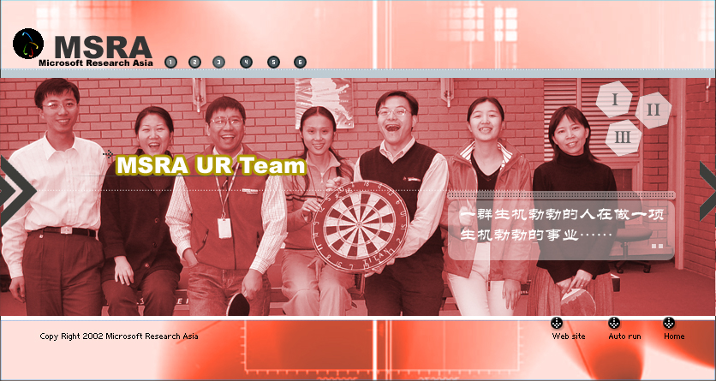
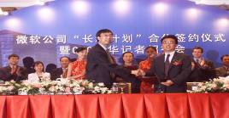
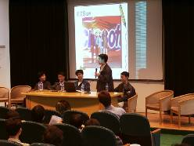
Local Economy is the Top Priority
University Collaboration & Software Colleges
Training
  Software colleges (MS employee is dean)
Adding Chinese partners to GISVs:
  Elevating companies like CS&S to same level as Accenture
  Helping to train, partner, develop Chinese Sis and ISVs.
JVs & investments
  Steve Ballmer commitment to China.
JV Partnerships

Slide 20
Nurture Local Employees
In Microsoft Research
  2 Microsoft China employees → Corporate VPs
  Several local employees now senior managers
  Growth of many local employees
In Sales
  Microsoft Greater China MSN Director from China

Slide 21
Build Trust, not PR
China elevated at same level as US and Europe
Unified China organization led by Corp VP
Unified China strategy to support local ecosystem
  Consistent articulation of strategy
  Low profile leadership team

Slide 22
Conclusion
China is a huge opportunity
China is unique
Flexible, sincere, committed companies will succeed in China

Slide 23


Slide 24


