Slide 1
Conversational Computers:
Always 10 Years Away?
Kai-Fu Lee
Corporate Vice President
Microsoft Corporation

Slide 2


Why Conversational Interface?
Speech : “invented” for interaction
  “[Speech & language are] a biological adaptation to communicate information… One of nature’s engineering marvels” – Steven Pinker
  “Vision evolved from the need to survive; speech evolved from the need to communicate” – Michael Dertouzos.
Benefits of “Conversational Interface”
  “To me, speech recognition will be a transforming capability … when you can speak to your computer and it will understand what you're saying in context.” – Gordon Moore
  “Speech and natural language understanding are the key technologies that will have the most impact in the next 15 years.” – Bill Gates
Future UI vision assume conversational UI
  Apple’s “Knowledge Navigator”.
  Microsoft’s “information at your fingertips”.
Science fiction movies assume conversational UI

Slide 3

But “Always” 10 Years Away
1950
  Jerome Weisner predicted by 1960 machine translation may be possible
1957
  Herbert Simon predicted by 1967 machine will match human performance in many areas
1969
  US Expert Panel predicted “voice I/O will be in common use by 1978”
1993
  I predicted by 2003 every PC will ship with speech recognition
1998
  Gartner Group predicted PC UI will assume voice input by 2003

Slide 4
Decomposing the Prediction
Speech
Recognition
Natural
Language
Understanding
Text to Speech
Talk Outline
Speech recognition
Text to speech
Natural language understanding
Why have we been a constant 10 years away?
My 3-year & 10-year predictions

Slide 5
Talk Outline
Speech
Recognition
Natural
Language
Understanding
Text to Speech
Speech recognition
Text to speech
Natural language understanding
Why have we been a constant 10 years away?
My 3-year & 10-year predictions

Slide 6


Fundamental Equation of Speech Recognition
X is the acoustic waveform
W is the word string
A speech recognizer finds W such that
W = argmax p(W | X ) = argmax p(X | W ) p(W )
  p(X | W ) is the acoustic model
  p(W ) is the language model

Slide 7

Statistical Modeling
Improving the acoustic model – p(X | W )
  Statistical Approach
    Build a detailed statistical model for each word.
      Detail could be based on phonetics, speaker, dialect, gender, or data-driven details etc.
    Collect a lot more samples for each word.
      There is no data like more data.
    Go to step one.
Improving the language model – p(W )
  Statistical Approach – Trigrams.
    There is no data like more data.
  This helps recognition, not understanding.

Slide 8
Does Moore’s Law Help Speech?
Moore’s law is necessary but not sufficient
  Just faster chips means recognition errors appear faster.
Super-Moore’s law for speech:
  Faster processors/memory/disk +
  Getting more real data & feedback loop +
  Improved statistical models
Result:
  Moore’s law doubles performance in 18 months
  Super-Moore’s law halves errors in 60 months
Notes:
Faster chips mean recognition error appears faster ☹
New algorithmic advances needed to pass the Turing Test

Slide 9

Speech Recognition:
Approaching Human Error Rate
Microsoft licensed CMU Sphinx-II
Whisper in MSR
Speech in Office XP
Speech in Tablet/Office 11
Speech in Longhorn
Human
Error Rate
Notes:
Microsoft has continued to measure on a very real and hard task: human dictation.

Slide 10
Talk Outline
Speech
Recognition
Natural
Language
Understanding
Text to Speech
Speech recognition
Text to speech
Natural language understanding
Why have we been a constant 10 years away?
My 3-year & 10-year predictions

Slide 11
Fundamental Approach for TTS
Concatenative Synthesis
  Concatenation of pre-recorded speech units
  Front-end
    Natural language processing (word breaking, POS…)
    Determine emphasis to drive speed, pitch, loudness.
  Back-end
    Collect a lot of data
    Carefully segment & store in a database
    Select the best units from the database
      Find statistical metrics that match “naturalness”, e.g., smoothness rather than specific duration targets
      Use these metrics to select units
Notes:
一个单词的读音可以通过查词典得到。字音转换的主要是处理多音词例如中文中的“长”“长”，英文中的read read, subject, subject.
读音规则可以是专家写的规则，也可以用机器学习的方法得到。得到一个输入文字串相应的读音还不够，
因为同一个语音单元在不同上下文环境中会有很多变化，因此还需要多每个语音单元的上下文环境进行描述。这就是韵律分析。 韵律的范畴比较广，包括语调、节奏、轻重、强调.
Instead of predicting a numerical targets, we predict a pool of prosodically equivalent candidates for each unit. The most suitable segments are then selected by considering smoothness constraints across splicing boundaries.

Slide 12
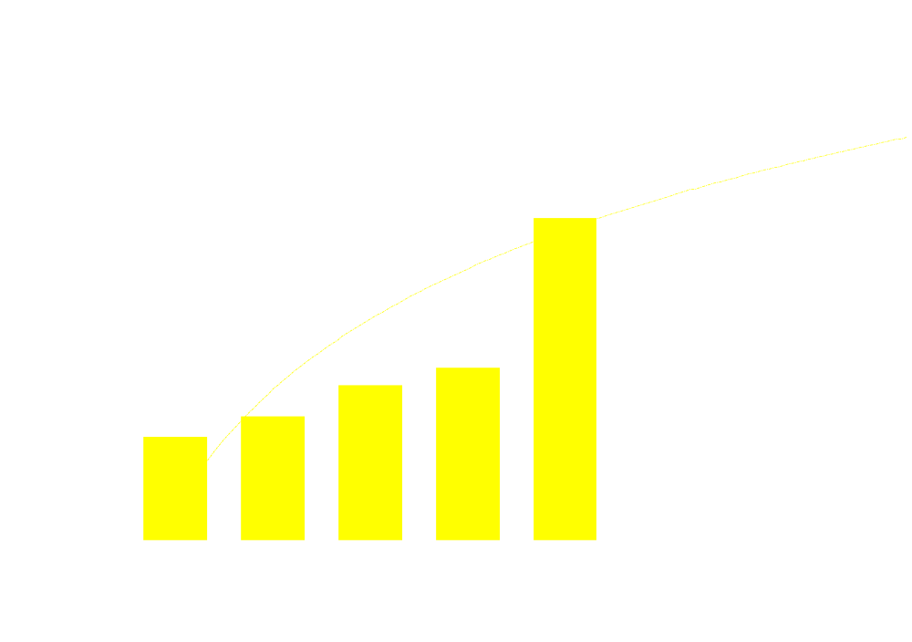

Text to Speech
Approaching Human Naturalness
Human
Naturalness
Naturalness
Notes:
TTS has improved a lot over the years, such that intelligibility is not a big issue any more. But there is still a substantial gap in naturalness.
Naturalness can be measured by asking users to rate the speech on a scale of 1 to 5, where 1 is very poor and 5 is perfect. Humans will combine many factors in the subjective rating. Certainly, buzzes, mechanical, and reverberant sounds will all hurt naturalness. But most importantly is the subjective feeling of “does it sound like a human or not”?
Systems 1 & 2 are formant-based systems, and systems 3 and on are concatenative systems. The last system is MSR’s Mulan.

Slide 13

ASR & TTS: Optimization & Engineering
By leveraging Moore’s law
Exponential improvements from…
  Faster CPU + bigger database + better algorithm
Approaching human abilities, but not AI, but…
  Optimization, or “speech engineering”
Still falls short of humans on:
  Learning, adaptation.
  Robustness to environment.
But many applications just from ASR & TTS:
  ASR: Dictation, speech search, speaker verification, language learning…
  TTS: Telephony info access, voice fonts, voice conversion…
Notes:
Assumes reasonable environment
Requires high-quality (headset) microphone
Cannot handle multiple speakers
Takes a lot of data to learn & adapt.
Human adapts on 1 syllable
Human learns to hear and understand from 10,000 hours of speech.
Human adapts to accents, environments…
“Intelligence engineering” by optimization
Similar to Deep Blue.

Slide 14
Talk Outline
Speech
Recognition
Natural
Language
Understanding
Text to Speech
Speech recognition
Text to speech
Natural language understanding
Why have we been a constant 10 years away?
My 3-year & 10-year predictions

Slide 15
Natural Language Understanding Combines:
Syntax (rules of the human’s language)
  Nouns, verbs, etc. and how they combine
    “Book about a trip to Chicago” vs. “Book a trip to Chicago”
  Normalize linguistic variations .
Semantics
  Meaning of the words
    Book means reserve a ticket; requires from-city, to-city, etc.
Context (additional hints)
  Domain knowledge :
    No train from Hawaii to Chicago
  Statistics : Book as a noun > Book as a verb
    “Book Chicago”
  Personal Preferences :
    Where you live, your calendar, how you pay…
  Model of time, urgency, presence
Dialog (resolving ambiguity & determine intent)
    “Buy a book or book travel?”
    “What date would you like to travel?”
Notes:
Know what I mean is the brain that takes all the inputs, words broken, syntax, semantics, utterances, context, and figures out the person’s intent.
To understand what you said, the librarian brings to bear a lot of knowledge, including:
Syntax of the language – understanding nouns / verbs… similar to diagramming a sentence in high school… “Book” means very different things as nouns and verbs.
Semantics – Book is not just a verb, but it specifically means reserving a ticket, which requires additional other fields.
Other hints – context, common sense, statistics / frequency, personal preference / knowledge. Who the asker is, who the answerer is, where they are, what they are doing at the time, the time of year, etc. All of that plays an implicit but vitally important role in answering a query. “Turkey” before Thanksgiving, and “Turkey” after Turkey earthquake are likely to mean different things.
If after parsing the sentence, and taking into account other hints, what the user said is still ambiguous or incomplete, then you could engage in a dialog to clarify any such part.
It may also be worth noting that the same is true in the real world--how many times have you asked a human a question and they said they didn't know, or said they did but it turned out they were mistaken, and you have to figure out who to ask? “I want to check in” to a hotel clerk, and “I want two chicken” to a butcher.
Use the librarian / Chicago example to illustrate these.
Knows where you live & how you pay (for delivery of goods).
Knows your preferences (travel by plane or bus).
Knows your relationships (who’s your boss, wife, etc.).
Knows what is important to you (email prioritization).
Can give high-level commands almost impossible using GUI.
“Page me if my mother calls”
Can pro-actively find things for you, not just delegate-and-do.
Keeps your data secure.

Slide 16
Applying Statistics to Understanding
Engineering approach:
  Focus on one domain, engineer all the knowledge.
  Collect data & create feedback loop to improve.
Applying Bayes Rule to understanding
  W is the word string
  M is the meaning
  A speech recognizer finds M such that
  M = argmax p(M | W ) = argmax p(W | M) p(W )
    p(W | M ) models all the ways to express a “meaning”
    p(M) is the semantic model

Slide 17
What is “unsolved” by Statistics?
Fusion of many sources of knowledge
Domain-free understanding
  Instant context switching
General knowledge
  History, sports, etc.
Common sense reasoning
  “Least common of all senses”
Ambiguity
  “Mr. Wright should write to Mrs. Wright right away”
Emotion, humor, etc.
Many of the challenges are “AI-complete”
Notes:
A good probability model p(W ) of saying next sentence W requires understanding
Holy Grail of Artificial Intelligence
To solve it, the computer needs to know:
The language: vocabulary and syntax
General Knowledge: geography, history, sports, …
Relationships among entities: cause/effect, etc
Common sense (“least common of all senses”)
Aware of context
Homophones: “Mr. Wright should write to Mrs. Wright right away”
Homographs: “Read this! I’ve read it before”
Polysemy: “I’m right, the hotel is on the right”
Language richness: Talk or speak
情感等。目前的TTS通常还只能生成没有特别的强调和情感的朗读语音，关于更加丰富的情感表达的研究还有很多基本问题有待解决。
斯大林 托洛茨基

Slide 18
Milestones in Speech Technology Research
Small Vocabulary, Acoustic Phonetics-based
Large Vocabulary; Syntax, Semantics,
Very Large Vocabulary; Semantics, Multimodal Dialog, TTS
Medium Vocabular,Template-based
Large Vocabulary, Statistical-based
Isolated Words; Connected Digits; Continuous Speech
Connected Words; Continuous Speech
Continuous Speech; Speech Understanding
Spoken dialog; Multiple modalities
Isolated Words
Filter-bank analysis; Time-normalization;Dynamic programming
Pattern recognition; LPC analysis; Clustering algorithms;
Hidden Markov models; Stochastic Language modeling;
Stochastic language understanding; Finite-state machines; Statistical learning;
Concatenative synthesis; Machine learning; Mixed-initiative dialog;
Fueled by Moore’s Law + Data + Research
1962 1967 1972 1977 1982 1987 1992 1997 2002
Notes:
1950s – various research labs tried to exploit the fundamental of acoustic/phonetic to ASR. Isolated digits recognition experiments were reported by Bell Labs for a single speaker relying heavily on measuring spectral resonances during the vowel regions of digits.
1960s – three key research developments in ASR; (a) RCA labs developed solutions for dealing with non-uniformity of time scales in speech events, (2) Vintsyuk (Russia) proposed dynamic programming (only became popular in the West in the 70s and 80s); (3) dynamic tracking of phonemes at CMU.
1970s – use of pattern recognition for ASR was developed Itakura applied the idea of LPC in ASR (already established in coding). IBM demonstrated simple dictation systems (Tangora). AT&T bagan series of efforts for making ASR truly speaker independent.
1980s – connected word recognition was further developed with the creation of level building dynamic programming methods. This decade was characterized by a shift from template-based methods to statistical modeling methods. Essentially the use of HMMs. DARPA invested into LVASR (e.g., SPHINX/CMU, BYPLOS/BBN).
1990s – emphasis on natural language with ASR being increasingly used for telephone networks and enhance operator services.
VRCP - automation of 0+ calls (AT&T Labs invented a new wordspotting technique, which made this service viable). Saves AT&T $200M-$300M. (deployed in 5ESS/OSPS)
800 Voice Recognition - automation of AT&T’s Call Prompter service using voice commands (e.g., “Press or say 1 for information”). Deployed in 4ESS/Isaic.
DA Call Completion - allows AT&T to complete a call made to AT&T’s DA. An ASR system listens to the digits played out by RBOC operators
VRCP 2.0 - added connected digit recognition to allow for more automation of calling card and third-number billed phone calls
AT&T VoiceLine - gave customers voice dialing by name and number. Speaker verification was also deployed to give added security but it was not ‘turned on’. Only a couple of thousand users subscribed.
Universal Card - connected digit recognition is used by customers to enter their account number in order to access UCS’s customer care line.
Voice Touch - deployed in AWS network pre-AT&T/McCaw merge. It provides voice dialing from cell phones (uses non-AT&T speech technology)
AT&T Direct - ASR is used to automate international calls made back to the US through the AT&T Direct service.
00 - automation - when AT&T customers dial “00” to get to an operator, they hit a speech-controlled user interface
SDN/NRA - connected digit recognition is used to allow SDN/NRA subscribers to do voice-dialing.
Infoworx - AT&T Solutions uses Infoworx to deploy IVR and voice-enabled services for its customers.
CALL ATT R2.0 - provide voice control of the CALL AT&T service. This was developed and deployment started. Then it was halted.
ATPS - this was an BMD/Infoworx play. Advanced voice-enabled service such as hotel or car rent services could not be developed. The was fully developed, but not deployed.
Universal VoiceLine - provided voice-dialing to consumers. It was access via 8YY number, with auto login from AT&T cell phones.
HMIHY - provides very advanced automation of 00- customer care using a sophisticated voice interface. This uses large vocab. ASR, language understanding and dialog management
OneReach - used TTS to provide customers with information over the phone
VoiceTone - see earlier viewgraphs
AT&T Mail Center - initial will use TTS to read e-mail messages over the phone. In 2000, Natoce has asked for adding ASR to provide full voice control of messaging.
800 Gold - provided simple voice dialing of 3 words (home, office, voicemail). Developed. Deployment on hold. (uses non- AT&T speech technology)

Slide 19
Talk Outline
Speech
Recognition
Natural
Language
Understanding
Text to Speech
Speech recognition
Text to speech
Natural language understanding
Why have we been a constant 10 years away?
My 3-year & 10-year predictions

Slide 20
Why Constant 10 Years Away?
Immature technology
  Improving but only recently becoming useful
Over-sold expectations
  Science fiction movies
  Effective (but not real product) demos
Under-estimated risks
  User habits are hard to change
  Cost of developing speech application is high
Things are different now!
  Technology is ready
  And we have learned our lessons.

Slide 21
What Have We Learned?
Don’t make predictions.
  … based on extrapolating from one data point!
There is no data like more data.
  Real data & feedback > Moore’s Law.
Change the world, one domain at a time.
  Breakthrough from data + rigor is just fine.
Start with user’s comfort zone.
Start with the greatest customer need & business opportunity.
Notes:
Reduce linguistic ambiguity: proceeds, IRA…
Reduce semantic ambiguity: I want to check in.
Natural (in search).
Top N precision, not top 1 precision.

Slide 22
Talk Outline
Speech
Recognition
Natural
Language
Understanding
Text to Speech
Speech recognition
Text to speech
Natural language understanding
Why have we been a constant 10 years away?
My 3-year & 10-year predictions

Slide 23
3-Year Speech Prediction:
Most Realistic Near-Term Speech Application
Customer Need
Poor
Alternative
Market Opportunity
Technology Readiness
Windows Commands & Applications / API
Desktop Dictation
Meeting / Voicemail Transcription
Accessibility
Mobile Devices / Cars
Telephony / Call Center

Slide 24
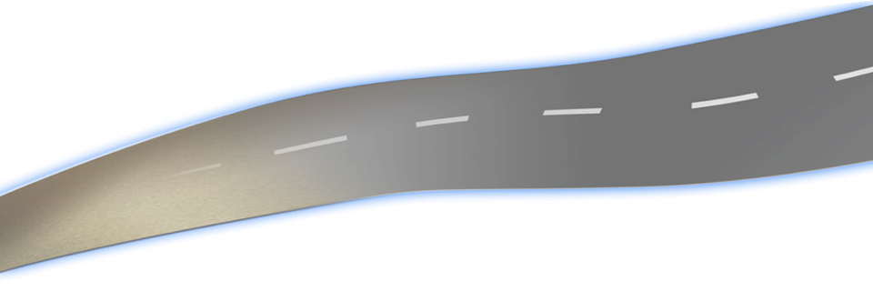
10-Year Speech Predictions
2005
2008
2010
2013
Telephony
Call Center
Mainstream app
(unified msg…)
VOIP converges
data & voice
Question
Answering
Mobility &
Automotive
applications
All phones
have speech;
Mainstream app
Central Part of
Mobile UI;
Mobile dictation
Task-specific
translation
Home appliances
Devices
Accessibility &
Asian
Dictation
Dictation &
New
applications
Structured
Search
Delegation
Key part of
Desktop UI;
Planning
Federation
Desktop
Personal
Annotations &
Recording search
Voicemail &
Meeting
Search
Mining from
audio data
(e.g., call center)
Voicemail &
Meeting
transcription
Voice data
Notes:
Last row:
When computers can see and hear, it should be much easier and less intrusive to communicate with them. They will also help us to see better, hear better, and remember better.
A little more conservative → need to add in user acceptance factor.

Slide 25
Conclusion
Speech technologies will follow Moore’s Law
  Faster CPU + more data + better algorithms.
  Near-human quality possible in 7-10 years
Natural language understanding is hard
  Domain-free reasoning & common sense hardest
  Truly human-level understanding likely elusive
Smart, conversational systems will emerge
  2-3 years: telephony, multimodal, accessibility.
  7-10 years: intelligent assistance, meeting search/transcription, speech everywhere.

Slide 26

© 2001 Microsoft Corporation. All rights reserved.

