Slide 1

.NET in
The Digital Decade
Kai-Fu Lee
Corporate Vice President
Microsoft Corporation
December 19, 2002

Slide 2








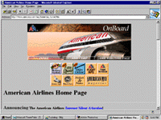

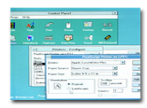




Computing Revolutions
2001
The Digital Decade
1995
Internet
1990
GUI
1985
PC
Notes:
© 2003 Microsoft Corporation. All rights reserved.
This presentation is for informational purposes only. Microsoft makes no warranties, express or implied, in this summary.

Slide 3
Changes in the Digital Decade
2000 : Internet connects content
2010 : Internet is the computer
Devices
300M PCs
1GHz/128MB/8GB
10B devices
50GHz/64GB/3TB
Software
Packaged product
for PC or server.
Re-usable web services on any device.
Security
Hacker attacks
Trustworthy systems
Content
Server : unstructured HTML & some database
PC : app documents
XML & structured content everywhere
UI
Graphical UI
Natural UI

Slide 4




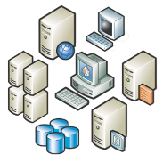


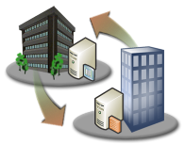
Information
Devices
People
Systems

Slide 5
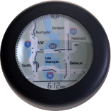
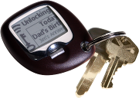
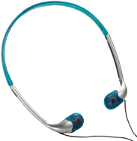



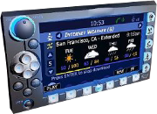
New Devices
Consumers
  Windows Media Center Edition
  Windows CE Smart Display
  Windows CE for Automobile
  Smart Personal Objects (watch, alarm clock….)
Knowledge Workers
  Tablet PC
  Meeting / Real-Time Collaboration Tools
Mobile Professionals.
  PocketPC Phone Edition
  Smart Phone.

Slide 6

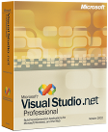
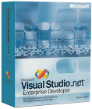
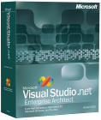
New Software Foundations
Industry Support of XML Web Services.
  WS-I : commitment to interoperate
Visual Studio.NET
  40+ languages.
  Web page, web application,
  GUI application, web services.
.NET Framework
  Common language runtime (40+ languages).
  “Managed” code protects the user
Many .NET Connected Products
  Windows, Office, MapPoint.NET, MS CRM,...
  Tremendous ISV Support: Adobe, Autodesk, ….
Notes:
Lightweight distributed computing
Work across organizational boundaries
Broadly supported family of standards
Common infrastructure

Slide 7
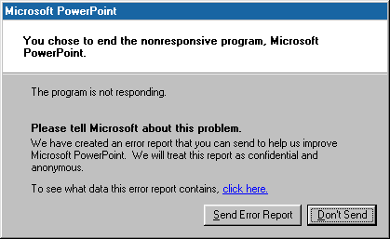
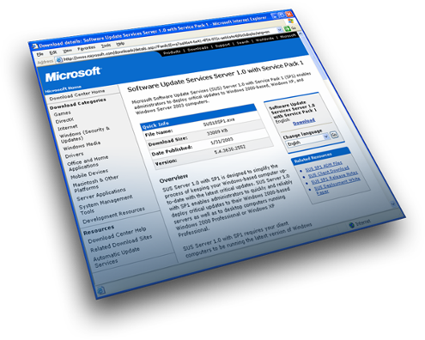
Trustworthy Computing
Security infrastructure
Development and testing tools
Online Crash Analysis and
Corporate Error Reporting
Software as a service
  Seamless software updating
  Security & anti-virus investments
  Spam initiatives
  Help/errors → service
Trustworthy hardware

Slide 8

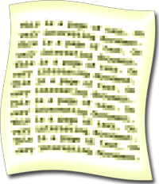
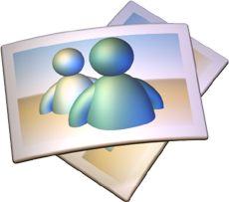




Structured Storage
Every Microsoft product will support XML.
SQL “Yukon” = foundation for XML & .NET.
Next Windows Release : “Longhorn”
  Built on SQL / Yukon structured storage.
  Data on PC and server will all be based on Yukon.
  Enables:
    Smart searching
    Smart browsing, navigating
    Smart delegating

Slide 9

Natural User Interface
Why Natural UI?
  Natural, expressive, scalable to any device.
  Best UI for .NET (structured, smart applications).
Examples of Natural UI:
  Meeting with John.
  How do I replace my printer cartridge?
  When is the Britney Spears concert?
  Send flowers to mom on her birthday
  Hold all calls unless it’s from my family.
Future :
  Computer evolves from tool to assistant.
  “Delegation” UI.

Slide 10
Conclusion
.NET will enable the “Digital Decade”:
  Supports industry standards.
  Great tools and runtime.
  Trustworthy Software.
  New software for new devices.
  Structured storage.
  Natural user interface.
No breakthroughs required!
  We know how to build everything.

Slide 11

© 2003 Microsoft Corporation. All rights reserved.
This presentation is for informational purposes only. Microsoft makes no warranties, express or implied, in this summary.

Slide 12


Web services from the beginning
Multi-language support
Best toolset
Standards for interoperability
Deep operating system integration
Third-party component marketplace
Options for small to large organizations

Slide 13




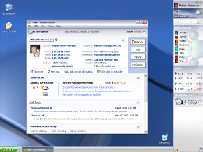
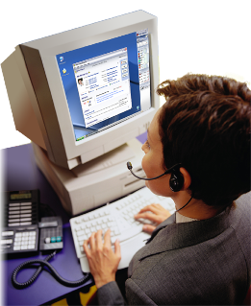

What’s Beyond?
Investments in many areas

Slide 14
