Slide 1

reqT
- an open, scalable systems modelling laboratory for research and teaching (and practice)
Download latest reqT.jar at http://reqT.org/ Run in terminal: java -jar reqT.jar

Slide 2
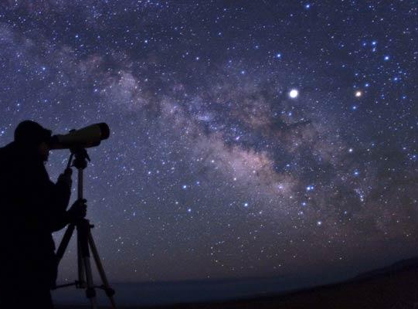
RE on planet Earth in 5-10 years ... ?
Some hypotheses
More continuous build, integration & deployment
Faster release cycles & Faster innovation
More SW eco systems, distributed developer communities, open source
=>
More decentralization and fewer centrally controlled 'Master Plans'
More coders will do the bulk of requirements engineering

Slide 3
reqT inception and high-level reqts
We want:
a free, open source tool for RE teaching
a laboratory to try out, integrate and demonstrate new research results
a scalable tool that supports models ranging from small "shopping lists" to huge reqts collections
a flexible tool:
mix natural language with computable structures
"methodology-agnostic" meta-model
a coder-friendly tool that integrate with coder's tools (my favourite editor, version system, scripting, api etc.)

Slide 4
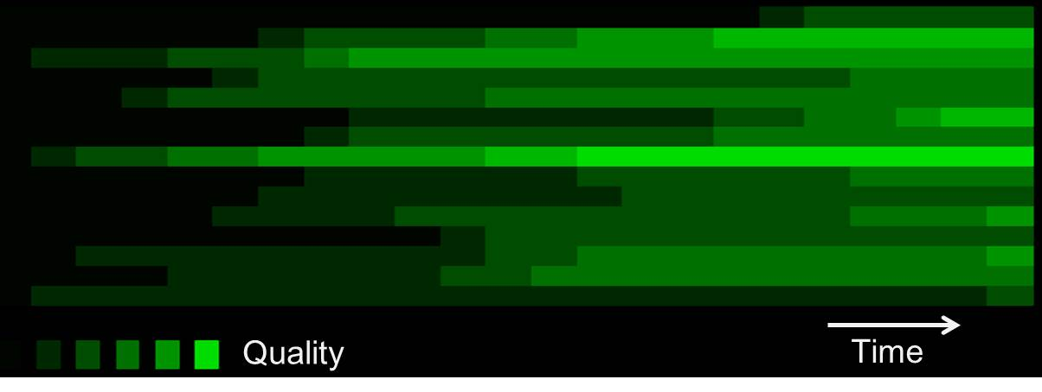
Evolving mix of levels of detail & quality in a requirements engineering continuum
Level of detail, specification quality

Slide 5
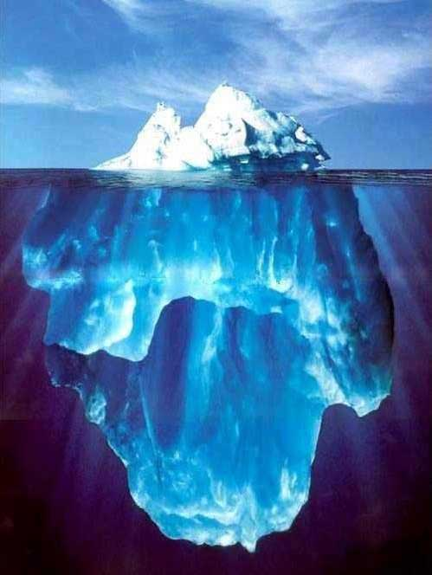
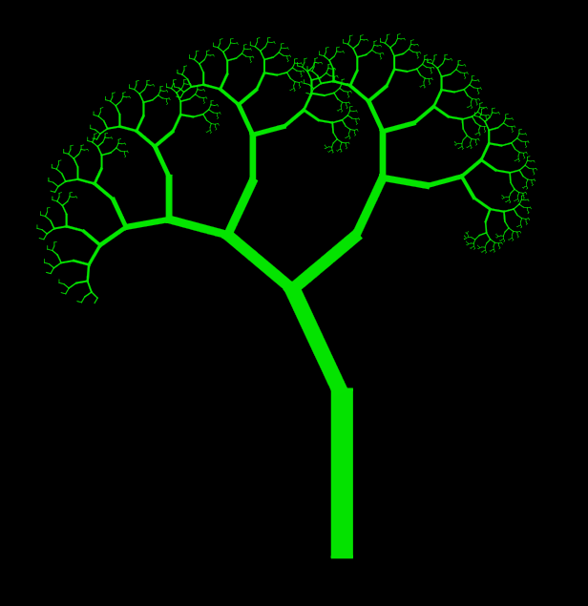
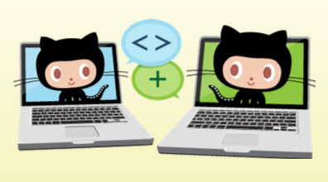
Scenario("Coders work in ecosystems with req+code+test in distributed git repos. Each stakeholder has its own, local understanding of ideas, roadmaps and acceptance criteria. Code is forked, pushed and pulled "organically" in the ecosystem. The joint ice berg is never complete. We manage local trees of req+code+test and mine sets of trees with big data technology on both dev repos and UX data. The community culture determine success rather than process control.")
myModel ++ yourModel

Slide 6
Evolving mix of levels of detail & quality in continuous requirements engineering
Level of detail, specification quality

Slide 7
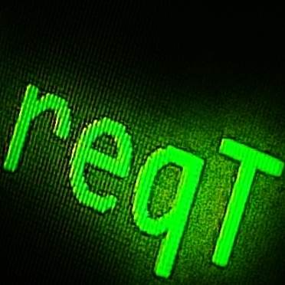
reqT architecture
Swing GUI
Domain Application
reqT
Embedded and external DSL
reqT/CSP
DSL
JaCoP
Scala
Libraries
Java
JVM
Platform

Slide 8
Open Source Software (OSS) in reqT
OSS
Licence
reqT
Scala libs & compiler
JaCoP
jLine
RSyntaxTextArea
jFlex
GraphViz
BSD-2-caluse
similar to BSD-2-caluse
GNU GPL v2 & v3
similar to BSD-2-caluse
similar to BSD-2-caluse
BSD-2-caluse
Eclipse Public License

Slide 9
reqT is metaprogrammed
The metamodel of reqT is expressed in reqT
reqT has a scala module that takes the reqT metamodel as input and generates a scala module that implements the reqT DSL
The bootstrap reqT DSL includes only a few elements such as Meta and superOf

Slide 10
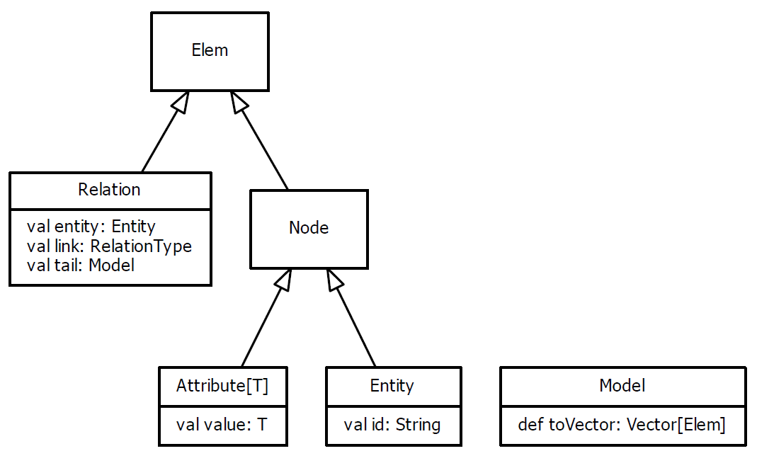
reqT v3.0 - generalized recursive structure
V3.0
metamodel

Slide 11
Some essential requirements entitites and attributes
Req generic, abstract
Feature decision item with status
Stakeholder
Goal
UserStory, TestCase
Quality
Function in -> processing -> out
Data I/O, percistency
Design existing systems, UX
Issue fix bug vs new feature?
...
Gist short one-liner
Spec detailed txt
Why
Example
Prio
Cost
Benefit
Status
...

Slide 12
Some essential requirements relations
Requirements entities have relations that turn the reqts into a graph
Model(
Req("a") requires Req("b")
)
has
requires
excludes
helps
hurts
...

Slide 13
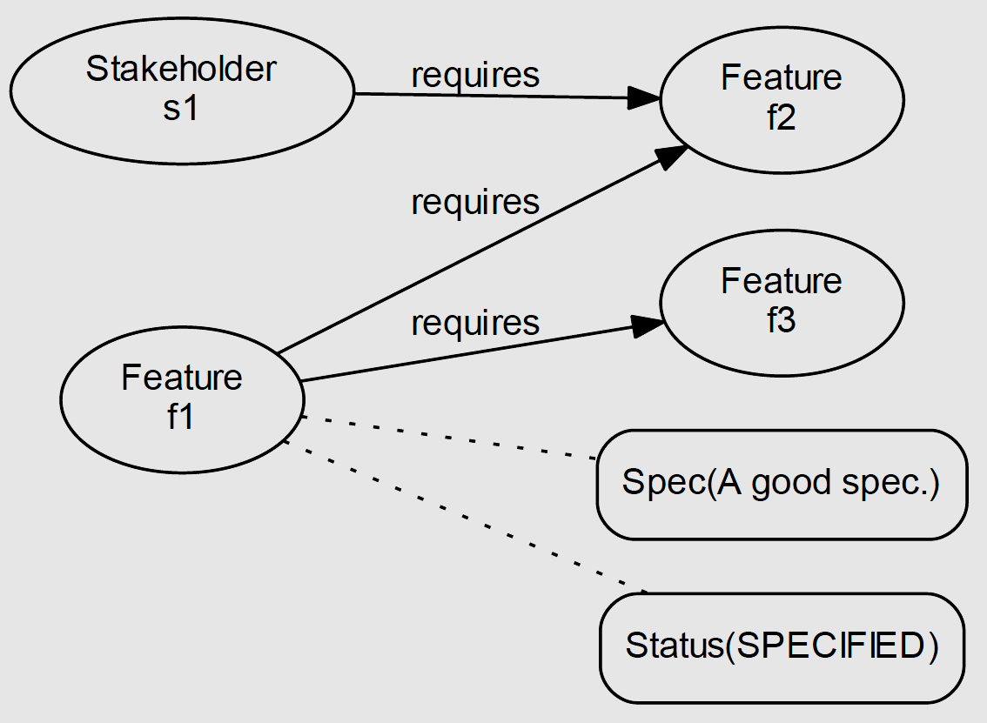
Requirements as graph structures
val m = Model(
Feature("f1") has (Spec("A good spec."), Status(SPECIFIED)),
Feature("f1") requires (Feature("f2"), Feature("f3")),
Stakeholder("s1") requires Feature("f2")
)
m.toGraph.save("graph.dot")
$ dot -Tpdf graph.dot -o graph.pdf
http://graphviz.org

Slide 14
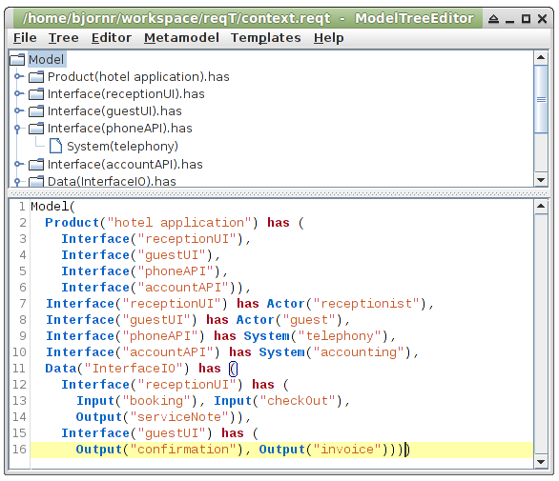
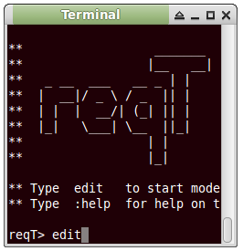
Ctrl+E
Edit selected tree node
Tree
Ctrl+R
Replace selected tree node by Model in editor
Editor
Ctrl+Enter
Enter code to console and evaluate

Slide 15
Status(value: Level)
up
RELEASED
reqT> val s = Status.start
s: reqT.Status = Status(ELICITED)
reqT> s.up
res1: reqT.Status = Status(SPECIFIED)
reqT> s.down
res2: reqT.Status = Status(DROPPED)
up
TESTED
down
up
down
IMPLEMENTED
up
up
down
PLANNED
FAILED
up
up
VALIDATED
down
up
POSTPONED
down
down
init
SPECIFIED
up
down
down
ELICITED
DROPPED
down
down
up

Slide 16
Split and merge
val myModel = Model(Req("x") has Spec("a"))
val yourModel = Model(Req("y") has Spec("b"))
val merged = myModel ++ yourModel
merged.toScala.save("newModel.scala")
Model(
Req("x") has Spec("a"),
Req("y") has Spec("b")
)

Slide 17
Summary: The power of reqT
Scalable datastructure from 1 to 10E4
Scripting with power of Scala
GUI optimized for power users
Works with git and similar tools
Constraint solving with power of JaCoP

Slide 18
The future of reqT
Software engineering laboratory
Product line engineering feature model checking
Integrate testing concepts to merge RE & VV
Integrate risk modelling
Integrate NLP and IR
Analyzer with metrics
Vizualizer with graphs
Growing an OOS Community
Pull requests invited
Use reqT for OI facitilation
Master thesis projects
Front-end + back-end cloud app in HTML5

Slide 19
Thanks!

