Slide 1

reqT
- an open, scalable systems modelling laboratory for research & teaching (& practice)
Download latest reqT.jar at: http://reqT.org/ Run in terminal: java -jar reqT.jar

Slide 2
Preview of discussion items after/during talk and demo
What are your requirements on a requirements engineering open source software (OSS) tool?
For research?
For teaching ?
How to best involve the academic RE community in taking a collective ownership of and contribution to a wide-spread OSS RE tool?
How should the reqT OSS project be governed to make it easy for you to contribute?

Slide 3
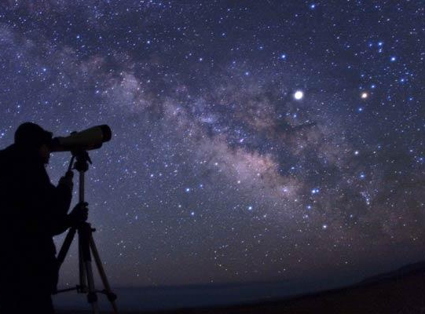
RE on planet Earth in 5-10 years ... ?
Some hypotheses
More continuous build, integration & deployment
Faster release cycles & Faster innovation
More SW eco systems, distributed developer communities, open source
=>
More decentralization and fewer centrally controlled 'Master Plans'
More coders will do the bulk of requirements engineering

Slide 4
reqT inception and high-level reqts
We want...
a free, open source tool for RE teaching
a laboratory to try out, integrate and demonstrate new research results
a scalable tool that supports models ranging from small "shopping lists" to huge reqts collections
a flexible tool:
mix natural language with computable structures
"methodology-agnostic" meta-model
a coder-friendly tool that integrate with coder's tools (my favorite editor, version control, scripting, api etc.)

Slide 5
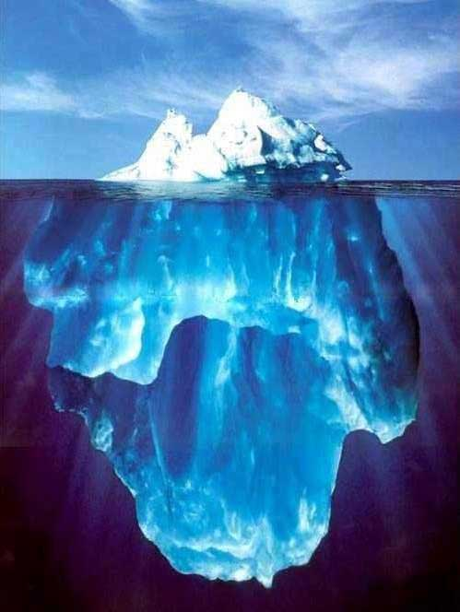
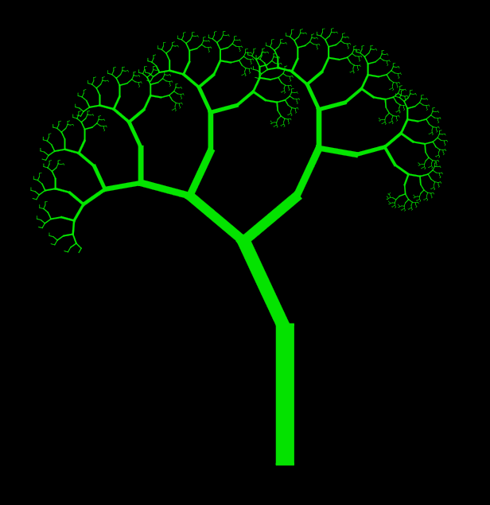

Scenario("Coders work in ecosystems with req+code+test in distributed git repos. Each stakeholder has its own, local understanding of ideas, roadmaps and acceptance criteria. Code is forked, pushed, pulled and merged continuously in the ecosystem. The implicit 'ice berg' of mixed, semi-formal models is neither complete nor fully consistent. We manage local trees of req+code+test and mine sets of mixed, semi-formal models with big data technology on both dev repos and UX data. The community culture and repo governance determine success rather than process control.")
myModel ++ yourModel

Slide 6
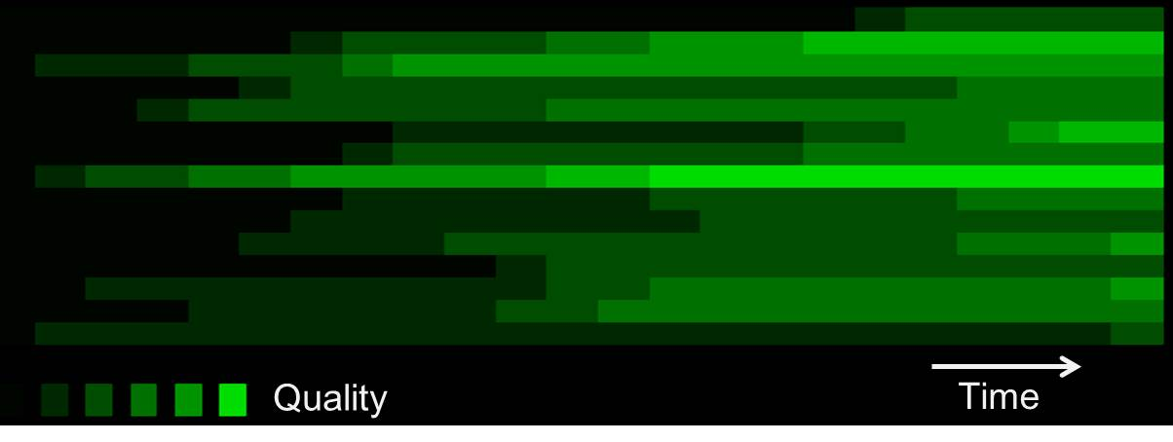
Evolving heterogeneous mix of levels of detail & quality in continuous requirements engineering
Level of detail, specification quality

Slide 7

reqT architecture
CLI + GUI
Domain Application
reqT
reqT/CSP
DSL
JaCoP
Scala
Libraries
Java
JVM
Platform

Slide 8
Open Source Software (OSS) in reqT
OSS
Licence
reqT
Scala libs & compiler
JaCoP
jLine
RSyntaxTextArea
jFlex
GraphViz
BSD-2-caluse
similar to BSD-2-caluse
GNU GPL v2 & v3
similar to BSD-2-caluse
similar to BSD-2-caluse
BSD-2-caluse
Eclipse Public License

Slide 9
reqT is metaprogrammed
The metamodel of reqT is expressed in reqT
reqT has a Scala module that takes the reqT metamodel as input and generates a Scala module that implements the reqT DSL
The bootstrap reqT DSL includes only a few elements such as Meta and superOf

Slide 10
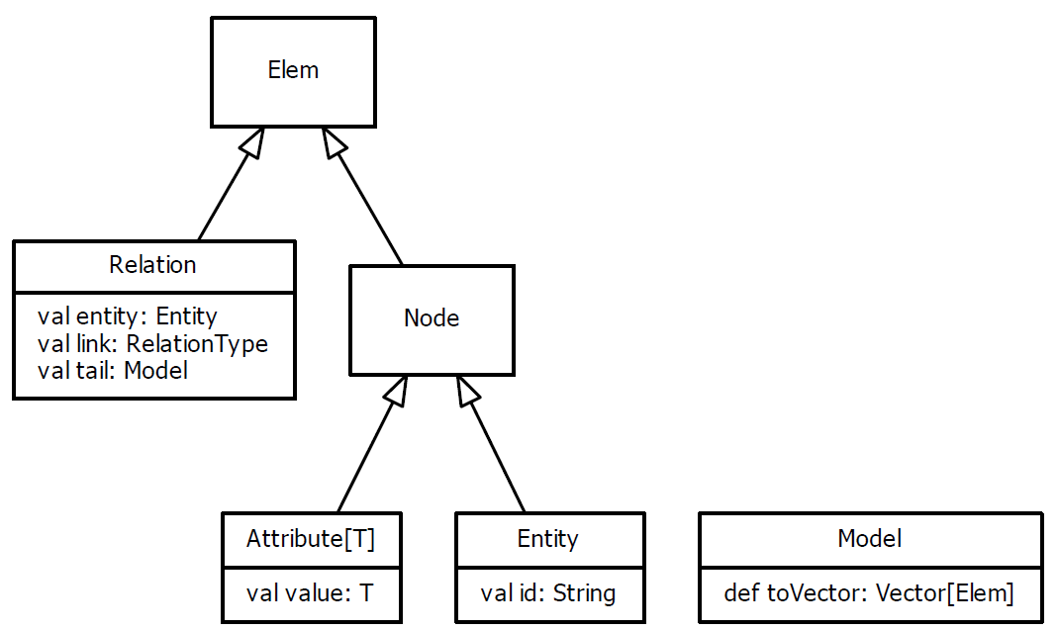
The embedded DSL provides a recursive, tree-like data structure

Slide 11
Some essential requirements entitites and attributes
Req generic, abstract, undecided
Feature decision item with status
Stakeholder
Goal
UserStory, TestCase, Issue
Quality
Function
Data
...
Gist short one-liner
Spec txt descr
Why
Example
Prio
Cost
Benefit
Status
...

Slide 12
Some essential requirements relations
Requirements entities have relations that turn the reqts into a graph
Model(
Req("a") requires Req("b")
)
has
requires
excludes
helps
hurts
...

Slide 13
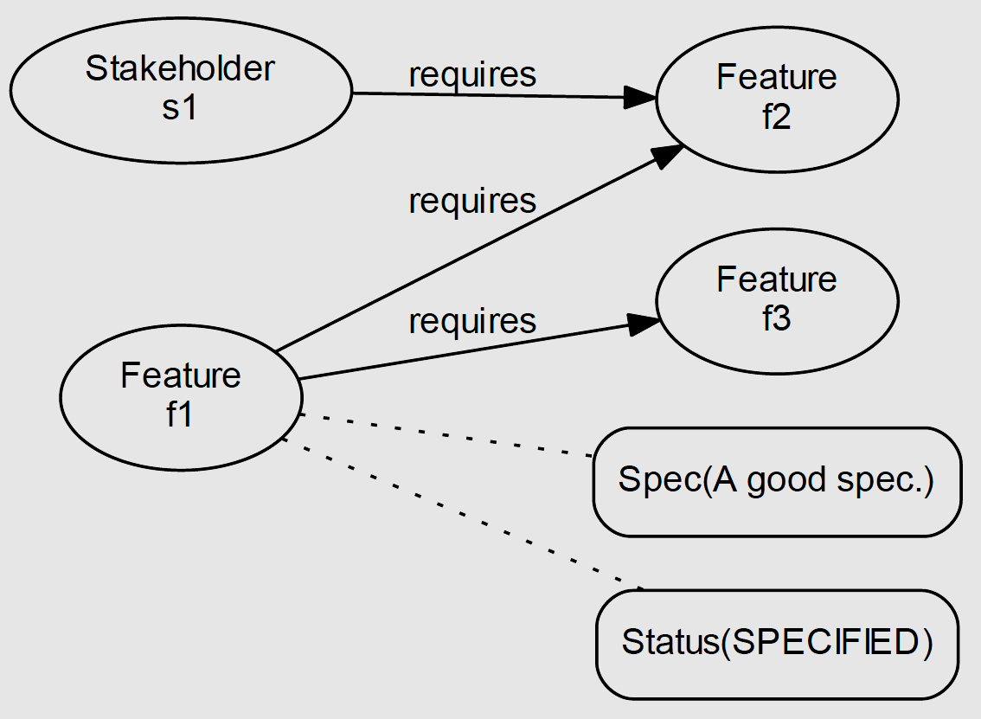
Requirements as graph structures
val m = Model(
Feature("f1") has (Spec("A good spec."), Status(SPECIFIED)),
Feature("f1") requires (Feature("f2"), Feature("f3")),
Stakeholder("s1") requires Feature("f2")
)
m.toGraph.save("graph.dot")
$ dot -Tpdf graph.dot -o graph.pdf
http://graphviz.org

Slide 14
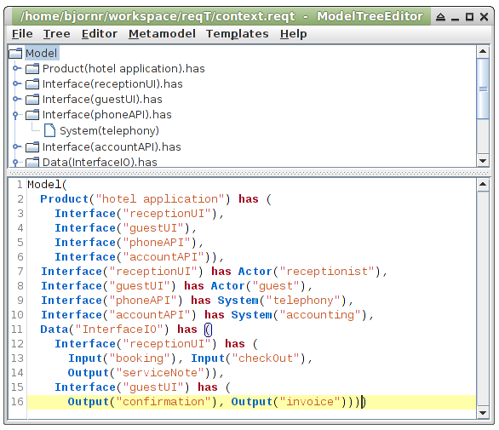
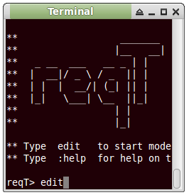
Ctrl+E
Edit selected tree node
Tree
Ctrl+R
Replace selected tree node by Model in editor
Editor
Ctrl+Enter
Enter code to console and evaluate

Slide 15
Split and merge
val myModel = Model(Req("x") has Spec("a"))
val yourModel = Model(Req("y") has Spec("b"))
val merged = myModel ++ yourModel
merged.toScala.save("newModel.scala")
Model(
Req("x") has Spec("a"),
Req("y") has Spec("b")
)

Slide 16
The goal-design scale in reqT
Model(
Goal("accuracy") has
Spec("Our pre-calculations shall hit within 5%"),
Feature("quotation") has
Spec("Product shall support cost recording and quotation with experience data"),
Function("experienceData") has
Spec("Product shall have recording and retrieval functions for experience data"),
Design("screenX") has
Spec("System shall have screen pictures as shown in Fig. X"))
// Adapted from RE text book by [Lauesen]

Slide 17
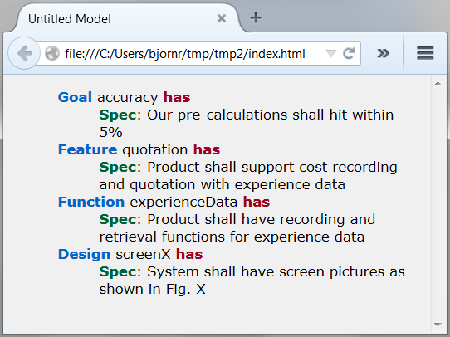
Product("reqT") has Feature("toHtml")

Slide 18
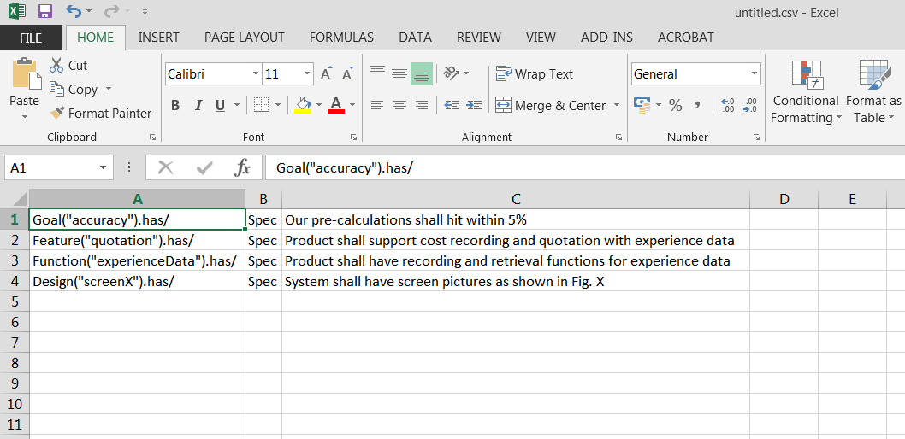
Product("reqT") has Feature("toTable")

Slide 19
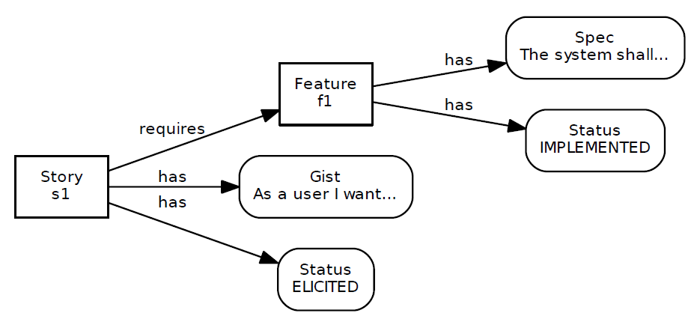
Product("reqT") has Feature("toGraph")
Model(
Feature("f1") has (
Spec("The system shall..."),
Status(IMPLEMENTED)),
Story("s1") has (
Gist("As a user I want..."),
Status(ELICITED)),
Story("s1") requires Feature("f1")
)

Slide 20
Status(value: Level)
up
RELEASED
reqT> val s = Status.start
s: reqT.Status = Status(ELICITED)
reqT> s.up
res1: reqT.Status = Status(SPECIFIED)
reqT> s.down
res2: reqT.Status = Status(DROPPED)
up
TESTED
down
up
down
IMPLEMENTED
up
up
down
PLANNED
FAILED
up
up
VALIDATED
down
up
POSTPONED
down
down
init
SPECIFIED
up
down
down
ELICITED
DROPPED
down
down
up

Slide 21
Example: variability model
Model(
Component("apperance") has (
VariationPoint("color") has (
Min(0), Max(2),
Variant("blue"), Variant("red"), Variant("green")),
VariationPoint("shape") has (
Min(1), Max(1), Variant("round"), Variant("square")),
VariationPoint("payment") has (
Min(1), Max(2), Variant("cash"), Variant("credit")),
VariationPoint("payment") requires Variant("cash"), /* mandatory */
Variant("round") excludes Variant("red"),
Variant("green") requires Variant("square")),
Component("apperance") requires VariationPoint("shape"), /* mandatory */
App("free") requires Component("apperance"),
App("free") binds (
VariationPoint("shape") binds Variant("round")),
App("premium") requires Component("apperance"),
App("premium") binds ( /* violating variability constraints */
VariationPoint("color") binds (Variant("red"), Variant("green")),
VariationPoint("shape") binds (Variant("round"), Variant("square")),
VariationPoint("payment") binds Variant("cash")))

Slide 22
Summary: The power of reqT
Scalable data structure from 1 to 10E4
Scriptable with the power of Scala
CLI + GUI for power users
Works with git and similar tools
Constraint solving with JaCoP
Methodology agnostic: 'bag of concepts'
Open metamodel => metaprogramming

Slide 23
The future of reqT?
Growing requirements engineering laboratory
Visualizer by integrating some graph lib
Analyzer with metrics and checking
Product line engineering variability model checking
Integrate testing concepts to merge RE & VV
Integrate risk modelling
Integrate NLP and IR techniques
Growing an OOS Community
Your pull requests are welcome!
Master thesis projects
Front-end + back-end cloud app in HTML5?

Slide 24
Discussion
What are your requirements on a requirements engineering open source software (OSS) tool?
For research?
For teaching ?
How to best involve the academic RE community in taking a collective ownership of and contribution to a wide-spread OSS RE tool?
How should the reqT OSS project be governed to make it easy for you to contribute?

Slide 25
Thanks!
bjorn.regnell@cs.lth.se
Download latest reqT.jar at: http://reqT.org/ Run in terminal: java -jar reqT.jar

