Slide 1
A standalone Workflow Engine with Designer, Monitor
and Restful API

Slide 2
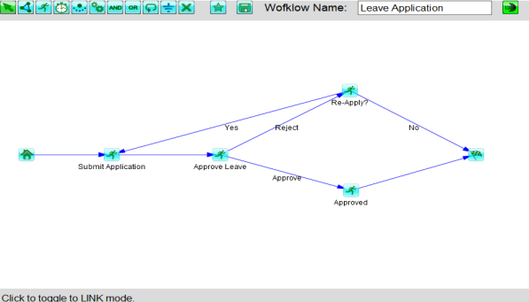
Create workflow template with Workflow Designer

Slide 3
Or compose manually
String wft = "<?xml version=\"1.0\" encoding=\"UTF-8\"?><cf:workflow xsi:schemaLocation=\"http://lkh.com/cflow ../schemas/wft.xsd\" name=\"tobedelete\“><node id=1></node>"
+ "</cf:workflow>";
String wftname = "rstest1";
String wftid = client.uploadWft(accessKey, wft, wftname);

Slide 4
With Restful API, you can
Start a workflow

Slide 5
With Restful API, you can
Start a workflow
Get user’s worklist

Slide 6
With Restful API, you can
Start a workflow
Get user’s worklist
Show task form

Slide 7
With Restful API, you can
Start a workflow
Get user’s worklist
Show task form
Complete a task

Slide 8
With Restful API, you can
Start a workflow
Get user’s worklist
Show task form
Complete a task Repeat until worklist is empty

Slide 9

TASK
A task should be done by people (doer)

Slide 10

TIMER
Process will hold on here for a specified period

Slide 11

Child Process
Invoke a child process.

Slide 12

SCRIPT
Invoke a
JavaScript
Java Call
Web Service

Slide 13

AND
Continue when precedding nodes are all completed

Slide 14
OR
Continue when any one of precedding nodes is completed

Slide 15
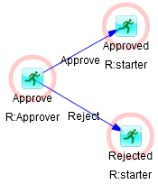
Route by user choice

Slide 16
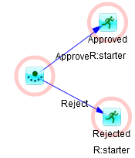
Route by child’s return
Sub process

Slide 17
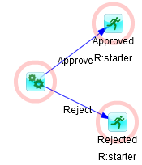
Route by script’s return
SCRIPT

Slide 18
Role and Team mapping
Template: Task to Role
Team: Role to Person mapping
Process: Task to Person

Slide 19
Process control
Pause a task
Resume a task
Suspend a process
Resume a process
Cancel a process
Modify a process while its running

Slide 20
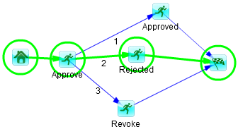
Process monitoring
Process footprint

Slide 21
Other features
Task delegation Task occupation Referenced participator Participator mutual exclusion
Read/change process context Process history

