Slide 1
API CALL
API Call

Slide 2
API CALL
API Call

Slide 3
API CALL
API Call
Title:...
Authors:...
Abstract:...
Pub-Date:...
...

Slide 4
API CALL
API Call
Title:...
Authors:...
Abstract:...
Pub-Date:...
...
10.xxx…

Slide 5
API CALL
API Call
{…}
DOI: 10.xxx…
Title:...
Authors:...
Abstract:...
Pub-Date:...
...
Title:...
Authors:...
Abstract:...
Pub-Date:...
...
10.xxx…

Slide 6
API CALL
API Call
10.xxx…
{…}
DOI: 10.xxx…
Title:...
Authors:...
Abstract:...
Pub-Date:...
...
Title:...
Authors:...
Abstract:...
Pub-Date:...
...
10.xxx…

Slide 7
API CALL
API Call
10.xxx…
{…}
DOI: 10.xxx…
Title:...
Authors:...
Abstract:...
Pub-Date:...
...
Title:...
Authors:...
Abstract:...
Pub-Date:...
...
10.xxx…

Slide 8

API CALL
API Call
https://www.wikipedia.org
https://www.wikipedia.org
https://www.wikipedia.org/wiki/Metascience

Slide 9
API CALL
API Call
https://www.wikipedia.org
https://www.wikipedia.org
https://www.wikipedia.org/wiki/Metascience

Slide 10

API CALL
API Call
wiki/Metascience
https://www.wikipedia.org
https://www.wikipedia.org
https://www.wikipedia.org/wiki/Metascience

Slide 11
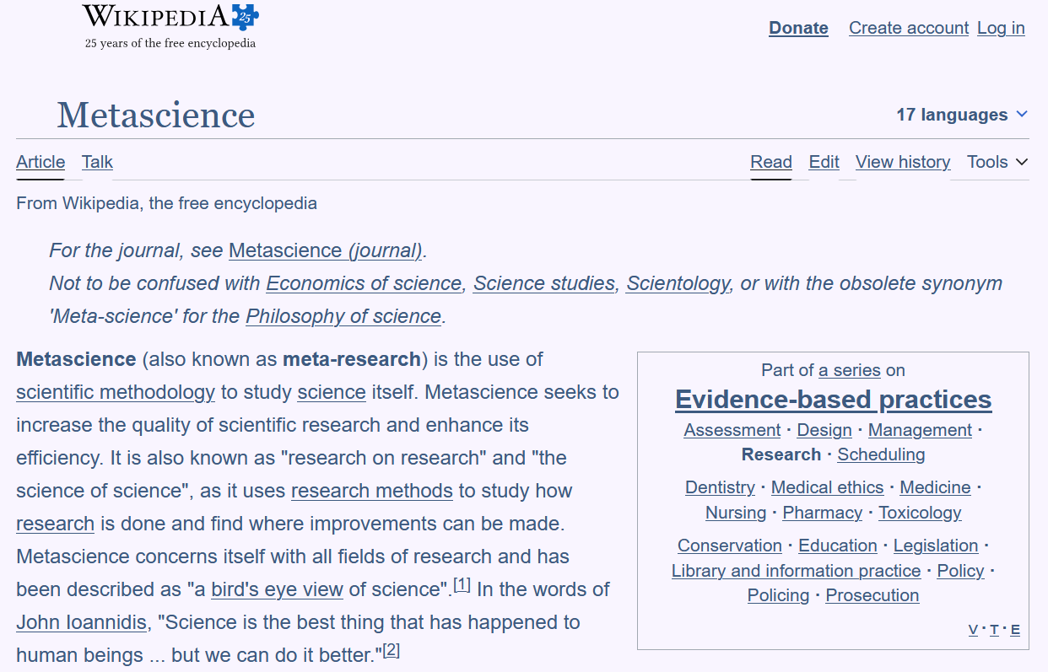
API CALL
API Call
https://www.wikipedia.org
https://www.wikipedia.org/wiki/Metascience

Slide 12
https://api.crossref.org
https://api.crossref.org.org
https://api.crossref.org/
works/10.1016/S0140...

Slide 13

works/10.1016/S0140...
https://api.crossref.org
https://api.crossref.org.org
https://api.crossref.org/
works/10.1016/S0140...

Slide 14
works/10.1016/S0140...
https://api.crossref.org
https://api.crossref.org.org
{
title: “Illeal-lymph...
authors: [
0:{
First: ...
...
https://api.crossref.org/
works/10.1016/S0140...

Slide 15
code
library(httr)
req <- request(“https...
resp <- req |> req_perform
json <- resp |> resp_body_j
http
httr2
requests

