Slide 1
One Theme To Rule Theme All!!!
Presented by Geoff Maxey
DrupalCamp Atlanta October 1, 2011

Slide 2
Objective
Demonstrate a basic knowledge base of tools that can help create an adaptable, responsive application.
How to combine those tools into a single application that can provide a unique interface for users to access the same data and content no matter how the content is accessed.
In short, the basics you can use to forge:
The One Theme To Rule Them ALL!

Slide 3
Who Must be Ruled?
Men (Desktops/Laptops)
Elves (Tablets)
Dwarves (Smart Phones)
Goblins (IE) †
Hobbits (Have no need for such fanciful things) ††
† not going there :P
†† also IE users and maybe AOL, too.

Slide 4
Men (Desktops/Laptops)
Average size (Resolution): 1024 x 728
Abilities:
HTML4+/CSS3
Javascript/jQuery
Full AJAX/JSON
FLASH
And much more…

Slide 5
Elves (Tablets)
Average size (Resolution):
Portrait: 768 x 1024
Landscape: 1024 x 768
Abilities:
HTML4+/CSS3
Javascript/jQuery
Select AJAX/JSON

Slide 6
Dwarves (Smart Phones)
Average size (Resolution):
320 x 480
Can expand to: 640 x 960
Abilities:
HTML4+/CSS
Limited Javascript/jQuery
Limited AJAX/JSON

Slide 7
Forge Ingredients
Fluid/Liquid Widths
CSS Media Queries
CSS Transitions
jQuery User Agent detection
jQuery Mobile

Slide 8
Fluid/Liquid Widths
Set a main parent width
Children widths are represented as a percentage of the parent width
Note: Combined children’s percentages should be less than 100% to leave room for margin and padding.

Slide 9
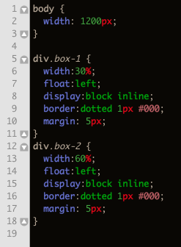
Fluid/Liquid Widths
CSS Example:
Notes:
After show this then switch back to browser to show the layout in effect.

Slide 10
CSS Media Queries
Exposes media and browser elements
Can create style subsets in reaction to the viewing environment
Basically you can create new layouts for varying resolutions, including those from tablets and mobile devices.

Slide 11
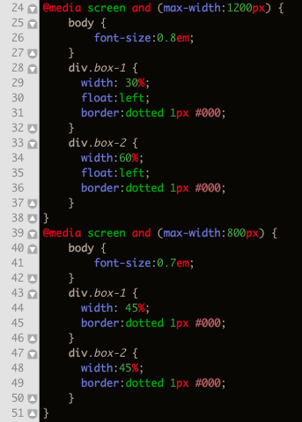
CSS Media Queries
Example:
Notes:
Go into transitions before demoing this bit so you can show off both element at one time.

Slide 12
CSS Transitions
Cut out choppy movement and allow a graceful transition between style subsets.
Can use time in miliseconds (ms) to stretch out the animation to your transition.

Slide 13
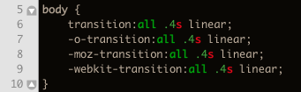
CSS Transitions
Example:

Slide 14
jQuery Mobile and HTML5
Simplest implementation of HTML5 elements required for jQM to run.
“data-role” attributes tell jQM about our mark-up.
Page
Header
Content
Footer

Slide 15
JS/jQuery
Detect User Agent
Dynamically add JS and CSS files based on User Agent

Slide 16
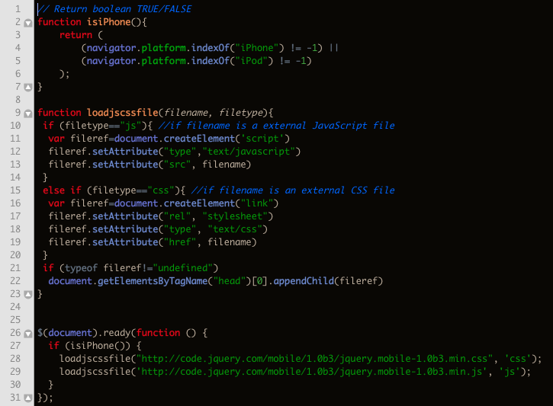
JS/jQuery

Slide 17
Resources
Slides, code, and extras available at:
git@github.com:cntlscrut/Demo-Site-setup.git
More info on jQM:
http://jquerymobile.com/test/
Drupal starter themes:
http://drupal.org/project/zen
http://drupal.org/project/omega

Slide 18
More Resources
CSS Transitions:
https://developer.mozilla.org/en/css/css_transitions
CSS Media Queries:
http://www.w3.org/TR/css3-mediaqueries/

