Slide 1
Chapter 9 Virtual Memory

Slide 2
Objectives and Outline
Objectives
To describe the benefits of a virtual memory system
To explain the concepts of demand paging,
page-replacement algorithms, and
allocation of page frames
To discuss the principle of the working-set model
Outline
Background
Demand Paging
Copy-on-Write
Page Replacement
Allocation of Frames
Thrashing
Memory-Mapped Files
Allocating Kernel Memory
Other Considerations
Operating-System Examples

Slide 3
Background
Virtual memory – program uses virtual memory which can be partially loaded into physical memory
Benefits:
Only part of the program needs to be in memory for execution
more concurrent programs
Logical address space can therefore be much larger than physical address space
execute programs larger than RAM size
Easy sharing of address spaces by several processes
Library or a memory segment can be shared
Allows for more efficient process creation

Slide 4
Virtual Memory That is Larger Than Physical Memory
Page 0
0
Page 1
1
2
Page 2
Page 2
3
Page 0
Page 1
4
unavail
Page 3
Page 2
Page 3
…
Page 0
move pages
…
Page 4
unavail
Page 4
Page 3
n-2
Page 1
page n-2
Page n-1
n-1
page table
Physical memory
page n-2
page n-1
all pages of program sitting on physical Disk
Virtual memory

Slide 5
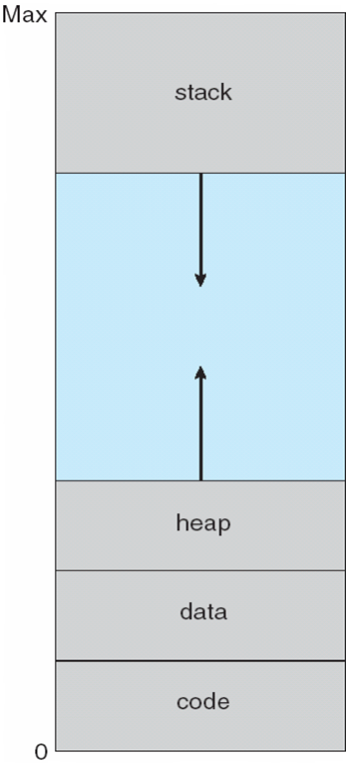
A typical virtual-address space layout of a process
function parameters;
local variables;
return addresses
unused address space
will be used whenever
needed
malloc() allocates
space from here
(dynamic memory allocation)
global data (variables)

Slide 6
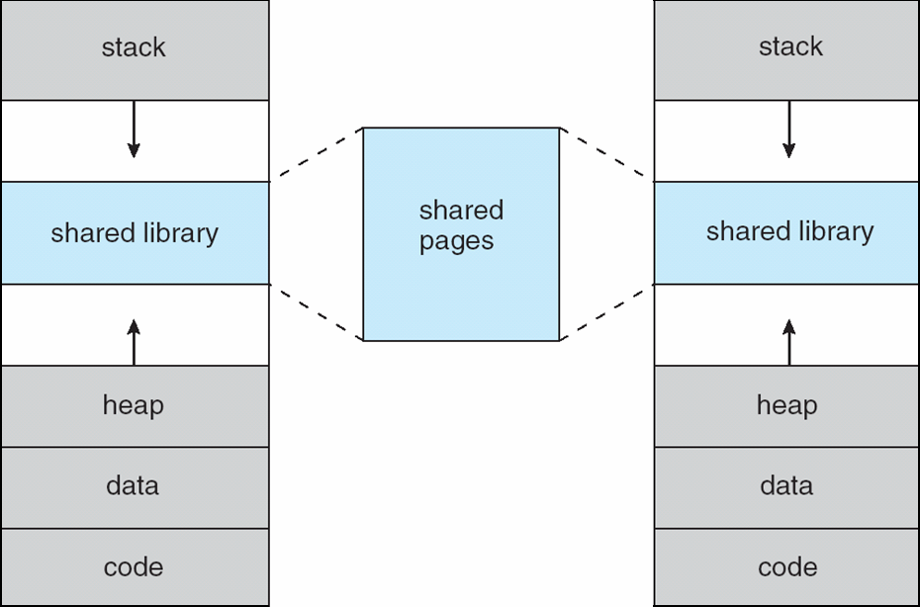
Shared Library Using Virtual Memory
Virtual memory of process A
Virtual memory of process B
only one copy of
a page needs to
be in memory

Slide 7
Implementing Virtual Memory
Virtual memory can be implemented via:
Demand paging
Bring pages into memory when they are used, i.e., allocate memory for pages when they are used (accessed/references/needed).
Demand segmentation
Bring segments into memory when they are used, i.e., allocate memory for segments when they are used.

Slide 8
Demand Paging
Bring a page into memory only when it is needed
Less I/O needed
Less memory needed
Faster response
More users
Page is needed when running program makes a reference to it
invalid reference (page is not in used portion of address space) ⇒ abort
not-in-memory ⇒ bring to memory
Pager never brings a page into memory unless page will be needed

Slide 9
Valid-Invalid Bit
With each page table entry a valid–invalid bit (validation bit) is associated (v ⇒ in-physical-memory, i ⇒ not-in-memory)
Initially valid–invalid bit is set to i on all entries
Example of a page table snapshot:
During address translation, if valid–invalid bit in page table entry
is i ⇒ page fault
Frame #
valid-invalid bit
v
v
v
v
i
….
i
i
page table

Slide 10
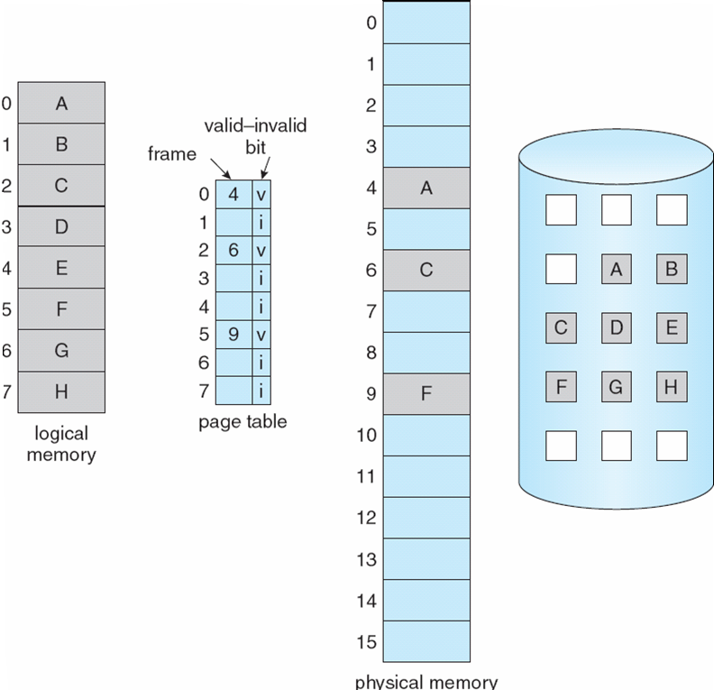
Page Table When Some Pages Are Not in Main Memory

Slide 11
Page Fault
When CPU makes a memory reference (i.e. page reference), HW consults the page table. If entry is invalid, then exception occurs and kernel gets executed.
Kernel handles such a case as follows:
Kernel looks at another table to decide (the table keeps used virtual memory regions of the process):
Invalid reference (page is in unused portion of address space) → Abort
Just not in phy memory → PAGE FAULT
(page is in used portion, but not in RAM)
Get empty frame. We may need to remove a page - swapping out - ; if page modified, need disk I/O to write back to disk)
Bring page from disk into frame - swapping in - (need disk I/O)
Reset tables (install mapping into page table)
Set validation bit = v
Restart the instruction that caused the page fault

Slide 12
Page Fault (Cont.)
If page fault occurs while trying to fetch an instruction, fetch the instruction again after bringing the page in.
If page fault occurs while we are executing an instruction: Restart the instruction after bringing the page in.
For most instructions, restarting the instruction is no problem.
But for some, we need to be careful.

Slide 13
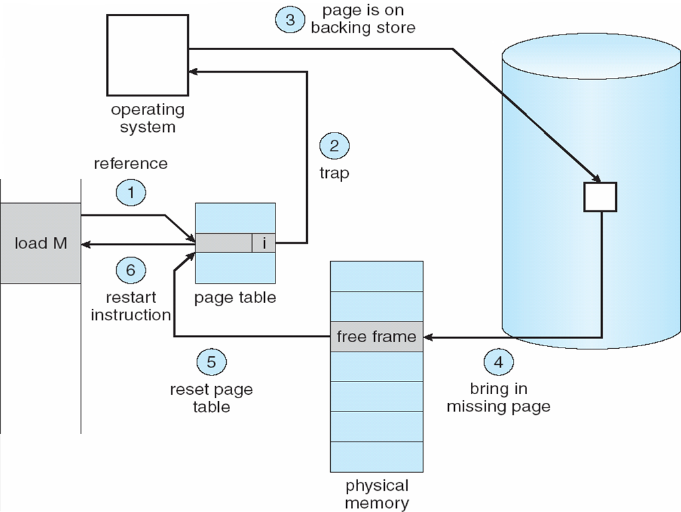
Steps in Handling a Page Fault
swap
space

Slide 14
Performance of Demand Paging
Page Fault Rate (p): 0 ≤ p ≤ 1.0
if p = 0 no page faults
if p = 1, every reference is a fault
Effective Access Time to Memory (EAT)
EAT = (1 – p) x memory_access_time
+ p x (page fault overhead
+ time to swap page out (sometimes)
+ time to swap page in
+ restart overhead time)
page fault
service time

Slide 15
Demand Paging Example
Memory access time = 200 nanoseconds
Average page-fault service time = 8 milliseconds
EAT = (1 – p) x 200 + p (8 milliseconds)
= (1 – p) x 200 + p x 8,000,000
= 200 + p x 7,999,800
If one access out of 1,000 causes a page fault (p = 1/1000), then
EAT = 8.2 microseconds.
This is a slowdown by a factor of 40!!
(200 ns / 8.2 microsec ~= 1/40)

Slide 16
Other benefits of virtual memory
Virtual memory has other benefits:
Copy-on-Write (fast process creation)
Memory-Mapped Files (later)

Slide 17
Copy-on-Write
Copy-on-Write (COW) allows both parent and child processes to initially share the same pages in memory If either process modifies a shared page, only then is the page copied
COW allows more efficient process creation as only modified pages are copied

Slide 18
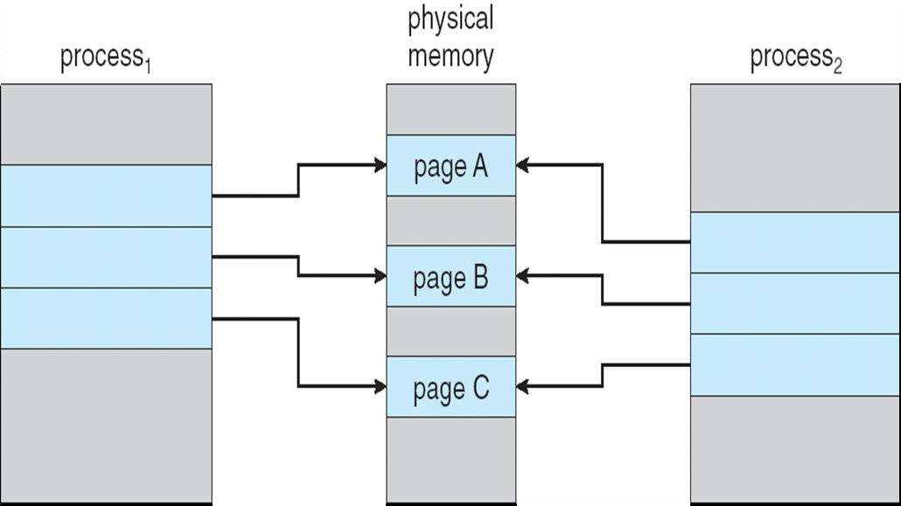
Before Process 1 Modifies Page C

Slide 19
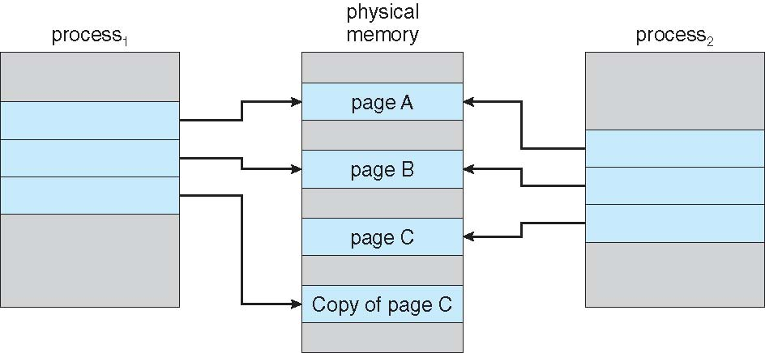
After Process 1 Modifies Page C

Slide 20
Page Replacement

Slide 21
What happens if there is no free frame?
Page replacement – find some page in memory, but not really in use, swap it out
Algorithm ? Which page should be removed?
performance – want an algorithm which will result in minimum number of page faults
With page replacement, a page may be brought into memory several times (memory ←→ disk)
Prevent over-allocation of memory by modifying page-fault service routine to include page replacement

Slide 22
Page Replacement
Use modify (dirty) bit to reduce overhead of page transfers – only modified pages are written to disk while removing/replacing a page.
Page replacement completes separation between logical memory and physical memory
large virtual memory can be provided on a smaller physical memory

Slide 23
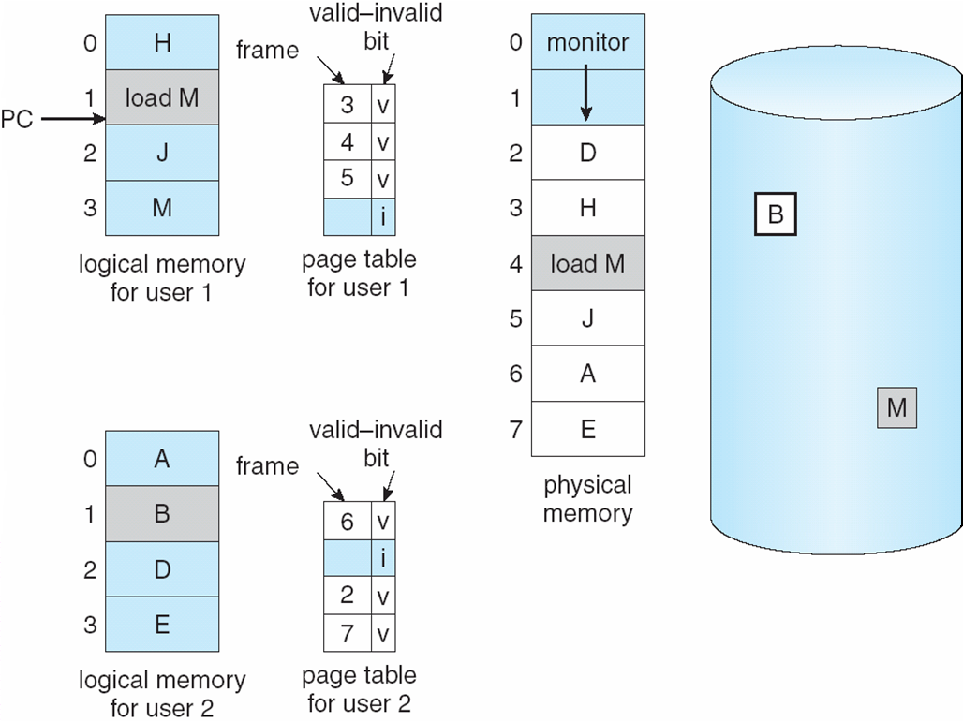
Need For Page Replacement
While executing “load M”
we will have a page fault and we need
page replacement.

Slide 24
Basic Page Replacement
Steps performed by OS while replacing a page upon a page fault:
Find the location of the desired page on disk
Find a free frame: - if there is a free frame, use it - if there is no free frame, use a page replacement algorithm to select a victim frame; - if the victim page is modified, write it back to disk.
Bring the desired page into the (new) free frame; update the page and frame tables
Restart the process

Slide 25
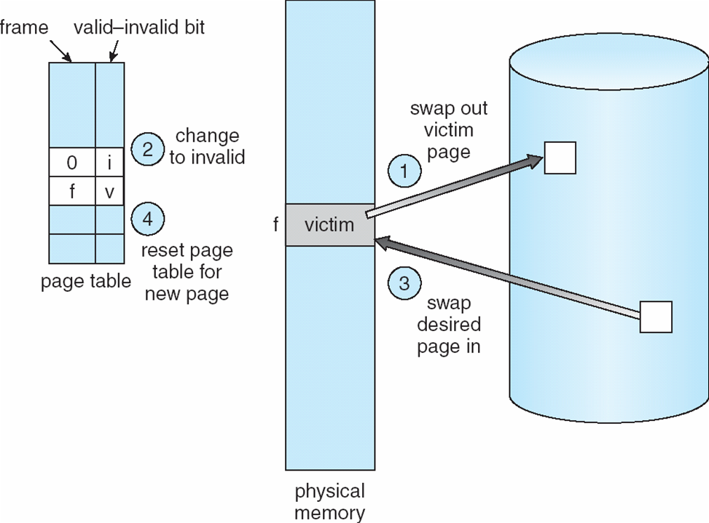
Page Replacement

Slide 26
Page Replacement Algorithms
Want lowest page-fault rate
Evaluate an algorithm by running it on a particular string of page (memory) references (reference string) and computing the number of page faults on that string
In all our examples, the page reference string is
1, 2, 3, 4, 1, 2, 5, 1, 2, 3, 4, 5

Slide 27
Driving reference string
Assume process makes the following memory references (in decimal) in a system with 100 bytes per page:
0100 0432 0101 0612 0102 0103 0104 0101 0611 0102 0103 0104 0101 0610 0102 0103 0104 0609 0102 0105
Example: Bytes (addresses) 0…99 will be in page 0
Pages referenced are:
1, 4, 1, 6, 1, 1, 1, 1, 6, 1, 1, 1, 1, 6, 1, 1, 6, 1, 1
Corresponding page reference string
1, 4, 1, 6, 1, 6, 1, 6, 1, 6, 1

Slide 28
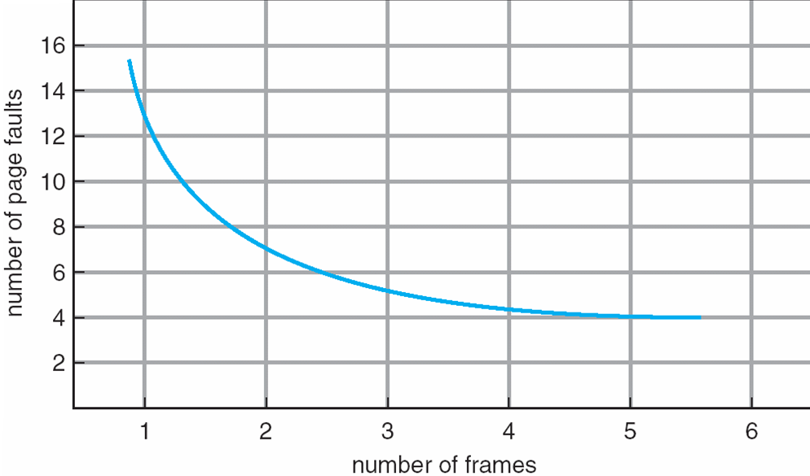
Graph of Page Faults Versus The Number of Frames

Slide 29
First-In-First-Out (FIFO) Algorithm
Reference string: 1, 2, 3, 4, 1, 2, 5, 1, 2, 3, 4, 5
3 frames (3 pages can be in memory at a time per process)
4 frames
Belady’s Anomaly: more frames ⇒ more page faults
1
1
4
5
2
2
1
3
9 page faults
3
3
2
4
1
1
5
4
2
2
1
5
10 page faults
3
3
2
4
4
3

Slide 30
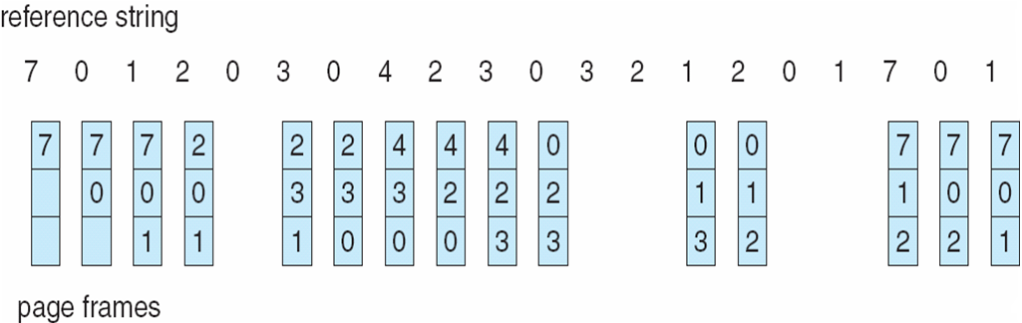
FIFO Page Replacement

Slide 31
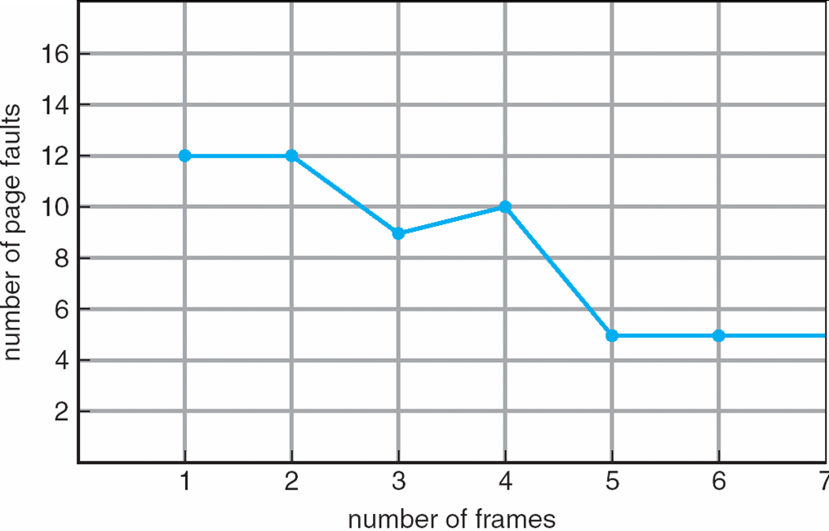
FIFO Illustrating Belady’s Anomaly

Slide 32
Optimal Algorithm
Replace page that will not be used for longest period of time
4 frames example
1, 2, 3, 4, 1, 2, 5, 1, 2, 3, 4, 5
How do you know this?
Used for measuring how well your algorithm performs
1
4
2
6 page faults
3
4
5

Slide 33
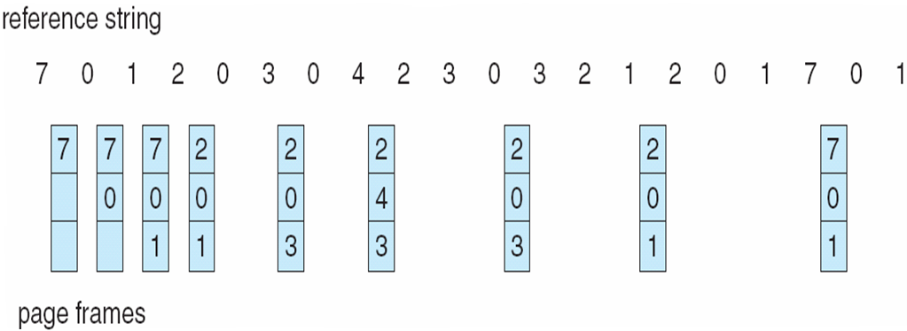
Optimal Page Replacement

Slide 34
Least Recently Used (LRU) Algorithm
Reference string: 1, 2, 3, 4, 1, 2, 5, 1, 2, 3, 4, 5
1
1
1
1
5
2
2
2
2
2
3
5
5
4
4
4
4
3
3
3
8 page faults

Slide 35
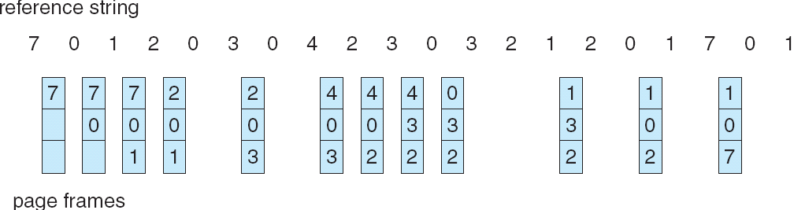
LRU Page Replacement

Slide 36
LRU Algorithm Implementation
Counter implementation
Every page entry has a counter field; every time page is referenced through this entry, copy the clock into the counter field
When a page needs to be replaced, look at the counters to determine which one to replace
The one with the smallest counter value will be replaced
…
…
frame#
counter
frame#
counter
PTE
clock
frame#
counter
…
…
Page Table

Slide 37
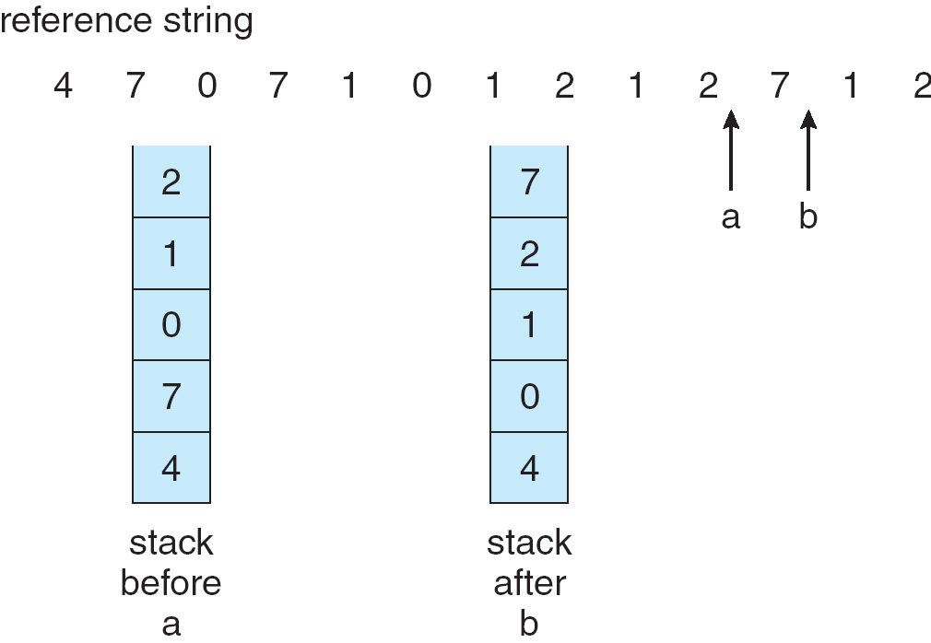
Use of a Stack to Record The Most Recent Page References

Slide 38
LRU Approximation Algorithms
Reference bit
Additional Reference bits
Second Chance 1
Second Chance 1 (clock)
Enhanced Second Chance

Slide 39
Reference Bit
Use of reference bit (R bit)
With each page associate a bit, initially = 0 (not referenced/used)
When page is referenced, bit set to 1
Replace the page which R bit 0 (if one exists)
We do not know the order, however (several pages may have 0 value)
Reference bits are cleared periodically
(with every timer interrupt, for example)
For example: every 10 ms.

Slide 40
Additional Reference Bits
Besides the reference bit (R bit) for each page, we can keep an Additional Reference Bits (lets call it as ARB) field associated with each page. For example, an 8-bit field that can store 8 reference bits.
At each timer interrupt (or periodically) R bit shifted from left into ARB. All other bits shifted right.
The value in the ARB field indicates when the page is accessed approximately.
When a page is to be replaced, select the page with smallest ARB field value.
R bit
ARB field for a page

Slide 41
Additional Reference Bits Example
At tick 1: R: 0, ARB: 0000000
R is set (R:1)
At tick 2: R:0, ARB: 1000000
R is not set
At tick 3: R:0, ARB: 0100000tt
R is set (R:1)
At tick 4: R:0, ARB: 1010000
….
t

Slide 42
Second-Chance Algorithm 1
FIFO that is checking if page is referenced or not; Need R bit
If page to be replaced, look to the FIFO list; remove the page close to head of the list and that has reference bit 0.
If the head has R bit 1, move it to the back of the list (i.e. set the load time to the current time) after clearing the R bit.
Then try to find another page that has 0 as R bit.
May require to change all 1’s to 0’s and then come back to the beginning of the queue.
Add a newly loaded page to the tail with R = 1.
R=1
R=1
R=0
R=0
R=1
R=1
Head
Tail
(Youngest)
(oldest)

Slide 43
Second-Chance Algorithm 1
Head
Example:
1
1
0
0
1
Before page removal
C
A
B
E
D
Access page H
0
1
0
0
1
After page removal
E
D
C
A
H
B is removed

Slide 44
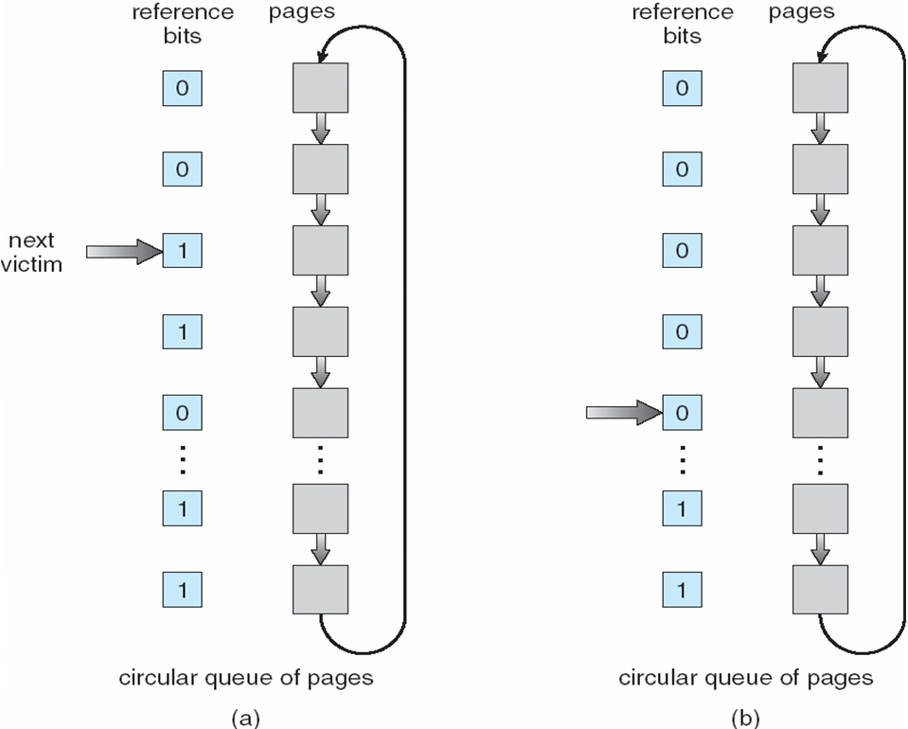
Second-Chance Algorithm 2 (Clock Algorithm)
Second chance can
be implemented using
a circular list of pages;
Then it is also called
Clock algorithm
Next victim pointer

Slide 45
Enhanced Second-Change Algorithm
Consider also the reference bits and the modified bits (dirty bit) of pages
Reference (R) bit: page is referenced in the last interval
Modified (M) bit: page is modified after being loaded into memory
Four possible cases (R,M):
0,0: neither recently used nor modified
0,1: not recently used but modified
1,0: recently used but clean
1,1: recently used and modified
We replace the first page encountered in the lowest non-empty class.
Rest is the same with second-chance algorithm

Slide 46
Counting Algorithms
Keep a counter of the number of references that have been made to each page
LFU Algorithm: replaces page with smallest count
MFU Algorithm: based on the argument that the page with the smallest count was probably just brought in and has yet to be used

Slide 47
Allocation of Frames
Each process needs minimum number of pages
Example: IBM 370 – 6 pages to handle SS MOVE instruction:
instruction is 6 bytes, might span 2 pages
2 pages to handle from
2 pages to handle to
Various allocation approaches
fixed allocation (this is a kind of local allocation)
Equal allocation
Proportional allocation (proportional to the size)
priority allocation (this is a kind of global allocation)
global allocation
local allocation

Slide 48
Fixed Allocation
Equal allocation – For example, if there are 100 frames and 5 processes, give each process 20 frames.
Proportional allocation – Allocate according to the size of process
Example:

Slide 49
Priority Allocation
Use a proportional allocation scheme using priorities rather than size
If process P_{i} generates a page fault,
select for replacement one of its frames
select for replacement a frame from a process with lower priority number

Slide 50
Global versus Local Allocation
When a page fault occurs for a process and we need page replacement, there are two general approaches:
Global replacement – can select a victim frame from the set of all frames;
one process can take a frame from another
Local replacement – can select a victim frame only from the frames allocated to the process.
A process uses always its allocated frames

Slide 51
Thrashing
If a process does not have “enough” pages, the page-fault rate is very high. This leads to:
low CPU utilization
operating system thinks that it needs to increase the degree of multiprogramming
another process added to the system
Thrashing ≡ a process is busy swapping pages in and out

Slide 52
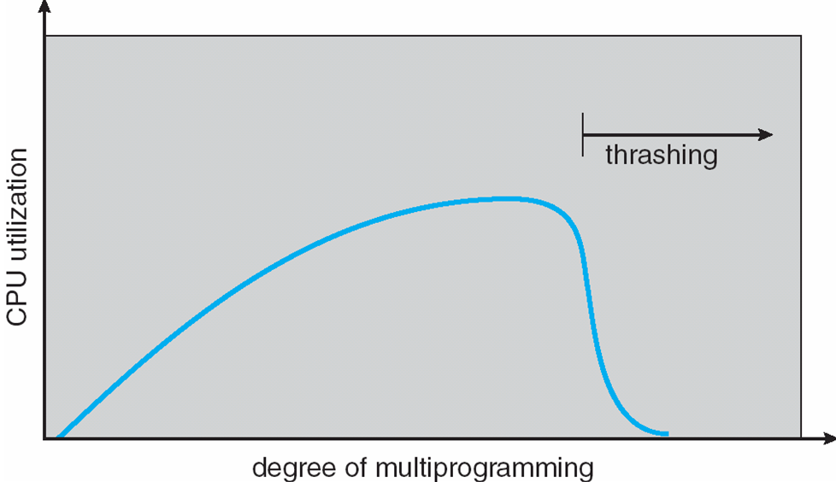
Thrashing (Cont.)

Slide 53
Demand Paging and Thrashing
Why does demand paging work? Locality model (locality of reference)
Process migrates from one locality to another
Localities may overlap
Why does thrashing occur? Σ size of locality > total physical memory size

