Slide 1
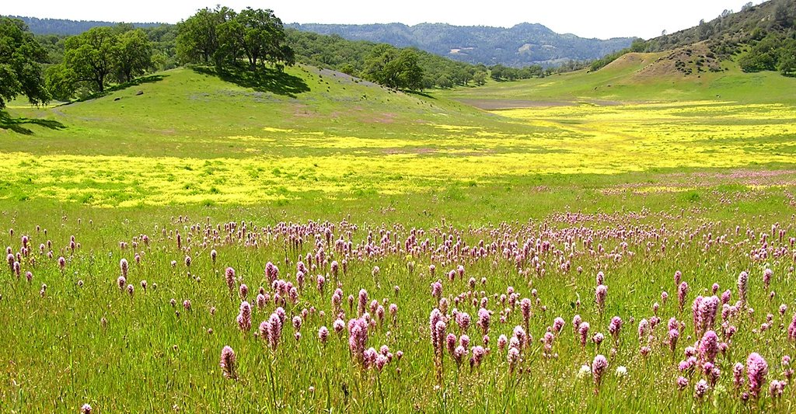
3.7.2 Grassland Ecosystems
A wide range of landscapes in which the vegetation is mainly formed by grasses and small annual plants are adapted to India’s various climatic conditions.
These form a variety of grassland ecosystems with their specific plants and animals.

Slide 2
Grasslands cover areas where rainfall is usually low and/or the soil depth and quality is poor.
The low rainfall prevents the growth of a large number of trees and shrubs, but is sufficient to support the growth of grass cover during the monsoon.

Slide 3
Grassland Types in India:
Grasslands form a variety of ecosystems that are located in different climatic conditions:
1). Shola grasslands : occur on hillslopes alongside the extremely moist evergreen forests.
2). The high cold Himalayan pastures. In the Himalayan mountains there are There are tracts of tall elephant grass in the low-lying.
3).Terai Grassland: south of the Himalayan foothills.
4).The semi-arid grasslands : in Western India, parts of Central India, and in the Deccan Plateau.

Slide 4
Many of the grasses and other small herbs become dry and the part above the ground dies during the summer months.
In the next monsoon the grass cover grows back from the root stock and the seeds of the previous year.
This change gives grasslands a highly seasonal appearance with periods of increased growth followed by a dormant phase.

Slide 5
A variety of grasses, herbs, and several species of insects, birds and mammals have evolved.
These animals are adapted to live in conditions where food is plentiful after the rains, so that they can store this as fat that they use during the dry period when there is very little to eat.
Man began to use these grasslands as pastures to feed his livestock when he began to domesticate animals and became a pastoralist in ancient times.

Slide 6
1). The Himalayan pasture belt
Extends up to the snowline.
The grasslands at a lower level form patches along with Coniferous or broadleaved forests.
The animals migrate up into the high altitude grasslands in summer and move down into the forest in winter when the snow covers the grassland.
These have a large variety of grasses and herbs.
Himalayan hill slopes are covered with thousands of colorful flowering plants.
There are also a large number of medicinal plants.

Slide 7
2). The Terai grassland
Consists of patches of tall grasslands interspersed with a Sal forest ecosystem.
The patches of tall elephant grass, which grows to a height of about 5 meters., are located in the low-lying waterlogged areas.
The Sal forest patches cover the elevated regions and the Himalayan foothills.
The Terai also includes marshes in low-lying depressions.
This ecosystem extends as a belt south of the Himalayan foothills

Slide 8
3). The Semi-arid grassland
SEMI ARID plains of Western India, Central India and the Deccan are covered by grassland tracts with patches of thorn forest.
Several mammals such as the wolf, the blackbuck, the chinkara, and birds such as the bustards and floricans are adapted to these arid conditions.
The Scrublands of the Deccan Plateau are covered with seasonal grasses and herbs on which its fauna is dependent.
It is teaming with insect life on which the insectivorous birds feed.

Slide 9
4). The Shola grasslands
Consist of patches on hill slopes along with the Shola forests on the Western Ghats, Nilgiri and Annamalai ranges.
This forms a patchwork of grassland on the slopes and forest habitats along the streams and low lying areas.
Grasslands are not restricted only to low rainfall areas.
Certain grassland types form when clearings are made in different forest types.

