Slide 1
Orlando Kubernetes Cloud Native Meetup – October 2021
GITOPS WITH K8S AND FLUX

Slide 2
Intros
Mike Thompson – Director of Operations – SightPlan
https://www.linkedin.com/in/mikethompson7/
Chris Nuber – Sr. Solutions Architect / Consulting lead – SUSE RGS
https://www.linkedin.com/in/chris-nuber-2a16853/

Slide 3
SightPlan (our awesome host)
With decades of industry experience, the SightPlan team has an unparalleled understanding of community operations. Through that lens, we develop innovative, affordable solutions to help operators meet today’s challenges and those to come in the future.
https://sightplan.com

Slide 4

SUSE Rancher Gov’t Solutions
SUSE RGS delivers secure and certified open-source and cloud-native software for US Government clients adopting DevSecOps across the IT landscape.
The public sector wing of SUSE (Formerly Rancher Labs)

Slide 5






SUSE Rancher Open Source Projects

Slide 6
Technologies used tonight
Docker – Container runtime
GIT – version control for source code
K3D – Kubernetes (k3s) run in docker containers
FLUX – GitOps tool, keeps running apps in sync with version control
Kustomize – Built into kubectl, think config management for k8s

Slide 7
How does Flux operate?
Operates using a set of controllers running in Kubernetes
Source Controller – given a Git Repo definition, watches repos for updates and pulls in changes
Notification Controller – Event handler, sends notifications to external systems (Teams, Slack, Discord, etc) based on Events from the other controllers
Helm Controller - Watches for creation of or changes in HelmRelease objects and takes action accordingly.
Kustomize Controller - Watches for creation of or changes in Kustomization objects and takes action accordingly.

Slide 8
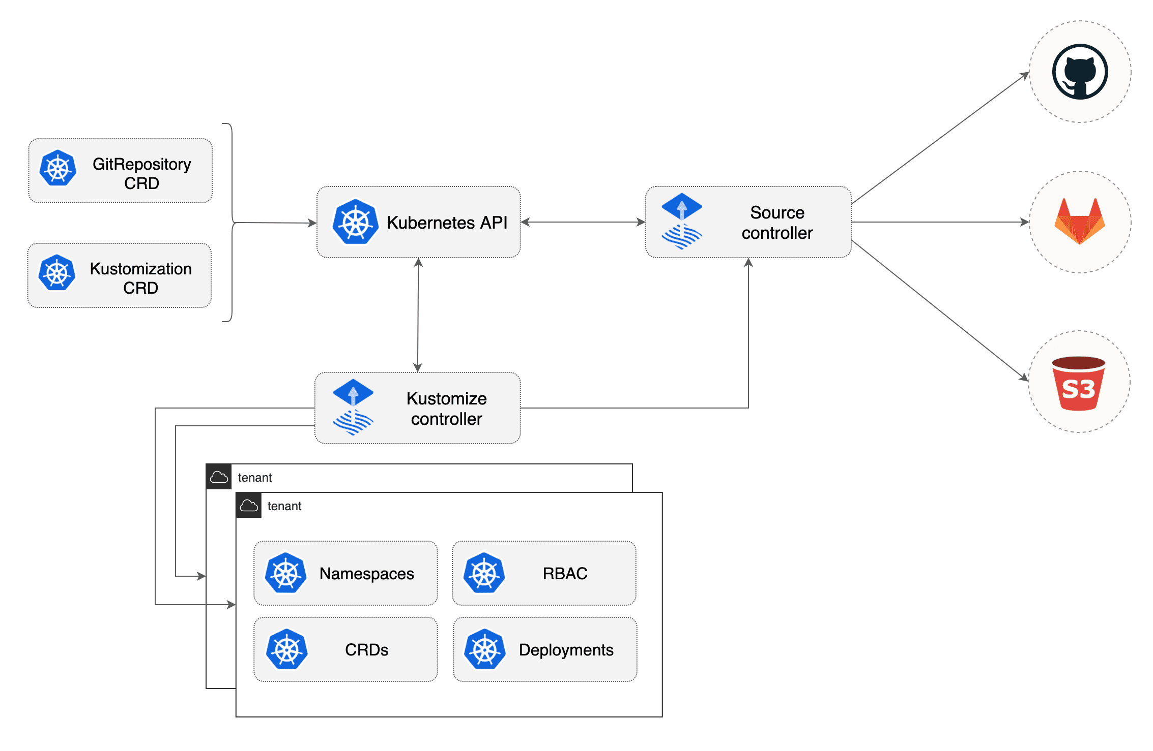
Kustomize Controller

Slide 9
Hands-on Lab What are we doing?
Deploying a Kubernetes cluster using k3d
Installing Flux for gitops
Deploying a GitRepository and Kustomization object
Logging into the application via a browser
Modifying the source code in git for the app and demonstrating the automation performed by Flux.

Slide 10
Helpful links
https://github.com/cnuber/gitops-demo
https://github.com/cnuber/qjs-demo
https://fluxcd.io/docs/ - FluxCD documentation
https://k3d.io – k3d documentation
https://github.com/criticalstack/quake-kube QuakeJS k8s
https://susergs.com – SUSE RGS homepage
https://sightplan.com – SightPlan homepage
https://slack.rancher.io/ - Public Rancher Users slack
https://kubernetes.io/docs/reference/kubectl/cheatsheet/

