Slide 1
Merging algorithms for MetaSearch
U4959060 PengFei Li
Supervisors: Paul Thomas, David Hawking

Slide 2
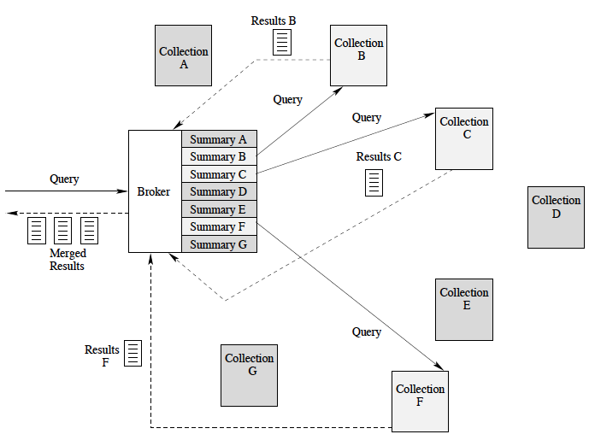
Background
Hidden Web
Distributed Information
Retrieval (Federated Search)
Collection Representation
Collection Selection
Result Merging
Evaluation
Result Merging

Slide 3
Motivation
The Gap
Reality World and TREC
Implementation
Performance Various
Characteristic of ANU Repositories
Multimedia
Multi-Structure
Limited Overlap
Small Scale

Slide 4
Related Work
Score Based
Document Surrogate
Probabilistic Model
SRRs
Title
Snippet
And more…
SRRs as SE Score

Slide 5
Problems
Data Collection
System Architecture
Algorithm Implementation
Evaluation

Slide 6
Plan
Literature Review
Data Collection
Framework Building
Algorithm Implementation
Algorithm Developing
Testing
Evaluation
Writing

