Slide 1
Merging algorithms for MetaSearch
U4959060 PengFei Li
Supervisors: Paul Thomas, David Hawking

Slide 2
Problem
Search information about Paul Thmoas
And More….

Slide 3
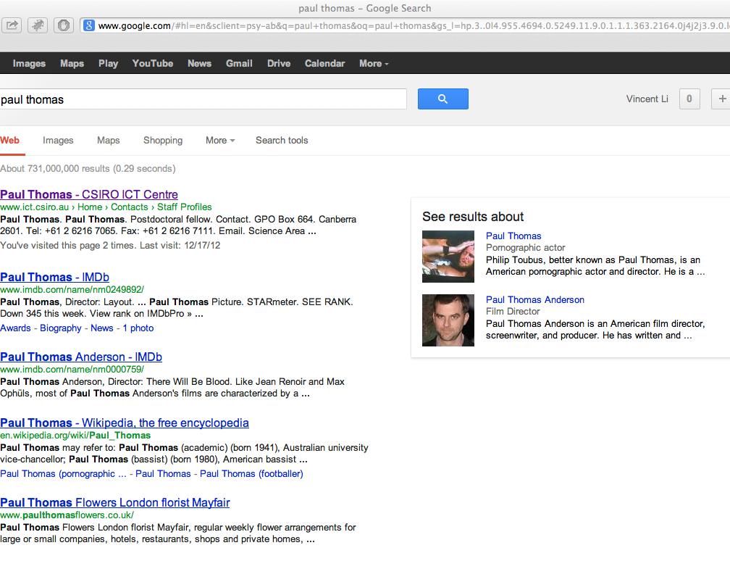
Solution
Google
MetaSearch

Slide 4
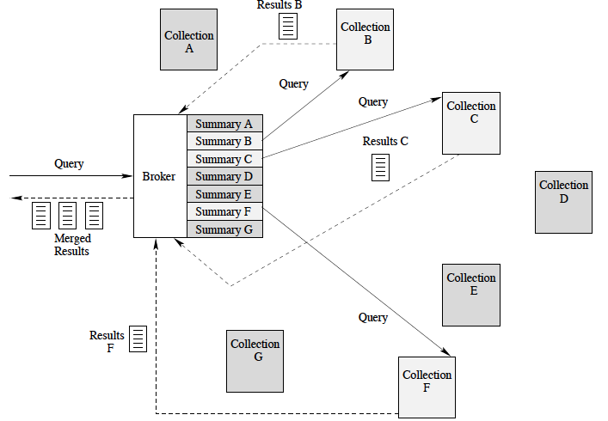
Solution
Architecture of MetaSearch
Notes:
A metasearch engine is a search tool that sends user requests to several other search engines and/or databases and aggregates the results into a single list or displays them according to their source.

Slide 5
Introduction
Data Collection
System Architecture
Algorithm Implementation
Evaluation

Slide 6
Related Work
Score Based （Normalization, Voting）
Document Surrogate
SRRs
Title
Snippet
And more…
SRRs as SE Score
Machine Learning Approaches
Probabilistic Model
Clustering (based on training queries)

Slide 7
Plan
Literature Review
Data Collection
Framework Building
Algorithm Implementation
Algorithm Developing
Testing
Evaluation
Writing

Slide 8
Thank you

