Slide 1
Merging algorithms for MetaSearch
U4959060 PengFei Li
Supervisors: David Hawking, Paul Thomas

Slide 2
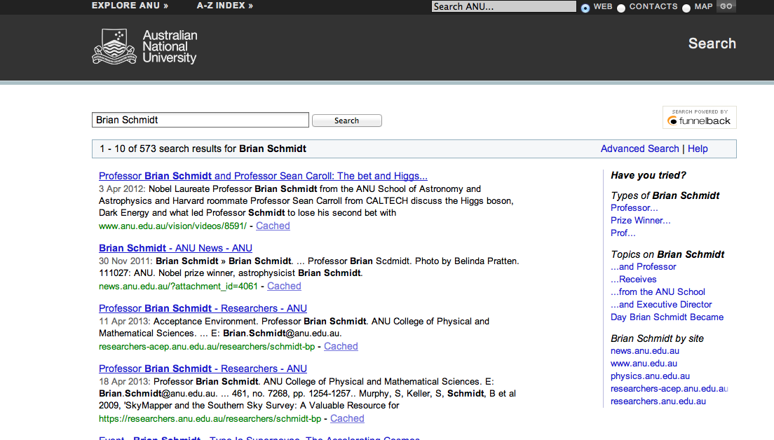
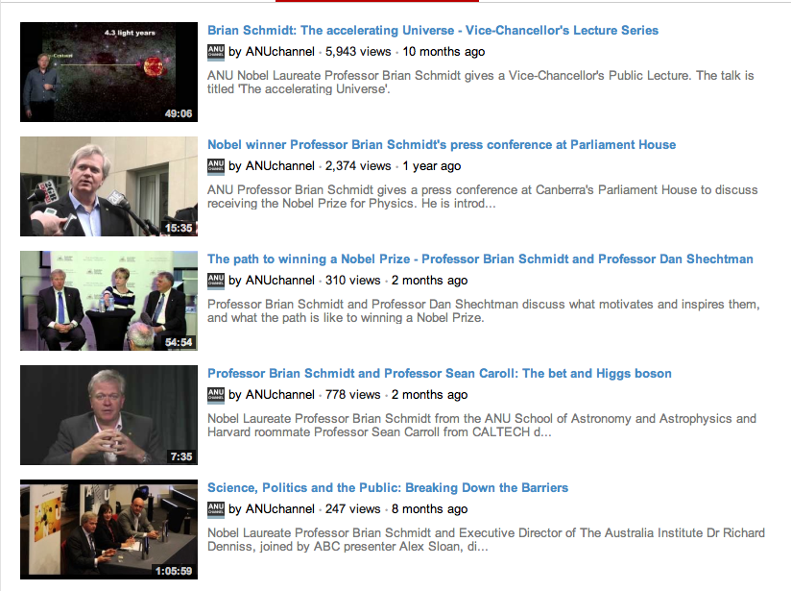
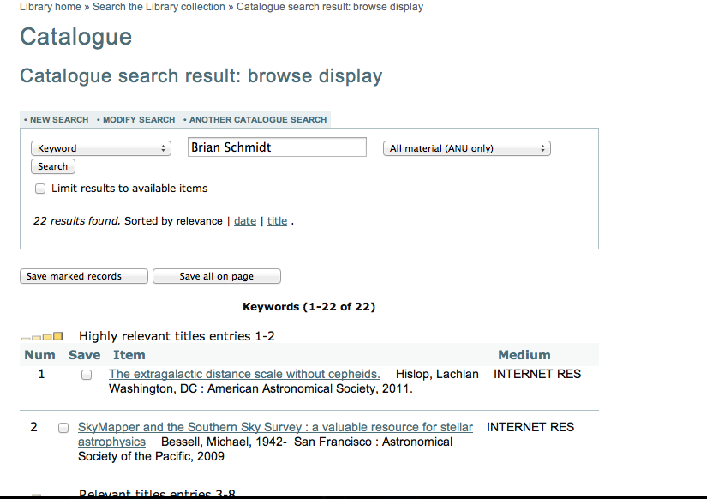
Topic Review
Search Information about the Nobel Prize Winner Brian Schmidt
…

Slide 3
Topic Review
Search Information about the Nobel Prize Winner Brian Schmidt

Slide 4
Topic Review
Search Information about the Nobel Prize Winner Brian Schmidt
Meta-search

Slide 5
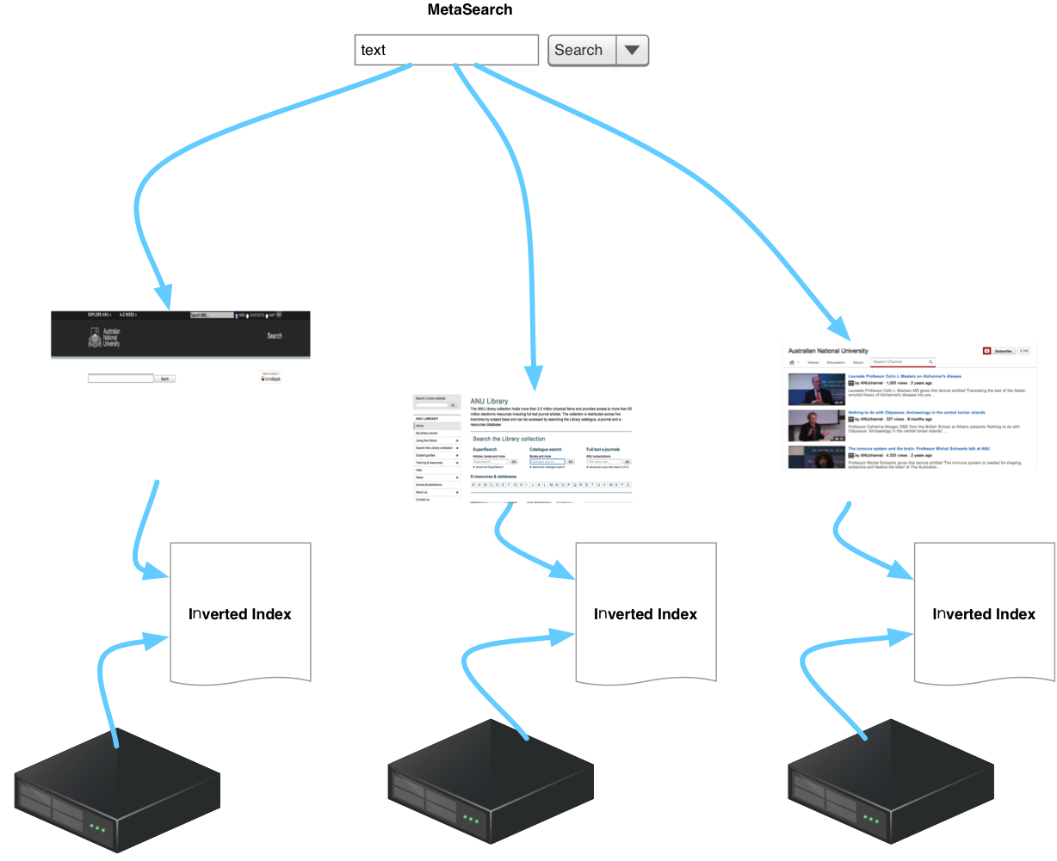
Topic Review

Slide 6
Topic Review
How?

Slide 7
Plan Review
Literature Review ✔
Data Collection ✔
Framework Building ✔
Algorithm Implementation (4 Implemented)
Algorithm Developing
Testing
Evaluation (On going)
Writing (On going)

Slide 8
Previous Works
Aggregated Meta-search
Non-aggregated Meta-search

Slide 9
Previous Works
General Methods
Round-Robin
Raw-Score Algorithms
Original Score
Estimated Score
Collection Weight
Machine Learning Approaches
SSL
Document Distribution
Clustering
Bayes’s theorem.

Slide 10
Previous Works
Aggregated-Meta-Search-Specific Methods
Linear Combination
CombXX (Fox & Shaw 1994)
LC model
Voting Algorithm
Borda-fuse
Condorcet Fusion

Slide 11
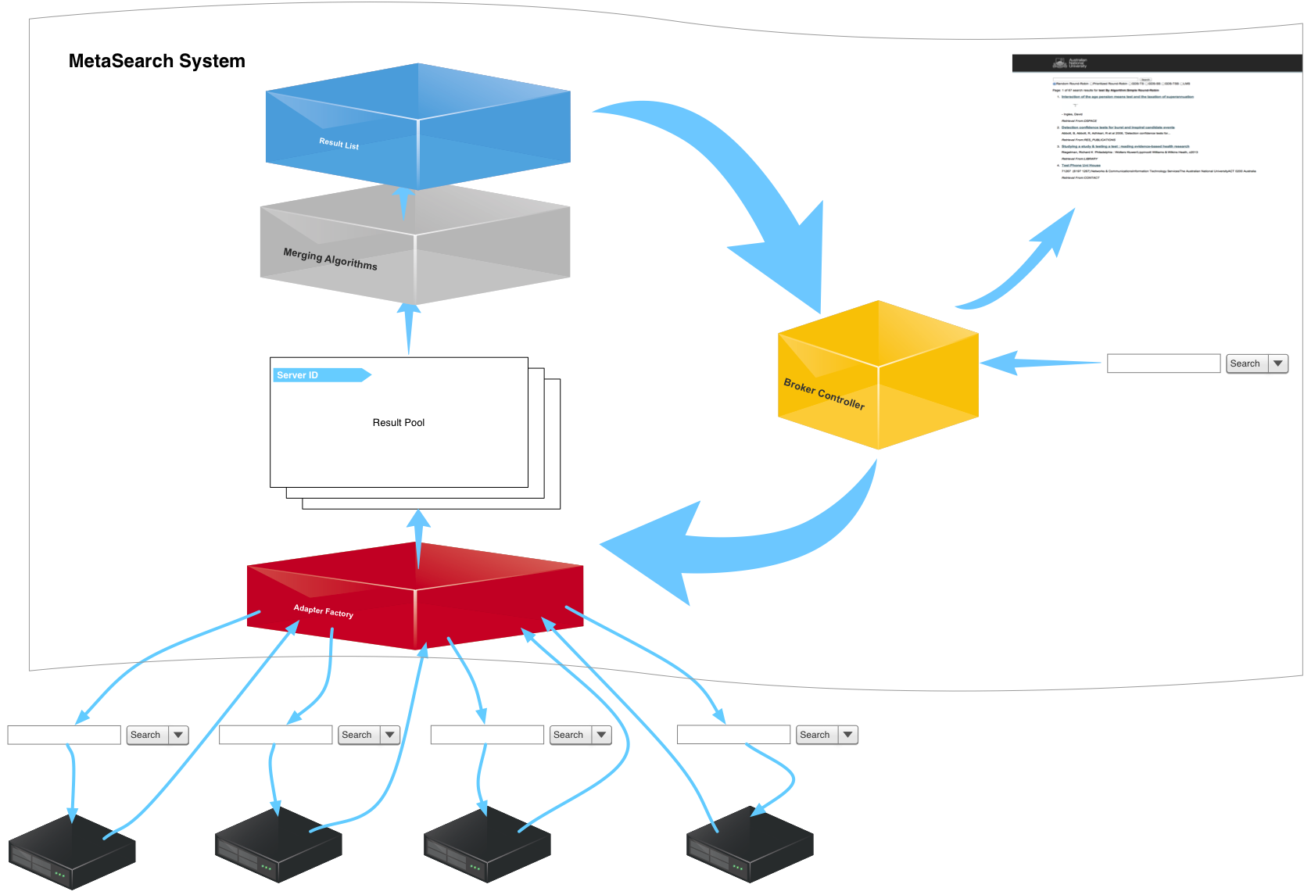
Architecture

Slide 12
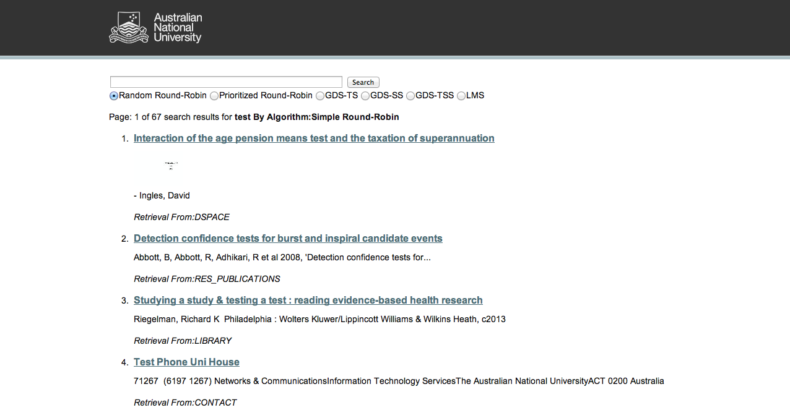

Slide 13

Algorithm Implementation
Round-Robin
Weighted Round-Robin
Generic document score
LMS

Slide 14
Evaluation
Evaluation Methods
Document Score Gathering
Source of Queries
Source of Assessors
Query Allocation
User Interface
Evaluation Process

Slide 15
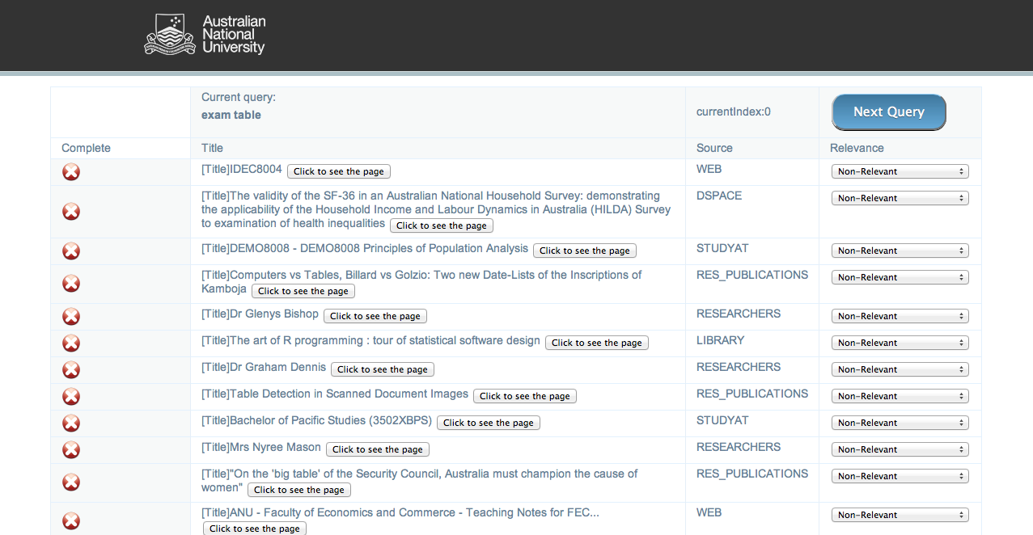
Evaluation
http://relsevaluation.appspot.com

Slide 16
Next Step
Executing Evaluation
Implementing Previous Algorithms
Evaluation cycle
New idea (Extending SSL?)
Thesis Writing

Slide 17
Question?
Thank you!

