Slide 1
Taking a shot at free throws
Analytics Team:
Dipika Kumar
Robert Schroer
Isaac Winters
Chidera Nwaubi

Slide 2
Motivation & Summary
If a team has higher free throw percentage then they will have more wins
Free throws can impact a team’s ability to win

Slide 3
Questions
Do teams that win more games have a higher free throw percentage?
Do teams that win more games have more free throw attempts?
Do teams that win more games make more free throws?
Is there a bias in free throw attempts toward home teams?

Slide 4
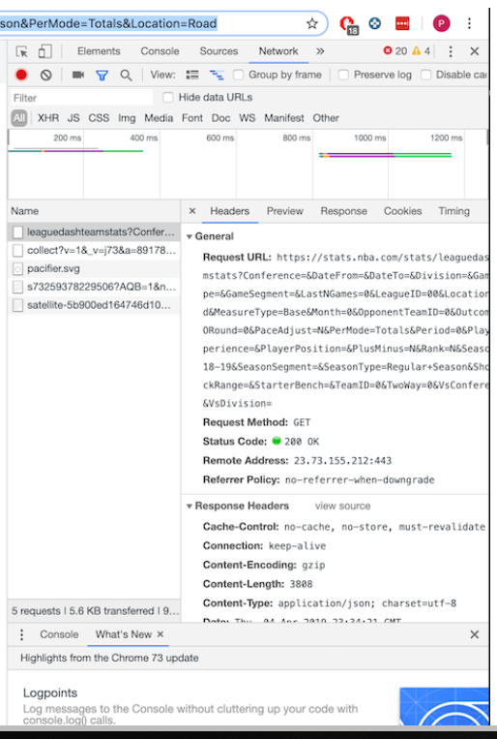
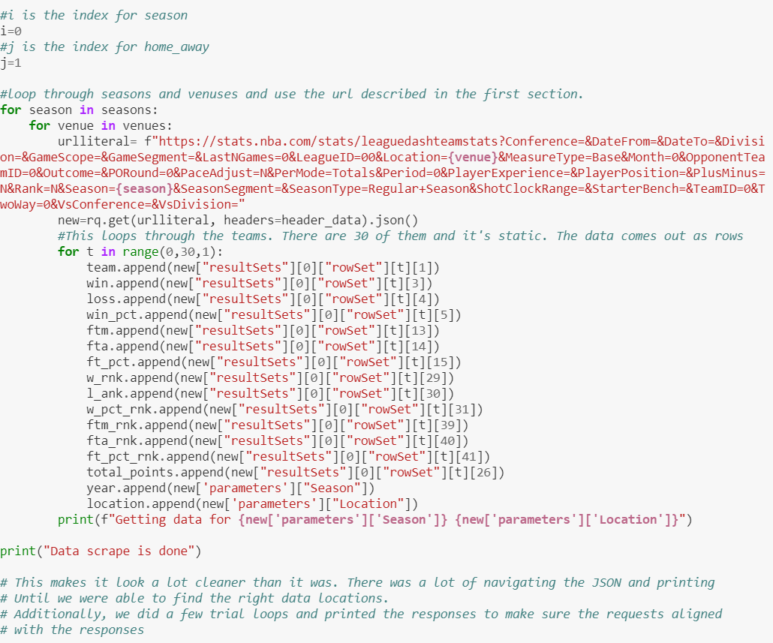
Our Data Source

Slide 5
Data Clean-Up & Exploration
Game venue data
Problem discovery due to rank
Franchise name changes
More than 30 teams

Slide 6
Data Analysis

Slide 7
Data Analysis (Cont.)

Slide 8
Data Analysis (Cont.)

Slide 9
Data Analysis (Cont.)

Slide 10
Data Analysis (Cont.)

Slide 11
Data Analysis (Cont.)

Slide 12
Data Analysis (Cont.)

Slide 13
Findings
Better free throw shooting teams tend to have more wins
Yes there is a home court bias but it is not a large one

Slide 14
Post Mortem
Does more points equal more wins
Obtain individual game data pool
Free throw attempts home vs away based on the point differential for the game

Slide 15
Audience q&A

