Slide 1
ITECH7409: Software Testing
Unit Testing

Slide 2
Last lecture
Test planning
Test engineers & test managers
Reviews
Static testing
Dynamic testing
White box testing
Flow charts to decide test cases

Slide 3
This lecture
Unit testing
White-box testing
Black-box testing

Slide 4
Test cases
Plainly speaking – how hard it is to find faults in the software?
Testability is determined by two practical problems
How to provide the test values to the software
How to observe the results of test execution
Test cases relate to their environments. In a batch system, it is usually clear what comprises a test case. For Web applications, test cases can vary from generating part of a Web page to a test case that completes several commercial transactions. In a real-time system, such as in avionics, a test case could involve an entire flight.
Unit testing

Slide 5
Dynamic unit testing: White box testing
A good test has a high probability of finding an error
The tester must understand the software and how it might fail
A good test is not redundant
Testing time is limited; one test should not serve the same purpose as another test
A good test should be “best of breed”
Tests that have the highest likelihood of uncovering a whole class of errors should be used
A good test should be neither too simple nor too complex
Each test should be executed separately; combining a series of tests could cause side effects and mask certain errors

Slide 6
Dynamic unit testing: White box testing
Statement Testing (Algebraic Testing): Test single statements
Loop Testing:
Cause execution of the loop to be skipped completely. (Exception: Repeat loops)
Loop to be executed exactly once
Loop to be executed more than once
Path testing:
Make sure all paths in the program are executed
Branch Testing (Conditional Testing): Make sure that each possible outcome from a condition is tested at least once

Slide 7
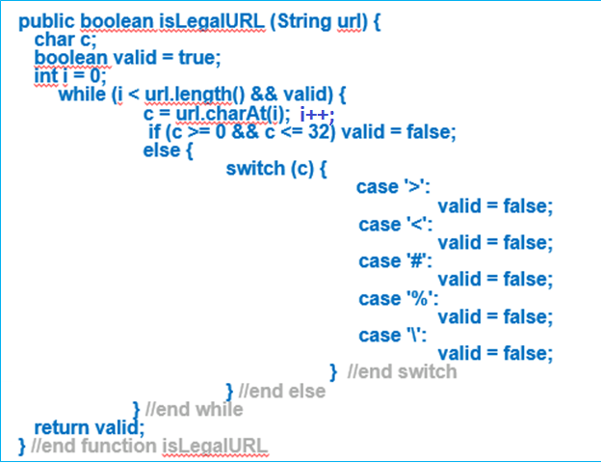
Start
Get user String
Set valid = true and i = 0
Yes
Test url.length > 0 and valid=true
No
Set c to char at index i, i++
Test String is >,<,#,%,\
No
c has value between 0 and 32
Yes
Set valid = false
End
Yes

Slide 8
Start
Possible Tests:
Input a variety of String inputs
null
“”
Strings containing non-valid characters such as ©, £, ¥
Strings containing >
Strings containing <
Strings containing #
Strings containing %
Strings containing \
Valid URL addresses
Get user String
Set valid = true and i = 0
Can you suggest any other possible tests?
Test url.length > 0 and valid=true
No
Set c to char at index i, i++
Test String is >,<,#,%,\
No
c has value between 0 and 32
Yes
Set valid = false
End
Yes

Slide 9
Dynamic unit testing: White box testing
FindMean (FILE ScoreFile)
{ float SumOfScores = 0.0;
int NumberOfScores = 0;
float Mean=0.0; float Score;
Read(ScoreFile, Score);
while (! EOF(ScoreFile) {
if (Score > 0.0 ) {
SumOfScores = SumOfScores + Score;
NumberOfScores++;
}
Read(ScoreFile, Score);
}
/* Compute the mean and print the result */
if (NumberOfScores > 0) {
Mean = SumOfScores / NumberOfScores;
printf(“ The mean score is %f\n”, Mean);
} else
printf (“No scores found in file\n”);
}

Slide 10
White box testing: identify steps
FindMean (FILE ScoreFile)
{ float SumOfScores = 0.0;
int NumberOfScores = 0;
float Mean=0.0; float Score;
Read(ScoreFile, Score);
while (! EOF(ScoreFile) {
if (Score > 0.0 ) {
SumOfScores = SumOfScores + Score;
NumberOfScores++;
}
Read(ScoreFile, Score);
}
/* Compute the mean and print the result */
if (NumberOfScores > 0) {
Mean = SumOfScores / NumberOfScores;
printf(“ The mean score is %f\n”, Mean);
} else
printf (“No scores found in file\n”);
}
1
2
3
4
5
6
7
8
9

Slide 11
Dynamic unit testing: White box testing

Slide 12
Deciding test cases
Start
1
a (Covered by any data)
2
b
(Data set must contain at least
one value)
(Positive score)
d
3
e
(Negative score)
c
4
5
(Data set must
h
(Reached if either f or
be empty)
f
g
6
e is reached)
7
j
(Total score < 0.0)
i
(Total score > 0.0)
8
9
k
l
Exit
Exit
Unit testing

Slide 13
Dynamic unit testing: White box testing
Uses the control structure part of component-level design to derive the test cases
These test cases
Guarantee that all independent paths within a module have been exercised at least once
Exercise all logical decisions on their true and false sides
Execute all loops at their boundaries and within their operational bounds
Exercise internal data structures to ensure their validity

Slide 14
Basis Path Testing
Basis Path Testing is a white-box testing technique proposed by Tom McCabe. It uses flow graph notation
Enables the test case designer to derive a logical complexity measure of a procedural design
Uses this measure as a guide for defining a basis set of execution paths
Test cases derived to exercise the basis set are guaranteed to execute every statement in the program at least one time during testing.

Slide 15
Flow graph notation
A circle in a graph represents a node, which stands for a sequence of one or more procedural statements
A node containing a simple conditional expression is referred to as a predicate node
Each compound condition in a conditional expression containing one or more Boolean operators (e.g., and, or) is represented by a separate predicate node
A predicate node has two edges leading out from it (True and False)

Slide 16
Flow graph notation
An edge, or a link, is a an arrow representing flow of control in a specific direction
An edge must start and terminate at a node
An edge does not intersect or cross over another edge
Areas bounded by a set of edges and nodes are called regions
When counting regions, include the area outside the graph as a region, too.

Slide 17
Flow graph
Software Artifact : Java Method
/**
* Return index of node n at the
* first position it appears,
* -1 if it is not present
*/
public int indexOf (Node n)
{
for (int i=0; i < path.size(); i++)
if (path.get(i).equals(n))
return i;
return -1;
}
Flow Graph
1
i = 0
2
i < path.size()
3
if
5
4
return -1
return i

Slide 18
Flow graph
Graph
Abstract version
Edges
1 2
2 3
3 2
3 4
2 5
Initial Node: 1
Final Nodes: 4, 5
6 requirements for Edge-Pair Coverage 1. [1, 2, 3] 2. [1, 2, 5] 3. [2, 3, 4] 4. [2, 3, 2] 5. [3, 2, 3] 6. [3, 2, 5]
1
2
3
Test Paths
[1, 2, 5]
[1, 2, 3, 2, 5]
[1, 2, 3, 2, 3, 4]
5
4

Slide 19
Flow Graph Example
FLOW CHART
FLOW GRAPH
0
0
R4
1
1
2
2
3
R3
3
6
4
6
4
R2
7
8
5
R1
7
8
5
9
9
11
10
11
10

Slide 20
Independent program paths
Defined as a path through the program from the start node until the end node that introduces at least one new set of processing statements or a new condition (i.e., new nodes)
Must move along at least one edge that has not been traversed before by a previous path
Basis set for flow graph on previous slide
Path 1: 0-1-11
Path 2: 0-1-2-3-4-5-10-1-11
Path 3: 0-1-2-3-6-8-9-10-1-11
Path 4: 0-1-2-3-6-7-9-10-1-11
The number of paths in the basis set is determined by the cyclomatic complexity

Slide 21
Cyclomatic complexity
Provides a quantitative measure of the logical complexity of a program
Defines the number of independent paths in the basis set
Provides an upper bound for the number of tests that must be conducted to ensure all statements have been executed at least once
Can be computed three ways
The number of regions
V(G) = E – N + 2, where E is the number of edges and N is the number of nodes in graph G
V(G) = P + 1, where P is the number of predicate nodes in the flow graph G
Results in the following equations for the example flow graph
Number of regions = 4
V(G) = 14 edges – 12 nodes + 2 = 4
V(G) = 3 predicate nodes + 1 = 4

Slide 22
Deriving the Basis Set and Test Cases
Using the design or code as a foundation, draw a corresponding flow graph
Determine the cyclomatic complexity of the resultant flow graph
Determine a basis set of linearly independent paths
Prepare test cases that will force execution of each path in the basis set

Slide 23
Flow Graph example
1 int functionZ(int y)
2 {
3 int x = 0;
4 while (x <= (y * y))
5 {
6 if ((x % 11 == 0) &&
7 (x % y == 0))
8 {
9 printf(“%d”, x);
10 x++;
11 } // End if
12 else if ((x % 7 == 0) ||
13 (x % y == 1))
14 {
15 printf(“%d”, y);
16 x = x + 2;
} // End else
18 printf(“\n”);
19 } // End while
20 printf("End of list\n");
21 return 0;
22 } // End functionZ

Slide 24
Flow Graph example
1 int functionZ(int y)
2 {
3 int x = 0;
4 while (x <= (y * y))
5 {
6 if ((x % 11 == 0) &&
7 (x % y == 0))
8 {
9 printf(“%d”, x);
10 x++;
11 } // End if
12 else if ((x % 7 == 0) ||
13 (x % y == 1))
14 {
15 printf(“%d”, y);
16 x = x + 2;
} // End else
18 printf(“\n”);
19 } // End while
20 printf("End of list\n");
21 return 0;
22 } // End functionZ
3
4
6
7
9
12
13
10
15
16
18
20
21

Slide 25
Deriving the Basis Set and Test Cases
Using the design or code as a foundation, draw a corresponding flow graph
Determine the cyclomatic complexity of the resultant flow graph
Determine a basis set of linearly independent paths
Prepare test cases that will force execution of each path in the basis set

Slide 26
Flow Graph example
Edges Initial Node: 3
Final Node: 21
3 4
4 6
4 20
6 7
6 12
7 9
7 12
9 10
10 18
12 13
12 15
13 15
13 18
15 16
16 18
18 4
20 21
3
4
6
7
9
12
13
10
15
17 edge pairs
16
18
20
21

Slide 27
Flow Graph example
Edges Initial Node: 3
Final Node: 21
3 4
4 6
4 20
6 7
6 12
7 9
7 12
9 10
10 18
12 13
12 15
13 15
13 18
15 16
16 18
18 4
20 21
3
4
R5
R6
6
7
R4
9
12
13
R2
R3
10
15
R1
17 edge pairs
16
18
20
6 regions
21

Slide 28
Cyclomatic complexity
3
4
R5
13 nodes:
3, 4, 6, 7, 9, 10, 12, 13, 15, 16, 18, 20, 21
R6
6
7
R4
9
12
13
R2
R3
10
5 predicate nodes: 4, 6, 7, 12, 13
15
R1
16
18
20
21

Slide 29
Cyclomatic complexity
3
Can be computed three ways
The number of regions
V(G) = E – N + 2, where E is the number of edges and N is the number of nodes in graph G
V(G) = P + 1, where P is the number of predicate nodes in the flow graph G
Results in the following equations for the example flow graph
Number of regions = 6
V(G) = 17 edges – 13 nodes + 2 = 6
V(G) = 5 predicate nodes + 1 = 6
R6
4
R5
6
7
R4
9
12
13
R2
R3
10
15
R1
16
18
20
21

Slide 30
Loop testing
A white-box testing technique that focuses exclusively on the validity of loop constructs
Four different classes of loops exist
Simple loops
Nested loops
Concatenated loops
Unstructured loops
Testing occurs by varying the loop boundary values
Example: for (i = 0; i < MAX_INDEX; i++) while (currentTemp >= MINIMUM_TEMPERATURE)

Slide 31
Loop testing
Concatenated
Loops
Unstructured Loops
[Pressman]
Simple
loop
Nested
Loops
Unit Testing
Reference: Pressman, R. Software Engineering: A Practitioner’s Approach. McGraw-Hill, 2005

Slide 32
Testing of simple loops
Skip the loop entirely
Only one pass through the loop
Two passes through the loop
m passes through the loop, where m < n
n –1, n, n + 1 passes through the loop
‘n’ is the maximum number of allowable passes through the loop

Slide 33
Testing of nested loops
Start at the innermost loop; set all other loops to minimum values
Conduct simple loop tests for the innermost loop while holding the outer loops at their minimum iteration parameter values; add other tests for out-of-range or excluded values
Work outward, conducting tests for the next loop, but keeping all other outer loops at minimum values and other nested loops to “typical” values
Continue until all loops have been tested

Slide 34
Testing of concatenated loops
For independent loops, use the same approach as for simple loops
Otherwise, use the approach applied for nested loops
Testing of unstructured loops
Redesign the code to reflect the use of structured programming practices
Depending on the resultant design, apply testing for simple loops, nested loops, or concatenated loops

Slide 35
Loop testing
For loops, termination verification:
Try to find invariants that guarantee termination:
e.g., show for some loop variable
Its value decreases with every round,
the value domain for this variable is well founded – no infinite descending chains.
x’ = x – i, where x’ is value in next loop round, i > 0,
x range over natural numbers.
For loops, test repetition of:
-0,
- 1,
representative number of times;
max number (if exists) of times.

Slide 36
Black-box testing
Complements white-box testing by uncovering different classes of errors
Focuses on the functional requirements and the information domain of the software
Used during the later stages of testing after white box testing has been performed
The tester identifies a set of input conditions that will fully exercise all functional requirements for a program
The test cases satisfy the following:
Reduce, by a count greater than one, the number of additional test cases that must be designed to achieve reasonable testing
Tell us something about the presence or absence of classes of errors, rather than an error associated only with the specific task at hand

Slide 37
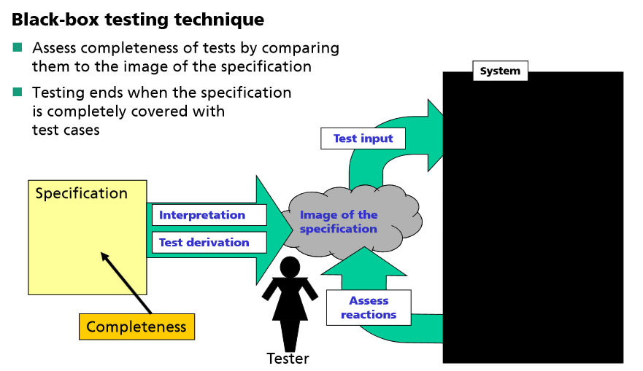
White box testing is conducted by developer who has a technical view of the source code. Black box testing is done by test engineers with end-user perception.

Slide 38
Dynamic unit testing: Black box testing
Black-box testing
Knowing the specified function that a product has been designed to perform, test to see if that function is fully operational and error free
Includes tests that are conducted at the software interface
Not concerned with internal logical structure of the software
Categories
Incorrect or missing functions
Interface errors
Errors in data structures or external data base access
Behavior or performance errors
Initialization and termination errors

Slide 39
Questions answered by Black-box testing
How is functional validity tested?
How are system behavior and performance tested?
What classes of input will make good test cases?
Is the system particularly sensitive to certain input values?
How are the boundary values of a data class isolated?
What data rates and data volume can the system tolerate?
What effect will specific combinations of data have on system operation?

Slide 40
Equivalence partitioning
In black-box testing, it can be difficult to decide how many tests are enough to cover all aspects of the system.
Ideally, it is hoped that a single (or at worst a few) test cases will single-handedly uncovers a complete class of errors. Any approach that could find such test cases would reduce the total number of test cases to be developed.
The equivalence partitioning method has been designed to reduce the number of test cases necessary to cover the test domain.

Slide 41
Equivalence partitioning
Input data and output results often fall into different classes where all members of a class are related.
Each of these classes is an equivalence partition or domain where the program behaves in an equivalent way for each class member.
Test cases should be chosen from each partition.
Thoroughly test all input options described in the specifications, in all combinations
including that of same input as standard input and as file input, if that is an option.
Test boundaries of input
Test boundaries of output
Test each invalid input

Slide 42
Equivalence partitioning
Equivalence partitioning divides the input domain of a program into classes of data from which test cases are derived. The resulting groups are known as equivalence classes for an input condition. Test cases are derived from these classes.
An equivalence class represents a set of valid or invalid states for input conditions.
Example: valid input for a system is an integer representing a month of the year, i.e. 1 to 12 are valid integers.
valid input
1 12

Slide 43
Equivalence partitioning
Testing guidelines for sequences:
Test software with sequences which have only a single value.
Use sequences of different sizes in different tests.
Derive tests so that the first, middle and last elements of the sequence are accessed.
Test with sequences of zero length.
Test with sequences of maximal length or nesting – if exists.

Slide 44
Equivalence partitioning
From each equivalence class, test cases are selected so that the largest number of attributes of an equivalence class are exercise at once.
For non-valid inputs, there are two equivalence classes and valid inputs there is one.
Non valid inputs
Non valid inputs
1 12
valid inputs
Do you need to test 1, 2, 3, 4, 5,6,7, 8, 9, 10, 11 and 12 for valid inputs?

Slide 45
Equivalence partitioning
Rules for constructing equivalence classes: (“Myers: The art of software testing, John Wiley & Sons, New York, 1979”)
1.If an input condition specifies a value range, one valid and two invalid equivalence classes are to be formed
2.If an input condition specifies a number of values, one valid and two invalid equivalence classes are to be formed

Slide 46
Equivalence partitioning
Derive test cases regarding valid equivalence classes by selecting test data from as many valid equivalence classes as possible. This reduces number of test cases regarding valid equivalence classes to a minimum
Derive test cases regarding invalid equivalence classes by combining test data from exactly one invalid equivalence class with test data from valid equivalence classes. When using two or more invalid input values at the same time, be sure to know which value caused the error handling to be processed.

Slide 47
Guidelines for Equivalence partitioning
If an input condition specifies a range, one valid and two invalid equivalence classes are defined
Input range: 1 – 10 Eq classes: {1..10}, {x < 1}, {x > 10}
If an input condition requires a specific value, one valid and two invalid equivalence classes are defined
Input value: 250 Eq classes: {250}, {x < 250}, {x > 250}
If an input condition specifies a member of a set, one valid and one invalid equivalence class are defined
Input set: {-2.5, 7.3, 8.4} Eq classes: {-2.5, 7.3, 8.4}, {any other x}
If an input condition is a Boolean value, one valid and one invalid class are define
Input: {true condition} Eq classes: {true condition}, {false condition}

Slide 48
Equivalence partitioning
Example –Specification
A routine of a booking system computes invoices from private and business customers. For computing, the system requires the customer ID, the invoice amount, and the receipt of payment. Invoice amount and receipt of payment are positive numbers (minimum is one) without leading zeros, limited to six digits. Customer IDs start with a “P” for private or a “B” for business customers. The routine produces true, if the receipt of payment is equal to or greater than the invoice amount. The routine produces false, if the receipt of payment is less than the invoice amount.

Slide 49
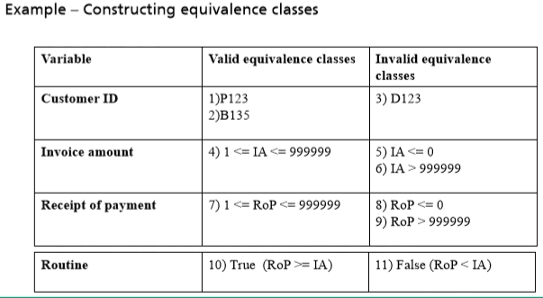

Slide 50
Boundary value analysis
A greater number of errors occur at the boundaries of the input domain rather than in the "center“
Boundary value analysis is a test case design method that complements equivalence partitioning
It selects test cases at the edges of a class
It derives test cases from both the input domain and output domain

Slide 51
Guidelines for Boundary value analysis
1. If an input condition specifies a range bounded by values a and b, test cases should be designed with values a and b as well as values just above and just below a and b
2. If an input condition specifies a number of values, test case should be developed that exercise the minimum and maximum numbers. Values just above and just below the minimum and maximum are also tested
Apply guidelines 1 and 2 to output conditions; produce output that reflects the minimum and the maximum values expected; also test the values just below and just above
If internal program data structures have prescribed boundaries (e.g., an array), design a test case to exercise the data structure at its minimum and maximum boundaries

Slide 52
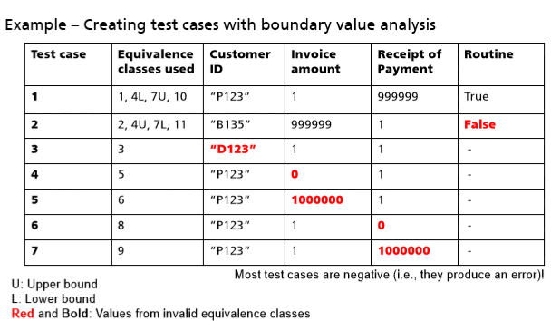

Slide 53
Unit testing
Static Analysis:
Hand execution: Reading the source code
Walk-Through (informal presentation to others)
Code Inspection (formal presentation to others)
Dynamic Analysis:
White-box testing (Test the internal logic of the subsystem or object)
Black-box testing (Test the input/output behavior)
Data-structure based testing (Data types determine test cases)

Slide 54
References
Ammann & Offutt (2008). Introduction to Software Testing
Damodar, C.(2012). Software Testing. Available http://SoftwareTestingHelp.com
Dennis, Wixom & Tegarden (2015). Systems Analysis & Design, An Object-Oriented Approach with UML
Fraunhofer IESE. Online testing tutorial from wwwagse.informatik.uni-kl.de/teaching/p.../Testing-tutorial_2011.pdf
ISTQB (2015). Examination materials from http://istqbexamcertification.com/
Pressman, R. (2005). Software Engineering: A Practitioner’s Approach. McGraw Hill.
Sommerville (1996). Software Engineering, 5th ed. Addison-Wesley Publishers.

