Slide 1

Ética: Fundación de las Comunidades Universitarias y de Ingeniería
Sponsored by the
Social, Ethical, and Global Issues (SEGI) in Engineering Program
Dr. Luis O. Jiménez Rodríguez
Dr. Christopher Papadopoulos
(With some small elaborations by Dr. William Frey)

Slide 2
Outline
Ethics
Problem-Solving
Practice in Problem-Solving
Code of Ethics
Engineering Ethics Jeopardy

Slide 3
I. Ética
Definición de ética
Distinción de ética y ley
Analogía: ética y diseño
Tres Preguntas de evaluar opciones de ética
Practica: 4 escenarios de ética

Slide 4
Pero … ¿Qué es la Ética?

Slide 5
Definir la ética
Ética: “Disciplina filosófica que estudia racionalmente la conducta humana desde un punto de vista de los deberes y virtudes morales”. (Ferrer, p. 26)
Reflexiona sobre los deberes (normas), consecuencias de nuestros actos y virtudes que construyen nuestro ethos.
Notes:
Primary point: ethics is about reflecting on our behavior and the world that we want to create (ethos). The image of the community is demonstrative.

Slide 6
Relativism
Formal Definition
“The ethical theory that denies the existence of universal moral truths and proposes that right and wrong must be defined variously, based on differences in cultural norms and mores.
What is morally right is “relative to” one’s society and time in history, not absolute across time and cultures”
Cultural and Individual Relativism
One places cultural beliefs beyond criticism, the other individual beliefs
Gregory Pence. (2000). A Dictionary of Common Philosophical Terms. McGraw-Hill”19

Slide 7
Relativism
People mistake it for tolerance and empathy
We should project ourselves imaginatively into the perspectives of others
But relativism denies a moral standpoint so that we would lose ourselves in the thoughts and emotions of others
In its bad sense, relativism provides an excuse for not opposing evil and for not standing up for moral principle
Is the rightness of slavery a matter of individual or cultural belief?
Was Hitler merely doing what was right for him when he sent millions to their death in gas chambers?
It hardly seems possible that Hitler’s victims were able to pursue their good (=autonomy) when Hitler gained the power to realize his good (=killing non Aryans).
Relativism thus tries to evade moral conflict. But we must learn to work through moral conflict morally

Slide 8
Ethics and the Law
Law: “Society’s attempt to formalize into written rules the public’s ideas about what constitutes right and wrong conduct in various spheres of life.”
Weber and Lawrence. (2011). Business and Society. McGraw-Hill: 561
Difference comes down to two points:
Ethics provides a standpoint from which to criticize and refine law
Law deals, mostly, with minimally acceptable conduct. Ethics starts there but, through virtue ethics, also treats exemplary conduct

Slide 9
Problem-Solving in Engineering Ethics

Slide 10
Analogy between design and ethics problems
Design Problem | Ethics Problem
Construct a prototype that realizes designated specifications | Construct a solution that realizes ethical values (justice, responsibility, reasonableness, respect, and safety)
Conflicts between specifications are resolved through integration of specifications | Resolve conflicts between values (moral vs. moral or moral vs. non-moral) by integration
Prototype must be implemented over background constraints | Ethical solution must be implemented over resource, interest, and technical constraints

Slide 11
Problem-solving in engineering
Problem Specification
Be as clear as possible about your problem
Solution Generation
Solutions are not found but made
Solution Testing
Is solution (1) Reversible, (2) Harm-minimizing, (3) acceptable when made public, and (4) code-friendly?
Solution Implementation
Design work arounds for resource, interest, and technical constraints

Slide 12
Solution Testing
See how your solutions stand up to three ethics tests, the code test, and a feasibility test

Slide 13
Tres pruebas para evaluar opciones o soluciones a problemas éticos: 1. Daño 2. Reversibilidad 3. Publicidad
Notes:
Will run through the questions quickly and apply them later when we do examples.

Slide 14
Prueba 1: Daño Ética de las Consecuencias
¿Hay algún daño? ¿Hace menor daño que las alternativas?
¿Es el remedio peor que la enfermedad?
¿Cuáles son los posibles daños si falla la integridad académica o profesional?
“does this option do less harm than
alternatives?”
Notes:
Luis

Slide 15
Prueba 2: Reversibilidad Ética del Deber y Derechos
¿Pensaría que es una buena opción si yo estuviera entre los afectados?
“Ponerse en los zapatos de los otros”
Ejemplo:
Compañeros
Profesores
Futuro cliente,
Futuro jefe,
Futuro subalterno,
Futuro colega,
Asociación profesional
Sociedad
“would I still think choice of this option good if I were adversely affected by it?”
Notes:
Luis

Slide 16
Prueba 3: Publicidad Ética de las Virtudes
¿Quisiera o me preocuparía que esta opción fuese dada a conocer en Internet?
“Ojos que no ven, corazón que no siente”
¿Qué pasaría si se enteraran …?
Comunidad universitaria
Futuros clientes o potenciales empleadores.
Asociaciones profesionales, IEEE, Colegio de Ingenieros
Familiares
El Gobierno
“would I want my choice of this option published in the newspaper?”
Notes:
Luis

Slide 17
Add a Code Test
1. Engineer to Public
Does the solution hold paramount public health, safety and welfare?
2. Engineer to Client
Does the solution maintain faithful agency?
3. Engineer to Profession
Does the solution uphold the integrity and honor of
the profession?
4. Engineer to Engineer
Does the solution maintain collegiality?

Slide 18
Make a Solution Evaluation Matrix
Solution / Test | Reversibility Test | Harm Test | Publicity Test | Code Test | Global Feasibility Test
Description | “would I still think choice of this option good if I were adversely affected by it?” | “does this option do less harm than alternatives?” | “would I want my choice of this option published in the newspaper?” | Does the solution present any major code violations? | What obstacles arise that could prevent the implementation of this solution?
Solution 1
Solution 2

Slide 19
Practice ethical problem-solving
Read the scenario
Compare the solutions
Use the tests

Slide 20
An inspector discovered faulty construction equipment and applied a violation tag preventing its continued use. The inspector’s supervisor, viewing the infraction to be minor, ordered the tag removed so the project would not be delayed. The inspector objected and was threatened with disciplinary action.
a. Does this scenario raise an ethical issue?
b. If so, does it portray an unethical action?
c. Do you think situation occurs often?
Ref. Martin & Schinzinger, p.7

Slide 21
You find out that the chemical plant at which you work has dumped waste in a landfill. Hazardous substances have permeated into the groundwater.
The plant’s engineers, many of them your colleagues, were aware of the hazard, but did not change the method of disposal because their competitors did it in the same, cheap way. No law explicitly forbade the practice, and the local government was not aware of the procedure.
What should you do? Choose the best and the worst of the following:
Insist that your colleagues change procedures and stop dumping hazardous chemicals in the landfill. But say nothing about the contamination of the groundwater to outsiders.
Insist that your colleagues stop dumping hazardous chemicals. Notify EPA officials that this has been done in the past and has contaminated groundwater. Propose a plan for cleanup
Nolo contendere. Go along with this activity. You are too far down the food chain to do anything about it.

Slide 22
An electrical engineer has worked at a power company for many years designing transmission lines. Her company recently decided to bid for a contract to build a nuclear power plant. She is concerned that nuclear power generates radioactive waste, and that nuclear power plants also require heavily armed security forces. She is also concerned that the uranium enrichment procedure used to make fuel rods can be adapted to create weapon-grade uranium.
Assume she has been asked by her company to carry out an ethical analysis of this nuclear power plant.
1. Reversibility: Analyze this project by reversing with the four stakeholders of engineering: pubic, client, profession, and peer. Is this project equally reversible?
2. Harm: Consider nuclear energy in conjunction with other alternatives: wind turbines, gas pipelines, coal-based technologies. It is, in comparison with these alternatives, harm minimizing?
3. Publicity: If you and your company go ahead with this, how would the public view you in terms of the following values: responsible, respectful, truthful, just, integrity.
4. Code: Does the nuclear power plant resonate with the four relations of the code test: public, client, profession, peer?

Slide 23
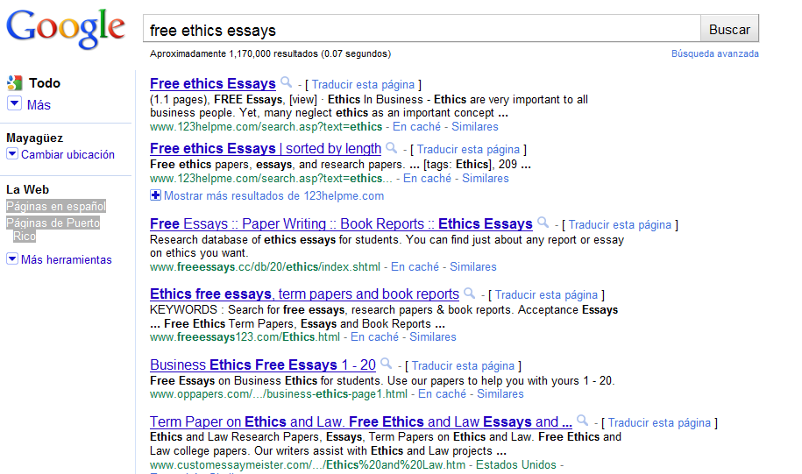
Tres Pecados Capitales contra la Integridad Académica
Fabricación, invención información o datos de experimentos que no se efectuaron.
Falsificación de datos, alteración de datos experimentales, resultados, o información.
Plagio, apropiación de métodos, datos, cuerpo de un texto, trabajos sin citar o reconocer la fuente.

Slide 24
Scenario 4
Your friend is downloading an essay from this website for a paper due tomorrow in his/her engineering ethics class
Using the three tests and the code test, construct an argument why a future engineer shouldn’t do this
(Can you think of a provision in the CIAPR code of ethics that would prohibit using the work of others without proper acknowledgement?)

Slide 25
Work on your scenario with your group
Prepare a debriefing statement

Slide 26
A Quick Detour to the CIAPR Code

Slide 27
How does the Code Work?
Does the code provide a rule for every possible problem?
Do code provisions ever conflict with one another? With themselves?
Which provisions set forth ideals? Which set forth compliance rules?
What does the code of ethics tell you about the fundamental aspirations of the profession of engineering?
Notes:
Might skip in the interest of time

Slide 28
Even the Pirate Articles of Agreement contain provisions of value
Outline democratic procedures for electing the captain and quartermaster
Set fair compensations for crew members injured when carrying out duties
Develops procedures for resolving conflicts
Embody values, perform different functions, and outline for the public community aspirations
Marcus Rediker. Villains of All Nations. Beacon Press. Peter T. Leeson. The Invisible Hook. Princeton

Slide 29
Principios Fundamentales de Ética Profesional
A fin de mantener y enaltecer la integridad, el honor y la dignidad de sus profesiones, de acuerdo a las más altas normas de conducta moral y ética profesional, el Ingeniero y el Agrimensor:
Deberán considerar su principal función como profesionales la de servir a la humanidad. Su relación como profesional y cliente, y como profesional y patrono, deberá estar sujeta a su función fundamental de promover el bienestar de la humanidad y la de proteger el interés público.
Serán honestos e imparciales y servirán con fidelidad en el desempeño de sus funciones profesionales, manteniendo siempre su independencia de criterio que constituye la base del profesionalismo.
Se esforzarán en mejorar la competencia y el prestigio de la ingeniería y de la agrimensura.

Slide 30
Ethical Issues in CIAPR Code
1. Velar por sobre toda otra consideración por la seguridad, el ambiente, la salud y el bienestar de la comunidad en la ejecución de sus responsabilidades profesionales.
2. Proveer servicios únicamente en áreas de sus competencias.
3. Emitir declaraciones públicas únicamente en una forma veraz y objetiva.
4. Actuar en asuntos profesionales para cada patrono o cliente como agentes fieles o fiduciarios, y evitar conflictos de intereses o la mera apariencia de éstos, manteniendo siempre la independencia de criterio como base del profesionalismo.

Slide 31
Ethical Issues in CIAPR Code
5. Edificar su reputación profesional en el mérito de sus servicios y no competir deslealmente con otros.
6. No incurrir en actos engañosos en la solicitud de empleo y en el ofrecimiento de servicios profesionales.
7. Actuar con el decoro que sostenga y realce el honor, la integridad y la dignidad de sus profesiones.
8. Asociarse únicamente con personas u organizaciones de buena reputación.
9. Continuar su desarrollo profesional a lo largo de sus carreras y promover oportunidades para el desarrollo profesional y ético de los ingenieros y agrimensores bajo su supervisión.
10. Conducirse y aceptar realizar gestiones profesionales únicamente en conformidad con las leyes y los reglamentos aplicables y con estos Cánones.

Slide 32
Practical Norms
1c: Cuando su juicio profesional haya sido revocado en circunstancias donde la seguridad, el ambiente, la salud o el bienestar de la comunidad se ponen en peligro, informarán a sus clientes o patronos de las consecuencias posibles. De continuar la amenaza a la seguridad, el ambiente, la salud o el bienestar de la comunidad, informarán sobre el particular a las autoridades concernidas.
1d: Cuando tengan conocimiento o suficiente razón para creer que otro ingeniero o agrimensor viola las disposiciones de este Código, o que una persona o firma pone en peligro la seguridad, el ambiente, la salud o el bienestar de la comunidad, presentarán tal información por escrito a las autoridades concernidas y cooperarán con dichas autoridades proveyendo aquella información o asistencia que les sea requerida.
5j: No aprobarán, timbrarán, estamparán o certificarán, según corresponda, ni autorizarán la presentación de planos, especificaciones, cálculos, dictámenes, memoriales o informes que no hayan sido elaborados por ellos o bajo su responsabilidad directa. Además, le darán crédito por el trabajo de ingeniería, agrimensura o arquitectura a quienes corresponda.

Slide 33
CIAPR Code in 1985
Principios Fundamentales de la Etica Profesional del Ingeniero y del Agrimensor
A fin de mantener y enaltecer el honor y la dignidad de su profesion y de acuerdo a las mas altas normas de conducta etica, el ingeniero y el agrimensor:
Seran honestos e imparciales y serviran con devocion en su empleo, a sus clientes y al publico
Se esforzaran en mejorar la eficiencia y el prestigio de la ingenieria y la agrimesnsura
Utiliazran sus conocimientos y destrezas para promover el bienestar de la humanidad
Canon 5
Se velara celosamente por la seguridad, salud, y bienestar del publico en la ejecucion de sus responsabilidades profesionales

Slide 34
Compare to 1994
FP1: Deberán considerar su principal función como profesionales la de servir a la humanidad. Su relación como profesional y cliente, y como profesional y patrono, deberá estar sujeta a su función fundamental de promover el bienestar de la humanidad y la de proteger el interés público.
Canon 1: Velar por sobre toda otra consideración por la seguridad, el ambiente, la salud y el bienestar de la comunidad en la ejecución de sus responsabilidades profesionales

Slide 35
NSPE Code of Ethics
Preamble. Engineering is an important and learned profession. As members of this profession, engineers are expected to exhibit the highest standards of honesty and integrity. Engineering has a direct and vital impact on the quality of life for all people. Accordingly, the services provided by engineers require honesty, impartiality, fairness, and equity, and must be dedicated to the protection of the public health, safety, and welfare. Engineers must perform under a standard of professional behavior that requires adherence to the highest principles of ethical conduct.
Fundamental Canons. Engineers, in the fulfillment of their professional duties, shall:
Hold paramount the safety, health and welfare of the public.
Perform services only in areas of their competence.
Issue public statements only in an objective and truthful manner.
Act for each employer or client as faithful agents or trustees.
Avoid deceptive acts.
Conduct themselves honorably, responsibly, ethically, and lawfully so as to enhance the honor, reputation, and usefulness of the profession.
National Society of Professional Engineers
http://www.nspe.org/Ethics/CodeofEthics/index.html
Notes:
Can be used to frame the comments of students in Exercise 1.

Slide 36
Additional Requirements in PR
Law 173 (August 12, 1988):
"To protect life, health, and property and to promote the general public welfare, every person who exercises or offers to exercise the profession of engineer, architect or surveyor in Puerto Rico, whether in the public or private sector, will be obligated to present supporting evidence that the above mentioned is in compliance with this law so as to practice the professions of engineer, architect, or surveyor, that the above mentioned is inscribed in the official register of the Board, and that the above mentioned is an active member of the College of Engineers and Surveyors of Puerto Rico or the College of Architects of Puerto Rico depending upon the case.”
To be a licensed engineer, one must
Have graduated from an accredited four year program in engineering
Have passed the “certification” examination offered once a year by the Examining Board for Engineering, Architecture, and Surveying
Be an active member of the College of Engineers and Surveyors of Puerto Rico.

Slide 37
Jeopardy
The Game
for Hard Core
Ethical Engineers

Slide 38
Some things to think about…

Slide 39
No te conviertas en …
Buscón
Chanchullero
Firmón
Negligente

Slide 40
Engineering is a Human Endeavor Engineering and technology influence human well being Engineering is for the purpose of improving human well being
Informed Conscience Cooperation between Rational Thought and Transcendent Values Introspection of one’s beliefs, values, and intentions Development of Convictions and Educated Choices
Deliberateness in Academic and Professional Pursuits I am choosing to be an Engineer

Slide 41
Assignment
Consider the following scenario:
Your Uncle has a single-story house and wants to build an additional second floor. His Friend is a draftsman and prepares a set of drawings for the design of the second floor based on some simple calculations of weight and the design used by the next-door neighbor. In order for your Uncle to receive permit to begin construction, the drawings must be stamped and signed by a licensed engineer, certifying that the that the design is structurally sound. Your Uncle is especially proud that you recently earned your license to practice structural engineering. He asks you to stamp and sign the drawings. However, after reviewing the drawings, you determine that there are serious flaws, particularly in the event of an earthquake. You explain this to your uncle but he insists on building the second story as designed by his Friend because it is cheap and he thinks it looks strong enough to withstand an earthquake.
Work in groups of 3-5. Imagine an ending to this scenario. The outcomes could represent ethical and/or unethical behavior, but in either case, use concepts from the seminar to develop your ideas. Bonus/Extra: develop your case into a play that you act out and post on YouTube.

Slide 42
Design good and bad solutions for the 2-story scenario
Buscón
Chanchullero
Firmón
Negligente
Construct a solution that falls prey to these vices
Respect
Responsibility
Truthfulness
Integrity
Construct a solution that realizes these virtues

Slide 43
Building a Second Floor on top of a Single-Floor Home
Prof. Christopher Papadopoulos
Social, Ethical, and Global Issues (SEGI) in Engineering Program
University of Puerto Rico, Mayaguez
Acknolwedgements:
Prof. Jose Arroyo
Excerpts from
MITIGATION OF SEISMIC HAZARD OF REINFORCED CONCRETE RESIDENTIAL STRUCTURES
WITH NON-RIGID CONNECTIONS
José Ramón Arroyo-Caraballo, Ph.D., P.E.
FINAL REPORT for the FEDERAL EMERGENCY MANAGEMENT AGENCY (FEMA)
HAZARD MITIGATION GRANT PROGRAM
JULY 2005
Includes excerpts from engineering drawings approved by ARPE.

Slide 44
Problems
Design criteria for the addition of a second floor are not directly specified in the building code. The engineer must perform a direct analysis to demonstrate that the design is sufficient to handle all loads: weight, wind (hurricane), and earthquake.
Most second floors that are actually built are not properly designed, even though they are approved by engineers.

Slide 45
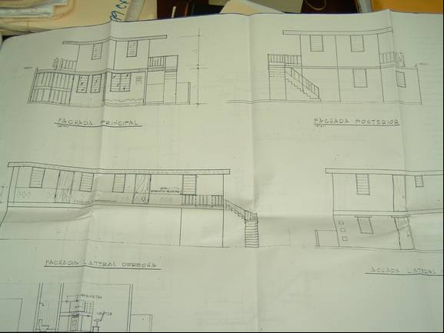
The Issue
Many people in Puerto Rico decide to add a second floor to their single-floor home.
Proposed Second Floor
Existing First Floor
Proposed Second Floor
Existing First Floor

Slide 46
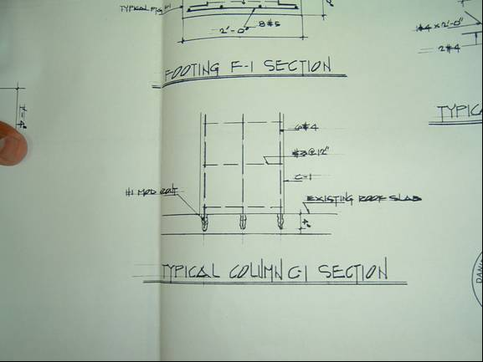
Improper Anchoring
Concrete columns that are built to support the second floor are often improperly anchored.
This diagram represents a typical column in actual construction of second floors. The reinforcing bars for this column are not inserted all the way through the existing roof slab. There is no added bracing from the bottom or sides of the column. In this case the column could tip over in a severe event.

Slide 47
Improved Anchoring
Column anchoring should include some lateral support/bracing.
The lateral bracing will prevent tipping. The length of the bracing must be long enough to spread out the load so that the bracing does not punch through the roof.

Slide 48
Reconocimiento
Dr. Marcel Castro
Dr. Christopher Papadopoulos
Dr. Jose Crespo
Dr. Jorge Ferrer
Dr. William Frey
Dr. David Lorenzo
Dr. Efraín O’Neill
Sra. Madeline J. Rodríguez

Slide 49
Referencias
Ian Barbour, Ethics in an Age of Technology, HarperCollins, 1993.
Elena Lugo, Ética Profesional para la Ingeniería, Ediciones Riqueña, Librería Universal.
M. David Ermann, Mary B. Williams, y Michele S. Shauf, Computers, Ethics, and Society, Oxford University Press, 1997.
Charles E. Harris, Michael S. Pritchard, and Michael J. Rabins, Engineering Ethics: Concepts and Cases, Wadsworth Publishing Company, 1995.
Joseph R. Herkert, Social, Ethical, and Policy Implications of Engineering, IEEE Press, 2000.
Cruz, J. A., Frey, W. J. (2003) An Effective Strategy for Integration Ethics Across the Curriculum in Engineering: An ABET 2000 Challenge, Science and Engineering Ethics, 9(4): 543-568.
Frey, W., O’Neill, E. (2008). Engineering ethics in Puerto Rico: Issues and narratives. Science and Engineering Ethics, 14(3), 422-425.
Frey, W. (2009). Teaching Virtue: Pedagogical Implications of Moral Psychology. In Science and Engineering Ethics. (Published Online) DOI 10.1007/s11948-009-9164-z
Stephen R. Covey, Los 7 hábitos de la gente altamente efectiva, Paidos, 1997.
Louis P. Pojman, Ethics: Discovering right and Wrong, Wadworth Publishing Company, 1990.
Jorge José Ferrer y Juan Carlos Álvarez, Para Fundamentar la Bioética, Editorial Desclee De Brouwer, 2003.
Mike Martin, Roland Schinzinger, Ethics in Engineering, McGraw-Hill, 2005

Slide 50
Portales en la Internet relacionados al tema
Connexions cnx.org (http://cnx.org/content/col10552/1.1)
ESENCe (http://www.umass.edu/sts/digitallibrary/)
Markkula Center for Applied Ethics http://www.scu.edu/SCU/Centers/Ethics/
National Institute for Engineering Ethics
http://www.niee.org
Center for the Study of Ethics in the Professions (http://ethics.iit.edu/)
Institute for Global Ethics http://www.globalethics.org
Onlineethics.org (http://www.onlineethics.org)
Engineering Case Library www.civeng.carleton.ca/ECL/cat-f93.html
Ethics Book Online http://www.et.byu.edu/~terryr/ethics/
Computing Cases (http://computingcases.org)

