Slide 1
Being an Ethical Job Candidate
Guidelines to Professional Employment for Engineers and Scientists from IEEE
Presented by William J. Frey
Center for Ethics in the Professions
UPRM

Slide 2
Performance Reviews at Enron
Sharon Watkins and Mimi Swartz in Power Failure: The Inside Story of Collapse of Enron provide a grisly description of the Performance Review Committee (PRC) of Enron
  Employee files (with photos) were placed on a large table
  Mentors and champions would move the files of favorites to the front while detractors would move them to the back
  Process continued until one side or the other dropped out from sheer exhaustion
Employees rated on a scale from one to five. Ratings were expected to be proportional, i.e., 20% would receive a ranking of 1, 20% of two, etc.
  The twenty percent ranked lowest would be fired
Evaluate the PRC process in terms of the ethics tests
What kind of employee profile would best thrive in this process?

Slide 3
What do you think?
A company cannot continue to exist when it purges every year 20% of its employees
This is exactly what should be done. Only the fittest should survive?
Twenty percent is too much. Cut only 10%.

Slide 4
Prospective Employee Obligations
Sincere Interest
  The professional employee (applicant) should attend interviews and accept reimbursement only for those job opportunities in which there is a sincere interest
  The applicant should prorate costs for multiple interviews during a given trip on a rational basis
  The guiding principle should be that the applicant receives neither more nor less than the cost of the total trip.

Slide 5
1. Bring Your Friends:
Maria, a talented student in computer engineering has accepted an offer to work for a prestigious firm. Then she receives a call for an interview with firm X. She tells them that she has already accepted an offer from Y, but the caller says that doesn’t matter. “We want to interview you anyway so that we can document affirmative action compliance. In fact, if you have any friends who are similarly situated (i.e., women who come from minority groups) please give us their names. We will fly all of you to our central headquarters for interviews at our expense. It will be a good vacation.

Slide 6
2. Working for Mega Weapons
Jorge is an unemployed computing professional. He is also a pacifist. Antonio, a friend, has a job prospect. Mega Weapons is looking for someone with Jorge’s expertise. Yes, he will be spending time developing the guidance systems for “smart bombs,”
But the accurate bombs will be less likely to go astray and kill innocent civilians. Jorge, however, remains unimpressed by this. “They’re still bombs,” he says, “and their primary purpose is to kill human beings. Besides, I would compromise myself by even accepting an interview. What if they ask me about my views on war? I would have to tell them the truth and then they would dismiss me as a candidate.”
Jorge tells his wife about the job prospect. While she supports his pacifism, she tells him that she can’t continue indefinitely as a waitress; her job is preventing her from completing her college degree and keeps her away from the children. She asks Jorge if there is any way he can reconcile this job with his pacifism.
What should Jorge do?

Slide 7
What do you think?
Is this sincere interest? Who is being deceived?

Slide 8
Prospective Employee Obligations
Full and Honest Disclosure
Job candidates have the obligation to provide job relevant information about themselves to the prospective employer
Candidate’s qualifications relative to the job description
  Educational experience
  Prior work experience
  Job-relevant skills and knowledge

Slide 9
3. Are You a Bleeding-Heart Pacifist?
Jorge is a pacifist. He is also an unemployed computing professional. Against his better judgment, his wife and friend, Antonio, have talked him into interviewing with Mega Weapons for a new opening working on the guidance systems of non-nuclear missiles. During the interview, the employer remarks that Mega Weapons has had trouble in the past with employees who have moral qualms about working on weapons projects. He then turns to Jorge and asks, “You’re not one of those bleeding-heart pacifists are you?”
How should Jorge answer this question?

Slide 10
What do you think?
Should Jorge answer the question?
Is this a proper question?
Does Jorge have sincere interest?

Slide 11
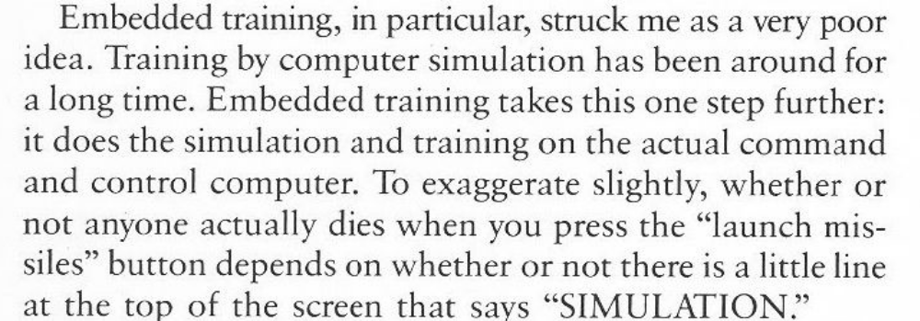
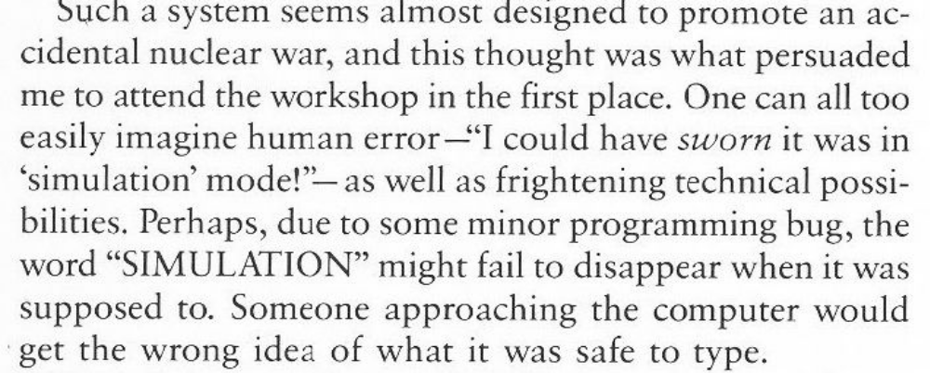
Sidebar on Borenstein

Slide 12
An argument you may not like…
I am a doctor
My “moral enemy” is lying on the table and needs my services to live.
As a doctor I have a moral and professional obligation to save him.
I am an engineer
I have expertise like Borenstein that is essential to a weapons project that has been publicly and politically validated
I have an obligation to set aside my personal beliefs to work on this project.

Slide 13
Prospective Employee Obligations
Honoring Confidentiality Agreements
The applicant should carefully evaluate past, present, and future confidentiality obligations in regard to trade secrets and proprietary information connected with the potential employment
The applicant should not seek or accept employment on the basis of using or divulging any trade secrets or proprietary information

Slide 14
4. We Protect Our Property
Pedro has a job offer from Z-Corp, a manufacturer of computer chips. Z-Corp has recently had problems with its competitors who have tried to hire away its employees to get information about their chip production process. In response, Z-Corp now includes a clause (non-disclosure agreement) in its employment contract that prohibits employees from working with competitors for up to five years. Should Pedro be concerned about this? What should he do?

Slide 15
5. You Can’t Sue Us!
Marta, a student at an Hispanic university has just accepted a job with a major U.S. corporation. The job seems ideal. However, she notices that her employment contract includes a clause to the effect that she cannot sue the corporation for wrongful dismissal should she be fired or laid off. Instead, the dispute would be resolved by an outside arbitrator. The arbitrator’s decision would be binding on both parties. Moreover, the arbitrator would be chosen by the company. Marta suspects that this agreement represents a “hard line” stance that the company has taken on wrongful dismissal suits. What should she do?

Slide 16
6. Can I Use What I Have Already Learned?
Mega Weapons, Inc. (MW) has been awarded a lucrative contract with the U.S. military to develop guided, non-nuclear missiles. This contract is based on MW’s considerable success in developing highly accurate computer guidance systems. While working with MW, you have had access to the details of these guidance systems, including information owned by MW and protected by the law. Recently, you have received a job offer from Amaco Arms, Inc. (AA). This offer came about through an unsolicited recommendation by a former classmate of yours; he now works for Amaco, is familiar with your experience and expertise, and suggested to his supervisors at Amaco that they try to hire you away from Mega Weapons. You will be helping them develop guidance systems for missiles and will be doing work similar to the work you are doing with Mega Weapons. AA competes directly with ME for military weapons contracts. It is more than likely that protected information you have had access to while working with Mega Weapons would be useful for what you would be doing with Amaco.
How should you respond to this job offer?

Slide 17
7. You Can’t Take it With You
You are leaving Computing Systems, Inc. to work for Compware, Inc,. a competitor. Before you leave Computing Systems, you are debriefed by the Personnel Office and a company lawyer on the proprietary information you have had access to while working with Computing Systems. They have itemized the information that you cannot divulge to or use in your work with Compware. It is your professional judgment that they are including information that is general knowledge and should not be considered confidential or proprietary. It is also information that would be useful—even essential—for what you will be doing in your new job. You feel that this confidentiality agreement is overly restrictive and would handicap you in your new job. What should you do?

Slide 18
What do you think?
Is it fair to put clauses in employment contracts that limit disclosure of company information and restrict an employee’s ability to sue?

Slide 19
Prospective Employee Obligations
Honoring Commitments
Having accepted an offer of employment, the applicant is morally obligated to honor the commitment unless formally released after giving an adequate notice of intent
The applicant should not use the funds or time of a current employer for the purpose of seeking new employment unless approved by the current employer

Slide 20
Employer Obligations
Prior Disclosure of Terms of Interview
The policy of the employer regarding payment of expenses incurred by the applicant in attending the interview must be made clear prior to the arranged interview

Slide 21
8. Oh, by the way…
Pedro, who will graduate at the end of the current semester, is a student at a well known Hispanic serving university. He and two of his classmates are flown by Comp-Org for an interview at company headquarters. While talking by phone with the company representative setting up the interview, he asks if there is anything he should do to prepare for the interview: information they want, a physical, etc. They answer, “No.” They also fax an itinerary of the interview—it looks routine. So Pedro and his classmates board the plane and arrive at their destination a few hours later. A company representative meets them and says that the first activity for the interview is a drug test. When Pedro objects—“Why weren’t we told about this before?”—he is told that if this is unacceptable to him, then he can get right back on the plan because the interview is over for him. What should Pedro and his classmates do?

Slide 22
Variation on 8
Students interviewing at Ford have to deal with an angry reaction from the company’s librarian.

Slide 23
Employer Obligations
Full Disclosure of the Technical and Business Nature of the Job
The applicant should have an interview with the prospective employer and, if possible, with the prospective supervisor, in order to understand clearly the technical and business nature of the job opportunity
The prospective employer should be ethically responsible for all the representations regarding the conditions of employment

Slide 24
What do you think?
How would a teacher satisfy a full disclosure obligation on the first day of class? What kind of information is required? What should be included in the syllabus?

Slide 25
Employer Obligations
Treating Candidate Application as Confidential
Applications for positions should be confidential
The expressed consent of the applicant should be obtained prior to communicating with a current employer

Slide 26
Why should a candidate’s application be kept confidential?

Slide 27
9. The Recommendation
A worker under your supervision has recently been fired for incompetence and repeated violations of confidentiality. Several weeks later, the worker returns to ask you for a letter of recommendation. He says you owe it to him; you fired him, and he has not been able to find any work and has a family to support. What should you do?

Slide 28
Employer Obligations
Minimizing Hiring During Layoffs
Employers should minimize hiring during periods of major curtailment of personnel

Slide 29
Employer Obligations
Providing a Satisfying Career Opportunity
Hiring of professional employees should be planned at all times to provide satisfying careers

Slide 30
Employer Obligations
Limiting an Employee’s Career Options
Agreements among employers or between employer and professional employee which limit the opportunity of professional employees to seek other employment or establish independent enterprise are contrary to the spirit of these guidelines

Slide 31
Employer Obligations
Full Disclosure in the Employment Offer
The employer’s written offer of employment should state all relevant terms, such as salary, understandings relating to relocation assistance, expected duration of employment (permanent or temporary), and patent obligations
The prospective employee should be informed of any papers requiring a signature

Slide 32
Employer Obligations
Adequate Reparation
Having accepted an applicant, an employer who finds it necessary to rescind an offer of employment should make adequate reparation for any injury suffered

Slide 33
Employer Obligations
Respecting Rights of Prospective Employees
  Privacy during the interview
  Sexual and other forms of harassment during the interview

Slide 34
10. Two Interviews
A recent graduate from University X, Marta has a positive interview with a local, respected company. She discussed her skills, experience, and asked several questions about working conditions and benefits. The interviewer, obviously impressed, asked Marta back for a second interview with his supervisor.
The second interview followed a different course. The interviewer, an older man, did not ask her about her skills or experience. Instead, he reminisced about his days as a college student. He talked about his children—what they were studying and their career plan. He mentioned his wife in passing. Then he told Marta that the people who do well in his company are hard workers; “the strongest person,” he said, “will do whatever is necessary to survive in a harsh, competitive environment.” Then he looked at her hands and asked if she was single and still lived with her parents. How should Marta answer these questions? Do these questions invade Marta’s privacy? Is this sexual harassment?

Slide 35
Your Task
You will be divided into groups and assigned a scenario
Each scenario involves a difficulty in interpreting an employer/employee obligation
Interpret the obligation as best you can.
Evaluate and rank the solutions given using 3 ethics tests and a feasibility test

Slide 36
Summary of Obligations
Sincere Interest (Candidate and Employer)
Full and Honest Disclosure (Employer)
  Terms of Interview
  Technical and Business Nature of Job
  Employment Offer
Honoring Confidentiality Agreements (Candidate)
Treating Candidate Application as Confidential (Employer)
Minimizing Hiring During Layoffs (Employer)
Providing a Satisfying Career Opportunity (Employer)
Adequate Reparation (Employer)
Treating candidates with dignity (privacy, harassment, etc) (Employer)

Slide 37
Harm / Beneficence
Does it do less harm and more good than the alternatives?
  Identify the likely consequences and sort them out as harms or benefits
    Use probability and magnitude as tie breakers
  Identify the agent and describe the action alternative under consideration
  Choose that alternative that does less harm and more good than the alternatives

Slide 38
Publicity / Ownership
Would I want to be publicly identified with this action? Would I want others to evaluate me as a person on the basis of this action?
  Identify the agent and the action
  Identify the value(s) that the action expresses
  Decide whether you would want to be identified publicly with this action/value(s)

Slide 39
Reversibility
Would I think this a good choice if I were among those affected by it? (Does this action treat stakeholders with respect?)
  Identify the agent, action, and the stakeholders
  Reverse with each stakeholder and evaluate the action from that standpoint
  Integrating the different stakeholder perspectives, do you find the action reversible in a global sense

Slide 40
Feasibility
Will it work? Can I implement this solution given resource, interest, and technical constraints?
  Resource: time, money, materials, supplies
  Interest: supervisor, organization culture, legal context, political/social context
  Technical: Would implementing the solution require unrealistic technical innovations?

Slide 41
References
Victoria S. Wike, “Professional Engineering Ethical Behavior: A Values-based Approach”. Proceedings of the 2001 American Society for Engineering Education Annual Conference & Exposition, Session 2461.
Michael S. Pritchard (1996) Reasonable Children: Moral Education and Moral Learning. Lawrence, KS: University of Kansas Press: 11.
Stephen H. Unger (1994) Controlling Technology: Ethics and the Responsible Engineer. New York: John Wiley & Sons: 315-325 (Reprinted with permission of IEEE)
Robert C. Solomon (1999) A Better Way to Think About Business: How Personal Integrity Leads to Corporate Success. Oxford, UK: Oxford University Press: 71-114.
See Onlineethics, www.onlineethics.org, for case on which “Oh, By the Way” is based.

