Slide 1
Acoustic Noise Cancellation

Slide 2
Objectives
To develop a Simulink® model of a noise reduction system using the Least Mean Squares (LMS) Algorithm.
To run the model on the Texas Instruments C6713 DSK.

Slide 3

What is Noise?
In the audio sense, “noise” refers to any other signals besides those we want to listen to.
Click on the icon to hear noise:

Slide 4
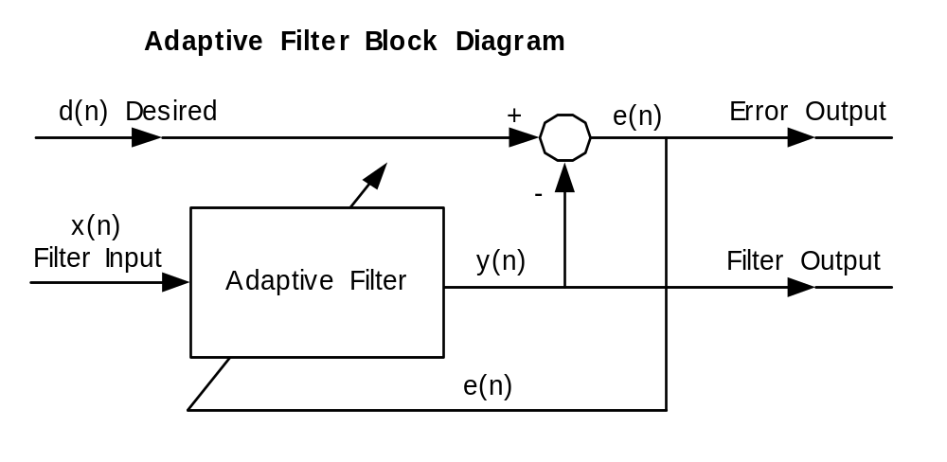
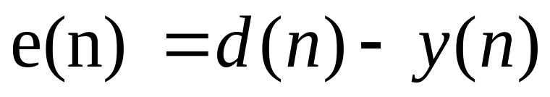
Adaptive Filter Block Diagram

Slide 5
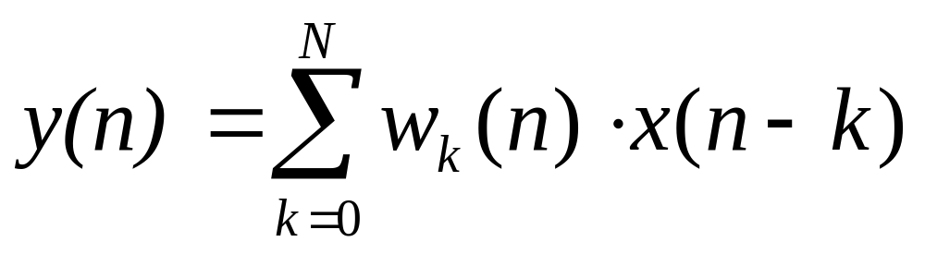
Adaptive Filter Equation
The Adaptive Filter is a Finite Impulse Response Filter (FIR), with N variable coefficients w.

Slide 6
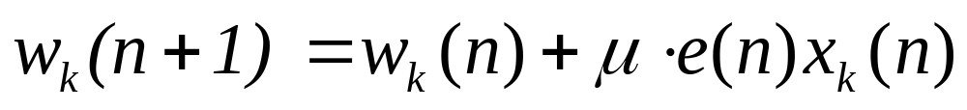
The LMS Equation
The Least Mean Squares Algorithm (LMS) updates each coefficient on a sample-by-sample basis based on the error e(n).
This equation minimises the power in the error e(n).

Slide 7
The Least Mean Squares Algorithm
The value of µ (mu) is critical.
If µ is too small, the filter reacts slowly.
If µ is too large, the filter resolution is poor.
The selected value of µ is a compromise.

Slide 8
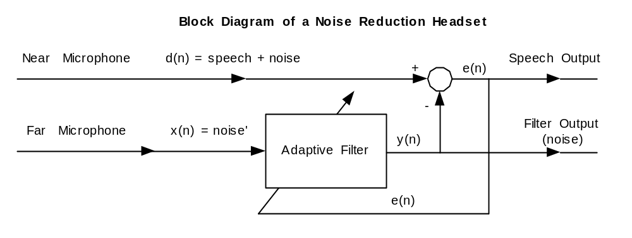
Audio Noise Reduction
A popular application of acoustic noise reduction is for headsets for pilots. This uses two microphones.

Slide 9
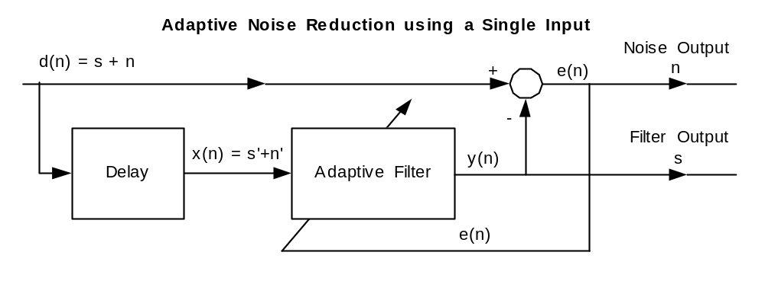
Noise Reduction using one Microphone
This scheme is suitable for the C6713 DSK.

Slide 10
Operation of C6713 Noise Reduction
Assumption: that speech does not change quickly. In this case, s = s’ + phase shift.
If the delay is longer than the size of the filter, then noise n ≠ n’.
The Adaptive Filter shapes s’ to make it as similar as possible as it can to s.
Random noise cannot be shaped.

Slide 11
Simulation

Slide 12
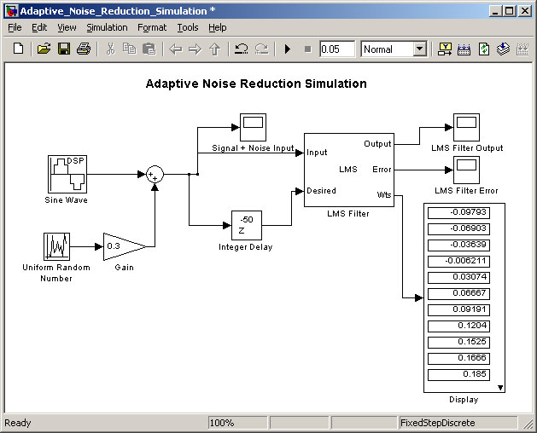
The Simulink Model
Open the following Simulink model: “AcousticNoiseCancellation”.

Slide 13
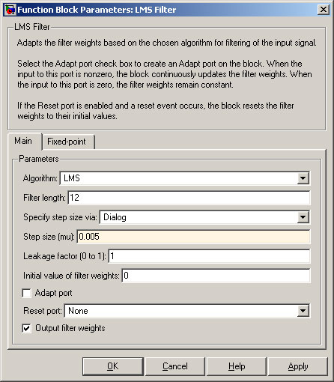
Setting the Step size (mu)
The rate of convergence of the LMS Algorithm is controlled by the “Step size (mu)”.
This is the critical variable.

Slide 14
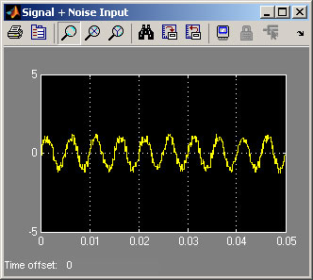
Trace of Input to Model
“Input” = Signal + Noise.

Slide 15
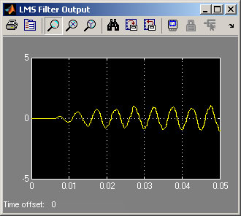
Trace of LMS Filter Output
“Output” starts at zero and grows.

Slide 16
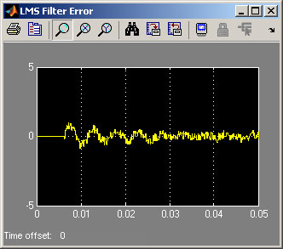
Trace of LMS Filter Error
“Error” contains the noise.

Slide 17
Introduction to Laboratory

Slide 18
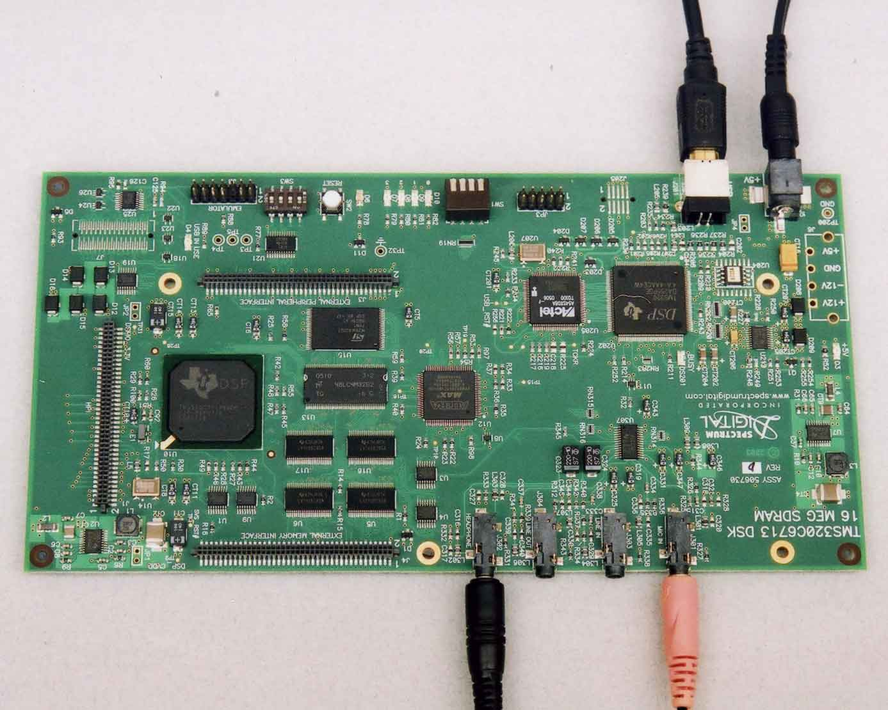
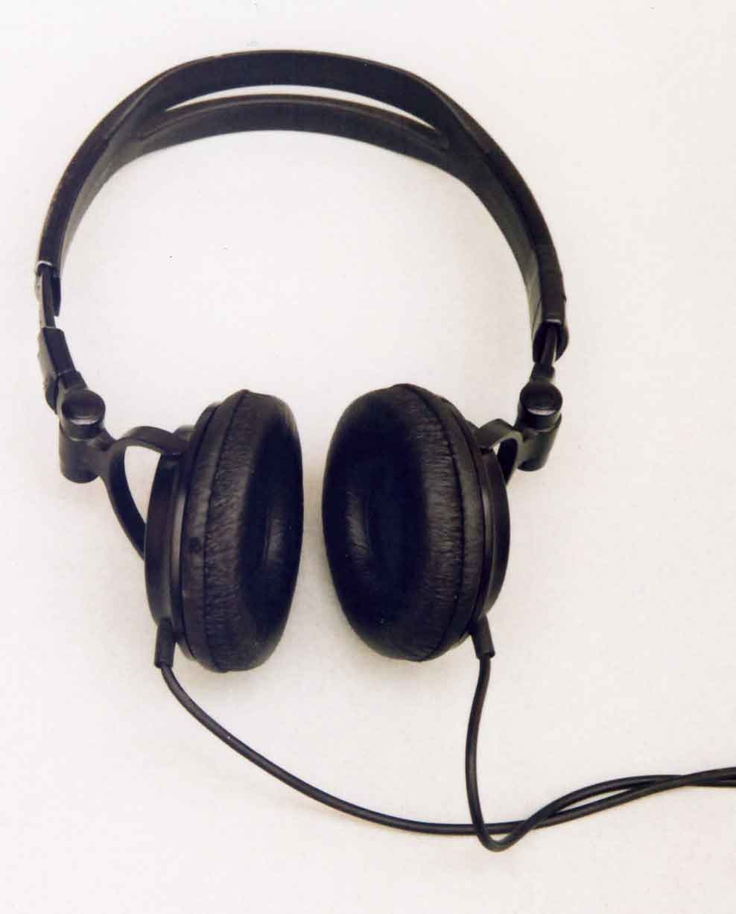
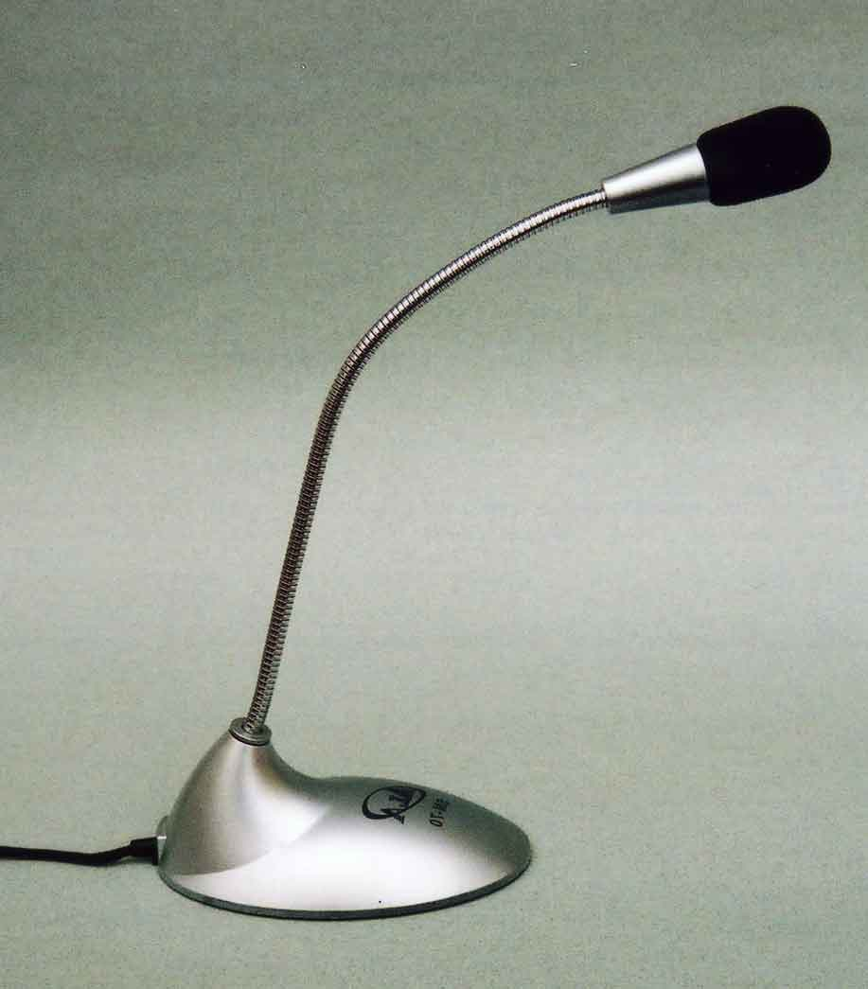
Typical C6713 DSK Setup
USB to PC
to +5V
Headphones
Microphone

Slide 19
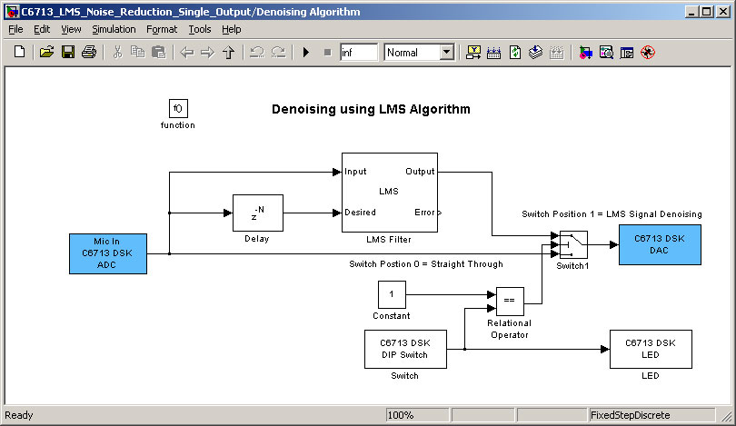
Modified Model for C6713 DSK
You will build the model “AcousticNoiseReductionDSKC6713”.

Slide 20
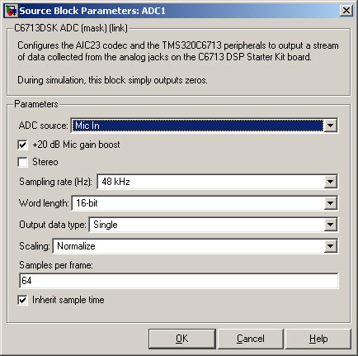
Using Frames
This model uses frames of data rather than individual bytes.
The “Samples per frame” is set to 64.

Slide 21
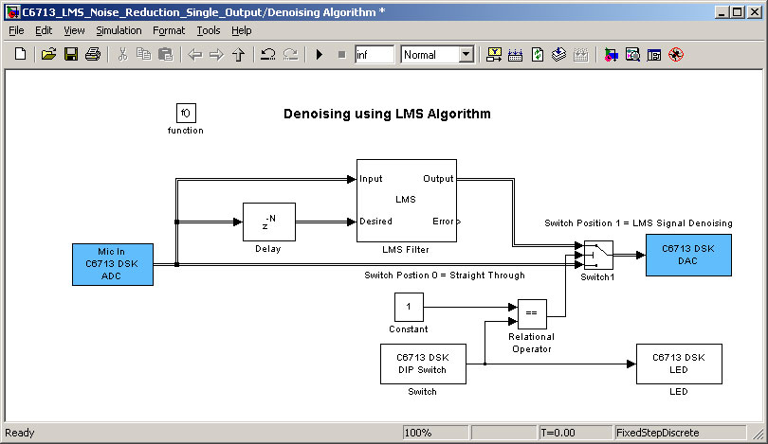
Built Model Showing Frames
When the model is built, the frames are shown as double lines.

Slide 22
Setting up the C6713 DSK
Plug an microphone and computer loudspeakers / headphones into the C6713 DSK.
Put the microphone next to a source of random noise e.g. an off-station radio.
Speak into the microphone.
Listen to the output.

Slide 23
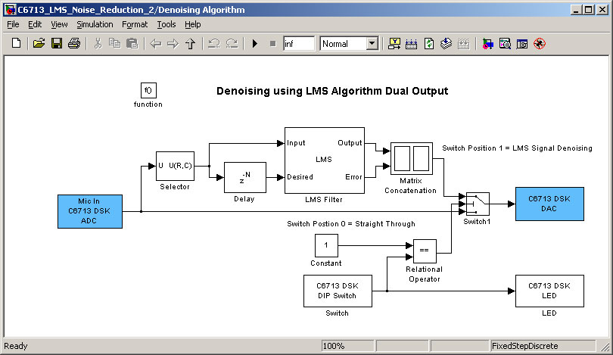
Second Model for C6713 DSK
Open the model “C6713_LMS_Noise_Reduction_Dual_Output”.

Slide 24
The Second Simulink Model
Uses a stereo signal:
  LMS Filter Output on one channel.
  LMS Filter Error on the other channel.
Note that in order to process stereo data, the matrix “selector” and “matrix concatenation” must be used.

Slide 25
Things You Can Try
Change the number of filter elements from 32 to see how many elements you need.
Change the step-size (mu) to see how the LMS converges.
Try other adaptive filter algorithms e.g. RLS.

Slide 26
References
Digital Signal Processing, A Practical Approach by Emmanuel C. Ifeachor and Barrie W. Jervis. ISBN 0201-59619-9.
Digital Signal Processing with C and the TMS320C30 by Rulph Chassaing. ISBN 0-471-55780-3.

