Slide 1
Class-D Audio Amplifier

Slide 2

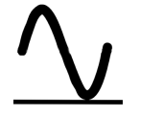


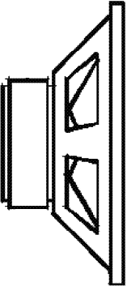
System Description
Analog to PCM Conversion
PCM to PWM Conversion
TMS 320F2808
Input Stage
Output Stage
(Amplifier)
Audio Source
Protection Circuit
Buffer
DC shift
Switching Amplifier
H-Bridge
LPF

Slide 3
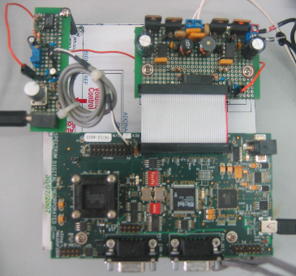

The System
12V
Power Supply
Audio Source
5V
Power Supply

Slide 4
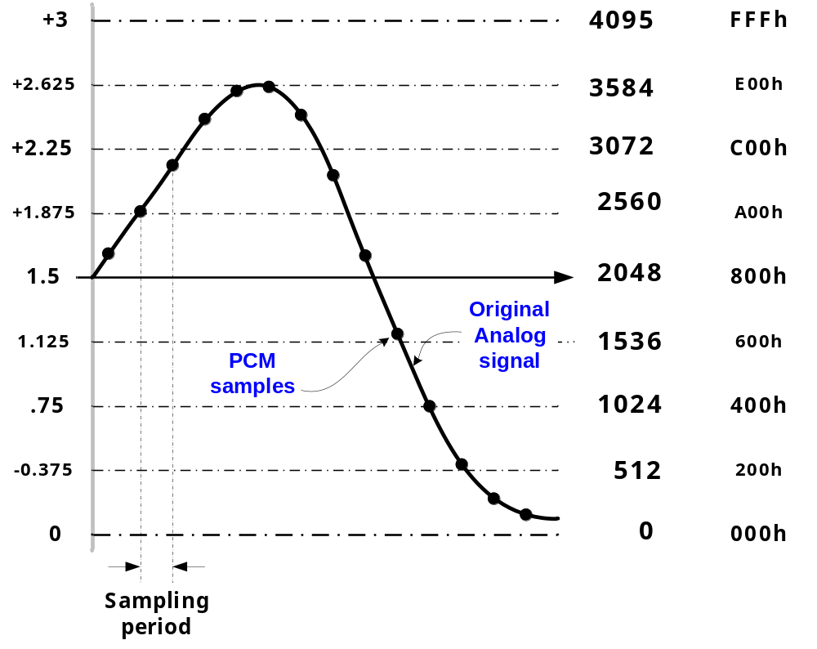
Analog to Digital (PCM) Conversion

Slide 5
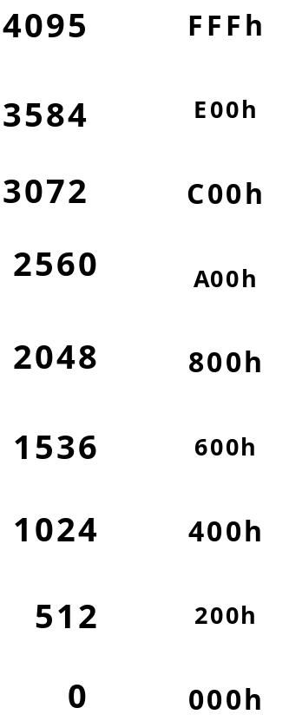
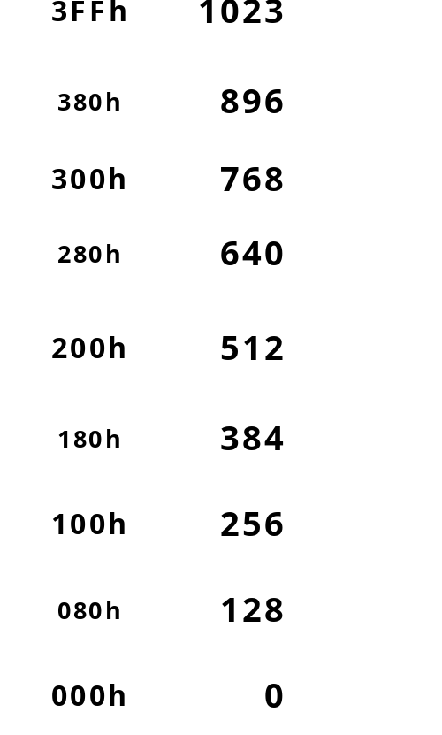
PCM to Duty Cycle Conversion
PCM Value
Duty Cycle
Shift Right 2 bits

Slide 6
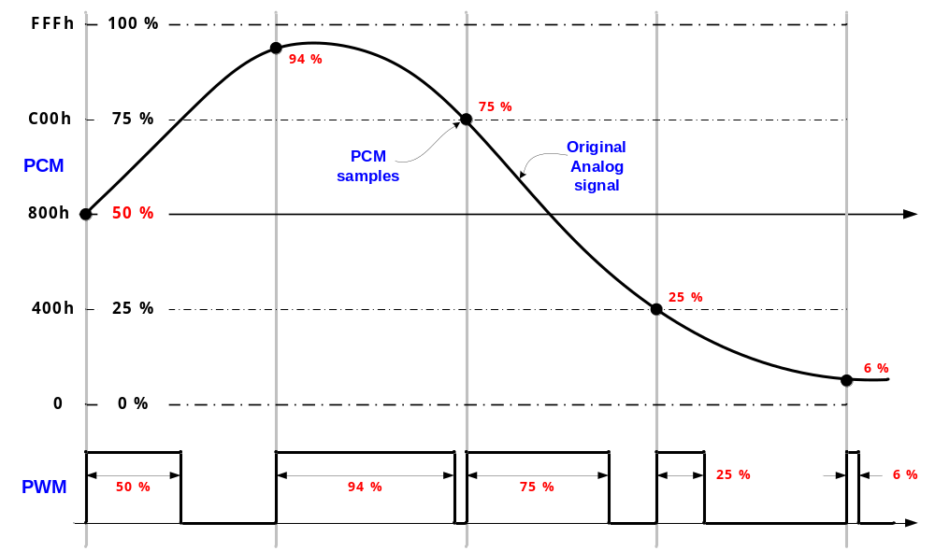
PCM → PWM

Slide 7
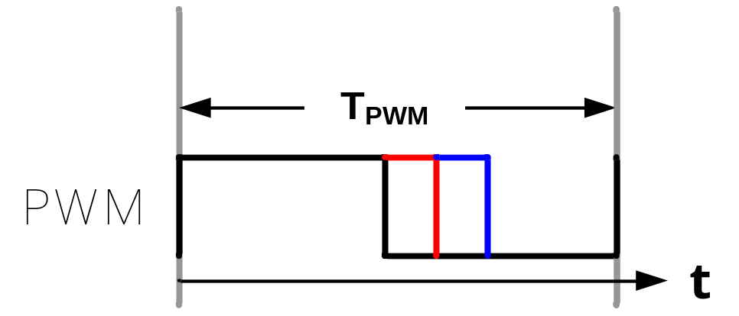
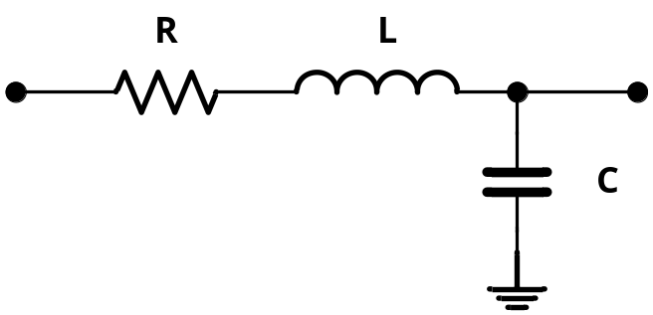

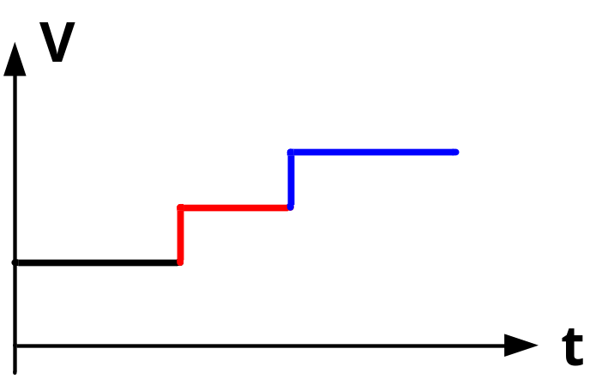
PWM → Analog

Slide 8
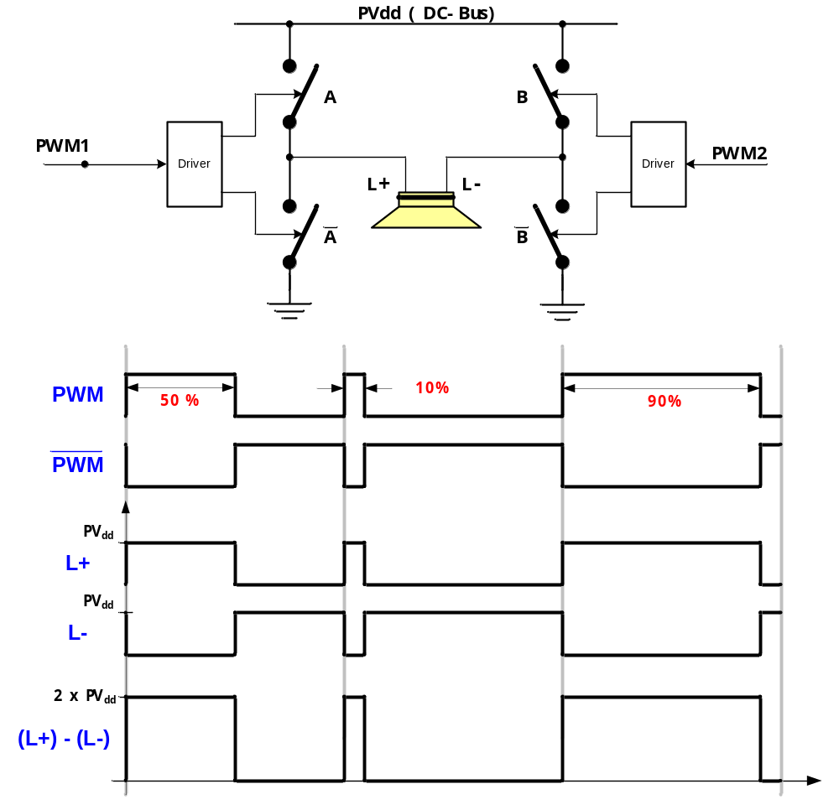
H-Bridge Power Topology

Slide 9
Input Circuit Functionality
TMS 320F2808
ADC
Input Stage
Audio Source
Analog Signal
Amplitude Scaling
DC removal
Limits DSP Input Voltage 0 – 3.3 V
Protection Circuit
Buffer
DC shift
VRef for ADC
Analog to Digital (PCM) Conversion:
0-3.3 V → 0-0xFFF

Slide 10
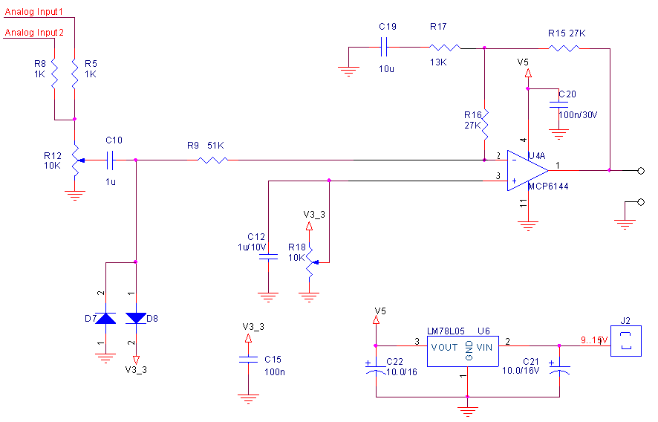
Input Circuit
DC Removal
+Volume
Buffer+HPF
To eZDSP-F2808
P8-1
GND
Reference
Voltage
1.5 V
Protection Circuit
DC/DC Converter

Slide 11
Output Circuit Functionality
PCM to PWM Conversion
PWM Control
TMS 320F2808
CPU
EPWM
Output Stage
(Amplifier)
Switching Amplifier
H-Bridge
LPF

Slide 12
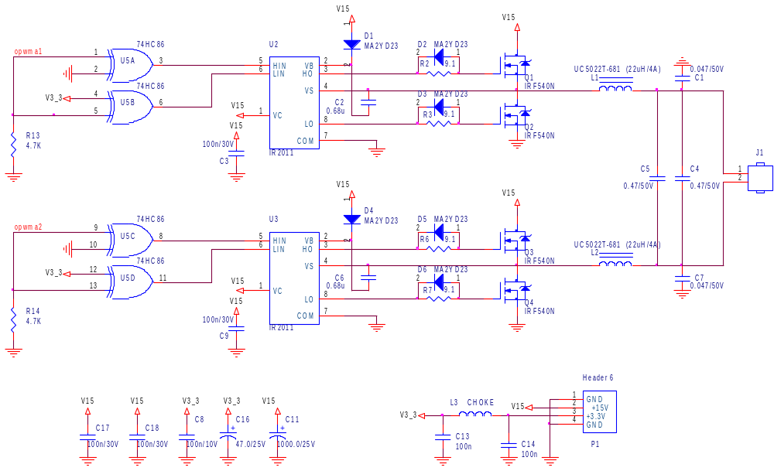
Output Circuit
PWM Inversion
Drivers
Protection
Full Bridge
LPF
EPWM1 - P8/9
EPWM2 - P8/11

Slide 13
Voltage Supply
5 V
Input Stage
eZDSP-F2808
3.3 V
Output Stage
(Amplifier)
DC/DC
12 V

Slide 14
Software Requirements
The input Signal
in range 0~3V
The Conversion Sequence
starts on SOC signal
Conversion Sequence
capture 8 times the same
channel with configuration:
ADC Clock = 12.5 MHz
S/H width = 320ns
Generates Interrupt at the
end of each
Conversion Sequence
At the Start:
Initialize:
CPU clock to 100MHz
GPIO for PWM output
Interrupt Vector (PIE)
Set up ADC, PWM
Enable HRPWM calibration
Select Interrupt on ADC EOS
Perform Endless Loop of
HRPWM calibration
PWM width is
1000 CPU clocks =
10us = 100KHz
Timer in Up-count mode
Values loaded at the
end of PWM duty cycle
When Timer is zero
PWM is inactive
When Timer = Value
PWM is active
Generate SOC signal at
the start of each PWM duty
cycle (Timer is zero)
TMS 320F2808
ADC
CPU
EPWM

Slide 15
Timing Diagram
Timer=CMPA
Timer=zero
CMPA Updated
PWM Timer
PWM1A=Set
PWM1A=Clear
PWM1A Out
PWM2A=Clear
PWM2A=Set
PWM2A Out
Timer=zero
SOC is generated
SOC Impulse
Analog to PCM Conversion
ADC generates
Interrupt
End-of-Sequence
PCM tp PWM
Conversion
CMPA Calculation
Interrupt
Exit Interrupt
ISR exit CMPA updated

Slide 16
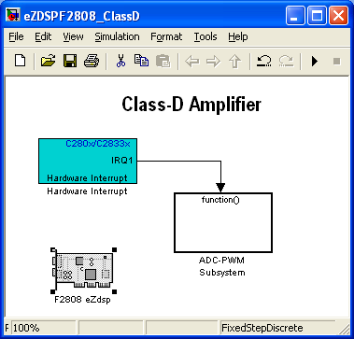
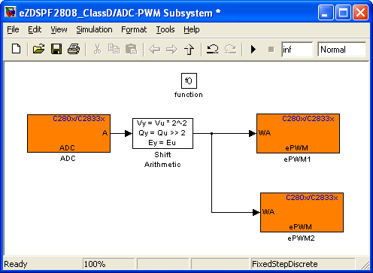
Simulink Model

Slide 17
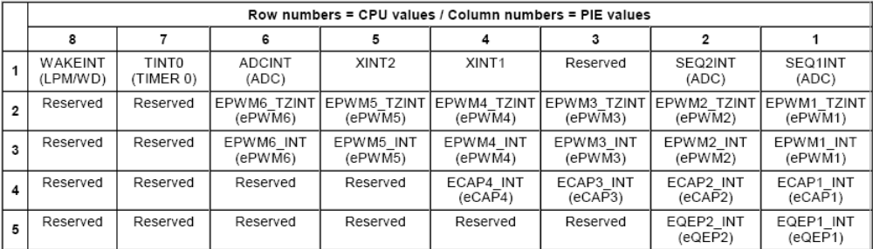
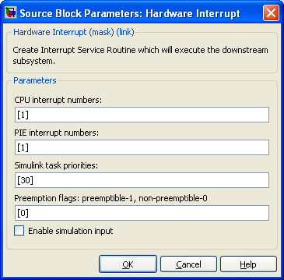
Hardware Interrupt Module

Slide 18
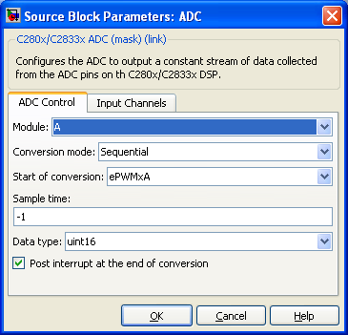
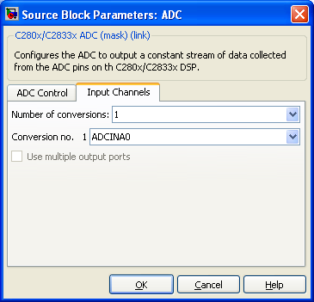
ADC Configuration

Slide 19
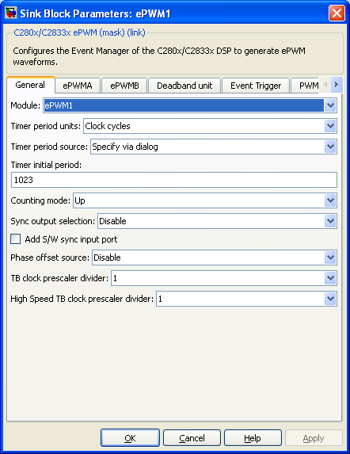
ePWM1 Settings (1)
Time-Base Settings:
  PWM Frequency 97.6 KHz (100 MHz/1024)
  with up-count mode timer

Slide 20
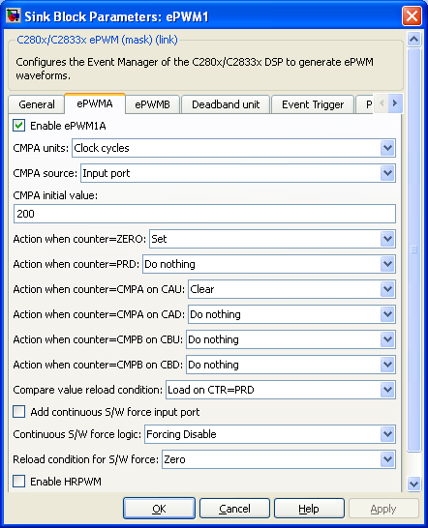
ePWM1 Settings (2)
Action-Qualifier:
  PWM= ‘1’ for TBCTR=0
  PWM =‘0’ for TBCTR=CMPA
Counter-Compare:
  Load new Value at the start of PWM duty cycle

Slide 21
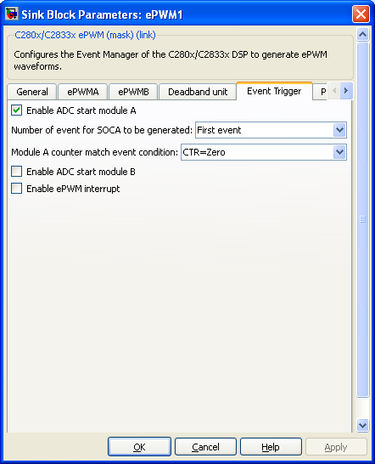
ePWM1 Settings (3)
Event-Trigger:
Generate SOC to module A at the start of PWM duty cycle

Slide 22

ePWM2 Settings (1)
Time-Base Settings:
  PWM Frequency 97.6 KHz (100 MHz/1024)
  with up-count mode timer

Slide 23
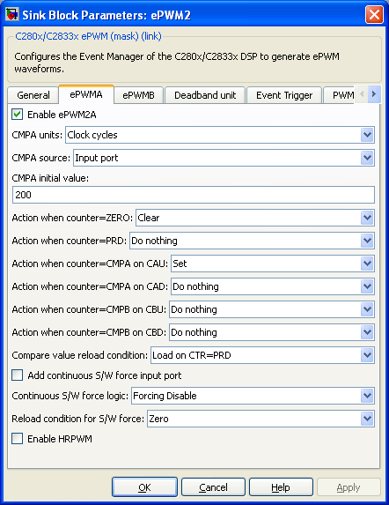
ePWM2 Settings (2)
Action-Qualifier:
  PWM= ‘0’ for TBCTR=0
  PWM =‘1’ for TBCTR=CMPA
Counter-Compare:
  Load new Value at the start of PWM duty cycle

Slide 24
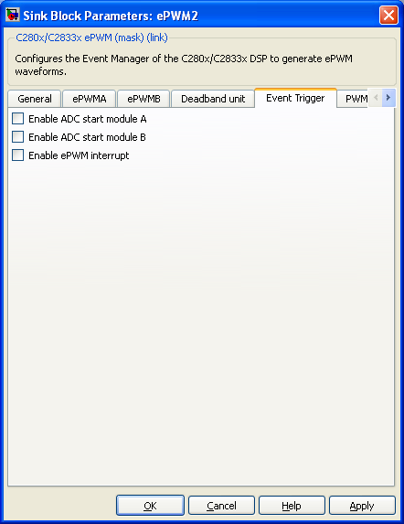
ePWM2 Settings (3)
Event-Trigger not activated

