Slide 1
Dual Tone Multi Frequency
(DTMF)

Slide 2
DTMF Signals
The DTMF is a popular signaling method between telephones and switching centers
DTMF is also used for signaling between the Telephone network and computer networks
The DTMF signals are Transmitted over a telephone line
Uses speech frequency signals
DTMF signals are the superposition of 2 sine waves with different frequencies

Slide 3
The DTMF Keypad
 | 1209 Hz | 1336 Hz | 1477 Hz
697 Hz | 1 | 2 | 3
770 Hz | 4 | 5 | 6
852 Hz | 7 | 8 | 9
941 Hz | * | 0 | #

Slide 4
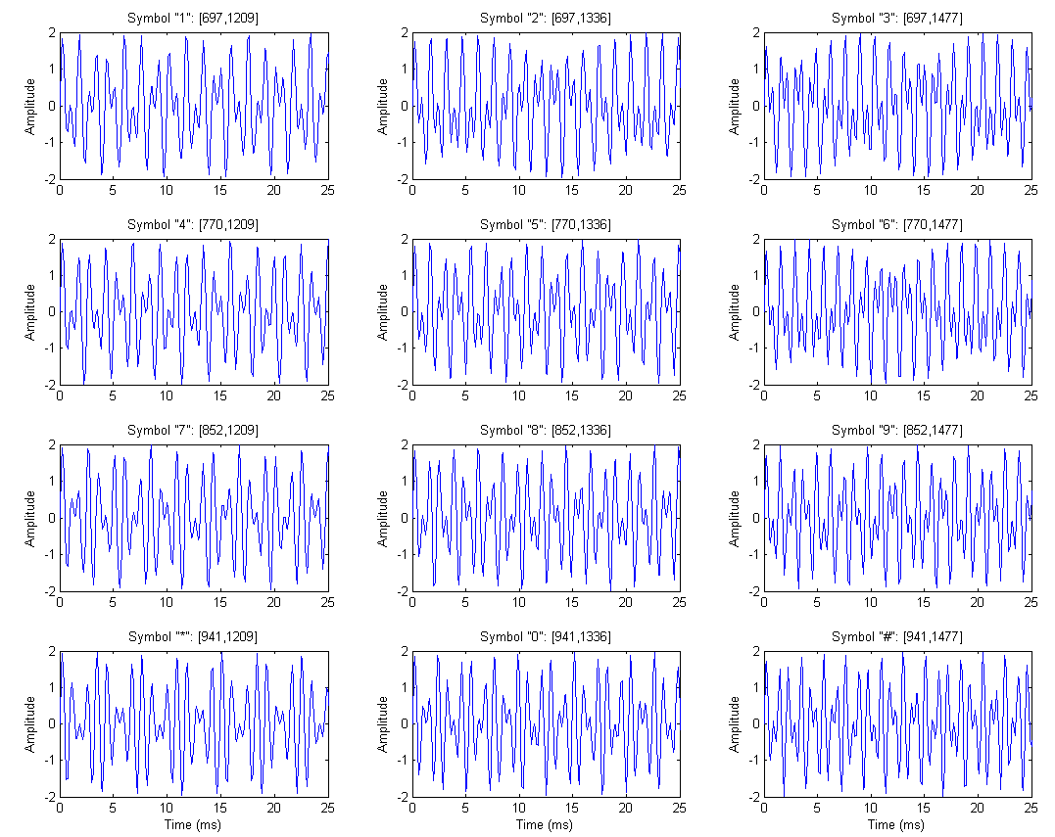
DTMF Digits

Slide 5
DTMF Generation
Row
Selector
697 Hz
770 Hz
852 Hz
Desired Digit
941 Hz
Dual Tone
+
Column
Selector
1209 Hz
1336 Hz
1477 Hz

Slide 6
DTMF Detection
Leading
Edge
Detection
Frequency
Detection
Enable
Convert to Display
Display
x[n]

Slide 7
Frequency Detection
Row Calculation
Digit
Calculation
697 Hz
770 Hz
852 Hz
941 Hz
Calculated Digit
x[n]
Column
Calculation
1209 Hz
1336 Hz
1477 Hz

Slide 8
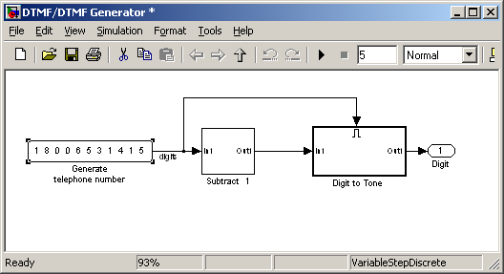
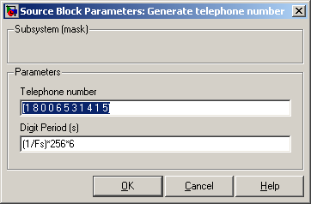
Simulation (cont.)
Selecting Digits for transmission

Slide 9
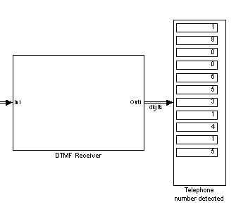
Simulation (cont.)
Detected Digits

Slide 10
Simulation (cont.)
The Receiver Performs:
Signal
Rcv
sensing
Edge Detected
samples
Buffer
Digit
Detect
Digit
New Digit

Slide 11
Simulation (cont.)
Digit Detection: transforms signal received to digit using the following detection blocks:
X_{1 …} X_{N}
Detect
1209 Hz
Detect
852 Hz
Detect
941 Hz
Detect
697 Hz
1 | 2 | 3
4 | 5 | 6
7 | 8 | 9
* | 0 | #
Detect
770 Hz
X_{1 …} X_{N}
Detect
852 Hz
Detect
941 Hz

Slide 12
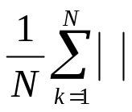
Simulation (cont.)
Detection block operation:
  Input: X₁…X_{N} signal samples
  Output: flag to indicate whether the signal has a correlation with the frequency under detection or not
  Implementation:
    Band Pass around the frequency under detection
    Average the absolute value of the BPF output
    Comparing the average to an agreed threshold
    Flag is up ⬄ the average is greater than the threshold
Detect
f_{b}
=
Threshold
Test
X₁…X_{N}
BPF
(f_{b}-eps , f_{b}+eps)
flag

Slide 13
Real-Time Environment
Based on the Simulation model
R-T Implementation involves detecting the digits only
The R-T Simulation involves a few modification to support the interface with the transmitter

Slide 14

Real-Time Environment (cont.)
PC
MATLAB:
  DTMF transmission
  GUI
PC
(Sound Card)
rtdx
Detected Digits
DTMF
DSK6713
TMS320C6713
Line In
DTMF Receiver
A/D

Slide 15
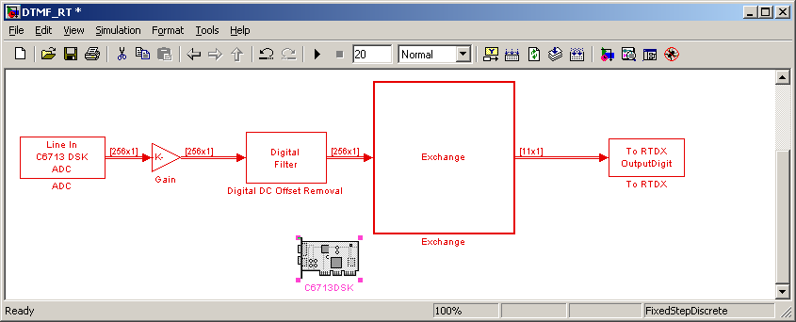
Real Time Environment (cont.)
The DTMF signal is processed in order to overcome DC offset and to make amplitude modifications:

Slide 16
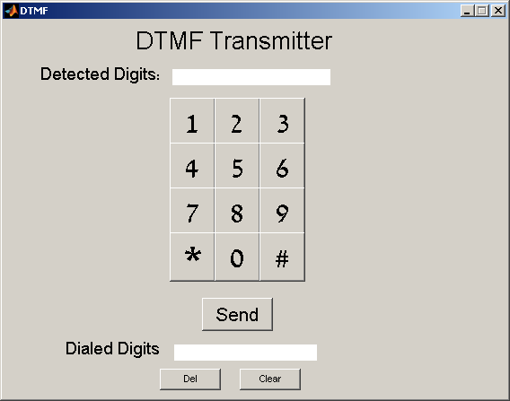
GUI Functionality
Load the DSK
Initialize RTDX
Create DTMF samples
Transmit them to PC Sound Card
Display Dialed and Dtected Digits for comparison

Slide 17
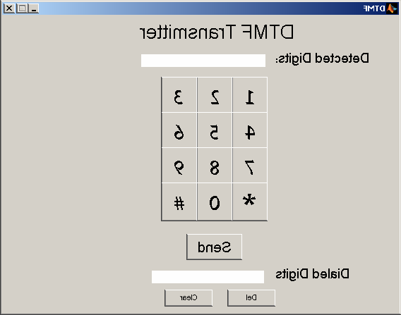
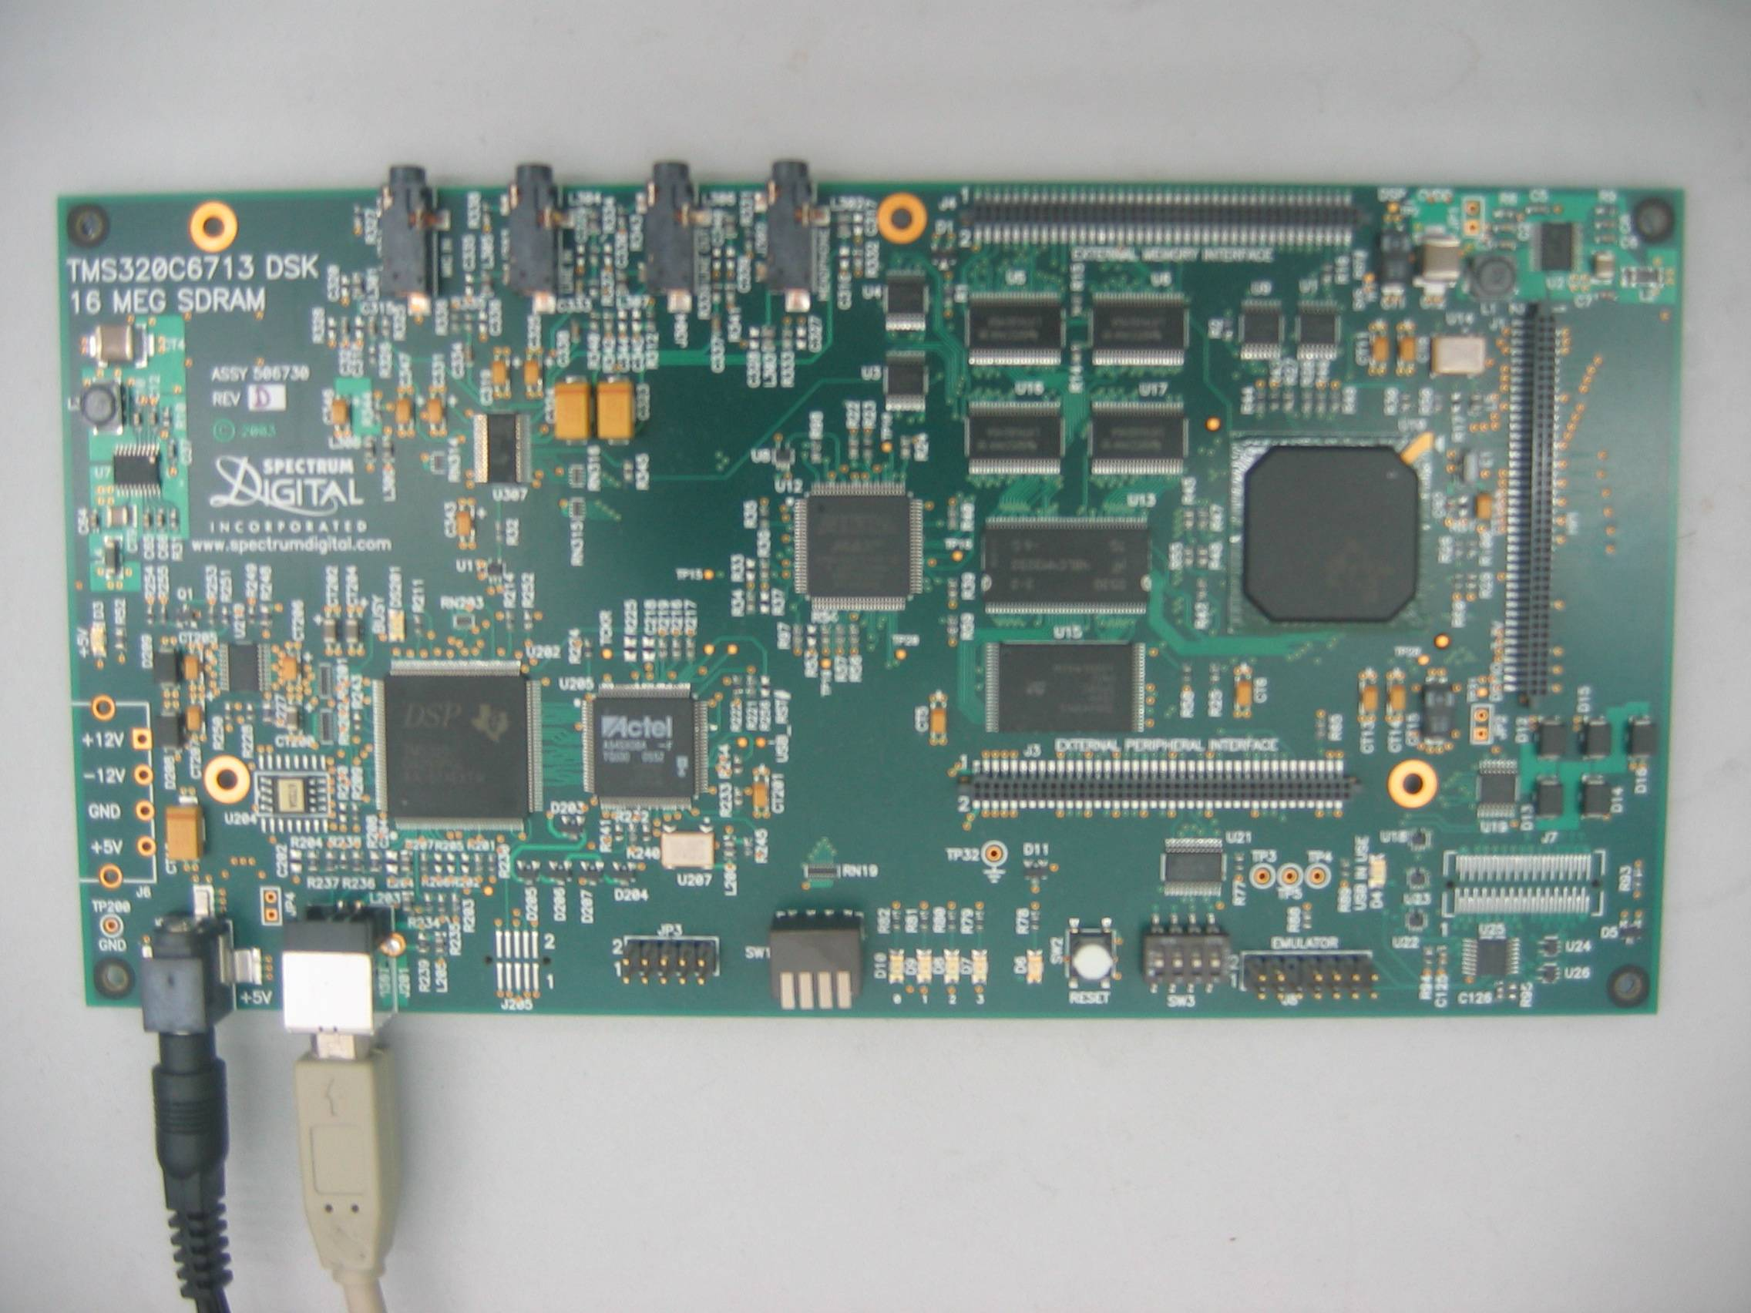
The System
Transmitted Digit
GUI
Sound Card
USB
Reported Digit
(RTDX)

