Slide 1
Echo and Reverberation

Slide 2
Objectives
To explain echo and reverberation.
To build Simulink® models.
To test the models using the Texas Instruments C6713 DSK with a microphone and headphones/computer loudspeakers.

Slide 3
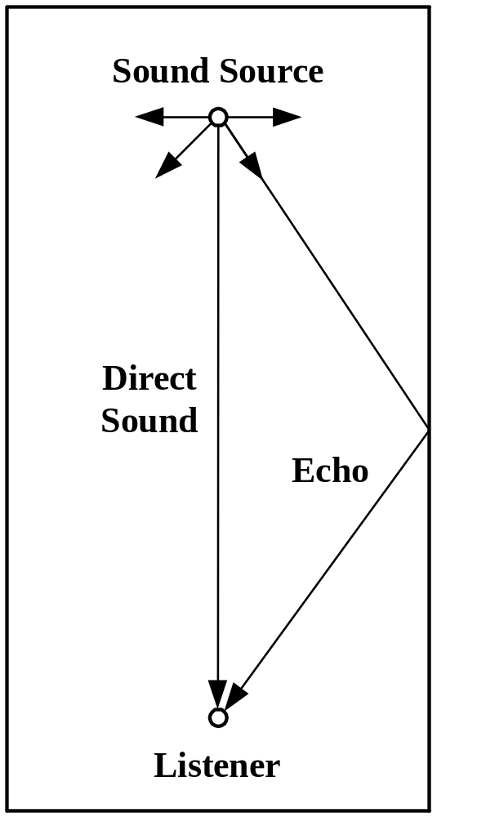

Echo
Echo is audible because the speed of sound is relatively slow, about 400 meters per second.
Click on icon to listen to echo.

Slide 4
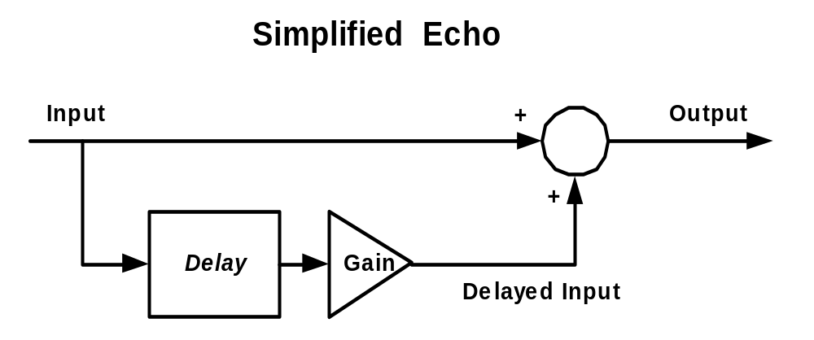
Block Diagram of Echo
For the time being, we will consider only one echo path.
Output = Input + Delayed Input.
Because of losses in the delayed path, Gain < 1.

Slide 5
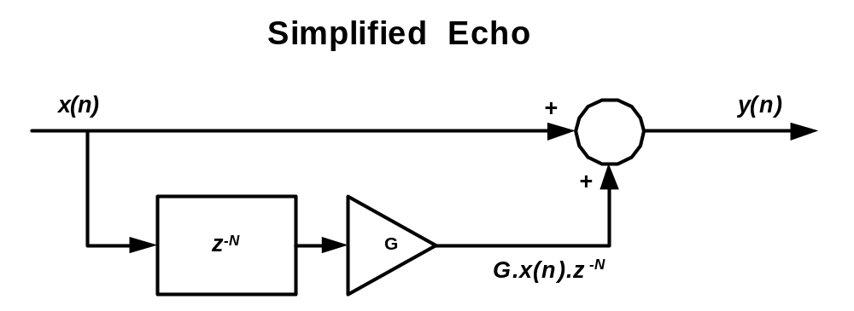
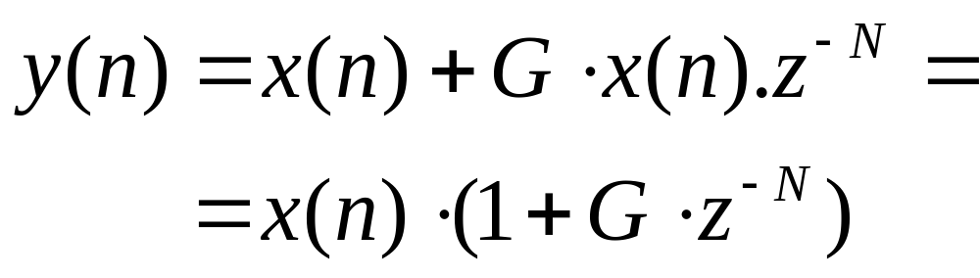
Equation for Simplified Echo

Slide 6
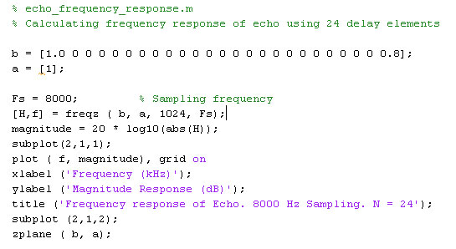
Frequency Response
The frequency response of echo can be calculated using the following .m file.

Slide 7
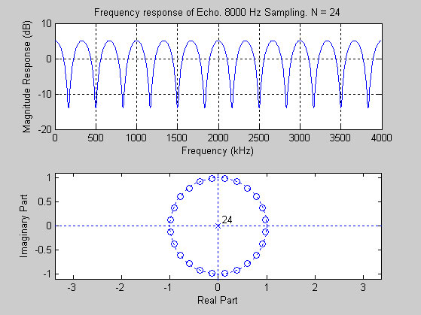
Frequency Response of Echo

Slide 8
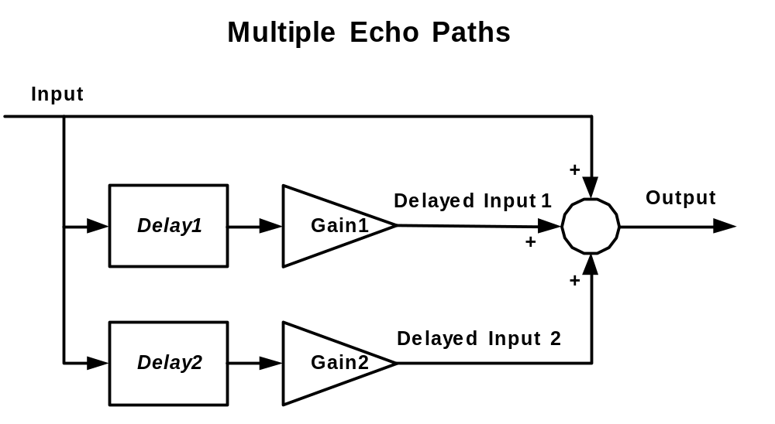
Multiple Echo Paths
A real room will have several echo paths.

Slide 9
Summary of Echo
The Echo output is derived solely from the input.
Certain frequencies are attenuated.
Because the poles lie inside the unit circle, echo is stable.

Slide 10
Reverberation
Reverberation is similar to echo, but uses a slightly different configuration.
Click on the icon to hear reverberation.

Slide 11
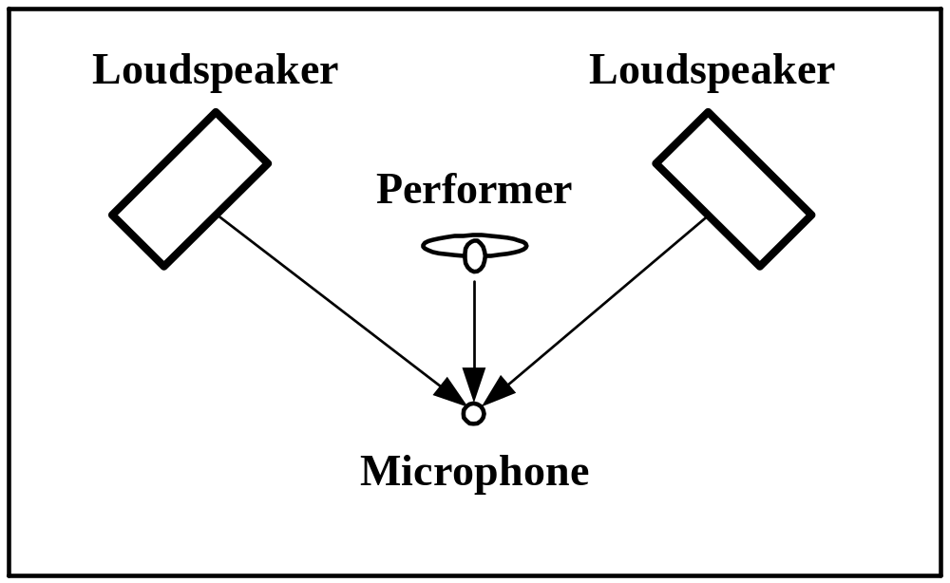
Reverberation on Stage
Sound reaches the microphone from both the performer and the the loudspeakers.

Slide 12
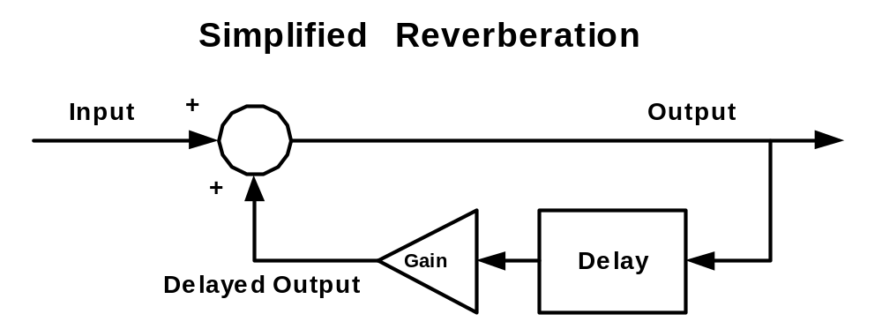
Block Diagram of Reverberation
Output = Input + Delayed Output

Slide 13
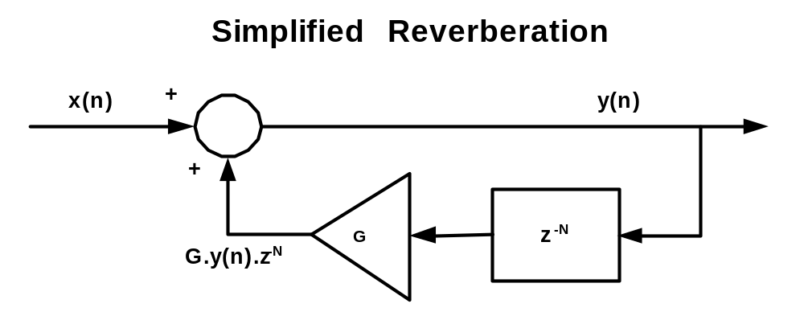
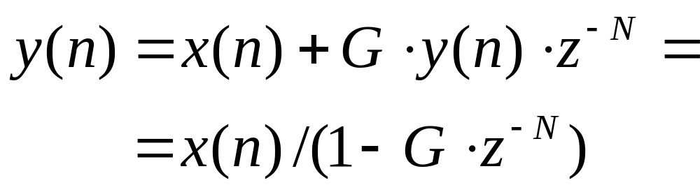
Simplified Reverberation Equation

Slide 14
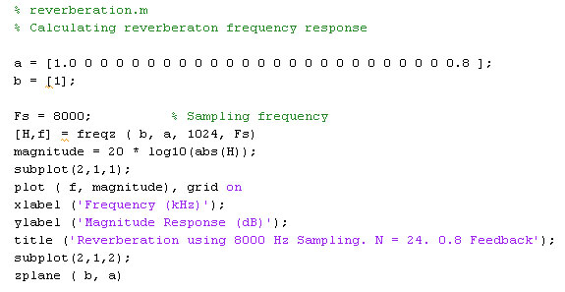
Matlab Model of Reverberation

Slide 15
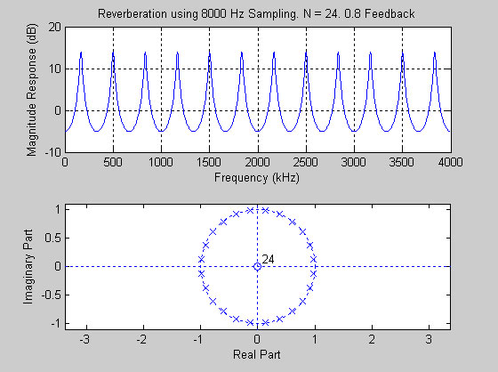
Reverberation Frequency Response

Slide 16
Summary of Reverberation
The output is derived from both the input and the previous output.
At certain frequencies, the output will be amplified.
Because the poles lie on the unit circle, reverberation can become unstable.

Slide 17
Real World Echo and Reverberation
A real room will have several echo paths.
When sound is reflected off a surface there will be “coloration”. Certain frequencies will be absorbed and there will be phase changes.
Therefore, a commercial echo / reverberation unit will contain many different delay paths.

Slide 18
Simulink Models

Slide 19
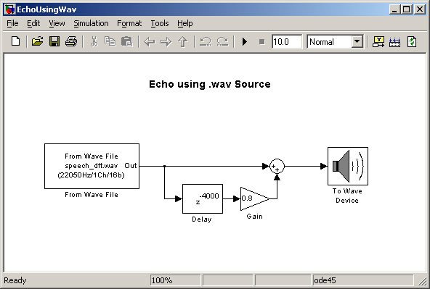
Simulink Model of Echo

Slide 20
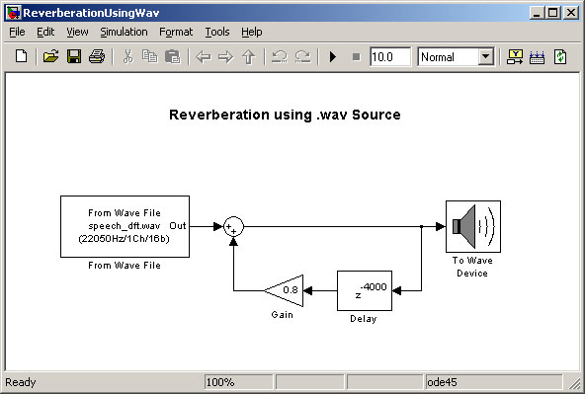
Simulink Model of Reverberation

Slide 21
Modifications for TI C6713

Slide 22
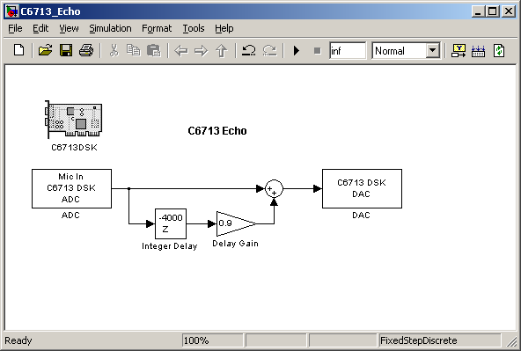
C6713 DSK Model of Echo

Slide 23
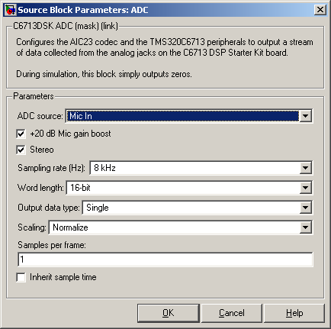
Sampling and Integer Delay
The sampling rate is 8000 Hz.
An Integer Delay of 4000 produces a delay time of 4000/8000 = 0.5 seconds.

Slide 24
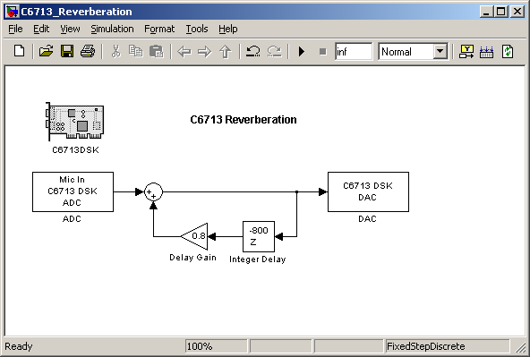
C6713 DSK Model of Reverberation

Slide 25
Simulink Model of Reverberation
Using 8000 samples per second, a delay of 800 samples will take 800/8000 = 0.1 seconds (100 ms).
A Delay Gain of 0.8 has been used. This means 80% of the output is fed back into the input.
  Increase this value for more reverberation, but less stability.
  Decrease this value for less reverberation, but more stability.

Slide 26
Introduction to Laboratory

Slide 27
The Complete Simulink Model
In the Laboratory you will build a Simulink Model for echo and reverberation.
You will be able to run different echo and reverberation effects on the C6713 DSK.

Slide 28
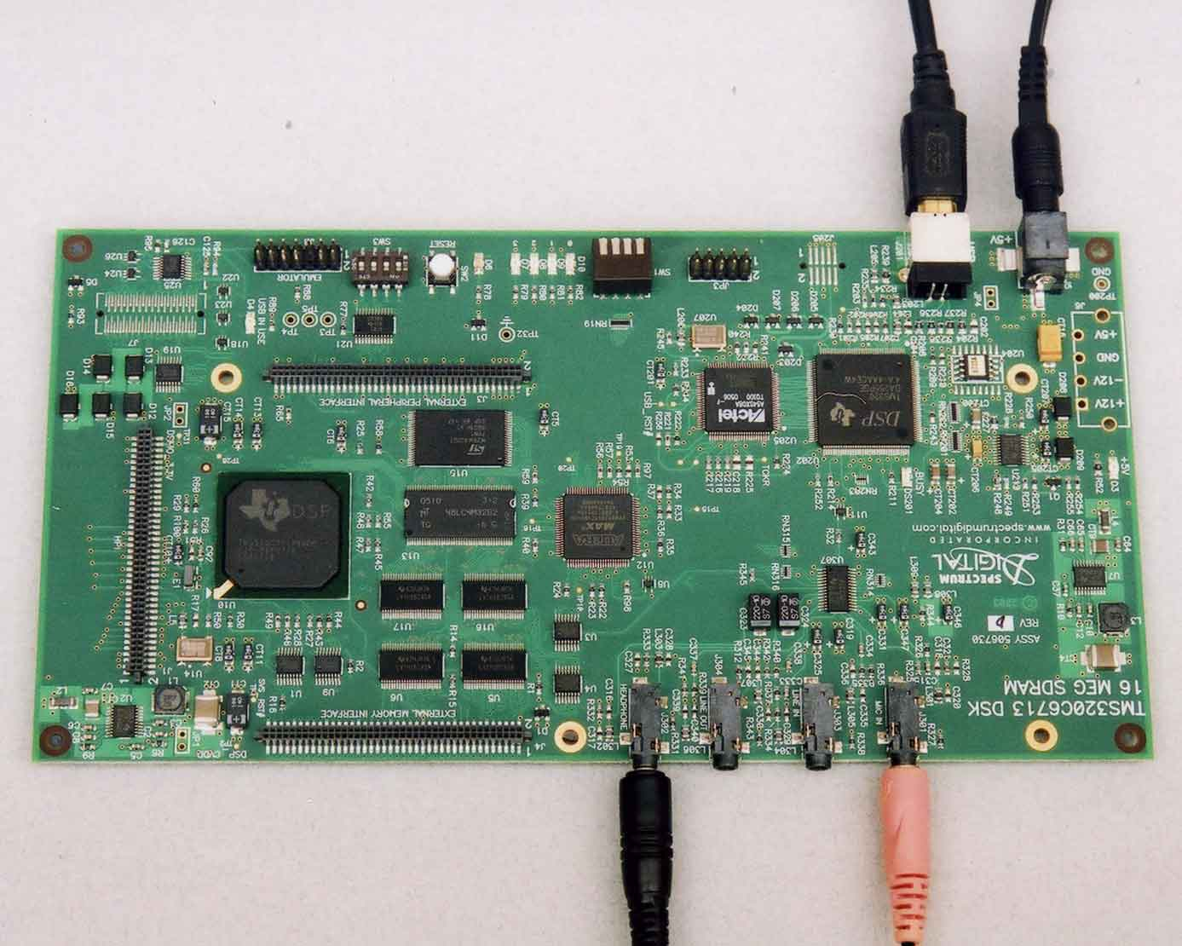
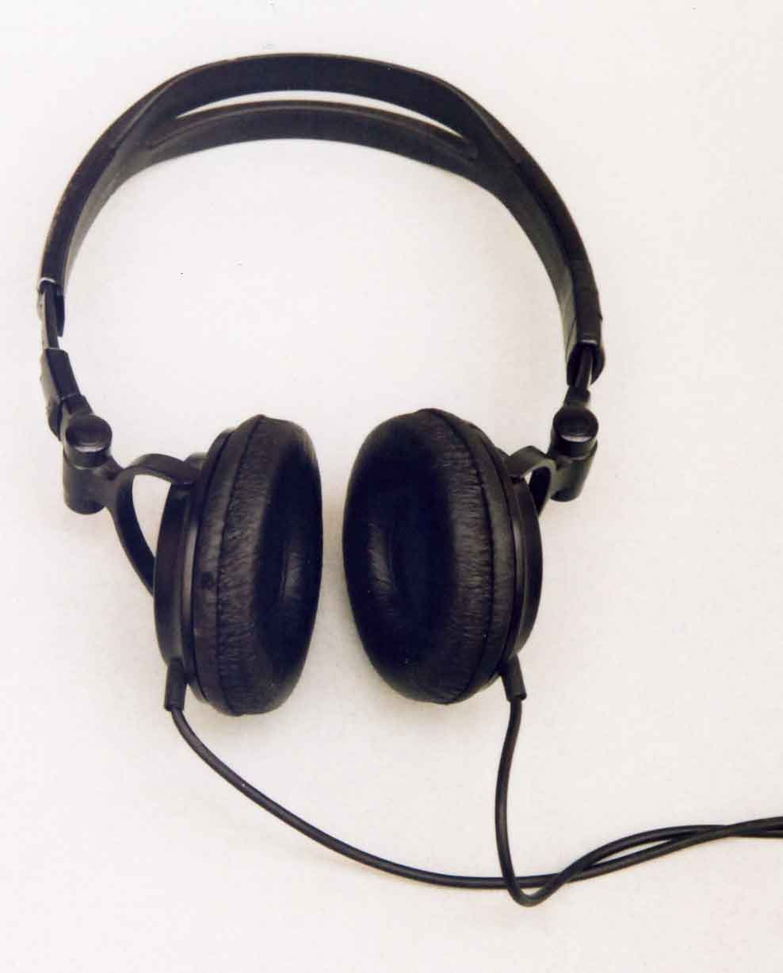
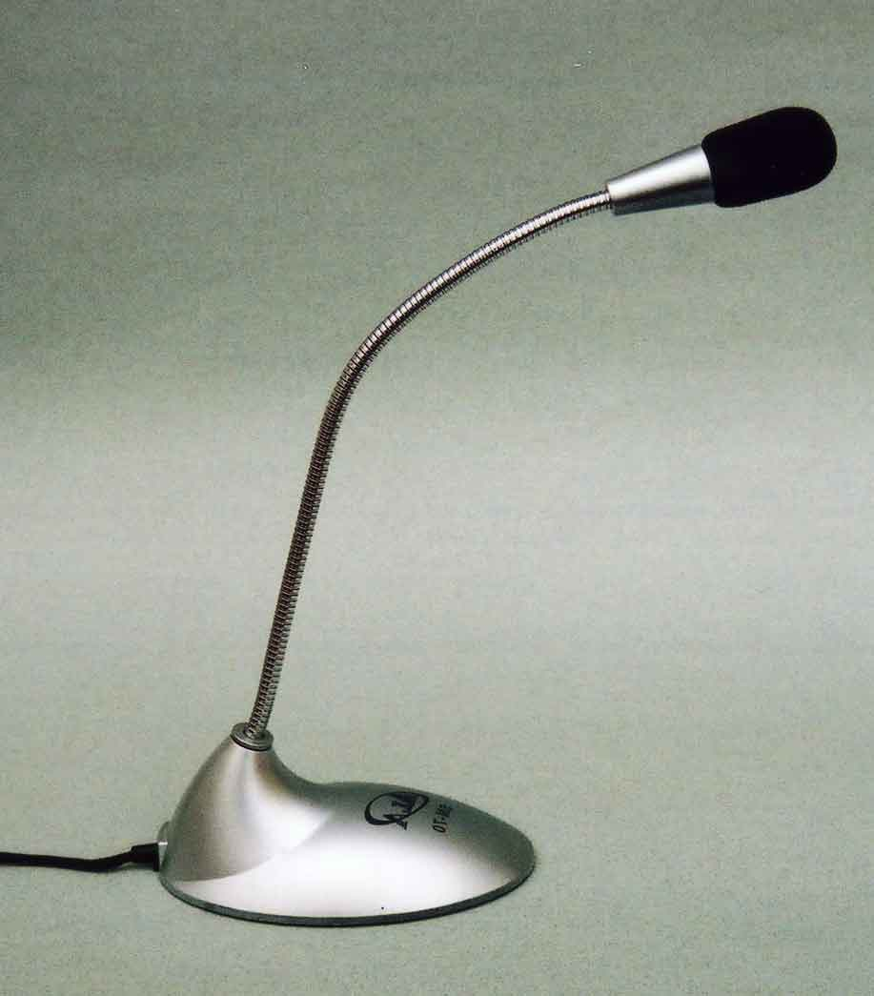
C6713 DSK Setup
USB to PC
to +5V
Headphones
Microphone

Slide 29
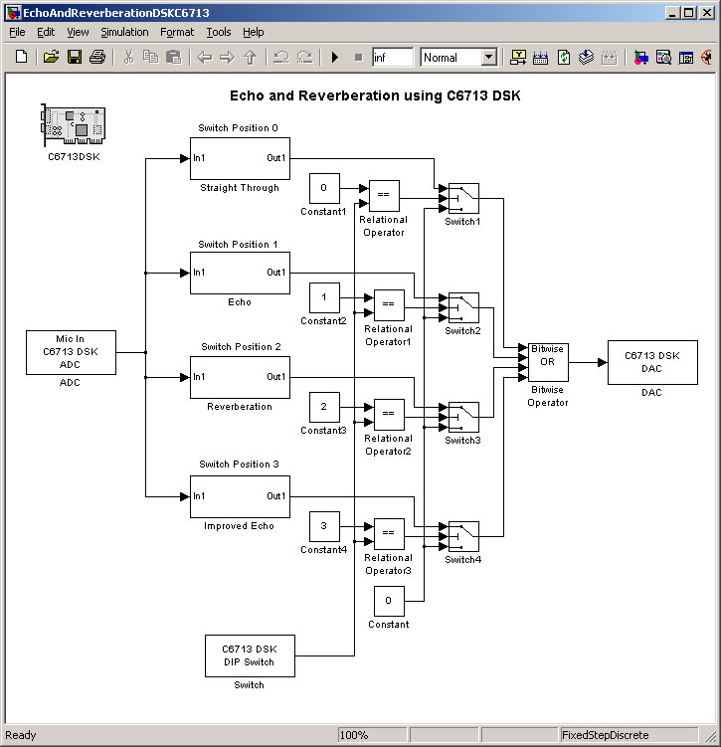
The Complete C6713 Model

Slide 30
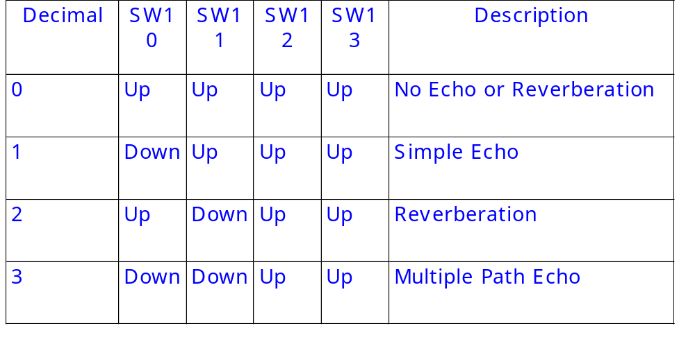
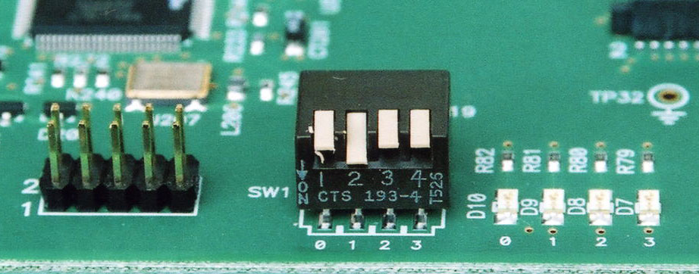
DSK Switch Settings

Slide 31
References
A Digital Signal Processing Primer by Ken Steiglitz. ISBN 0-8053-1684-1.

