Slide 1
Audio Conference Bridge

Slide 2
Outline
Introduction
The Hardware Platform
The AIC24 Driver
Creating a Simulink® block for the AIC24
The Audio Conference Application

Slide 3



The Audio Conference Bridge
Phone call with n participants (n > 2)

Slide 4
Limitations of the DSK6713 Hardware
The DSK6713 supports 2 analog audio interfaces
Only audio 2 I/O

Slide 5
The Hardware Platform
TLV320AIC24EVM
DSK6713
Headsets
TLV320AIC24
CODEC #0
TMS320C6713
CODEC #1
McBSP1
TLV320AIC24
CODEC #2
CODEC #3

Slide 6
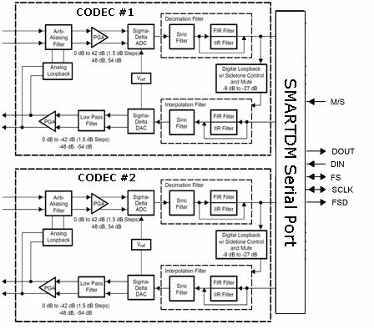
The TLV320AIC24

Slide 7
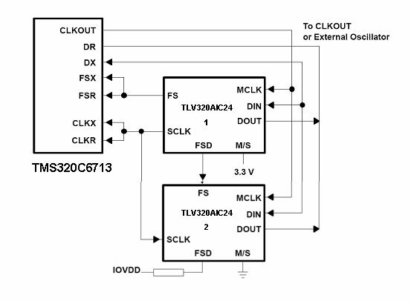
The DSP Interface to the CODEC
DSK6713
TLV320AIC24KEVM

Slide 8
The AIC24 Driver Layer
Interface is based on a user supplied callback function
Double-Buffering
  EDMA based
  Configurable buffer sizes
  Channel Sorting

Slide 9
Receiving Samples
Audio Ch. 0
Audio Ch. 1
Audio Ch. 2
Audio Ch. 3
TLV320AIC24
TLV320AIC24
CODEC 0
CODEC 1
CODEC 2
CODEC 3
TMS320C6713
McBSP1
Ch. 0
Ch. 1
Ch. 2
Ch. 3
Ch. 0
Ch. 1
Ch. 2
Ch. 3
Ch. 0
Ch. 1
Ch. 2
Ch. 3
DSP Memory
{
EDMA
{
N samples
from each channel
{
{

Slide 10
Transmitting Samples
TMS320C6713
DSP Memory
{
EDMA
{
N samples
from each channel
{
{
McBSP1
Ch. 0
Ch. 1
Ch. 2
Ch. 3
Ch. 0
Ch. 1
Ch. 2
Ch. 3
Ch. 0
Ch. 1
Ch. 2
Ch. 3
TLV320AIC24
TLV320AIC24
CODEC 0
CODEC 1
CODEC 2
CODEC 3
Audio Ch. 0
Audio Ch. 1
Audio Ch. 2
Audio Ch. 3

Slide 11
Double Buffering (frame #n+1)
Processing Samples
CPU
RcvBuf1
SndBuf1
RcvBuf2
Reading & Writing
Samples
SndBuf2
EDMA
EDMA
DRR1
DXR1

Slide 12
Double Buffering (frame #n)
Reading & Writing
Samples
RcvBuf1
SndBuf1
EDMA
EDMA
DRR1
DXR1
Processing Samples
CPU
RcvBuf2
SndBuf2

Slide 13
The Driver Structure
CPU
Processing
DSP
Memory
RcvBuf1
RcvBuf2
SndBuf1
SndBuf2
RcvDMA
EDMA
McBSP1RcvEvent
SndDMA
McBSP1XmtEvent
McBSP1
DRR1
DXR1
Interrupt upon receiving/transmitting a frame
AIC24

Slide 14
The Driver Structure
CPU
Processing
DSP
Memory
RcvBuf1
RcvBuf2
SndBuf1
SndBuf2
RcvDMA
SndDMA
EDMA
McBSP1RcvEvent
McBSP1XmtEvent
McBSP1
DRR1
DXR1
Interrupt upon receiving/transmitting a frame
AIC24

Slide 15
The Driver Interface
The user callback function header:
Process(Int16 *InBuf, Int16 *OutBuf)
InBuf a buffer containing the last buffer of samples read from the CODECs
OutBuf a buffer containing the samples that will be written to CODECs
For example: copy channel0 to channel2
  memcpy(InBuf, OutBuf+2*BufSize, BufSize)

Slide 16
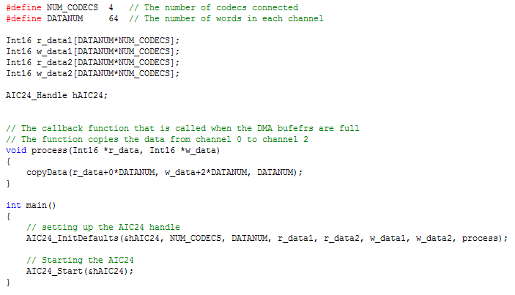
Sample Code

Slide 17
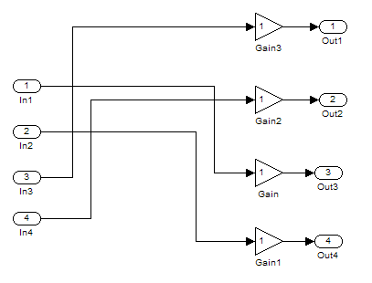
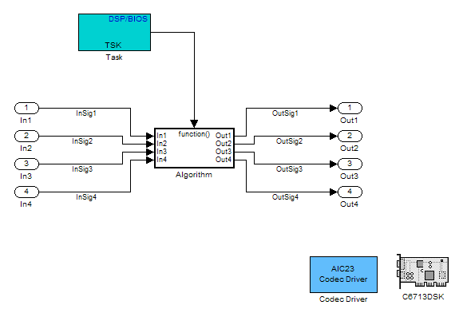
Migration to Simulink
A new Simulink model, containing the driver is created
This block can be integrated with an “Algorithm” block. For example: Switching channels

Slide 18
The Simulink Interface
Simulink creates a task for the processing
The task waits for a signal when the new buffer of the data is ready
The callback processing function signals (using a semaphore) to the Simulink task when the data is ready

Slide 19
Running the Application
Headsets
TLV320AIC24EVM
#1
#2
#3
Mic
J16
Phone
J1
Mic
J20
Phone
J4
Mic
J5
Phone
J10

Slide 20
The Algorithm
Power
Level₀
Selection Block
Power
Level₁
Power
Level₂
Inputs
(from CODECs)
Outputs
(to CODECs)
Conference
INP0
OUT0
INP1
OUT1
INP2
OUT2
Notes:
An Energy based selection
Calculate each input absolute power
Find the input with the maximum power value
Increment the number of times this input had the maximum power
In case one input has reached a certain threshold of “wining” rounds broadcast it to all the outputs and reset the count
We require a threshold number of winning rounds in order to avoid abrupt signals at the output

Slide 21
Output Signal Selection
For Each 64 samples frame the following algorithm is implemented:
Find Maximum Input Level
Increment Counter correspondent to the “loudest” channel
If the Counter value =10 THEN:
  Broadcast correspondent input channel to all outputs
  Reset Counter

Slide 22
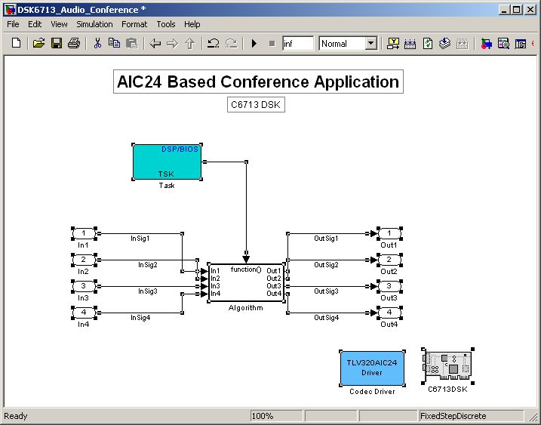
Simulink Model

Slide 23
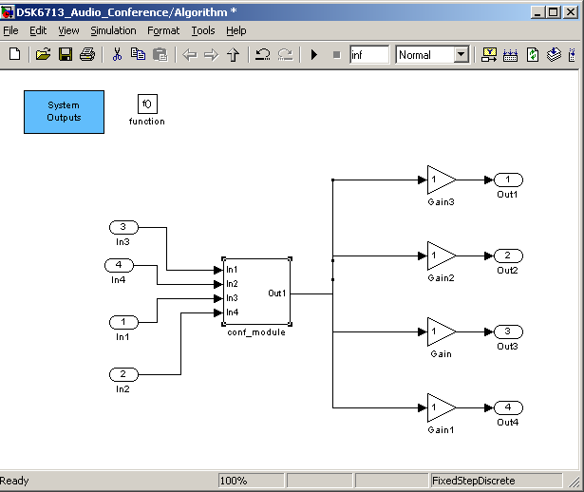
Signal Routing

Slide 24
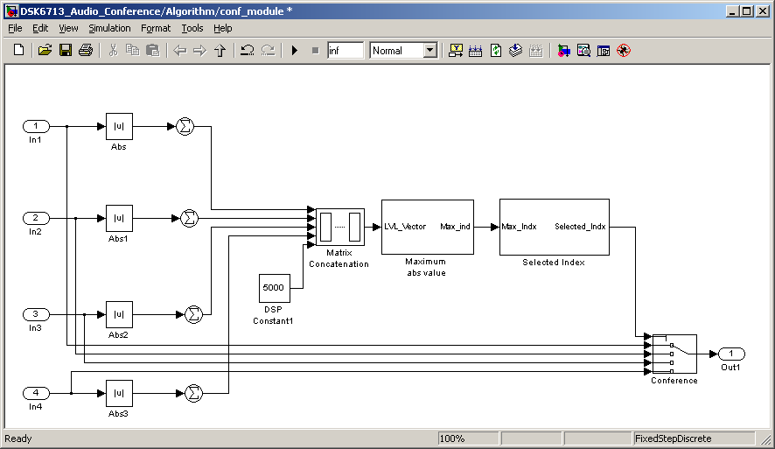
Algorithm Model
Level Meas.
Level Meas.
Channel Selection
Level Meas.
Conference
Level Meas.

Slide 25
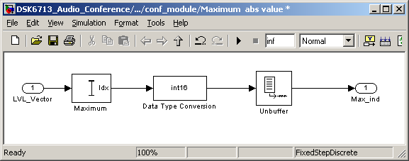
Finding Maximum Input Level

Slide 26
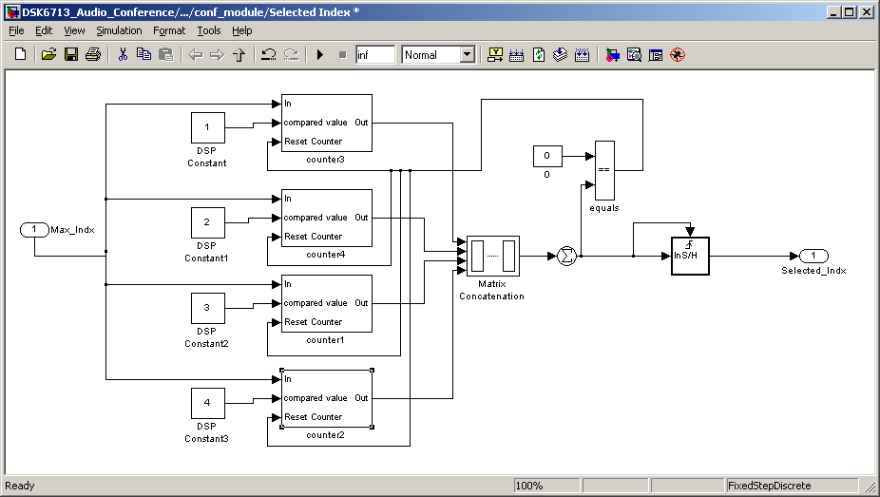
Index Selection

