Slide 1
Sensored Field Oriented Control of a Permanent Magnet Synchronous Motor
(PMSM)

Slide 2
Learning objectives
Review of Electromagnetic laws
Rotating magnetic fields
Structure of synchronous motors
Features of synchronous motors
BLDC and PMSM synchronous motor types
BLDC and PMSM control overview
Electro-mechanical parameters for a synchronous motor

Slide 3
Field generated by a current
I
Field
I
B = k*n*I
A conductor carrying a current produces a magnetic field around it.
A conductor that is wound into a coil produces a magnetic field along the axis of the coil.
The flux produced is proportional to the current through the coil and the number of turns in the coil.
I

Slide 4
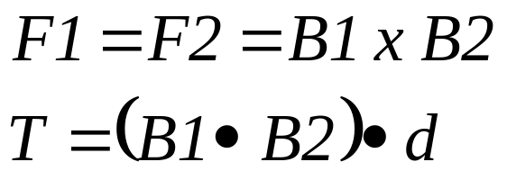
The Current in a Coil
F1
A coil carrying a current, placed in a magnetic field experiences a force that will cause it to rotate.
This force is given as the vector cross product of the flux produced by the coil and the flux that is impressed by the external magnetic field.
d
B1
I
F2
B2

Slide 5




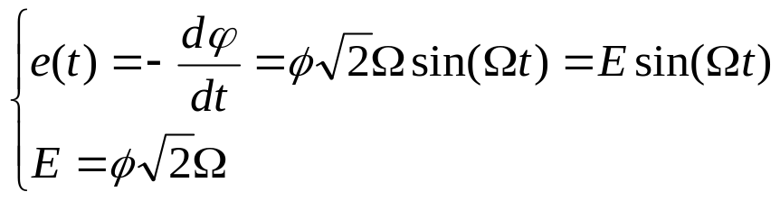
Back EMF generation
Magnet flux
N
a
S
B
e
A
Magnet rotating in front of winding “a” create an inductive voltage between A and B, e = V_{A}-V_{B} called Bemf (Back electromotive force)
Magnetic flux seen by the winding is given by:
Bemf is then equal to:
Notes:
Test d’insertion de commentaire

Slide 6
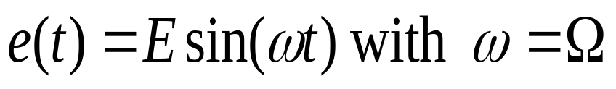
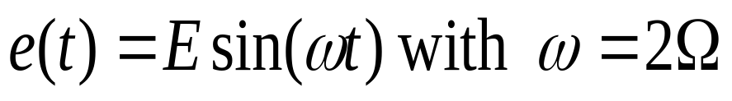
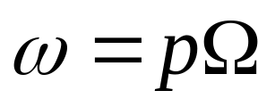


Pole pairs
1 pole pair
2 pole pairs
N
S
N
N
S
e
S
e
N
N
For a motor with p poles pairs we have
is the electrical frequency (rad/s)
is the mechanical frequency (rad/s) or simply the speed of the machine.

Slide 7
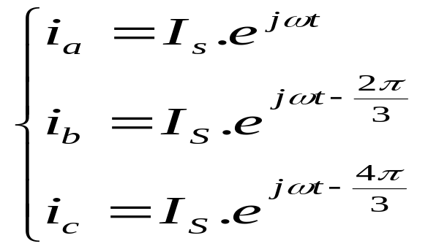
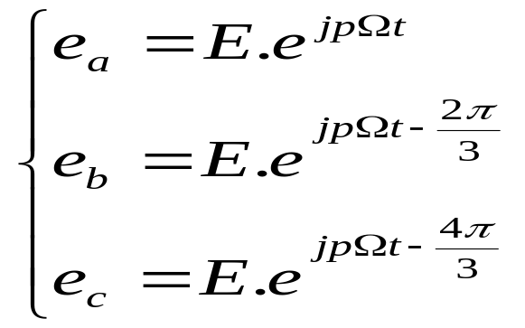
Three phases winding
c
i_{c}
N
S
a
i_{b}
i_{a}
b
For most three phase machines, the winding is stationery, and magnetic field is rotating
Three phase machines have three stator windings, separated 120° apart physically
Three phase stator windings produce three magnetic fields, which are spaced 120°in time

Slide 8
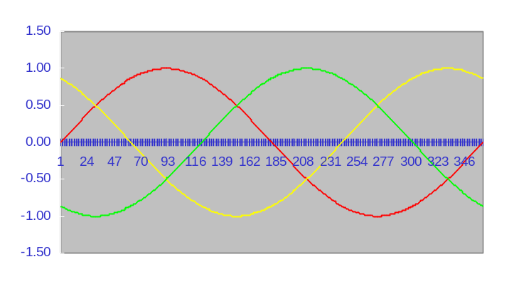

Application to Three Phases Machine
Operation Fundamentals
Three stationary pulsating magnetic fields
ia
A`
The three phase winding produces three magnetic fields, which are spaced 120° apart physically.
When excited with three sine waves that are a 120° apart in phase, there are three pulsating magnetic fields.
Fc
C
B
Fa
C`
Fb
B`
A
Phase currents
The resultant of the three magnetic fields is a rotating magnetic field.
ia
ib
ic

Slide 9
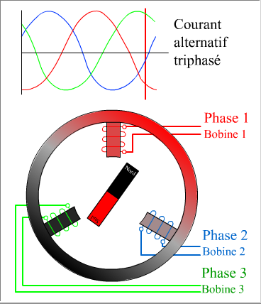
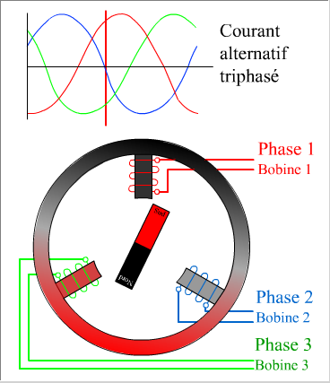
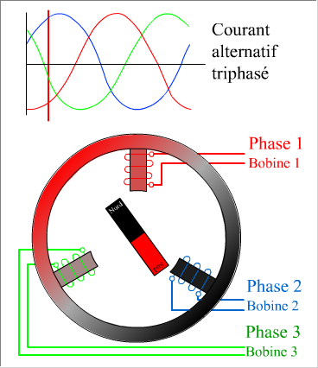
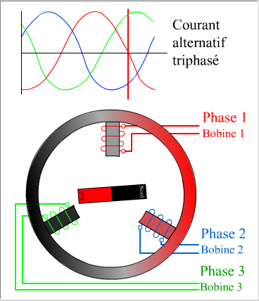
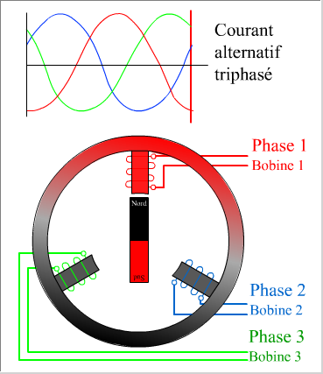
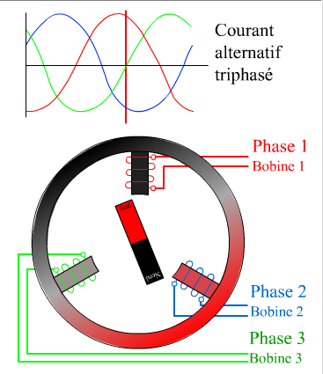
Synchronous operation
Three phase AC current
Three phase AC current
Three phase AC current
Three phase AC current
Three phase AC current
Three phase AC current
Phase 1
Coil 1
Phase 1
Coil 1
Phase 1
Coil 1
Phase 1
Coil 1
Phase 1
Coil 1
Phase 1
Coil 1
Phase 2
Coil 2
Phase 2
Coil 2
Phase 2
Coil 2
Phase 2
Coil 2
Phase 2
Coil 2
Phase 2
Coil 2
Phase3
Coil 3
Phase3
Coil 3
Phase3
Coil 3
Phase3
Coil 3
Phase3
Coil 3
Phase3
Coil 3

Slide 10
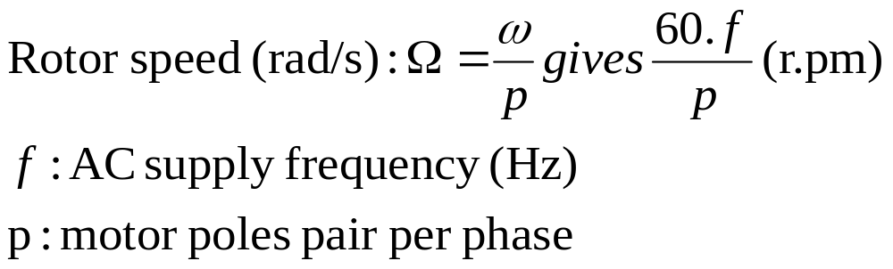
Theory of operation:
A`
Rotor field
C
F
φ
Rotor is carrying a constant magnetic field created either by permanent magnets or current fed coils
The interaction between the rotating stator flux, and the rotor flux produces a torque which will cause the motor to rotate.
N
B
N
S
C`
F
S
Stator field
B`
A
The rotation of the rotor in this case will be at the same exact frequency as the applied excitation to the rotor.
This is synchronous operation.
Example: a 2 poles pair synchronous motor will run at 1500 r.pm for a 50Hz AC supply frequency
Notes:
In its simplest form, a synchronous machine can be considered as constant magnetic field (rotor) placed inside a rotating magnetic excitation (stator). The rotor will constantly align itself with the stator flux.

Slide 11
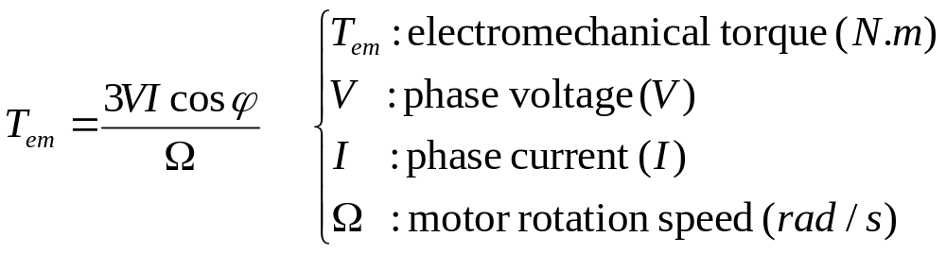
Electromechanical Parameters
i
V
e_{stator}
u_{L}
E_{s}
v
I
u_{L}
Simplified equivalent electrical scheme of a winding of a three phases synchronous motor
Note: stator resistance neglected

Slide 12
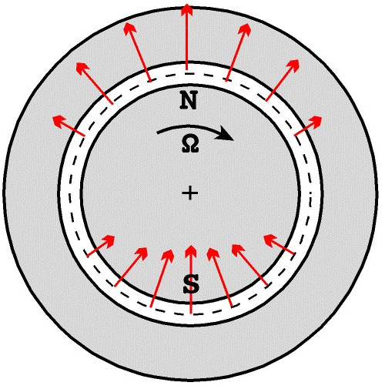
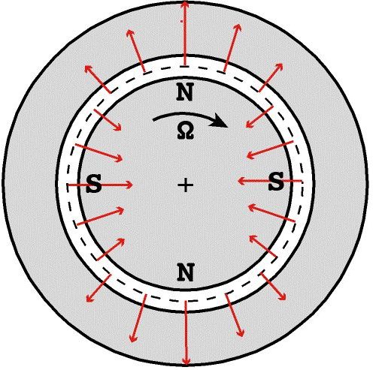
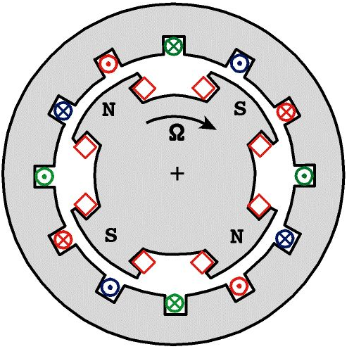
Synchronous Motor Rotor Construction
non-salient rotor pole (p=1)
non-salient rotor pole (p=2)
salient rotor pole (p=2)

Slide 13
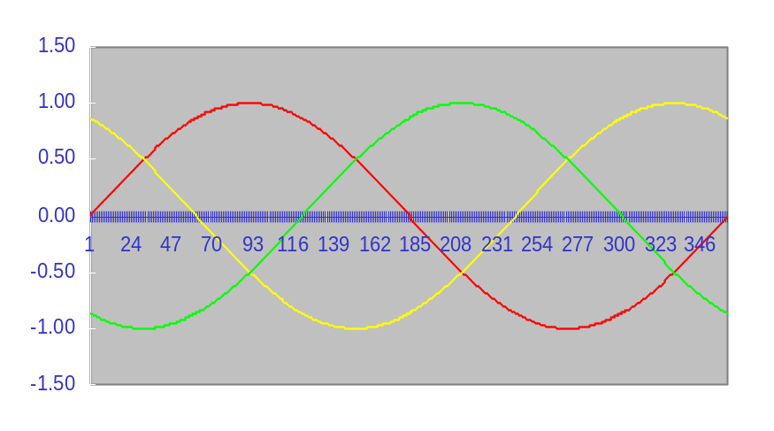
Synchronous machine classification: BLDC and PMSM
C
A`
Both (typically) have permanent-magnet rotor and a wound stator
BLDC (Brushless DC) motor is a permanent-magnet brushless motor with trapezoidal back EMF
PMSM (Permanent-magnet synchronous motor) is a permanent-magnet brushless motor with sinusoidal back EMF
F
N
B
C`
S
F
B`
A
Back EMF of BLDC Motor
Back EMF of PMSM
0⁰
30⁰
60⁰
90⁰
150⁰
210⁰
270⁰
330⁰
30⁰
90⁰
120⁰
180⁰
240⁰
300⁰
360⁰
60⁰
E_{a}
ea
eb
ec
Phase A
i_{a}
θ_{e}
Hall A
Phase B
i_{b}
θ_{e}
Hall B
Phase C
i_{c}
θ_{e}
Hall C
Notes:
Depending on the natural shape of the Bemf (motor structure and way of building it dependent) a BLDC or a PMSM control will be more appropriate I.e efficient. In lot of cases as it is quite hard to build a motor with a good trapezoidal Bemf shape, PMSM control will be prefered.

Slide 14
BLDC vs. PMSM
BLDC
Synchronous machine
Fed with direct currents
Trapezoidal BEMF
Stator Flux position commutation each 60 degrees
Only two phases ON at the same time
Torque ripple at commutations
PMSM
Synchronous machine
Fed with sinusoidal currents
Sinusoidal BEMF
Continuous stator flux position variation
Possible to have three phases ON at the same time
No torque ripple at commutations

Slide 15
Conclusion
Synchronous motors use magnetic interaction to convert electrical energy to mechanical.
Rotor must be synchronized with the rotating stator magnetic field in order to produce torque
Pole pair numbers and excitation frequency determine the mechanical rotation speed
Synchronous motors are classified in two categories: BLDC and PMSM
Each type require an appropriate control

Slide 16
PMSM Control
Synchronous Motors such as PM motors and SynRMs are getting more popular because of their high power density and high efficiency
PM Assisted SynRM uses advantages of both PM and Reluctance motor
The vector control strategy is far more complicated than control of a DC motor requiring use of multiple control loops

Slide 17
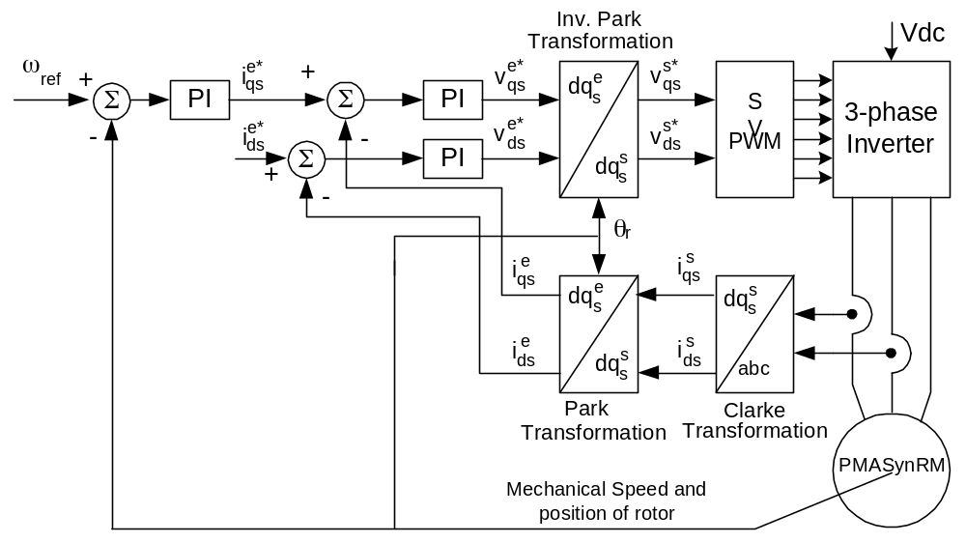
Control System Block-Diagram

Slide 18
Using the DMC Library
Speed
setpoint
ref
FC_PWM
DRV
Q0 / HW
PWM1A
PID
_IQ
Uout
ref
PID
_IQ
Uout
Ipark_D
Ipark_d
Vq
Ta
mfunc_c1
PWM1B
3-Phase
Inverter
fb
fb
PARKI
_IQ
SV_GEN
DQ
_IQ
theta
Tb
mfunc_c2
PWM2A
id_ref =0
ref
PID
_IQ
Uout
Ipark_Q
Ipark_q
Vd
Tc
mfunc_c3
PWM2B
fb
mfunc_p
PWM3A
PWM3B
park_D
PARK
_IQ
park_d
clark_d
CLARK
_IQ
clark_a
Ia_out
ILEG2
DRV
_IQ
LEG_A
theta
clark_b
Ib_out
LEG_B
park_Q
park_q
clark_q
clark_c
Q15
Q15
Ia_gain
Ib_gain
Q13
Q13
Ia_offset
Ib_offset
QEP
speed_frq
SPEED
FRQ
_IQ
shft_angle
theta_elec
QEP
THETA
DRV
_IQ
QEP_A
PMSM
theta_mech
QEP_A
Motor
speed_rpm
direction
dir_QEP
QEP_index
index_sync_flg

Slide 19
The Equivalent Simulink® Model
v_{qs}*
T_{a}
PWM
Driver
PWM1
i_{qs}*
v_{as}*
PWM2
PI
PI
T_{b}
PWM3
Inv.
Park
Space
Vector
Gen.
v_{ds}*
PWM4
i_{ds}*
v_{ds}*
v_{bs}*
PWM5
T_{c}
PI
PWM6
Voltage
Source
Inverter
q_{lr}
i_{ds}
i_{as}
i_{as}
Ileg2_
Bus
Driver
ADCIN1
Park
i_{bs}
ADCIN2
i_{qs}
Clarke
i_{bs}
ADCIN3
q_{lr}
Encoder
PMSM
w_{r}
SMOSPD
speed
estimation
QEP_A
q_{m}
Ramp
Gen.
QEP
driver
QEP_B
dir
QEP_inc
TMS320F28x controller
Notes:
the variables with superscript * are the reference values.
I believe that this is easier to read with the variable description which is given in the following slide (the students can see both, the schematic and the description on the student’s guide)

Slide 20
Variable Descriptions
i_{as} = Phase-a stator current
i_{bs} = Phase-b stator current
i_{αs} = Stationary α-axis stator current
i_{βs} = Stationary β-axis stator current
i_{ds} = Synchronously rotating d-axis stator current
i_{qs} = Synchronously rotating q-axis stator current
v_{αs} = Stationary α-axis stator voltage
v_{βs} = Stationary β-axis stator voltage
v_{ds} = Synchronously rotating d-axis stator voltage
v_{qs} = Synchronously rotating q-axis stator voltage
v_{dc} = DC-bus voltage
θ_{λr} = Rotor flux angle
θ_{m} = Mechanical angle
dir = Rotor direction
ω_{r} = Rotor speed
T_{a} = Phase-a duty cycle ratio of PWM signal
T_{b} = Phase-b duty cycle ratio of PWM signal
T_{c} = Phase-c duty cycle ratio of PWM signal
Notes:
This slide and the two following are for the student’s guide only. You should include use them while presenting the global schematic of PMSM3-1

Slide 21








Building Blocks
i_{as}
i_{as}
v_{αs}
v_{qs}
v_{qs}
v_{αs}
Clarke
Park
Inv.
Park
i_{bs}
i_{bs}
v_{βs}
v_{ds}
v_{ds}
v_{βs}
θ_{λr}
θ_{λr}
Variable transformation from
phase ab-axis to
stationary ab-axis
Variable transformation from
stationary ab-axis to
synchronously rotating dq-axis
Variable transformation from
synchronously rotating dq-axis to
stationary ab-axis
v_{as}
T_{a}
Space
Vector
Gen.
T_{b}
v_{bs}
T_{c}
Space-vector generator producing
the duty cycle ratio of PWM signals

Slide 22
Building Blocks (cont.)
i_{qs}*
q_{lr}
q_{m}
v_{qs}*
QEP_A
SMOSPD
speed
estimation
w_{r}
PI
QEP_B
QEP
driver
Ramp
Gen.
q_{m}
i_{qs}
dir
QEP_inc
dir
Proportional-Integral
controller
QEP driver and
shaft position and rotor direction
Speed estimation from
rotor position and rotor direction
T_{a}
PWM1
i_{as}
PWM Driver
PWM2
ADCIN1
Ileg2_
Bus
Driver
T_{b}
i_{bs}
PWM3
ADCIN2
PWM4
V_{dc}
T_{c}
PWM5
ADCIN3
PWM6
PWM generation
ADC driver for two line currents
and DC-bus voltage measurement

Slide 23
Hardware Setup
analog
I/O
P6
Power Supply
5V
Encoder
Permanent Magnet Synchronous Motor
Parallel Port
eZdsp 2812
DMC 550
P7
P3
P4
P5
Motor phases
Power Supply
24 Volts 4 Amps
+
220V
-
Encoder signal
2 Power inputs:
5V PSU for the DSP board only (software debug)
0 - 24V PSU for the power stage
Notes:
Check that the system is correctly connected
There is 2 power sources. The first one (5 Volts) is only powering the eZdsp, this solution will be used only during the first build level. The other one will apply 24 Volts to the power stage and will be used to run effectively the motor.
Ask the students to read the student’s guide which contains a step by step system check-up.
Check with each group of students that the board is correctly connected

Slide 24
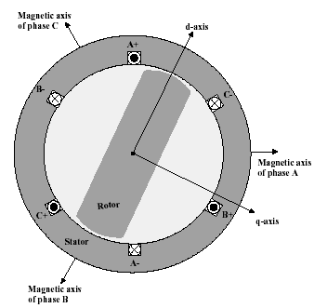
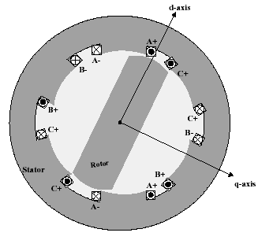
Synchronous Reluctance Motor
Two pole singly salient SynRM
Two pole doubly salient Switched RM

Slide 25
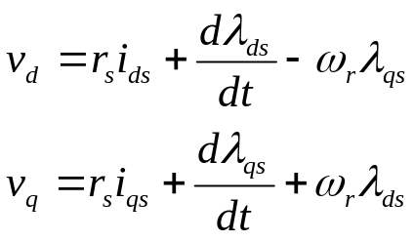
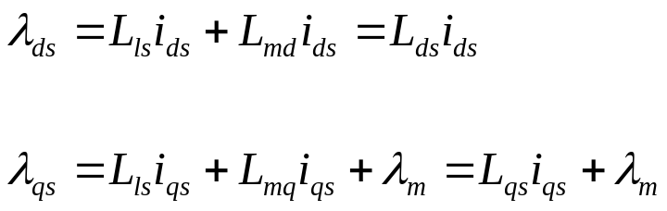
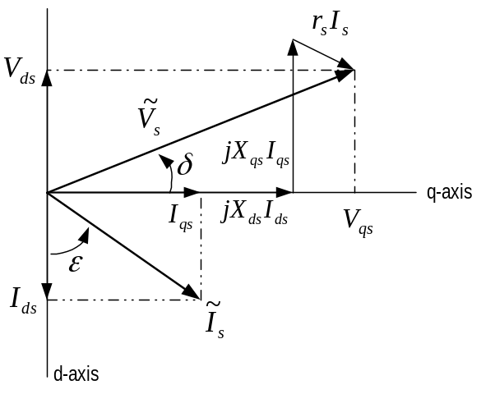
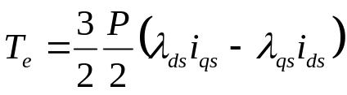
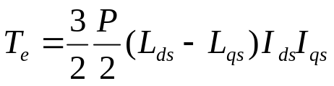
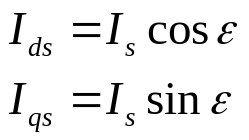
Background
d-q axes voltage and flux equations:
Torque equation:

Slide 26
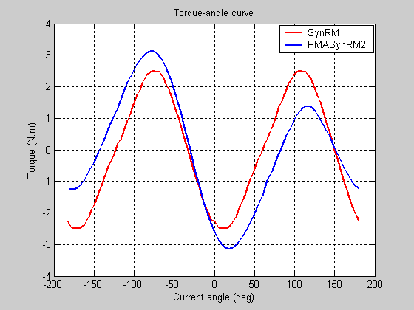
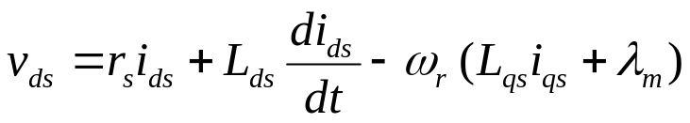
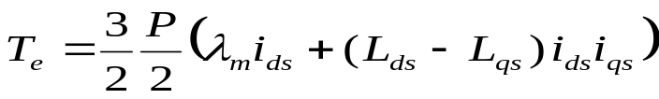
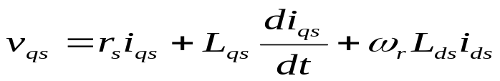
Output Torque in MASynRM

Slide 27
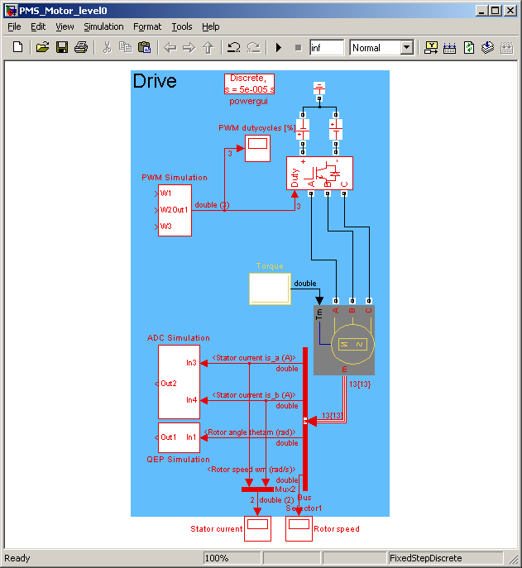
The PMS Motor Model

Slide 28
Model-Based Design of a PMSM
Build Level 1 – Space vector generation
Build Level 2 - Currents/DC-bus voltage measurement verification
Build Level 3 - Tuning of dq-axis current closed loops
Build Level 4 – Encoder verification
Build Level 5 – Speed closed loop

Slide 29
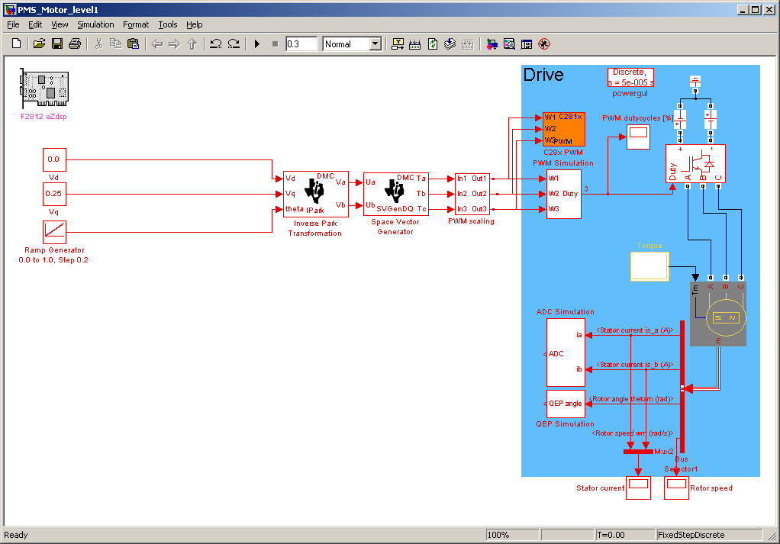
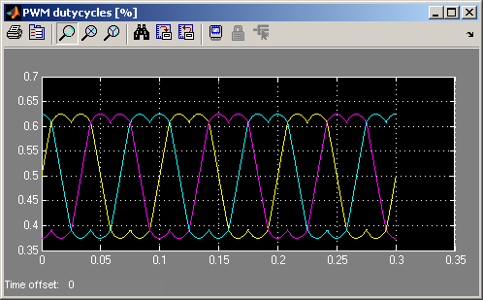
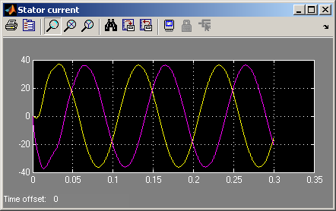
Space vector generation - Simulation

Slide 30
Space vector generation – Real Time
key modules under test
T_{a}
PWM1
Vq_testing
v_{αs}*
PWM2
Space
Vector
Gen.
T_{b}
PWM3
Inv.
Park
PWM
Driver
PWM4
Vd_testing
v_{ds}*
v_{βs}*
PWM5
T_{c}
PWM6
Voltage
Source
Inverter
rmp_out
speed_ref
Ramp
control
Ramp
Gen.
PMSM
TMS320F28x controller
Notes:
Vqs and Vds are fixed and we stimulate the Inverse Park block with a ramp generator which is simulating the electric (flux) angle. The output frequency of the PWMs waveform (not the carrier frequency) can be modified via Speed_ref.

Slide 31
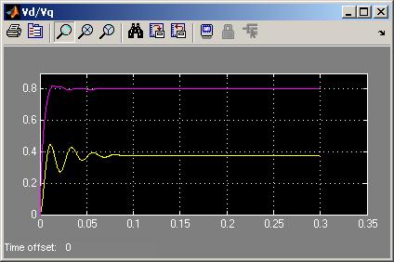
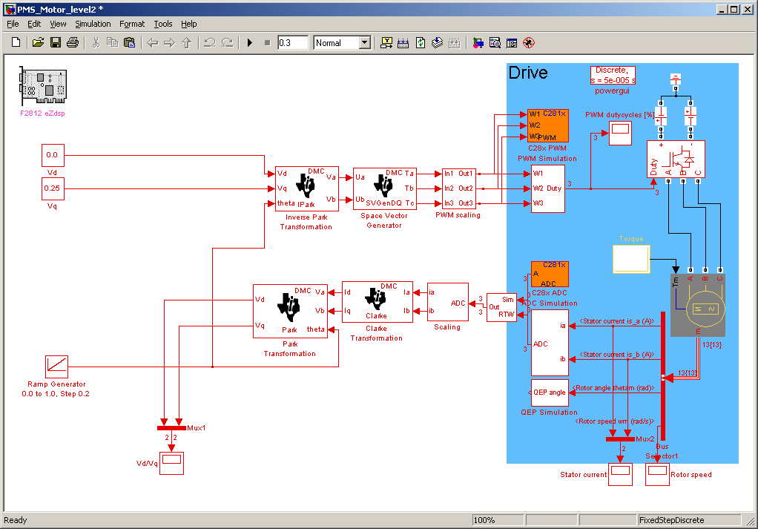
Currents/DC-bus voltage measurement verification - Simulation

Slide 32
Currents/DC-bus voltage measurement verification – Real Time
Vq_testing
T_{a}
PWM1
v_{αs}*
PWM2
Space
Vector
Gen.
T_{b}
PWM3
Inv.
Park
PWM
Driver
PWM4
Vq_testing
v_{ds}*
v_{βs}*
PWM5
T_{c}
PWM6
Voltage
Source
Inverter
θ_{e}
i_{ds}
i_{αs}
i_{a}
ADCIN1
Ileg2_
Bus
Driver
ADCIN2
i_{qs}
Park
i_{βs}
Clarke
i_{b}
ADCIN3
Speed_ref
Encoder
PMSM
Ramp
control
Ramp
Gen.
rmp_out
TMS320F28x controller

Slide 33
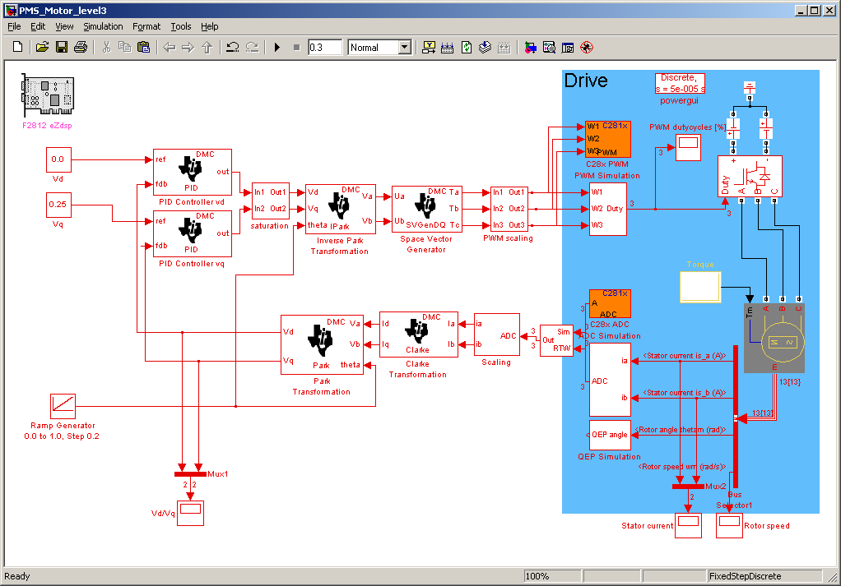
Tuning of dq-axis current closed loops - Simulation

Slide 34
Tuning of dq-axis current closed loops – Real Time
key module under test
T_{a}
PWM1
Iq_ref
v_{qs}*
v_{αs}*
PWM2
PI
Space
Vector
Gen.
T_{b}
PWM3
Inv.
Park
PWM
Driver
PWM4
Id_ref
i_{ds}*
v_{ds}*
v_{βs}*
T_{c}
PWM5
PI
PWM6
Voltage
Source
Inverter
rmp_out
i_{ds}
i_{αs}
i_{a}
ADCIN1
Ileg2_
Bus
Driver
ADCIN2
i_{qs}
Park
i_{βs}
Clarke
i_{b}
ADCIN3
Speed_ref
Encoder
PMSM
Ramp
control
Ramp
Gen.
TMS320F28x controller

Slide 35
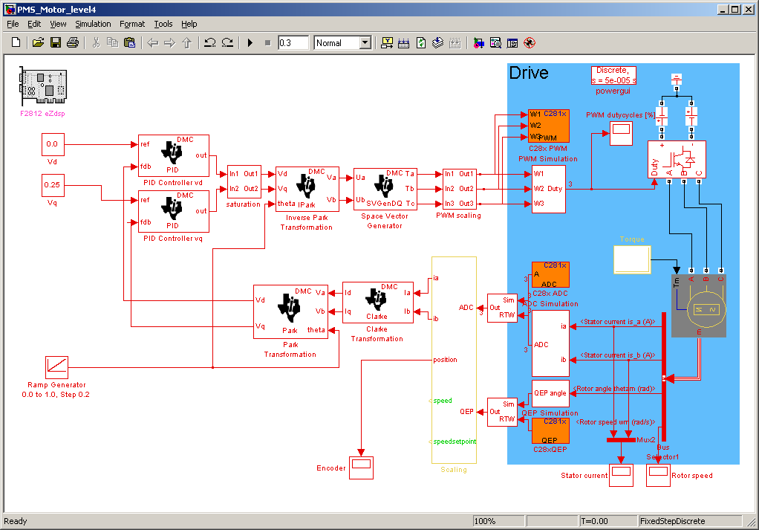
Encoder verification - Simulation

Slide 36
Encoder verification – Real Time
v_{qs}*
T_{a}
PWM1
Iq_ref
v_{αs}*
PWM2
PI
Space
Vector
Gen.
T_{b}
PWM3
Inv.
Park
PWM
Driver
PWM4
v_{ds}*
Id_ref
v_{ds}*
v_{βs}*
PWM5
T_{c}
PI
PWM6
Voltage
Source
Inverter
rmp_out
i_{ds}
i_{αs}
i_{a}
ADCIN1
Ileg2_
Bus
Driver
ADCIN2
i_{qs}
Park
i_{βs}
Clarke
i_{b}
ADCIN3
Speed_ref
Ramp
control
Ramp
Gen.
Theta_elec
Encoder
PMSM
QEP_A
θ_{m}
Ramp
Gen.
QEP
driver
QEP_B
dir
QEP_inc
TMS320F28x controller

Slide 37
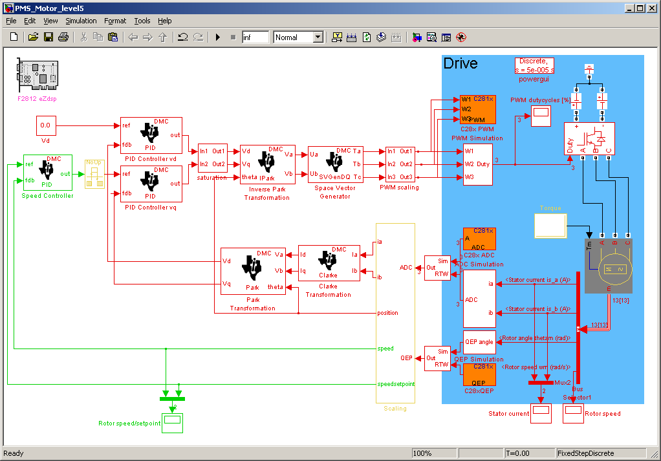
Speed closed loop - Simulation

Slide 38
Speed closed loop – Real Time
v_{qs}*
T_{a}
PWM1
i_{qs}*
v_{αs}*
PWM2
PI
PI
Space
Vector
Gen.
T_{b}
PWM3
Inv.
Park
PWM
Driver
PWM4
v_{ds}*
i_{ds}*
v_{ds}*
v_{βs}*
PWM5
T_{c}
PI
PWM6
Voltage
Source
Inverter
θ_{λr}
i_{ds}
i_{αs}
i_{as}
ADCIN1
Ileg2_
Bus
Driver
ADCIN2
i_{qs}
Park
i_{βs}
Clarke
i_{bs}
ADCIN3
θ_{λr}
Encoder
PMSM
ω_{r}
SMOSPD
speed
estimation
QEP_A
θ_{m}
Ramp
Gen.
QEP
driver
QEP_B
dir
QEP_inc
TMS320F28x controller

Slide 39
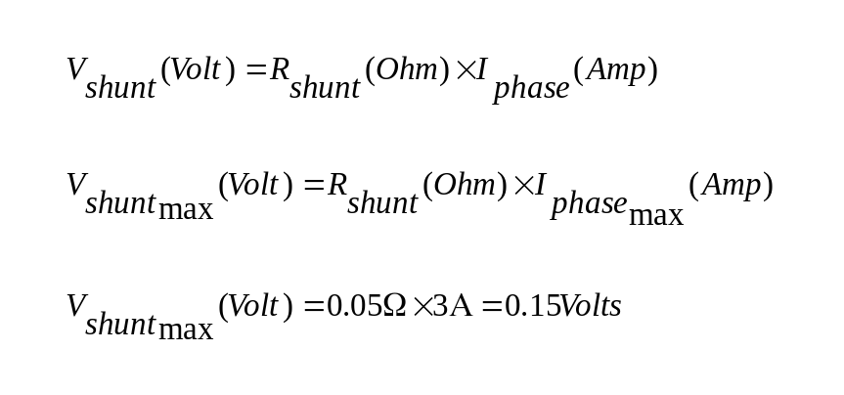
ADC gains/offsets Settings
I_{phase}(A)
V_{shunt}(V)
+3
+0.15
-3
-0.15
+ DC_BUS
PWM1
I_{phase}
A
PWM2
Shunt
0.05 Ohm
V_{shunt}

Slide 40
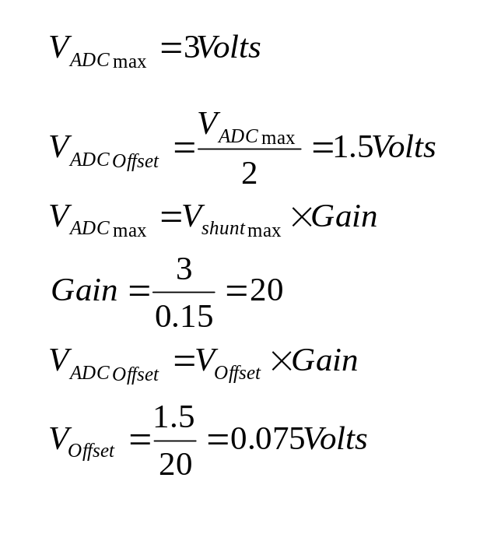
ADC gains/offsets Settings
V_{shunt}(V)
I_{ADC}(V)
+0.15
+3
V_{ADCmax}(V)
+1.5
V_{ADCOffset}(V)
-0.15
3.3V
R15
JP3
V_{Offset}(V)
+
-
V_{shunt}(V)
+
I_{ADC}(V)
-
R6

