Slide 1
Measuring
Signal-to-Noise Ratio in Real-Time

Slide 2
Measuring Signal-to-Noise Ratio in Real-Time

Slide 3
Objectives
To use statistics to measure the signal-to-noise ratio of an audio signal.
To build a Simulink model.
To measure the signal-to-noise ratio of an audio signal in real-time using the Texas Instruments C6713 DSK.

Slide 4
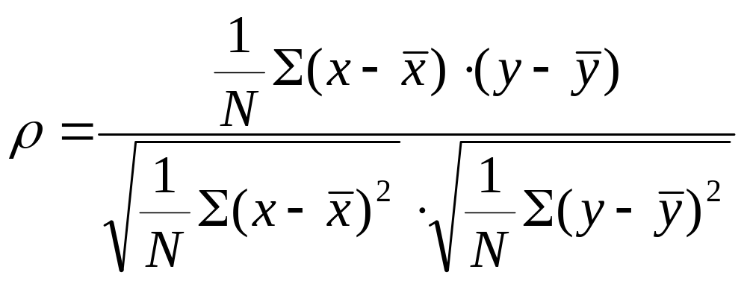
Correlation Coefficient
The “correlation coefficient” ρ measures the relationship between data series x and y:

Slide 5
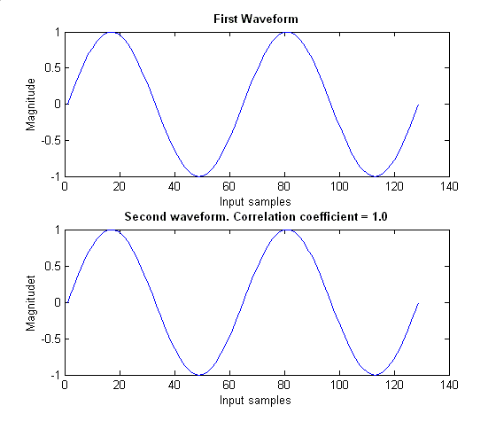
Correlation Coefficient 1.00
These two waveforms are identical.
The “correlation coefficient” ρ = 1.0

Slide 6
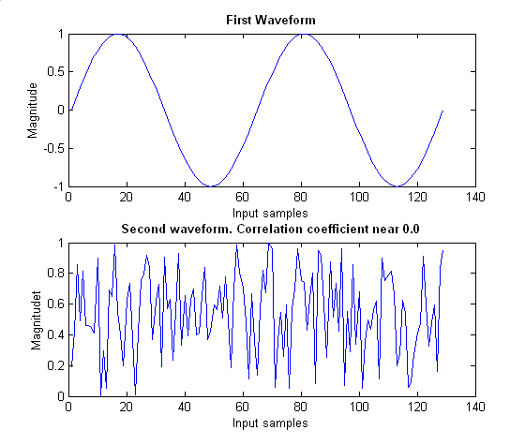
Correlation Coefficient ~0.00
Here one of the waveforms is random.
The “correlation coefficient” ρ ≈ 0.0

Slide 7
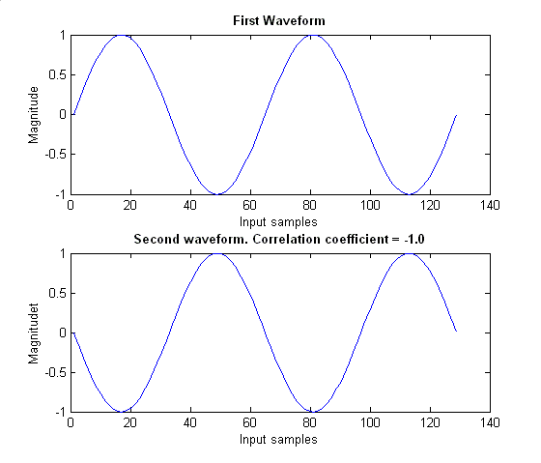
Correlation Coefficient -1.00
The waveforms are 180 degrees out of phase.
The “correlation coefficient” ρ = -1.0

Slide 8
Summary of Correlation Coefficient
The “correlation coefficient” ρ can take a value between –1.0 and 1.0
When ρ = 1.0, the two data series are identical.
When either series is random, ρ ≈ 0.0
When ρ = –1.0, the two identical data series have a phase difference 180 degrees.

Slide 9
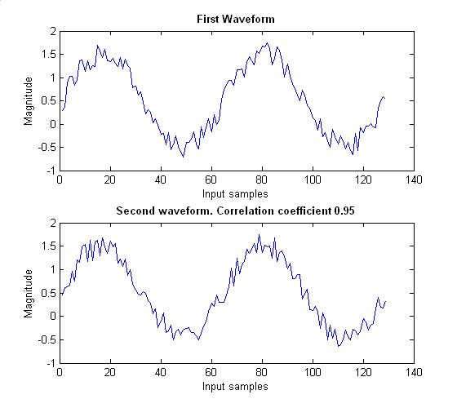
Correlation of Noisy Signals
Two “snapshots” of a waveform.
  95% signal
  5% noise.
The “correlation coefficient” ρ = 0.95

Slide 10
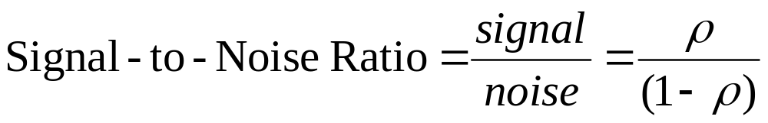
Signal and Noise
We have ρ = 0.95 (95%) signal.
The other (1 - ρ) = (1 – 0.95) = 0.05 (5%) noise.

Slide 11
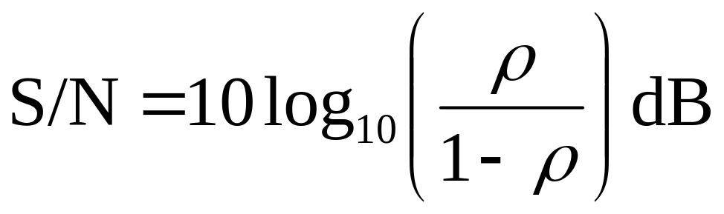
Signal-to-Noise Ratio
The usual way to express the signal-to-noise ratio (S/N) is in deciBels:
This gives the ratio of the power in the signal to the power in the noise.

Slide 12
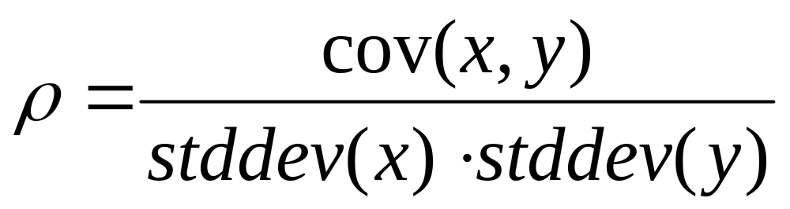
Correlation Coefficient Re-Written
To use standard Simulink blocks:
cov(x,y) = covariance of series x and series y
stddev(x) = standard deviation of series x
stddev(y) = standard deviation of series y

Slide 13
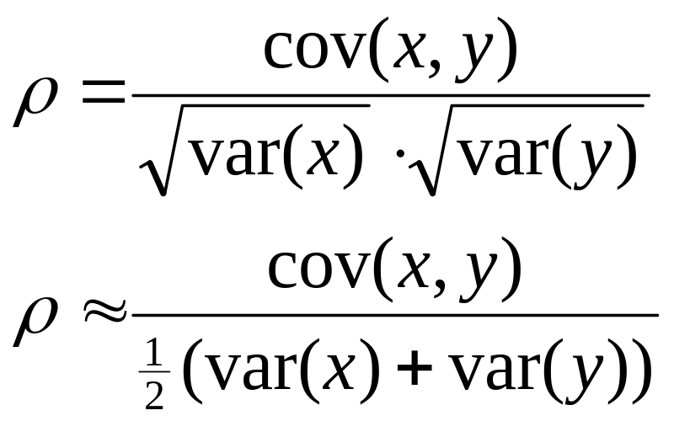
Correlation Coefficient Simplified
Where var(x) = variance of x and var(y) = variance of y.
Question. Why does this approximation work?

Slide 14
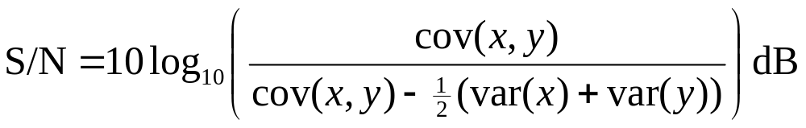
Simplified Formula
Do not need to calculate ρ.
Upside – model will run faster (no square roots).
Downside - there will a slight loss of accuracy.

Slide 15
Practical Application 1
“Best signal selection”. To select the best of several radio transmitters.
When an aircraft lands, there may be 10 receivers around the runway. The best of the 10 signals is selected.
Some car radios have two receivers. The better signal of the two is used.

Slide 16
Practical Application 2
A “noise gate”, for a mobile telephone.
  gives silence when no speech is present.
The signal-to-noise ratio tells us whether the signal is voice or noise.

Slide 17
Practical Application 3
In “Speech analysis”, to distinguish between voiced and unvoiced sounds.
Voiced sounds e.g. “a” and “b”
  have high signal-to-noise ratios.
Unvoiced sounds e.g. “s” and “sh”
  have low signal-to-noise.

Slide 18
Simulink Model

Slide 19
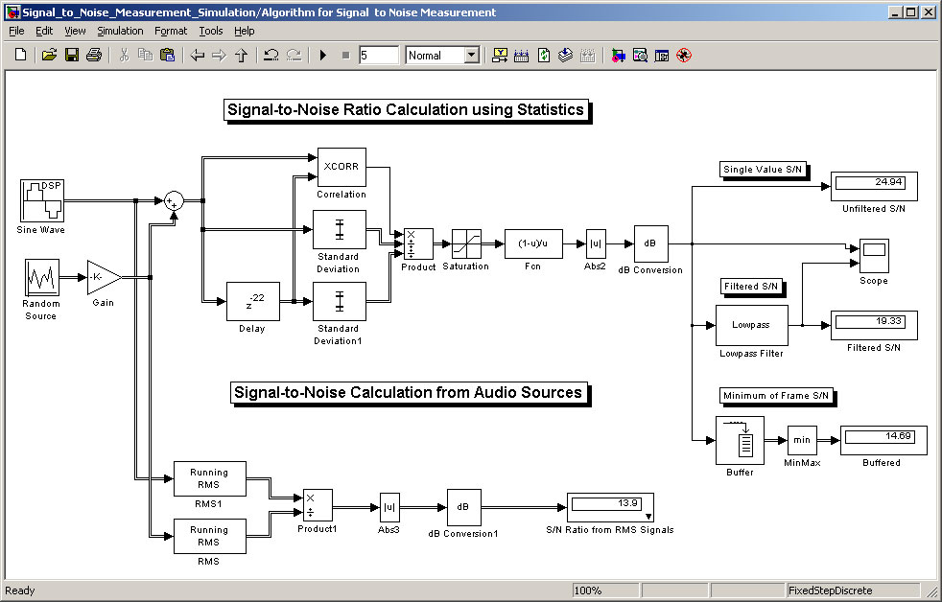
The Simulink Model

Slide 20
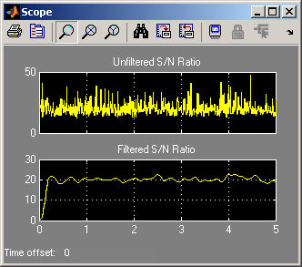
Algorithm Performance

Slide 21
Evaluating Performance
Run this model several times to evaluate:
  How accurate is this technique?
  How much delay is required?
  How long should each frame be?
  How is it effected by sampling frequency?
  How consistent are the outputs?
  Does it work equally well at all frequencies?

Slide 22
Introduction to Laboratory

Slide 23
Objectives
To run the Simulink® Model to determine the best frame size, sampling rate and delay times.
To modify the Simulink Model for use with the C6713 DSK.
To use the C6713 DSK to distinguish between an audio signal and random noise.

Slide 24
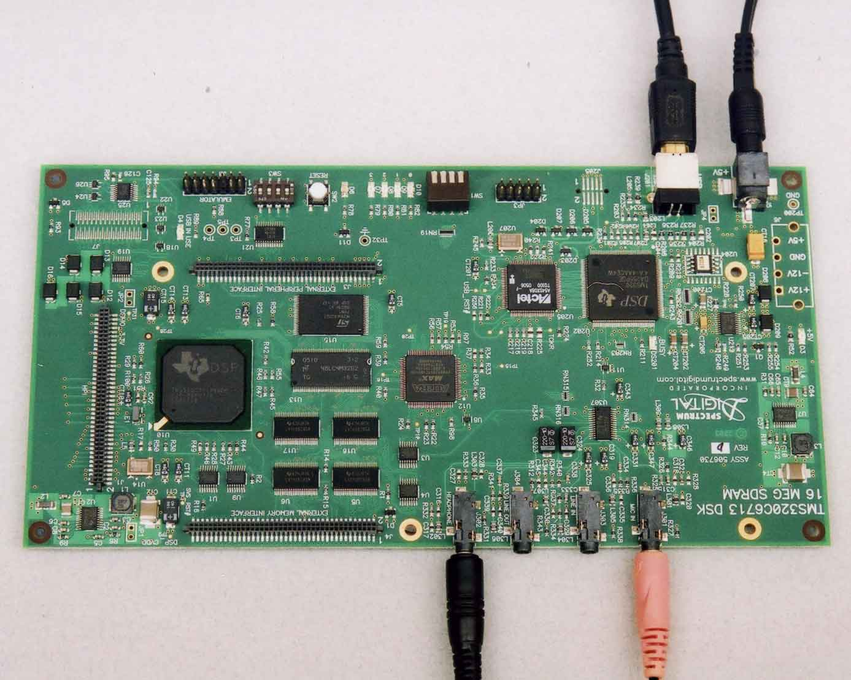
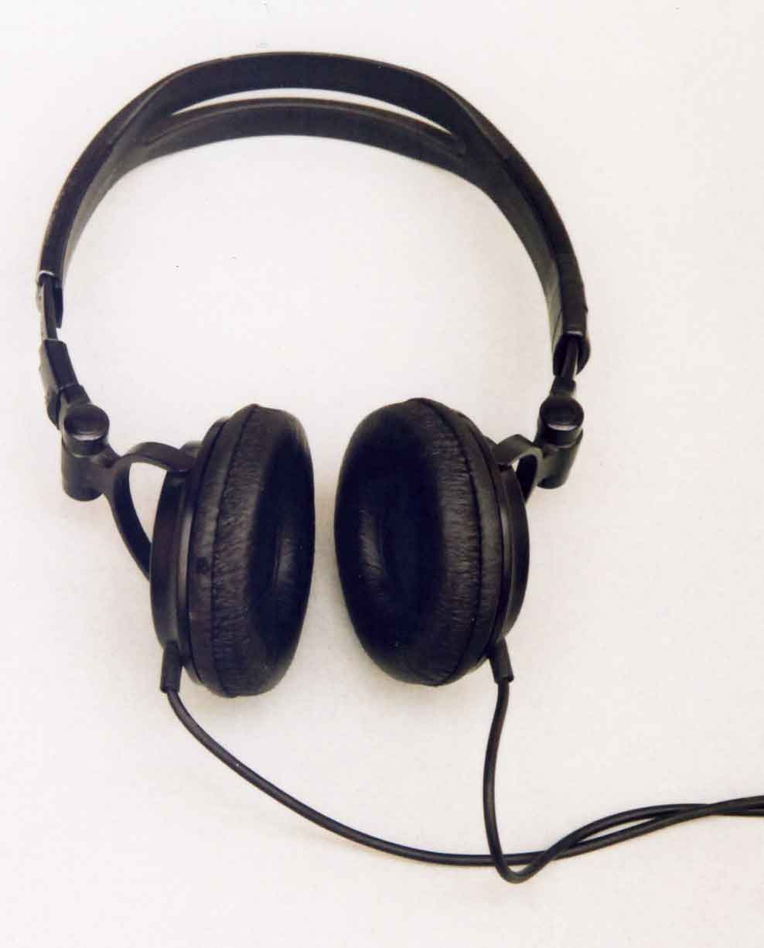
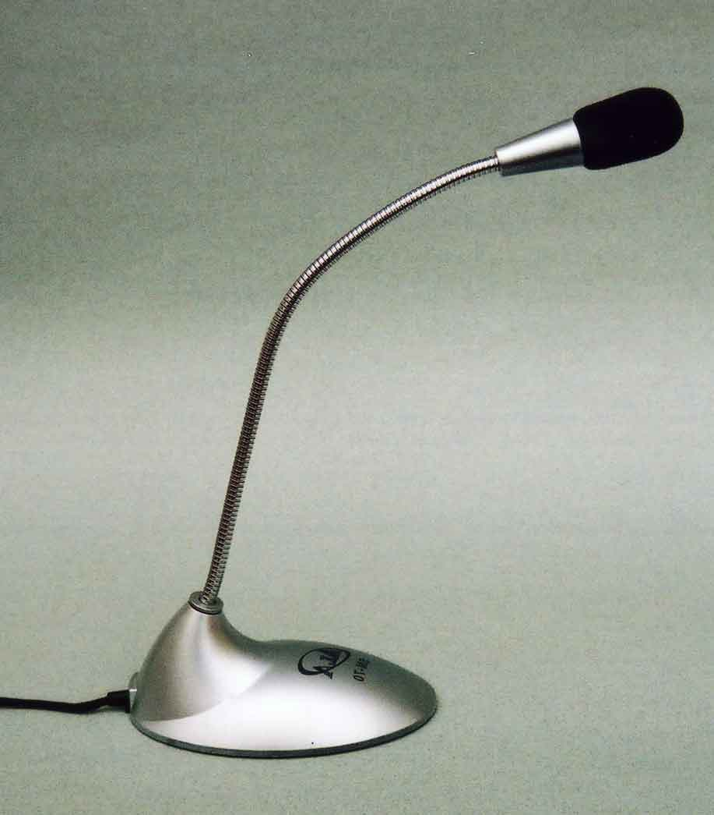
C6713 DSK Setup
USB to PC
to +5V
Headphones
Microphone

Slide 25
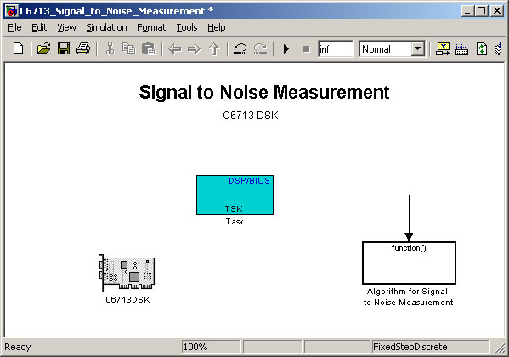
C6713 Model Parent

Slide 26
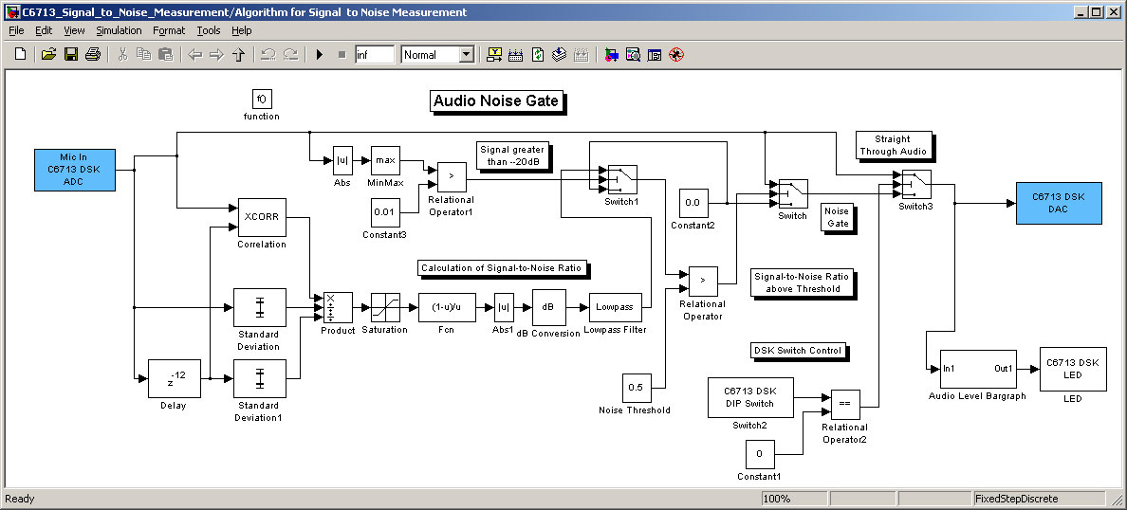
C6713 Algorithm

Slide 27
Some Conclusions
This demo was originally written for “best signal selection” for aircraft receivers.
The original code was written in fixed-point assembly language, that took 6 weeks to write.
With Embedded Target for Texas Instruments C6000, the job would have been done in a few days.

Slide 28
References
“Digital Signal Processing - A practical approach” by Ifeachor and Jervis. 5.2.2.2 “Detection and estimation of periodic signals in noise”. Pages 258-260.
“Correlation and Covariance of a Random Signal” by Michael Haag. http://cnx/rice.edu

