Slide 1
Spectrum Estimation

Slide 2
Preface
Our Goal is to Estimate the Spectrum of stochastic processes
We are concentrating in AR-Processes
3 methods of Estimation will be discussed: Periodogram, Burg and M-Covariance

Slide 3
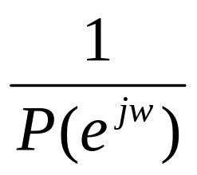
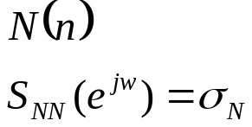
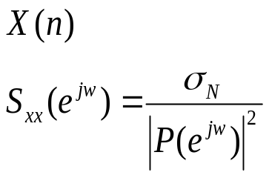
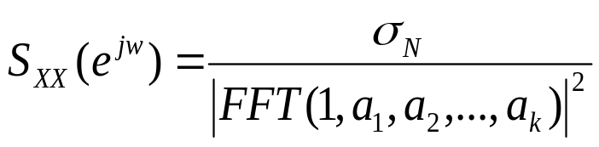
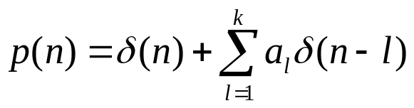
AR Basics
An Auto-Regressive (AR) process is commonly described as White Noise filtered by an all-pole LTI system:
Frequency domain characteristics:
  The AR Process Spectrum is given by:
Where:

Slide 4
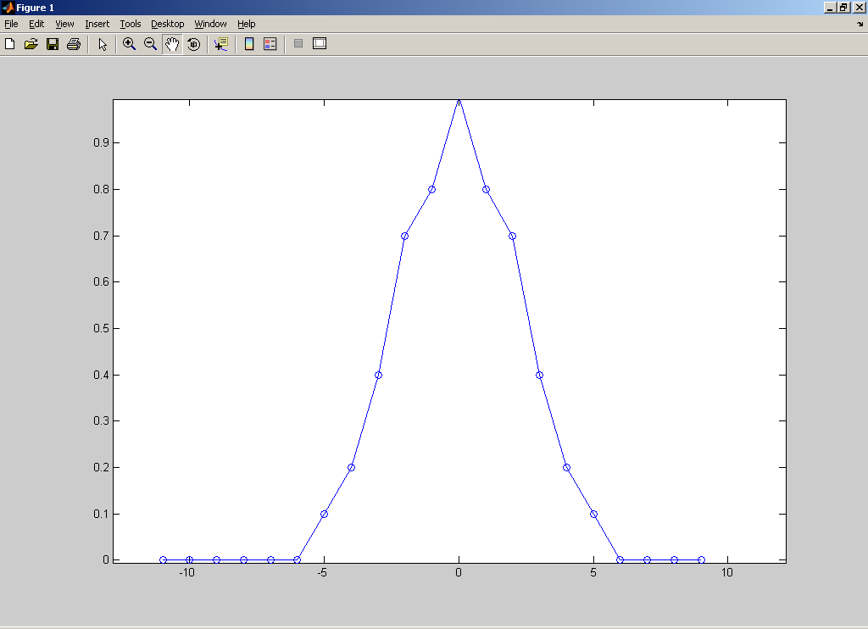

AR Basics cont.
Time Analysis of the process (of order k):
  every sample has correlation with at most k previous samples
  The autocorrelation function looks like:
  For every n<-k or n>k holds:

Slide 5
Estimation Methods
3 Methods:
  Periodogram
  Burg
  M-Covariance
Our Goal:
  Given a finite buffer of samples of the stochastic process estimate its spectrum
Assumption:
  The process is mean Ergodic and Correlation Ergodic

Slide 6
Periodogram
The Periodogram block computes a nonparametric estimate of the spectrum. The block averages the squared magnitude of the FFT computed over windowed sections of the input and normalizes the spectral average by the square of the sum of the window samples.

Slide 7
The Modified Covariance Method
The Modified Covariance Method block estimates the power spectral density (PSD) of the input using the modified covariance method. This method fits an autoregressive (AR) model to the signal by minimizing the forward and backward prediction errors in the least squares sense. The order of the all-pole model is the value specified by the Estimation order parameter. To guarantee a valid output, you must set the Estimation order parameter to be less than or equal to two thirds the input vector length. The spectrum is computed from the FFT of the estimated AR model parameters.

Slide 8
Burg Method
The Burg Method block estimates the power spectral density (PSD) of the input frame using the Burg method. This method fits an autoregressive (AR) model to the signal by minimizing (least squares) the forward and backward prediction errors while constraining the AR parameters to satisfy the Levinson-Durbin recursion.

Slide 9
Hands-On
Simulation
Implementation using the DSK6713
GUI to handle the R-T implementation

Slide 10
Simulation
The coefficients are known for the model
Internal generation of the true spectrum
Generation of the AR signal using white noise and all-poles filter
Comparison between all 3 methods in the model (to one another and to the true spectrum
The results are presented using the frequency domain

Slide 11
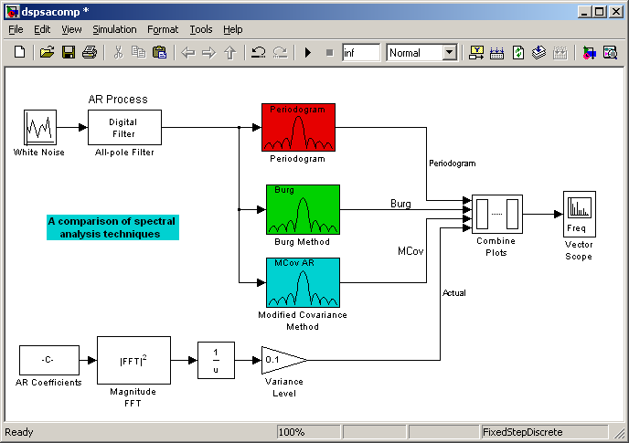
The Simulation Environment
Simulation involves the 3 methods simultaneously

Slide 12
Real-Time Environment
Based on the Simulation model
R-T Implementation contains 3 model files, each implements different method separately
We will present the Top-Down Architecture of the Real-Time solution

Slide 13
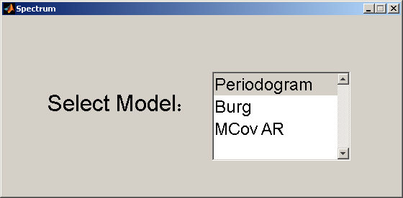

Real Time Environment (cont.)
PC
RTDX
DSK6713
CODEC
Line In
TMS320C6713
Line Out
All-pole Filter
Spectrum Estimator
Signal Generator
A/D
(Left)
D/A
(Left)
Oscilloscope
White Noise
Generate
Reference Spectrum
D/A
(Right)

Slide 14
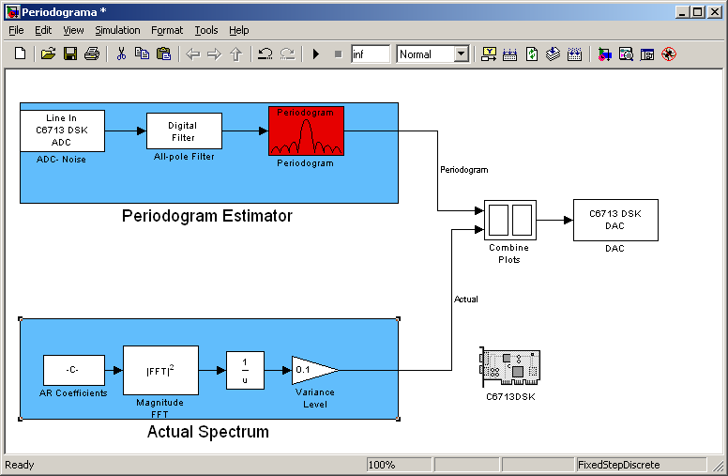
Real Time Environment (cont.)
R-T model using Periodogram Estimation:

Slide 15
GUI Functionality
Using Matlab GUI and TI libraries we will show how to build a gui that enables the user to control the model easily
The GUI involves RTDX calls to negotiate with the DSK in R-T
The RTDX is a proprietary interface that enables the Host to send/receive data to the dsk in R-T
The GUI enables the user to perform the following operations:
  Reloading a model (3 optional Estimation methods)

Slide 16
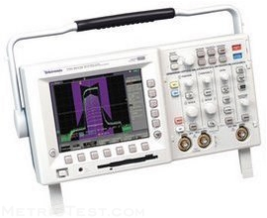
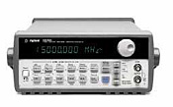
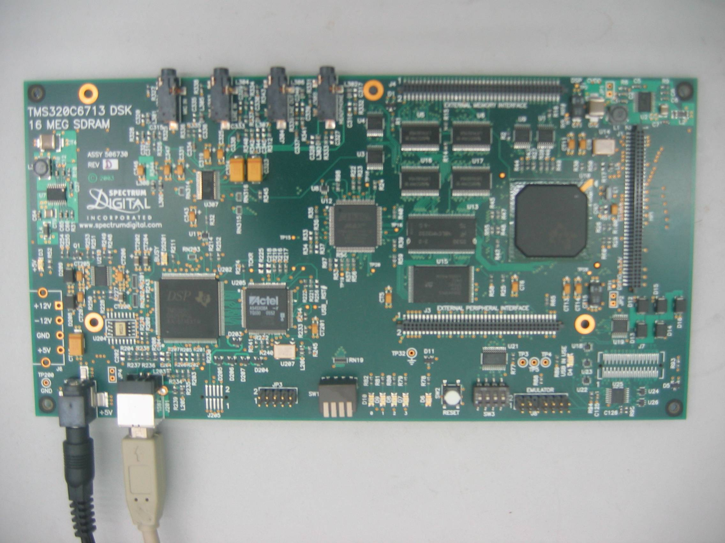
The System
Spectrum
Noise
Estimated Spectrum

