Slide 1
Video Surveillance with Motion Detection

Slide 2
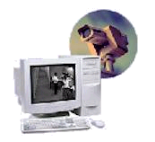
Application:
Surveillance Data-Stream Compression
Need: Continuous monitoring of scene with video camera
  Security (ATM booth, parking lot), Intelligent Highways, Bio/Pharmaceuticals, etc.
Problem: Generates large volumes of data to record, archive, and review
  Preferable to reduce data stream at the source (embedded compression)
Solution: Shrink data storage requirements
  Reduce size of each video frame to record, and/or
  Reduce total number of video frames to record
Simple Idea: Motion within camera’s field of view
triggers storage of “interesting” frames
Design Requirement:
Identify and record only these “interesting” video frames

Slide 3
Principle of Operation
Input Frames
Estimate
motion
energy
≥ thrsh?
Record/Display Frames
M
Yes

Slide 4
Principle of Operation
Display Control
Display
Frame
Count
Display
Record
Recorded Image
Input Frames
SAD
Display
Absolute Differences Image
Sum of Absolute Differences
(Motion Energy)
Trigger
Threshold
Threshold Display

Slide 5
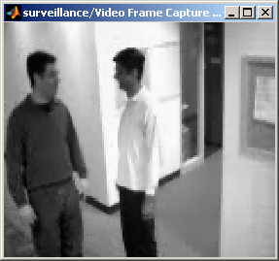
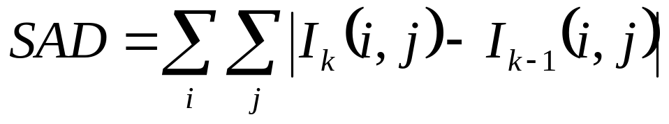
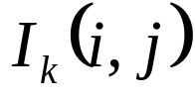
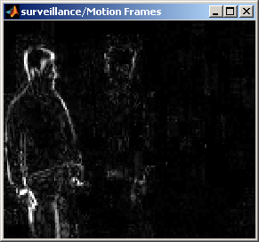
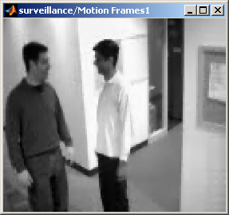
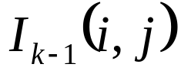
Motion Energy
Motion Energy
(Sum of Absolute Differences)
Current Frame
Previous Frame

Slide 6
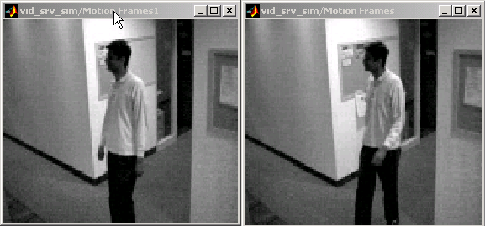
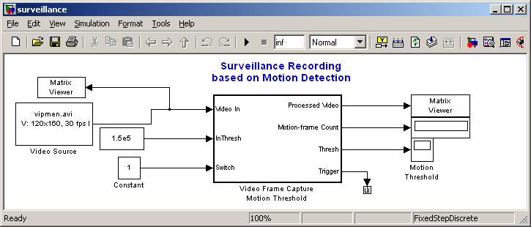
The Simulink® Model
Source Frames
High rate: 30 fps
Recorded Frames
Aperiodic rate
(<< 30 fps)
Total # of Recorded
Frames

Slide 7
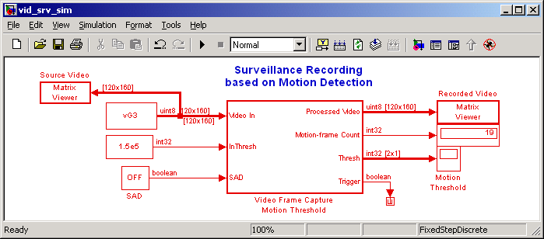
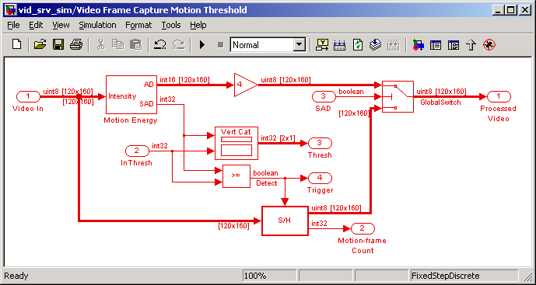
Simulink Model Hierarchy
Estimate
motion
Compare to threshold
Record frames
& update count
System Design and Simulation

Slide 8
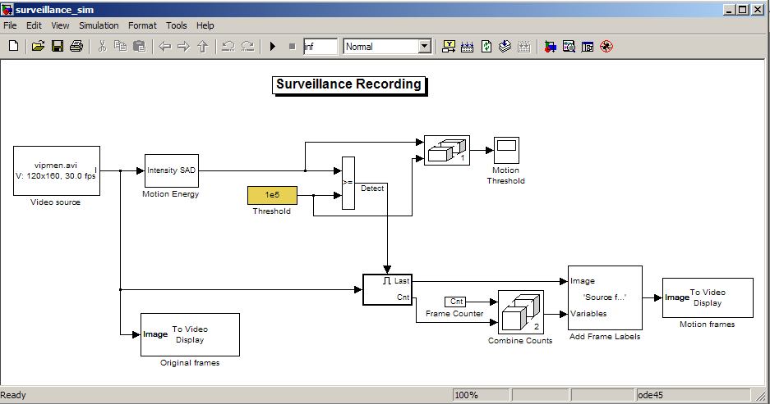
The Simulink Model
Estimate
motion
Compare to threshold
Record frames
& update count

Slide 9
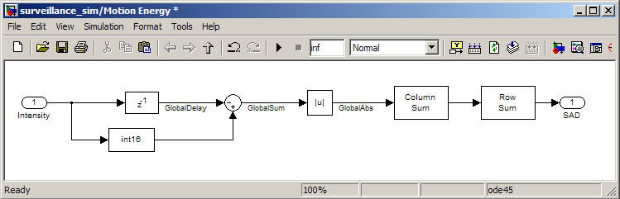
SAD Algorithm
uintN: N-bit unsigned integer
intN: N-bit signed integer
Sum of Absolute Differences
Very simple method of inter- frame video motion detection
Has efficient fixed-point (integer) implementation in hardware

Slide 10
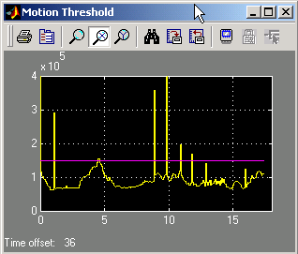
Motion Detection via Thresholding
Motion levels
Video Motion Estimate
Detection Threshold
Captured Video Frames

Slide 11
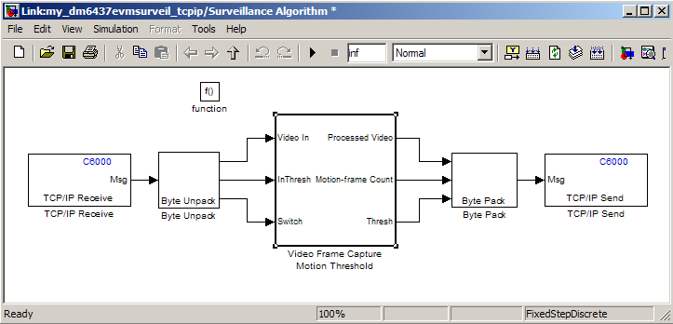
Migration to Real-Time
Replace Virtual Sinks/Sources by TCP/IP Receive/Transmit Blocks with Byte Unpack/Pack

Slide 12
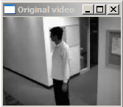
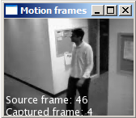
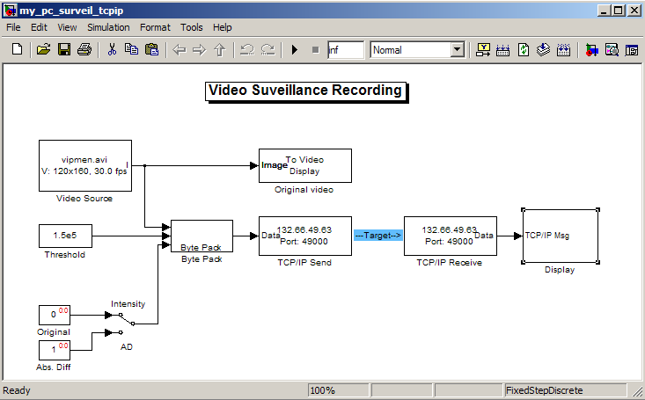
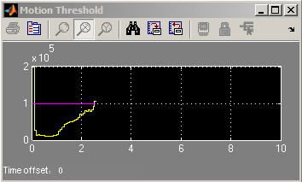
Real-time Visualization
Host-side visualization
Simulink PC Model
Monitor video capture
Motion Estimates

