Slide 1
Vehicle Dynamics

Slide 2
Objectives
To implement a simplified differential equation for the motion of a car.
To build and test a Simulink Model.
To run the model in real-time using the ezDSP F2812 hardware.

Slide 3

Motion of a Vehicle
Consider the case of a car driving in a straight line along a flat road.

Slide 4
Engine Power
The driving force is supplied by the engine.
Engine Power

Slide 5
Vehicle Weight
The weight of the vehicle will need to be overcome to move the vehicle.
Vehicle Weight

Slide 6
Wind Resistance
As the car moves, there will be wind resistance.
Wind
Resistance

Slide 7
Vehicle Speed
The engine power, vehicle weight and wind resistance determine the vehicle speed.
Vehicle Speed

Slide 8
Combined Factors
These factors can be brought together into an equation of motion.
v
F
b.v
m

Slide 9
Differential Equation
F = m.dv/dt + b.v where:
  F = force provided by the engine
  m = mass of vehicle
  dv/dt = rate of change of velocity (acceleration)
  b = damping factor (wind resistance)
  v = velocity (vehicle speed)

Slide 10
Transformed Equation
To implement the equation using Simulink, the equation needs to be first transformed.
F/m –v.b/m= dv/dt
We will set up a subsystem with:
  Force F as the input.
  Speed v as the output.

Slide 11
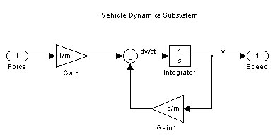
Continuous Implementation
Using Simulink, the equation can be implemented as a continuous system as shown in the diagram.
To generate v, we need to integrate the acceleration dv/dt.

Slide 12
Simulink Model

Slide 13
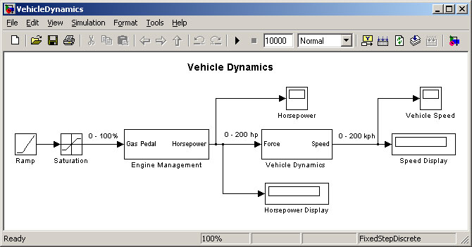
The Simulink Model
The model of vehicle motion is shown below:

Slide 14
Description of Model
The input to the system is the gas pedal, under control of the driver.
The “Engine Management” sub-system converts gas pedal to engine power.
The “Vehicle Dynamics” sub-system converts engine power to vehicle speed.
The output is provided in horsepower.

Slide 15
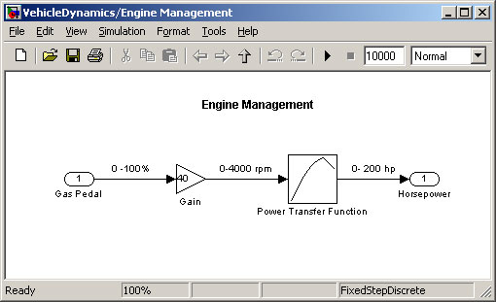
Engine Management Subsystem
This converts the gas pedal input (0-100%) to engine output power (0 – 200 hp).

Slide 16
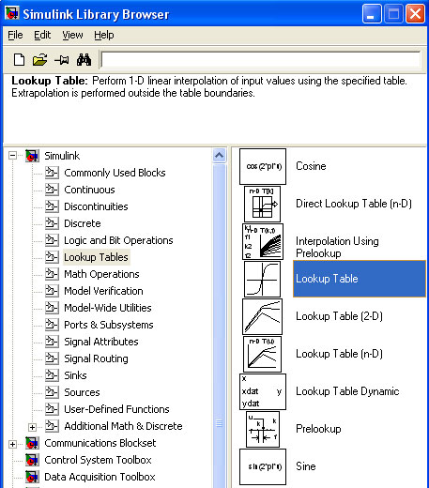
Lookup Tables
The conversion from rpm to power can be implemented using a lookup table.

Slide 17
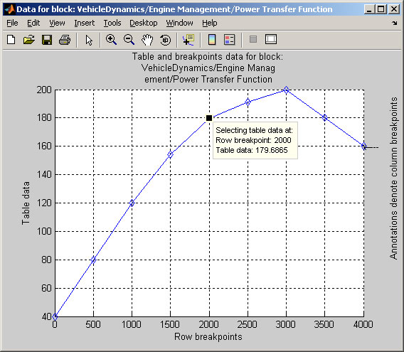
Lookup Table Curve
The table values can be adjusted to fit a smooth curve.

Slide 18
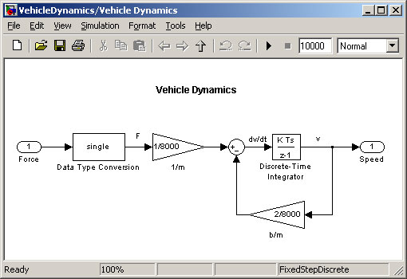
Vehicle Dynamics Subsystem
To implement the equation of motion on the C28x, a Discrete Time Integrator is required.

Slide 19
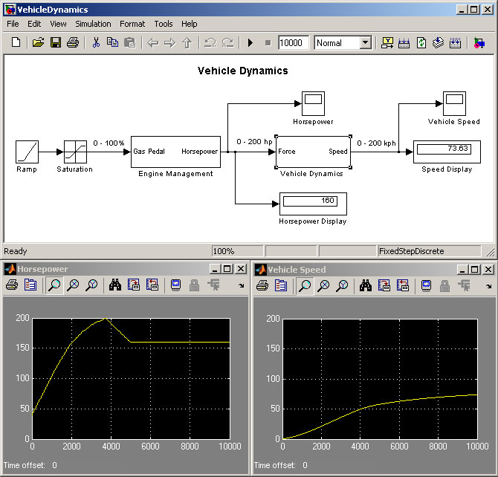
Running the Simulation
The ramp generator gently changes the Gas Pedal from 0% to 100%.
This simulates smooth acceleration.

Slide 20
Tuning the Model
Alter the mass m of the vehicle between 1 ton (for a small compact car) and 35 tons (for a truck).
Increase the wind resistance by increasing variable b.
Using real data from a car manufacturers website for the Lookup Table. You could also profile a diesel engine.
Replace the Ramp input with a Step input to simulate stamping on the gas pedal!

Slide 21
Introduction to Laboratory

Slide 22
Overview of Laboratory
The Simulink model will be modified to run on the ezDSP F2812 hardware.
A potentiometer will be used to simulate the gas pedal.
The output speed of the system will be monitored using a multi-meter.

Slide 23
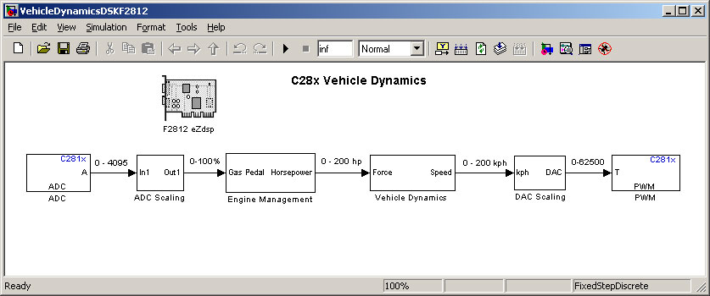
Modifications for C28x
To run on the ezDSP F2812, additional blocks from the Embedded Target for TI C2000 DSP are required.

Slide 24
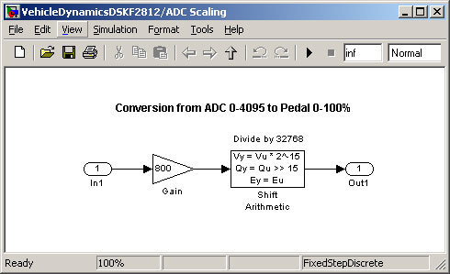
ADC Scaling
The ADC input 0-4095 needs to be scaled 0-100%.
Using fixed-point math, this can be implemented as multiply by 800 then divide by 32768.

Slide 25
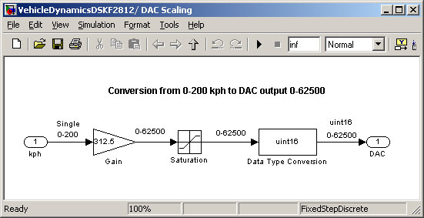
DAC Scaling
The input 0-200 kph needs to be scaled 0-62500 for the DAC.

Slide 26
References
ezDSP F2812 Technical Reference.

