Slide 1
Wavelet Denoising

Slide 2
Objectives
To introduce the Discrete Wavelet Transform (DWT)
To show how the DWT can be used to remove noise from an audio signal.
To demonstrate wavelet denoising in real-time using the Texas Instruments C6713 DSK.

Slide 3
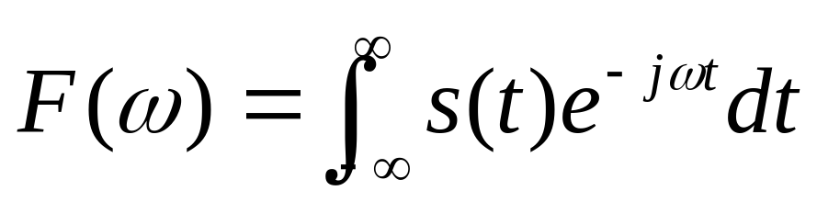
The Fourier Transform and Limitations
Multiplies the signal s(t) by an infinite sine wave.
No means of identifying exactly where an event occurs.
Does not cope well with discontinuous, bursts of signals, e.g. video, music, seismic

Slide 4
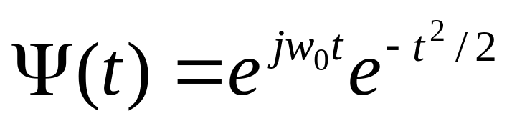

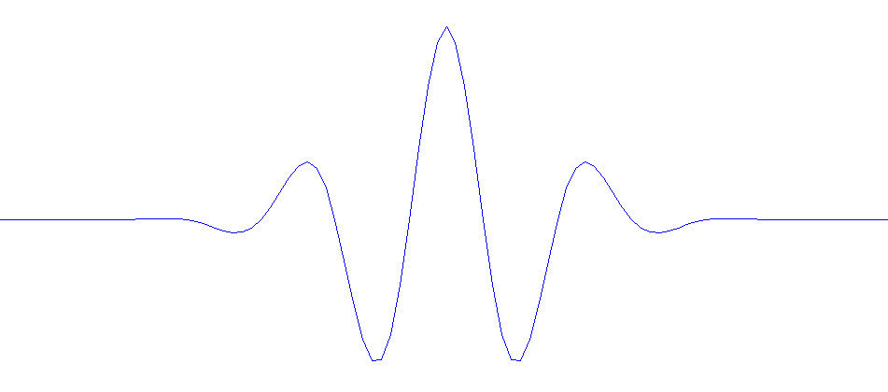
A Wavelet
Instead of an infinite sine wave for the transform, use a wavelet:
Morlet Wavelet
t

Slide 5
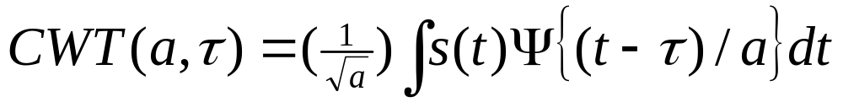
The Continuous Wavelet Transform
The Continuous Wavelet Transform (CWT) is defined as:
This can be interpreted as convolving the signal s(t) with the wavelet.

Slide 6
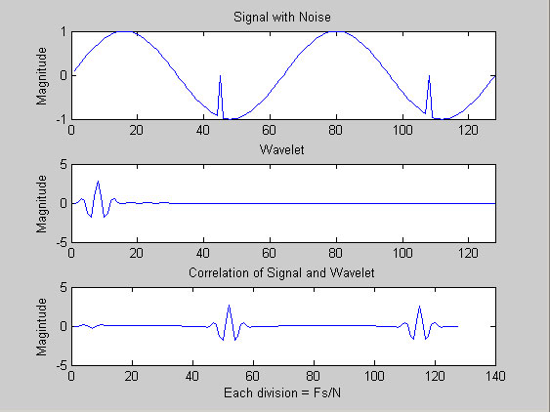
Correlate Wavelet with Noise Click
Noise
“Click”
Correlate by sliding wavelet across signal
Position
of Noise is
identified
by Wavelet

Slide 7
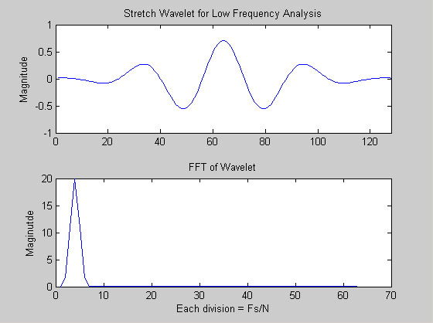
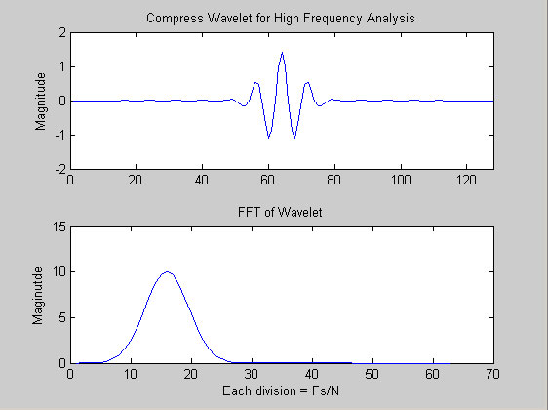
Wavelet Scaling
“Stretch” the original wavelet to work with low frequencies.
“Compress” the original wavelet to work with high frequencies.

Slide 8
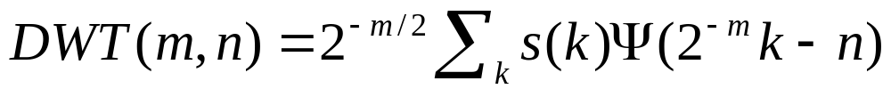
The Discrete Wavelet Transform (DWT)
Based on dyadic (2^) analysis.
Uses several wavelets to characterise signal.
Is computationally efficient.

Slide 9
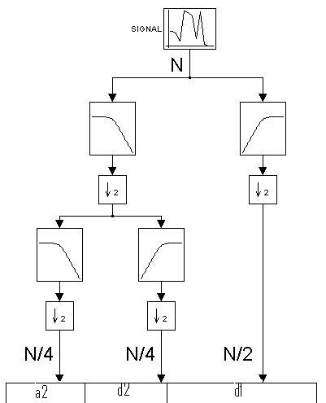
Diadic Filter Structure
The DWT uses wavelet filtering and down sampling.
It is a reversible process.
Uses wavelets of different scales at each level.
Breaks the signal down into a series of:
  a_{j} (“average”) coefficients.
  d_{j} (“detail”) coefficients.

Slide 10
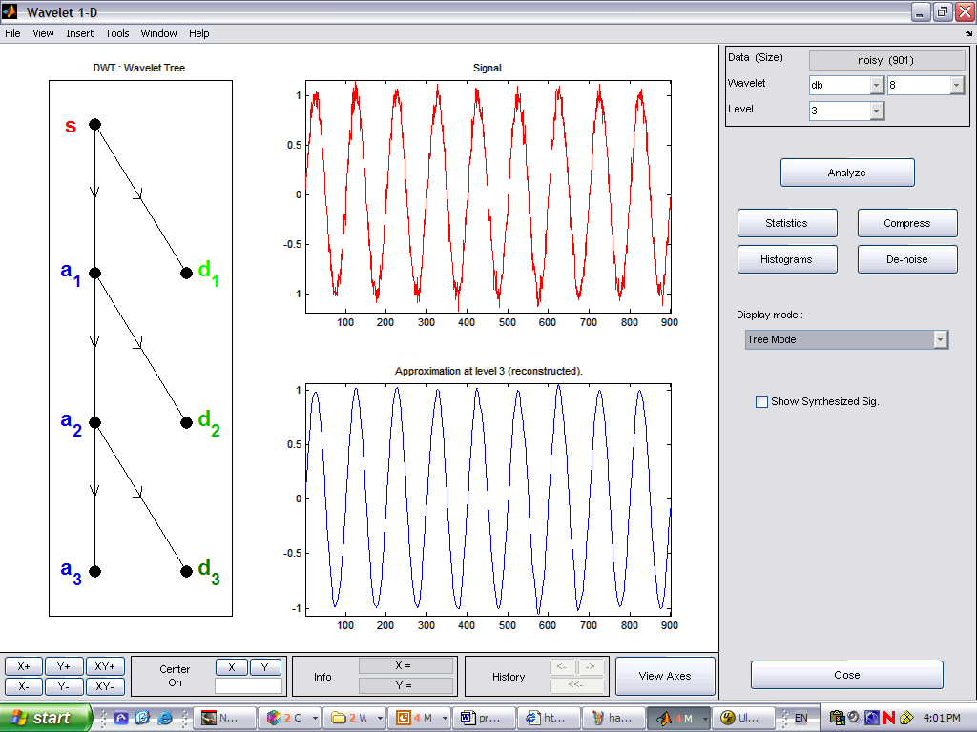
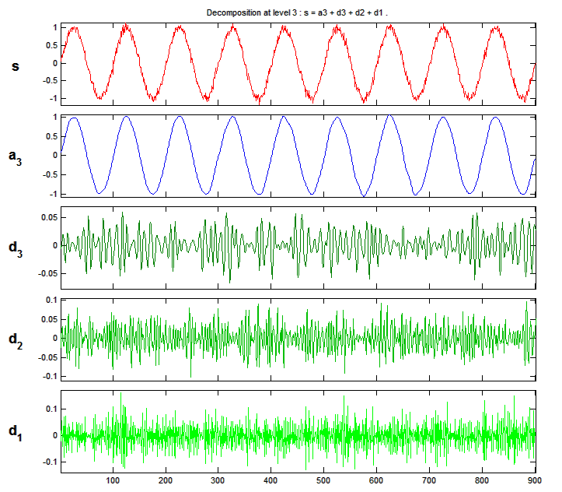
Wavelet Decomposition - Example

Slide 11
Result of Analysis
The DWT has separated the signal from the noise.
Most of the important information is contained at the “a₃” level. Low sampling rate, good for compression.
The high frequency noise is contained at the “d₁” level. This can be discarded to reduce the noise.

Slide 12
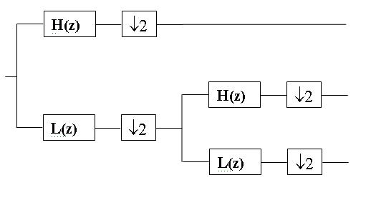
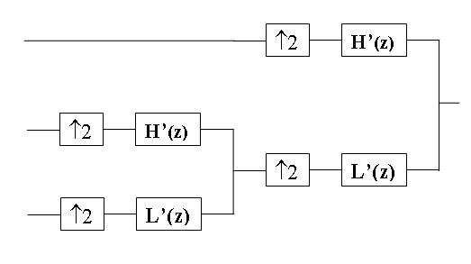
Reconstruction using IDWT
The input can be reconstructed using the Inverse Discrete Wavelet Transform (IDWT).
DWT Analysis
IDWT Reconstruction

Slide 13
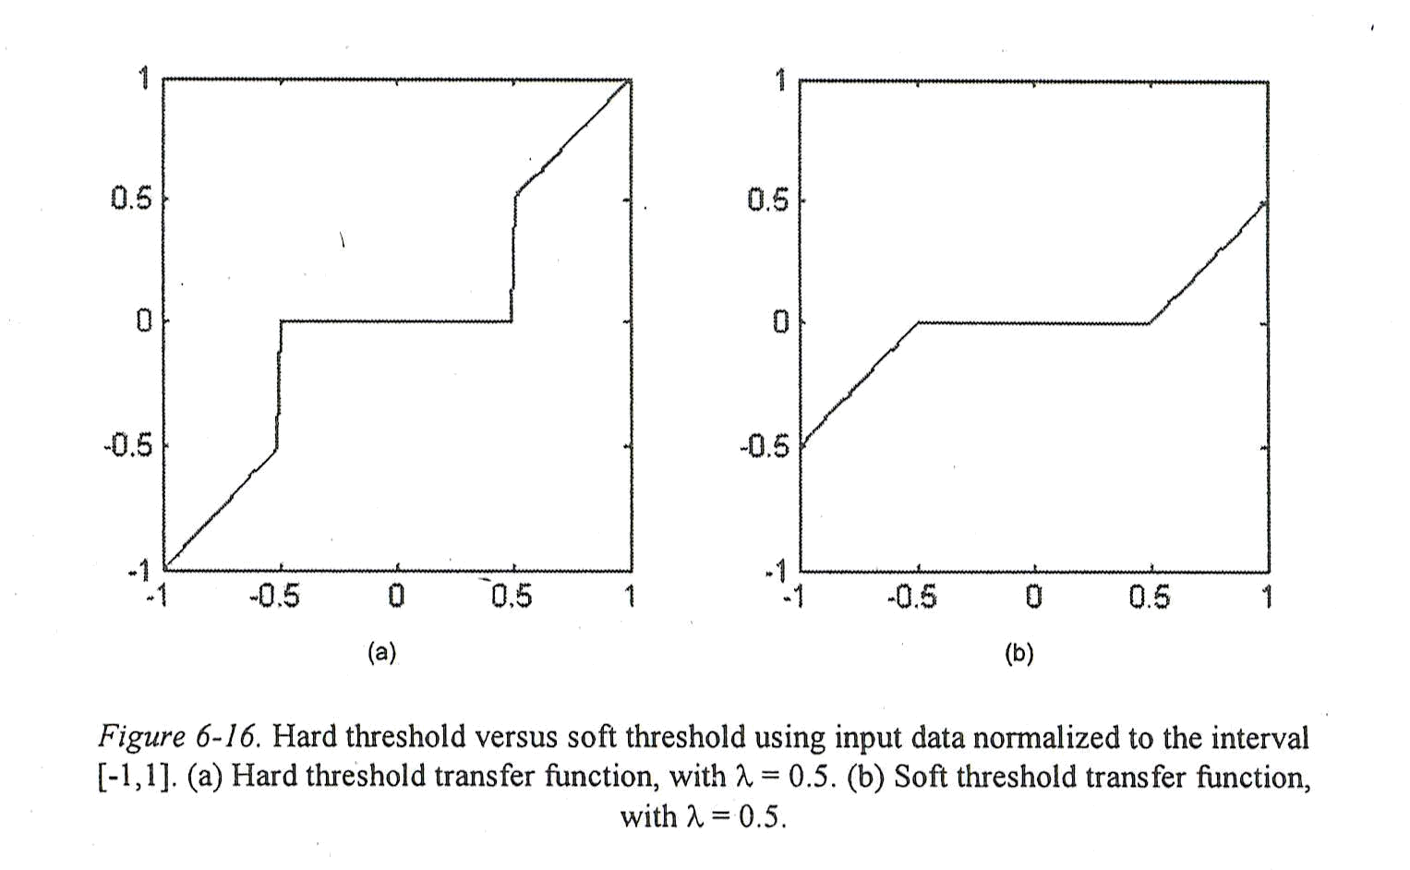
Scheme for Wavelet Denoising
Estimate Noise Level
and Set Thresholds
Noisy Signal
Shrink Wavelet Coefficients
Recovered Signal
Wavelet Transform
Inverse
Wavelet Transform

Slide 14

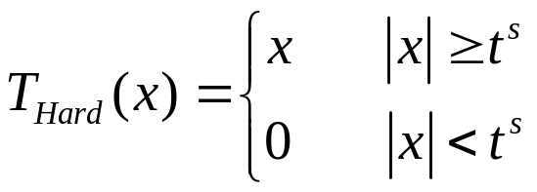
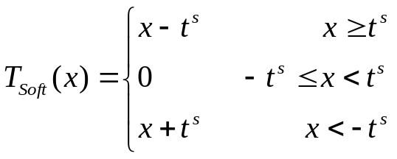
Soft Thresholding vs. Hard Thresholding
Hard Thresholding
Soft Thresholding

Slide 15
Hard and Soft Thresholding
Hard Thresholding:
  Ignore signals below noise threshold.
  Sharp transition from on/off.
Soft Thresholding:
  Ignore signals below noise threshold.
  Attenuates low-level signals.
  Smooth transition between on/off.

Slide 16
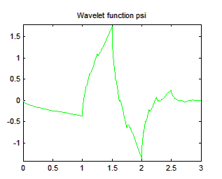
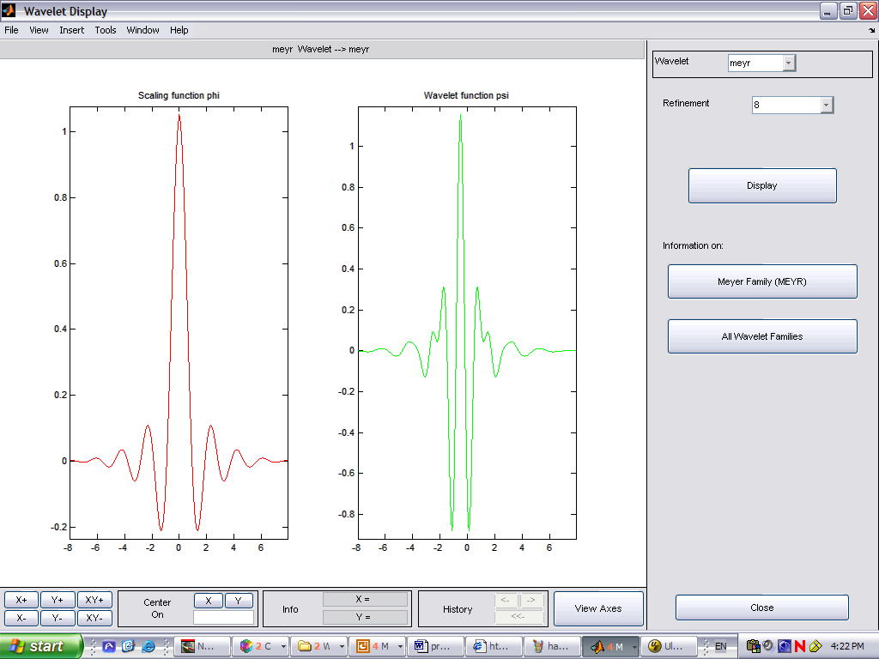
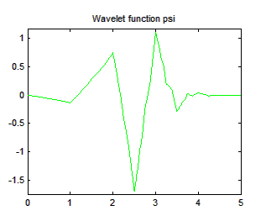
Some Wavelet Types
Wavelets do not have to be symmetrical.
db2
Meyer
symmlet3
המשפחה בה השתמשנו

Slide 17
Wavelet Selection
Arbitrary, but some guidelines available.
Wavelets have individual properties:
  Local symmetries, e.g. Mexican hat (Morlet).
  Orthogonal basis, e.g. Daubechies (db).
  Linear phase, e.g. biorthogonal.
  Compactly supported, e.g. db1 vs db4 for two discontinuities.
  Smoothness measured by derivatives or vanishing moments, e.g db2 vs db5.

Slide 18
Other Uses of Wavelets
Image / video compression (2D, 3D)
  DWT(JPEG2000), fingerprint image compression (FBI)
Data with transients, e.g. financial, seismic, ECG
Pattern matching, e.g. for biometrics, match at different scale.
Feature extraction, e.g. use detail as signature in metallurgy.
Multisensor data, e.g. multi-recording EEG and multi-scale PCA.
Communication systems, raised cosine filter is special case of Meyer.

Slide 19
Simulink ® Model

Slide 20
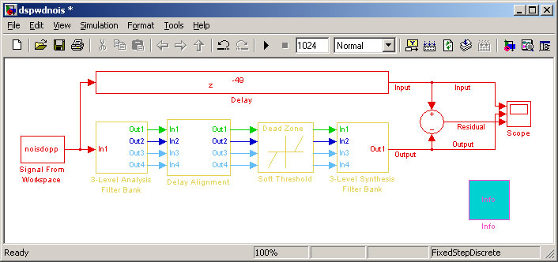
SImulink Denoising Model
The Simulink demo for a denoising algorithm is shown below:

Slide 21
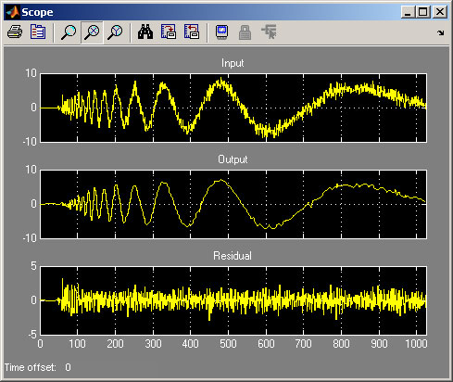
Wavelet Denoising of Signal
Signal + Noise
Signal
With noise removed
Noise

Slide 22
Simulink Model Description
The Simulink model contains four stages:
  Dyadic analysis filter (DWT)
  Delay alignment
  Dead zone to set noise thresholds
  Dyadic Synthesis Filter Bank (IDWT)
Each will be explained in more detail.

Slide 23
1. Dyadic Analysis Filter Bank
In the first stage, the input data block is analysed in terms of the Discrete Wavelet Transform (DWT).
The right type of wavelet needs to be chosen, that is one that can be accurately reconstructed using the IDWT.

Slide 24
2. Delay Alignment
This is a form of phase correction.
Low frequencies take longer time to go through the filter banks than do high frequencies.

Slide 25
3. Dead Zone
This is the actual noise reduction stage.
Set a minimum threshold for each band. Anything below this is ignored.
Downside – low level signals could be lost.
Assumption – there is more high frequency noise than low frequency noise.

Slide 26
4. Dyadic Synthesis Filter Bank
In the final stage, the output signal is re-constructed.
The Inverse Discrete Wavelet Transform (IDWT) is the complementary half of the Discrete Wavelet Transform (DWT).

Slide 27
Introduction to Laboratory

Slide 28
Denoising using the TI C6713 DSK
The laboratory demonstrates audio noise reduction in real-time using the Texas Instruments C6713 DSK.
You will speak into a microphone and hear how high frequency noise can be removed.
You can experiment with different types of wavelets and thresholds.

Slide 29
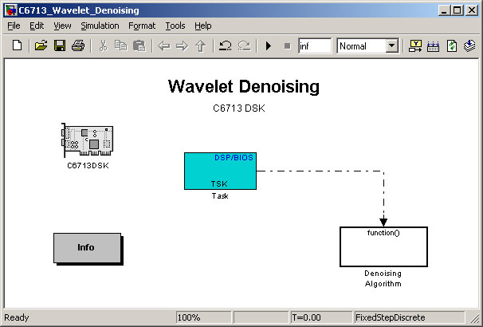
Matlab Model for Denoising
Load the “C6713_Wavelet_Denoising.mdl”

Slide 30
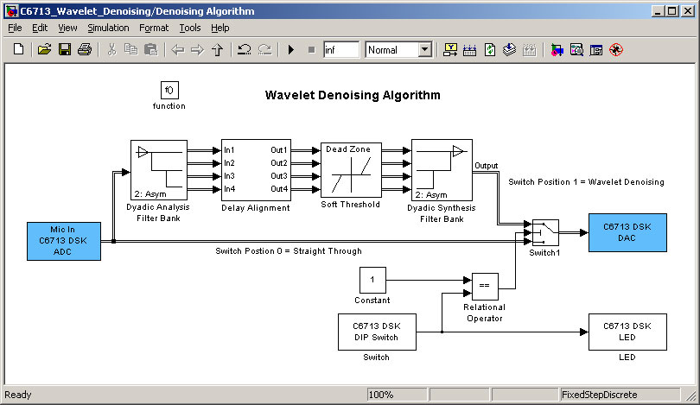
Denoising Subsystem

Slide 31
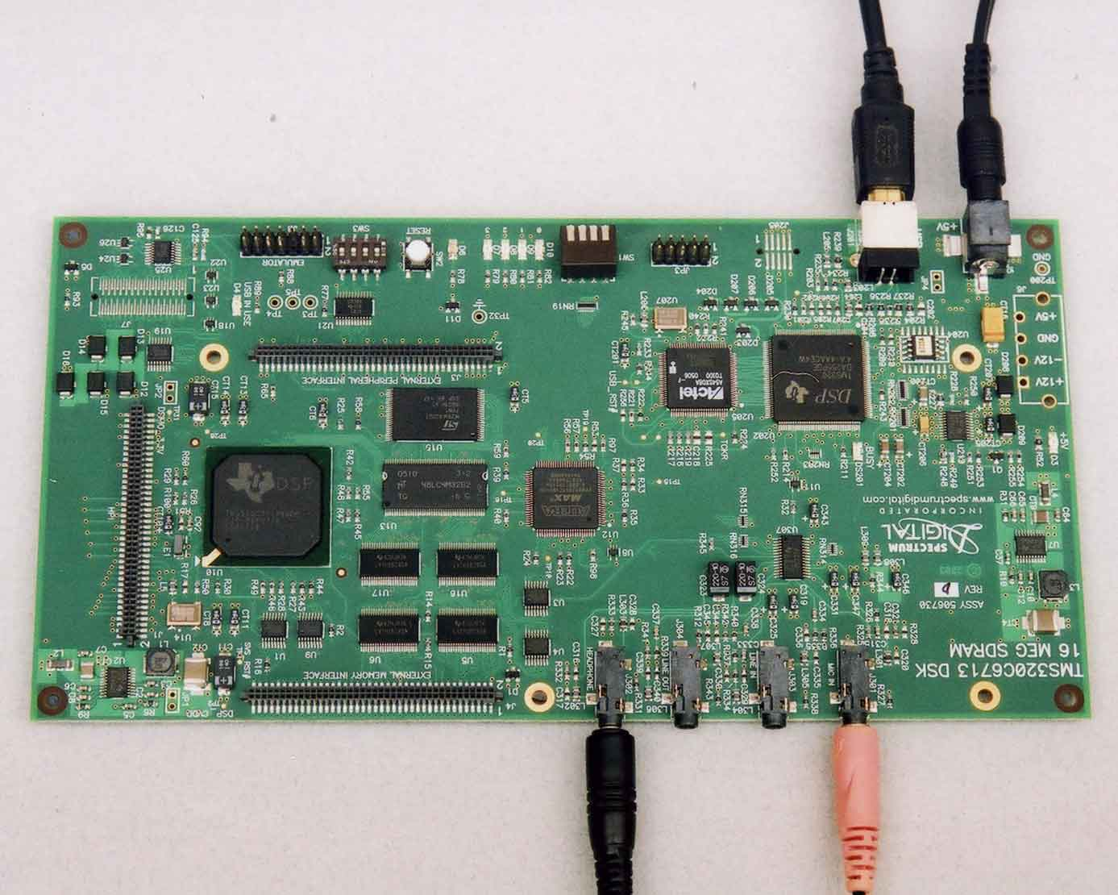
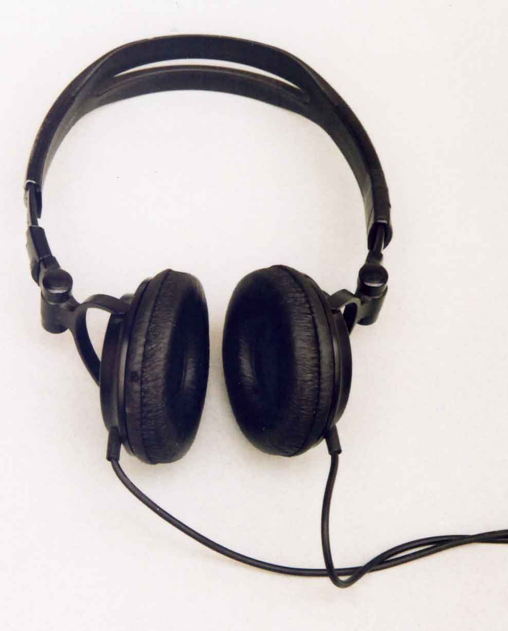
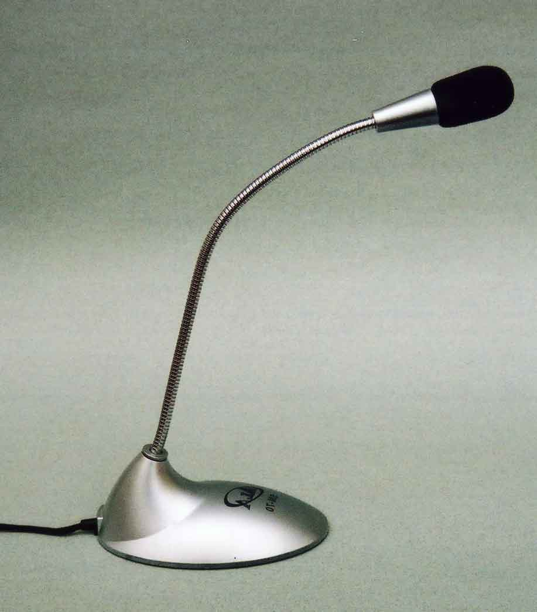
C6713 DSK Setup
USB to PC
to +5V
Headphones
Microphone

Slide 32
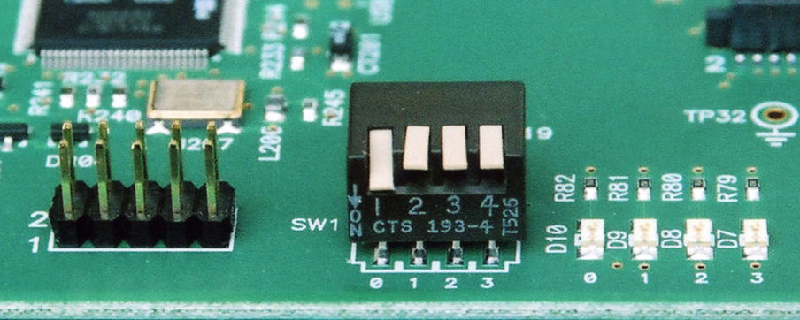
Wavelet Denoising on C6713 DSK
Speak into microphone. Compare results with two different switch positions:
  SW1 = off off off off. Original sound.
  SW1 = on off off off. Wavelet noise reduction.

Slide 33
References
On World-Wide Web: “The Wavelet Tutorial” by Robi Polikar. Part I to Part IV.
Digital Signal Processing, A Practical Approach by Emmanuel C. Ifeachor and Barrie W. Jervis. ISBN 0201-59619-9

