Slide 1

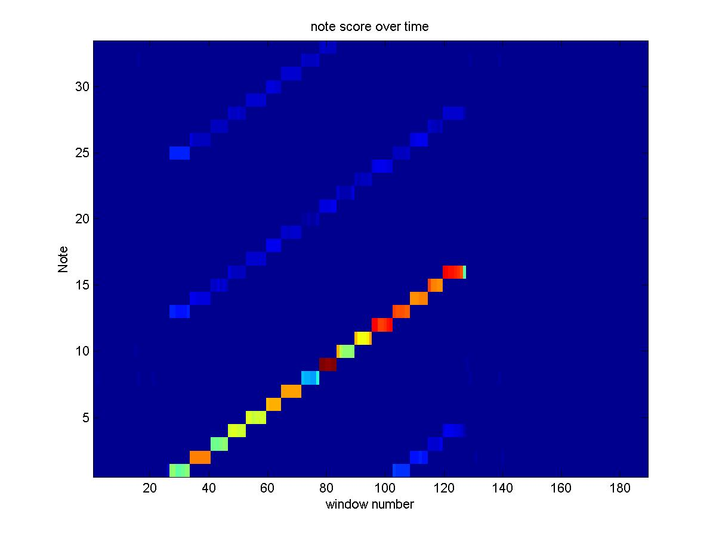
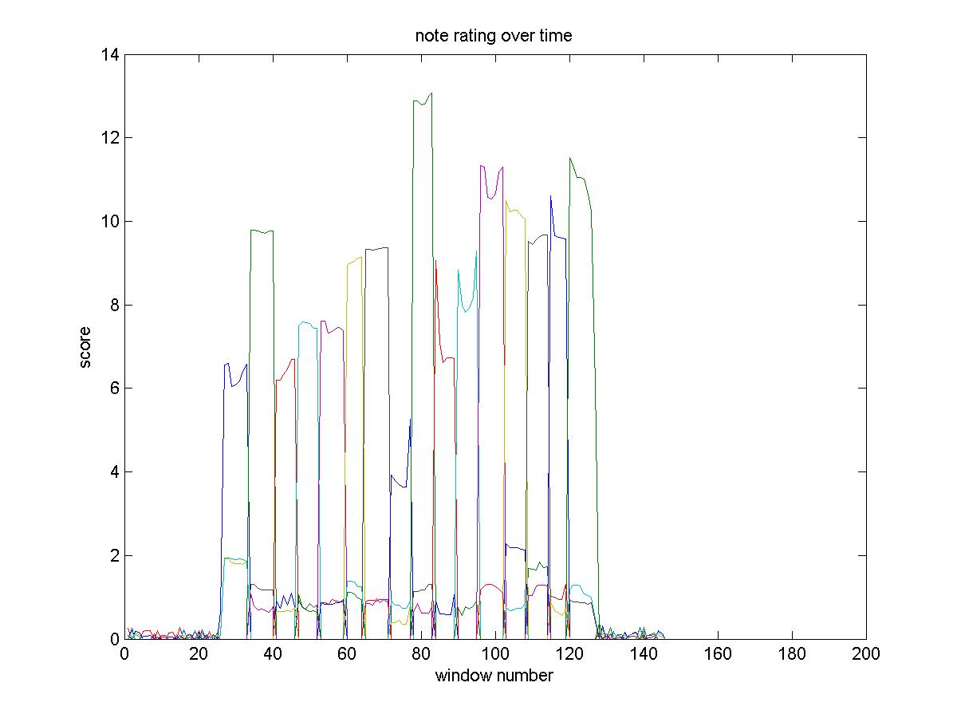
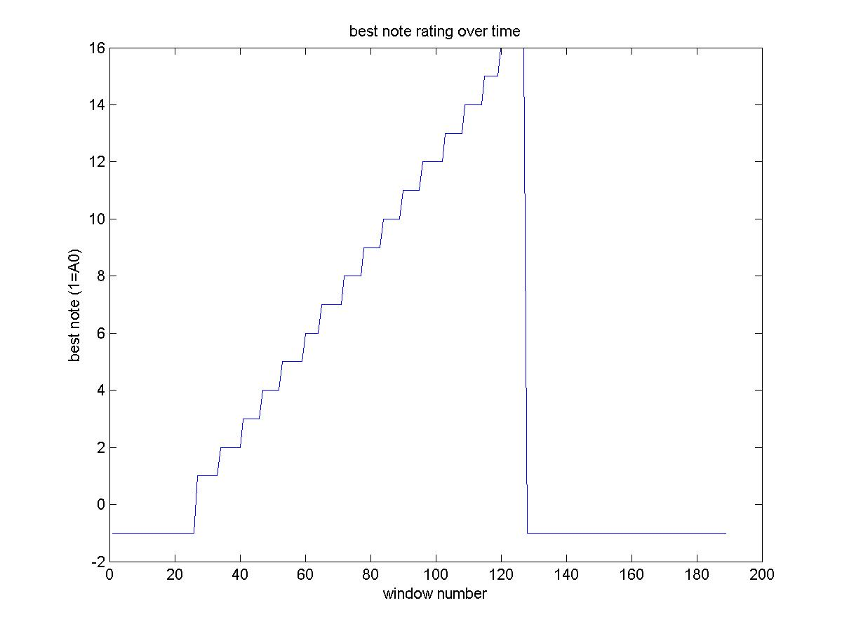
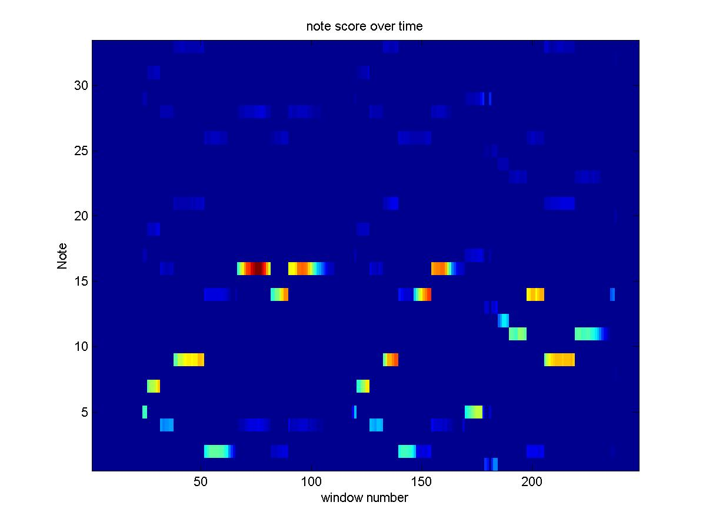
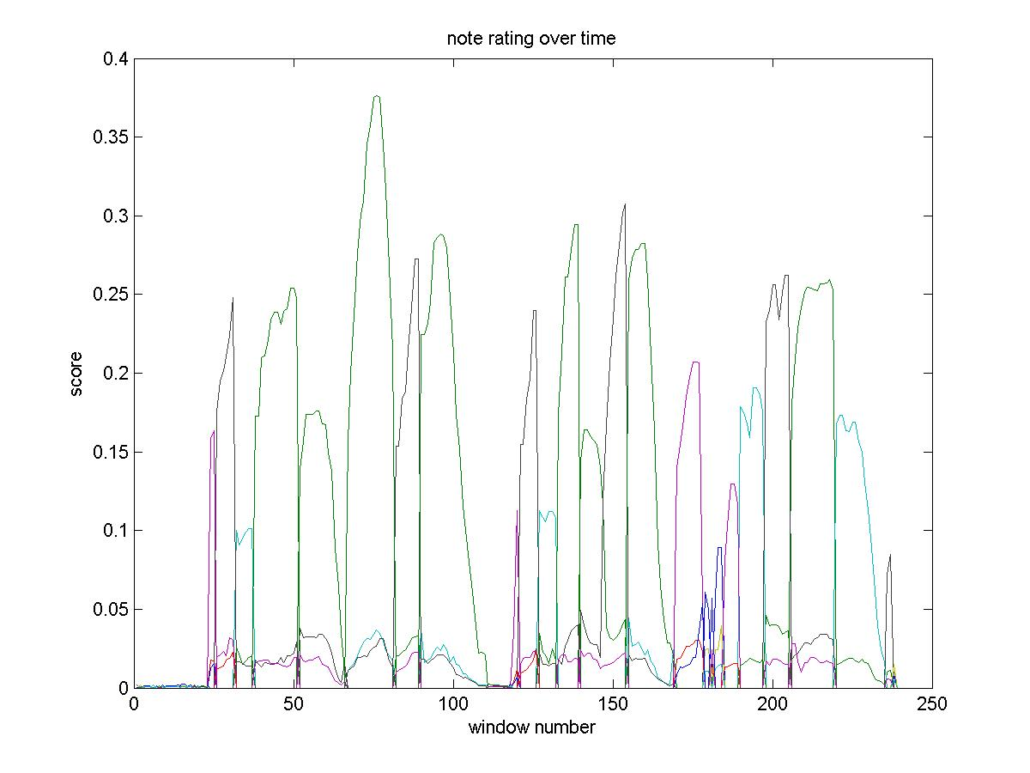
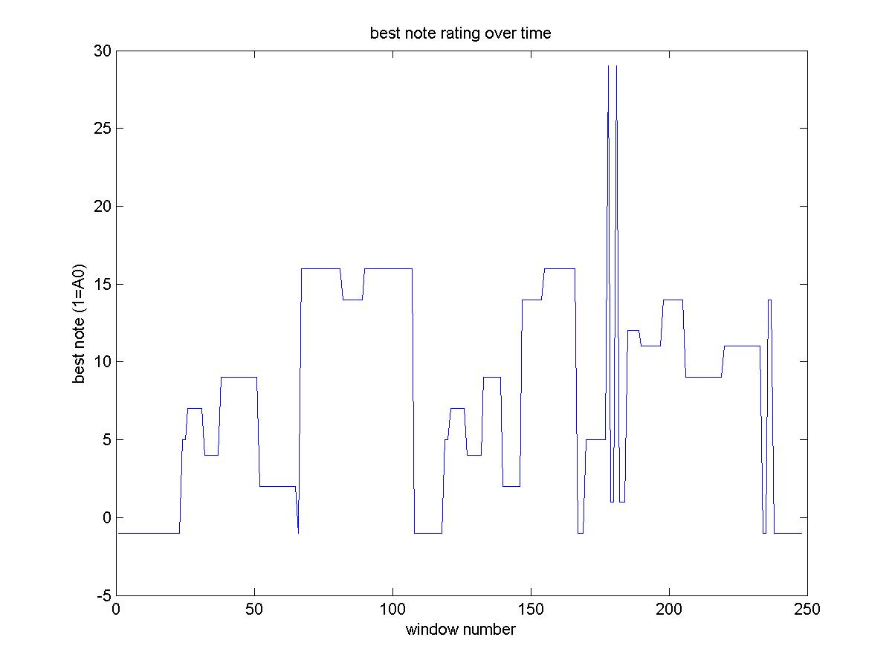
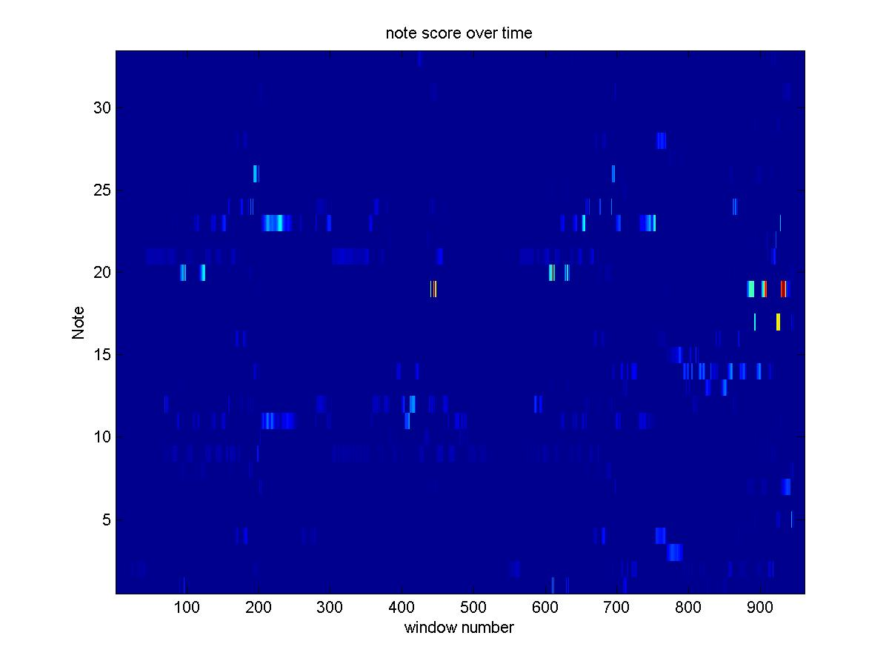
Instrument and Note Identification
by Charles Tripp, Michael Lawrence and Nathan Shaw
Abstract
Song
Note Samples
This project attempts (and, for the most part, succeeds) to identify a single instrument lost among a barrage of other instruments. More than that, it attempts to identify which sequence of notes the instrument is playing, the volume at which it plays them and the duration of time for which the instrument plays. We achieve this through comparing samples of the instrument for which we are looking with the examined song. A combination of heuristic and matched filter techniques are used
Boxcar
Hanning
Power of notes for chromatic scale
Likelihood of note being played for chromatic scale
Introduction
Matched
filter
FFT
Our project’s goal is to be able to take in a song and produce an output that will identify the notes that are being played by a specific instrument, when they are being played within the song and the length of time for which each note is played. The output is to be user friendly so that the note being played can be found relative to the time that has passed in the song.
Score estimation of chromatic scale
Power of notes for Stravinsky piece
Check power
at harmonics
of each note for the
“most powerful”
notes in window
FFT
Methods
Likelihood of note being played for
Stravinsky piece
The theory is relatively simple. For the instrument recognition to work, we must first have a sample of that instrument playing. Ideally, we would need only one sample from which we could derive all the others using the one-dimensional application of a Mellin-Fourier transform. Considerations of time, however, caused us to forgo this option. For the purposes of this project, 33 samples (i.e. notes) of a clarinet playing were recorded. Each of these samples was then matched against the inputted waveform to measure correlation. The algorithm for accomplishing this task is as follows:
1. If it is too large, "chop" the inputted waveform (henceforth referred to as "signal," an all-encompassing term) into smaller, easier-to-handle chunks;
2. Input each of those chunks into a program which takes the Fourier transform of both the signal and the samples, multiplies them, and then inverts them back into the time-domain (i.e. convolves the two signals);
3. Based on various thresholds and numerous considerations, choose the sample which most closely matches the signal (i.e. read off the highest peak and assign it a value; if that value is high enough, select it as the representative sample);
4. Output the data in a user-friendly fashion.
We carried out this algorithm utilizing Matlab commands.
Score estimation of Stravinsky piece
X
FFT
Filter samples so
that only relevant
samples are tested
Power of notes for a multi-instrument piece
Results and Conclusions
We found that our methodology was able to efficiently produce the output that we desired. The plots that we ended up with are able to communicate the information we were looking for by associating values from 1 to 33 with specific notes and then plotting the notes that appear versus time. As of yet, though, we have not analyzed a song that has multiple instruments playing at once and pick out a specific instrument. It would also be nice if we were able to develop our project to the point that our output would be the score of the analyzed song. We discovered as we did our project that there was a trade-off between precision and quality in that if we wanted our program to be more accurate in determining what the exact note being played was through shifting a threshold then the likelihood that the program would miss something that was there went up.
Inverse FFT
Score for this
sample in this window
Max

