Slide 1

Chapter 1 - History of Computing
Introduction to Computing
Chapter 2 - Industry of Computing
Chapter 3 – Structures in Computing
Chapter 4 – Security, Privacy, & Ethics in Computing
Chapter 5 – Current Uses in Computing
Greg Johnson
William.Johnson@gpc.edu
Julia Benson-Slaughter
Julia.Benson-Slaughter@gpc.edu

Slide 2
Computing?
Computer Frustration!
Peripheral Frustration!
Input Error!
Ultimate Frustration!

Slide 3
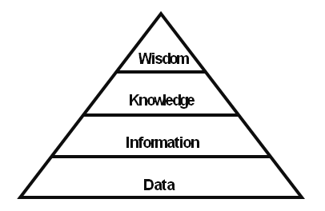
Data, Information, & Knowledge
What is data?
What is information?
What is knowledge?
Diagram by RobOnKnowledge (Own work) [CC-BY-SA-3.0 (http://creativecommons.org/licenses/by-sa/3.0)], via Wikimedia Commons from Wikimedia Commons

Slide 4
What's the difference?
One perspective from Bob Boiko of the University of Washington (video)
A more detailed explanation

Slide 5
Information = data + context
Group multiple pieces of data together
Establish relationships between data items
Provide context/framework for data
Interpret resulting combination

Slide 6
Validity of Information
Valid Data -> Valid Information?
Not necessarily!
What if the data is incomplete?
What if the data is inaccurate?
What if the context for the data is missing?
If information is invalid, what happens to knowledge?

Slide 7
Where Do Computers Fit In?
Computers store data.
Computers process data
Computers generate information

Slide 8
Data Processing Examples
Organize data
Calculate new data
Interpret data in a different format
Spreadsheets Database management systems
Accounting software
Graphics manipulation programs

Slide 9
Visualization as a Tool
David McCandless uses visualizations to turn large amounts of data into information.
Ted Talk 2010
Data, Information, Knowledge, Wisdom
Note his take on the diagram on page 3
His Information is Beautiful website has many more examples of visualizations of data.

Slide 10
Reflect & Investigate
Give your own example of valid data producing invalid information.
Explore the Information is Beautiful website and find a visualization, either in the blog or the Our Data section, that you think does a particularly good job of turning data into information. Why did you choose this particular item, and what makes it so good?

