Slide 1
Presenting to Managers and Other Professionals
The Cain Project in Engineering and Professional Communication
ENGINEERING SERIES

Slide 2
Professional Engineering Presenters
Are aware of organizational context
Know professional audience needs vs. professor’s needs
Build trust and confidence
Reinforce what they say with body language and advanced visuals
Make understandable, accessible presentations

Slide 3
Teams Communicate in an Organizational Context
ORGANIZATIONAL SYSTEM and CULTURE
^{Technical}
^{activities}
^{Team}
^{Presentation}
^{Input} ^{to}
^{Team}
^{Output to}
^{system}
^{Team’s} ^{professional role}

Slide 4
Managers Differ from Professors
Professors
Know more about subject than presenters
Interested in following correct procedures
Able to fill in gaps
May take no action
Judge on “right or wrong”
Managers
  Don’t know what you’ve found out
  Interested in how new information will achieve company goals or solve problems
  Not able to fill in gaps
  Will take action

Slide 5
Communication Enables Work of Other Groups and Company Processes
Team must frame technical content according to audience’s purposes, not just team’s purposes
To guide technicians work
To affect group discussion
To help teachers
inform students
EXXONMOBIL CHEMICAL: Many applications of information

Slide 6
Context May Be Global, Audiences International
^{EXXONMOBIL CHEMICAL EUROPE}

Slide 7
Signal Your Professional Identity to Build Trust
What characteristics or accomplishments of yours are related to their interests?
Is there a brief story or experience that proves these characteristics?
What empirical evidence can you offer?
Who would recommend you or your firm?

Slide 8
Good Delivery Also Builds Trust
Word choice - suited to audience knowledge
Body language - open, assured
Voice pacing and pitch - slows down for key statements, speeds up on details
Eye contact - direct and friendly
Delivery - enthusiastic but not nervous

Slide 9
Analyze Audience’s Expectations
Greatest benefits for audiences?
Keys to their decision?
  Purity of Product? Cost? Return?
  Implementation? Safety? Timing?
Their “Yes, but . . . .” objections”?
Their preferred forms of proof?

Slide 10
Organize to enable other groups’ work and processes
Use Two-Part Structure
  Introductory Summary
  Discussion
Choose common patterns to organize the discussion
  Need / Satisfaction
  Problem (Analysis into Parts) /Solution (comparison of options)
  Comparison
Use “Feature/Function/Benefits” Pattern
to Support Claims in a Sales Proposal
  Ex. “we introduced a recycle loop to heat the incoming stream and thereby reduce utilities costs.”

Slide 11
Sample Organization of Topics
Who you are, summary of benefits, what you will show
Critical problems or aspects of project
How design addresses these aspects
How features affect costs
Qualifications, implementation issues
Request for approval

Slide 12
How to Focus on Essentials
Simplify or focus claims, strip away clutter in graphics, argument
Build on what they already know
Present one point at a time
Preview, present, review

Slide 13
Establish a Professional Team Image
Coordinate your visual image - colors, styles of clothing
Introduce one another as you “hand off” the speaking role
Coordinate your speaking styles
Watch one another attentively
Practice so everyone is relaxed, confident

Slide 14
Use Parallelism
Not Parallel:
  Lyse cells in buffer
  5 minute centrifuging
  Supernatant is removed
Your turn
Parallel:
  Lyse cells in buffer
  Centrifuge for 5 minutes
  Remove supernatant

Slide 15
Slim down Wordy Text
The ideal anesthetic should quickly make the patient unconscious but allow a quick return to consciousness, have few side effects, and be safe to handle.
Ideal anesthetics
  Quick sedation
  Quick recovery
  Few side effects
  Safe to handle

Slide 16
Persuade with Graphs
Label clearly
Don’t include irrelevant information
Set up expectations with topic plus claim in the title
Coordinate point sizes to indicate hierarchy and enable viewer to grasp information without refocusing

Slide 17
Adjust Diagrams to Facilitate Understanding
Simplify when needed for complex audiences with varied backgrounds
Use font size and colors to direct attention
Choose animations to allow audiences to see portions of the whole

Slide 18
Sample Adaptations of Diagrams in Chemical Engineering Talks
Process Flow Diagrams

Slide 19
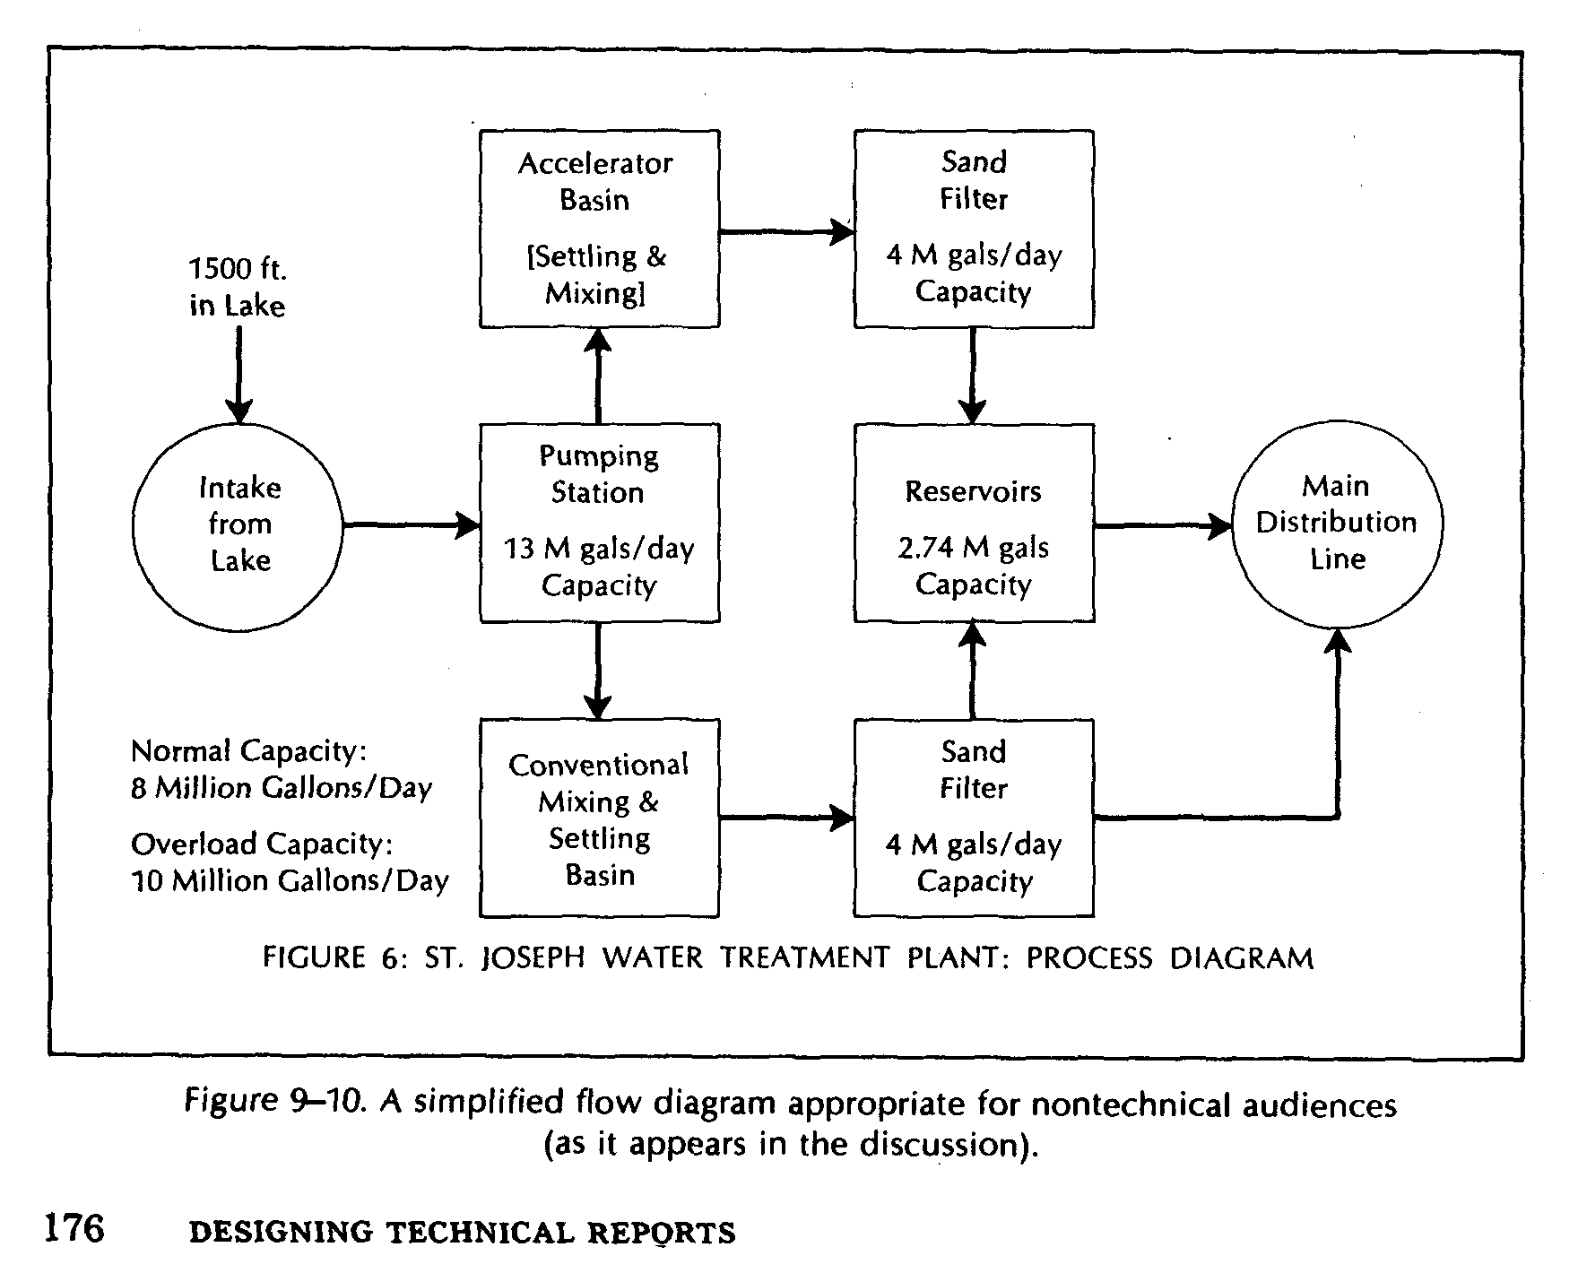
Offer Familiar Images First
Offer figure or image familiar to audience first
Technical image next
Water treatment xample for government officials

Slide 20
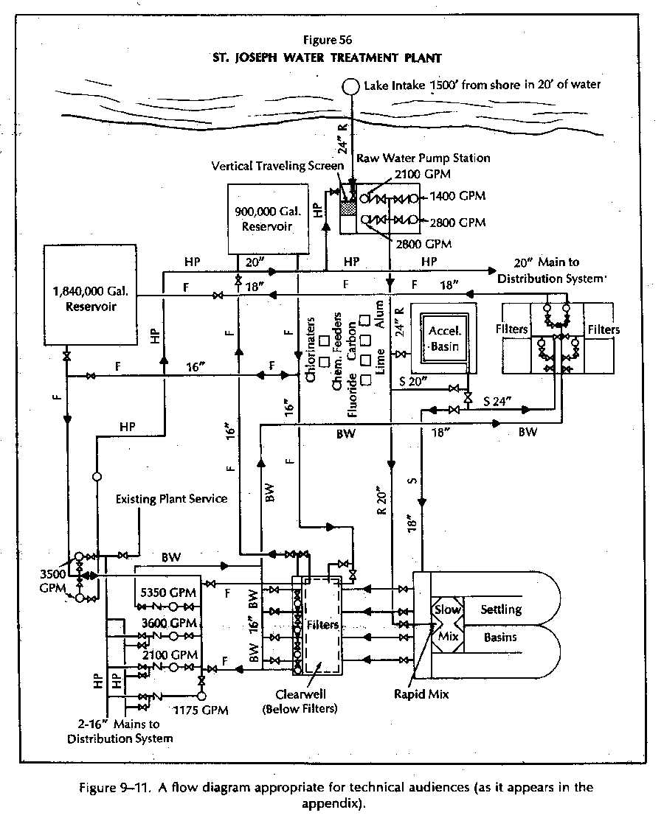
Give Technical Images Next
Build toward technical understanding
Sequence: Photo / diagram/ schematic/ cross-sections/other technical drawings
Water treatment example

Slide 21
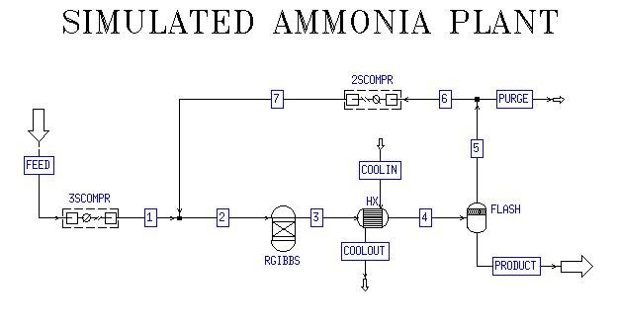
Show Sequence with Animations

Slide 22
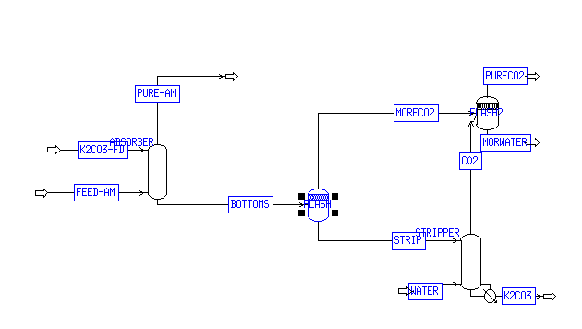
Process Flow Diagrams
(poor example--WHY?)
May be understood only by a few experts in audience
Adapt point sizes and fonts before inserting!

Slide 23
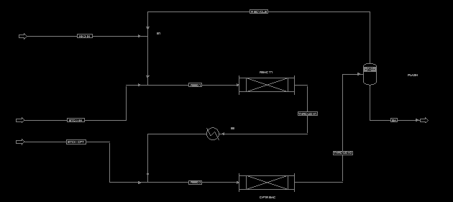
Process Flow Diagrams
Apply Basic Principles in Critique:
Hard to read in large room, no direction of attention

Slide 24
Achieve Professional Status
In Summary
Analyze context, audience
Make argument comprehensible, accessible
Establish your professional credibility through words, body language, and advanced visuals
Practice several times for poise, calm

Slide 25
Lead through Excellence
in Engineering Communication
More resources are available for you
under “Engineering Communication” at Connexions at http://cnx.org
at the Cain Project site at http://www.owlnet.rice.edu/~cainproj
in your course Communication Folder in OWLSPACE.

