Slide 1


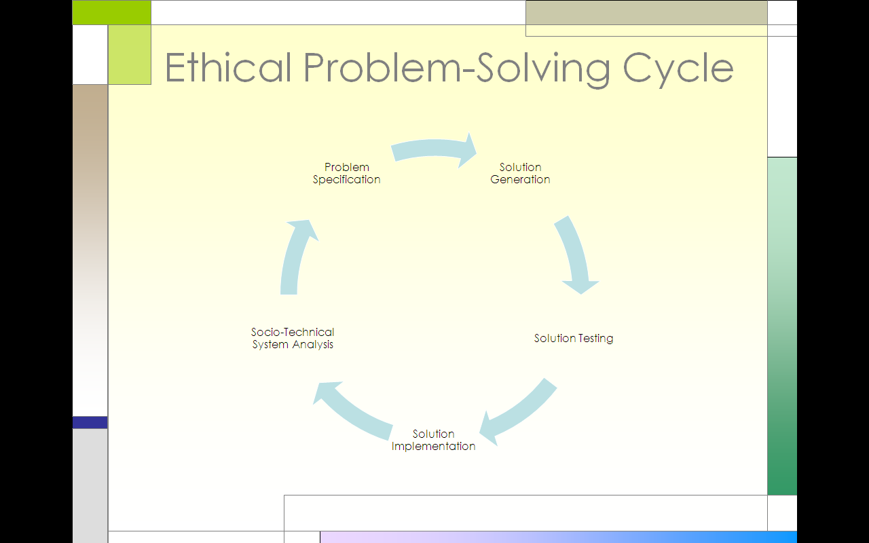
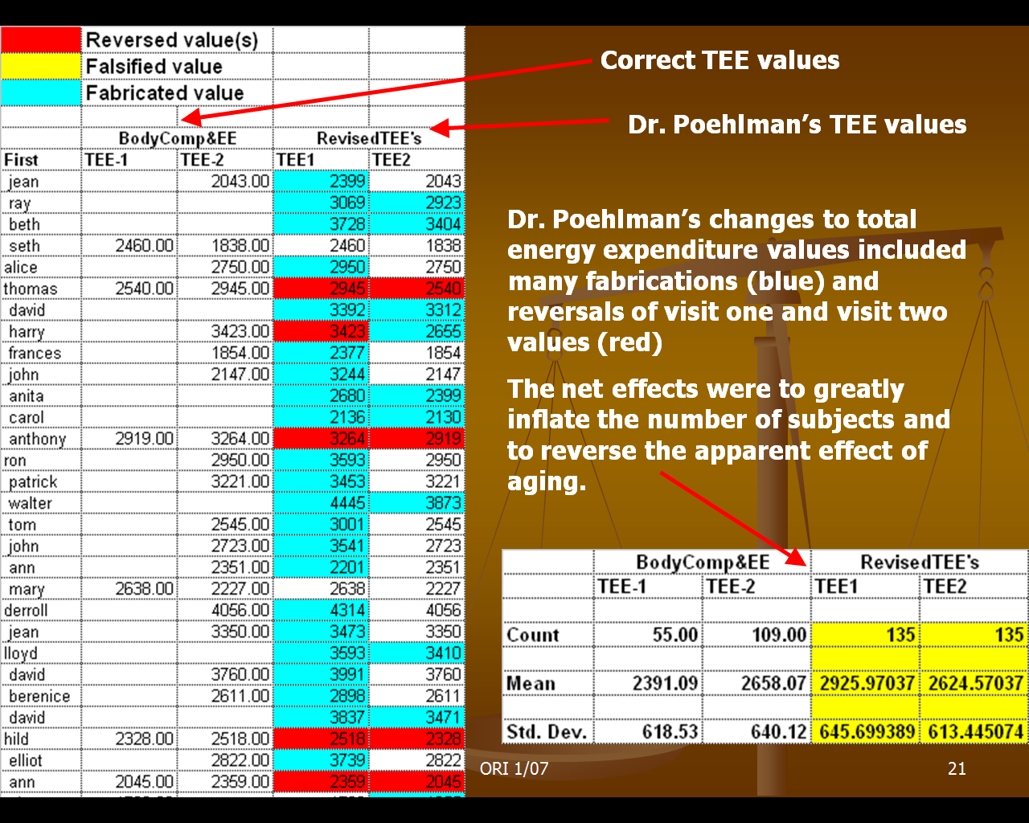
Research Misconduct: Case of Poehlman (GERESE)
William J. Frey and Carlos Ríos-Velázquez
University of Puerto Rico at Mayagüez, College of Business Administration and College of Arts and Sciences - Biology
Overview
Problem Solving Methodology
Solution Evaluation Matrix
Eric Poehlman currently teaches science to 9th grade students in Montreal, Canada. This is a long way from when he was a tenured professor University of Vermont and at the University of Maryland specializing in human obesity and aging. In 2006, he was found guilty of scientific misconduct for fabricating and falsifying 17 grant proposals and 10 research papers. Laboratory assistant, Walter NeNino, observed these irregularities and brought them to the attention of the ORI (Office of Research Integrity). After an intensive investigation, Poehlman spent a year and a day in federal prison and was subjected to a lifetime ban on applying for research funds (See Wikipedia and ORI Press Release
http://ori.dhhs.gov/misconduct/cases/press_release_peohlman.shtml
 |  | Harms and Benefits | Virtues and Values | Reversibility
Solution A | Do nothing | Propagating scientific falsehood Wasting scarce research funds | Displays vice of irresponsibility (based on lack of care) | Fails when reversing with scientists competing for research funds
Solution B | Confront Poehlman and given him a chance to come clean | Poehlman may not respond but take retaliatory action against you | Virtue of responsibility combined with reasonableness | May not reverse with rest of scientific community
Solution C | Report to University authorities | Harms Poehlman’s reputation (but this may not be avoidable) | Virtues of responsibility and reasonableness
Solution D | Report incident directly to ORI | Could harm reputations of both Poehlman and university | Responsibility but not reasonableness | May not reverse with university by not allowing them to investigate it themselves
Data Fabricated and Falsified by Poehlman
www.ncbiotech.org/services_and_programs/intellectual_exchange/documents/nih_integrity_five.ppt
Witness Testimony
(Chris B. Pascal, J.D., Director, Office of Research Integrity )
Socio-Technical System
The incident that triggered my suspicions occurred in late September, 2000 - I was asked by Dr. Poehlman to write a paper from a longitudinal database (Protocol #678). The paper was to examine the effects of age on lipids in men and women… When I presented him with the data, he was not satisfied with the results and asked for the database in order to verify data entries and check for what he described as "reversed" datapoints, … It was my belief that I was mistakenly given a “true” version of the dataset originally and then given the manipulated version the second time…
Laboratory Equipment | Chemicals and Medicines | Physical Surroundings | People, Groups, and Roles | Procedures | Laws | Research Data
 | Hormone Replacement Therapy |  | Dr. Poehlman (Resercher) | Fabrication | ORI procedures of investigation
 |  |  | Walter F. Denino (research asst) | Falsification | Civil procedures
 |  |  | US Attorney General Office | Grant Application | Criminal procedures
 |  |  | ORI (Office of Research Integrity) | Experimental procedures (double blind)
 |  |  | UVM and UM

Slide 2
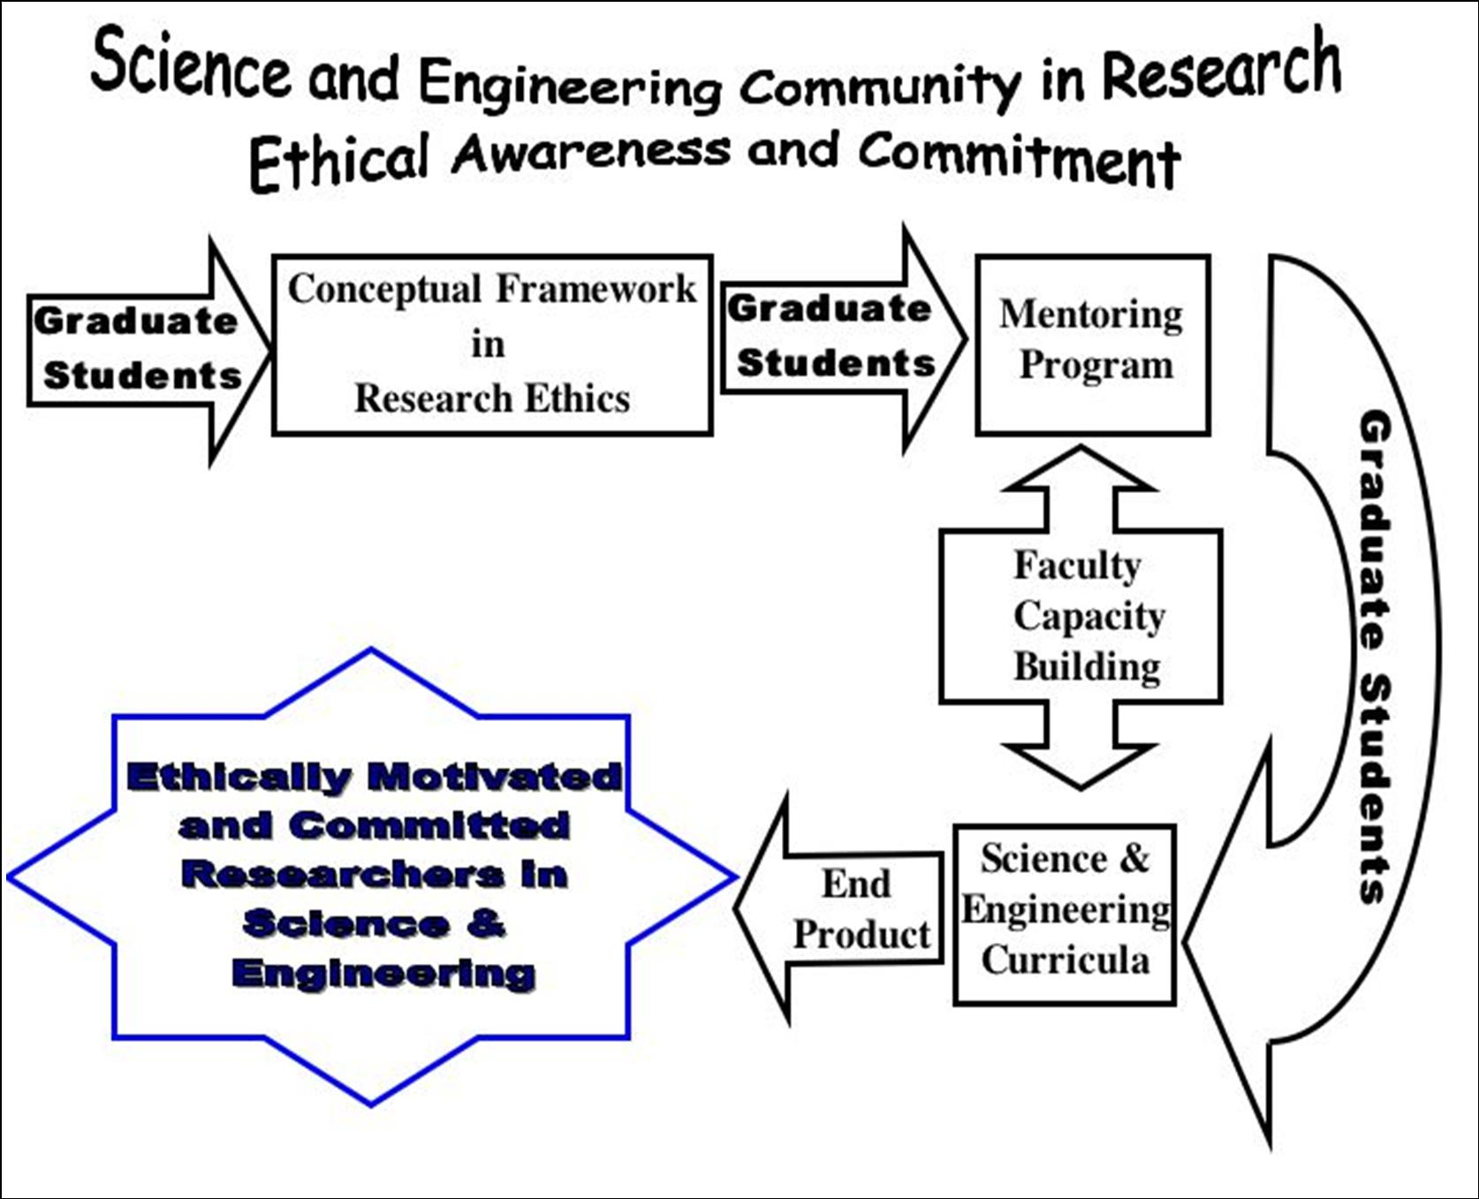
GRADUATE EDUCATION IN RESEARCH ETHICS FOR
SCIENTISTS AND ENGINEERS
Jorge J. Ferrér-Negrón¹, William J. Frey¹, Efraín O’Neill-Carrillo², Carlos Ríos-Velázquez³, Didier M. Valdés⁴
University of Puerto Rico at Mayagüez, Department of ¹Humanities, ²Electrical Engineering, ³Biology, ⁴Civil Engineering
Overview
Methods
Assessment
This project will employ an innovative EAC (Ethics Across the Curriculum) approach based on integrating (a) a newly designed freestanding course in graduate research ethics, (b) a series of workshops for graduate students in research ethics, and (c) ethics integration exercises and modules developed by engineering and science faculty for their discipline-specific courses. EAC requires the timely integration of ethics activities into strategic points throughout the science and engineering graduate curriculum to help graduate students recognize that ethics is a central, not a peripheral, component of research. To bring this point home, this project includes an innovative capstone activity where students will (1) prepare poster presentations on cases in research ethics, (2) analyze these using frameworks, concepts, and principles acquired throughout their education, and (3) present their analyses before peers and faculty mentors at a special activity, a Graduate Student Research Ethics Banquet.
The team of principal investigators, the senior personnel, and the EAC strategic approach attest to this proposal’s strong interdisciplinary focus. Ethical issues that arise in the categories of Academic Integrity, Research and Social Responsibility, and Research’s Environment provide this project’s central themes.
Task | Goals and Objectives | Performance Indicators | Data Collection Approach & Tools | Schedule
Ethics Across the Curriculum | Implement a framework to integrate ethical awareness and commitment in graduate curricula | Number of graduate courses impacted by faculty members with EAC and ethics modules, Number of Faculty Members that have been involved actively in EAC for Graduate Students. | Surveys Interviews with Department Heads Faculty follow-up activities | Formative: towards the end of each semester Summative: in summer
Course Development | Treat systematically topics in Research Introduce ethics and ethical deliberation | New graduate course created: Graduate Course on Research Ethics, graduate student learning outcomes | Student Portfolio Course exams Perception survey – final | Formative: Mid-semester Summative: Final Exam
Graduate Student Workshops | Ethical Awareness Ethical Evaluation Ethical Integration Value Realization | Specific modules in Research Ethics for Graduate students, Number of Graduate Students participating in the Awareness Workshops and in the Introductory Research Ethics Workshops for Students | Pre-test and post-test Gray Matters exercises Perception survey – final | Before and after each workshop
Faculty and Researchers Workshops | Introduce ethical theory and ethics across the curriculum to faculty Establish faculty mentoring on EAC | Number of Faculty members and researchers participating in the Research Ethics Workshops for Faculty and Researchers | Evaluation of cases developed, conceptual assessment (area-specific and interdisciplinary knowledge and capability) | Before and after each workshop
Main educational objective
To design and integrate a pilot program in research ethics for graduate students in science and engineering to prepare them to face the complex and encompassing ethical and social issues that arise in professional activity.
This project will increase graduate student ethical awareness and commitment through a series of activities:
Graduate student and faculty development workshops, a freestanding course, and a capstone activity.
2.Designing of research ethics cases and materials by the participating faculty for the graduate students.
3. Faculty mentoring workshops.
Intellectual merit and pedagogic impact
This proposal will adapt and integrate tested and successful approaches to ethics pedagogy:
EAC activities will be co-integrated with a freestanding course in graduate research ethics; the resulting synergies will strengthen both.
Faculty workshops will identify issues and develop classroom materials that will be integrated into the freestanding course.
4. The pedagogical activities proposed in this project, such as the Mentoring Program, provide excellent opportunities to test, assess, previous initiatives and even develop new teachable skills underling exemplary behavior and good works.
3. The interaction during the workshops and the mentoring activities will allow that students be coached in the skills needed to advocate ethical and professional values in the context of group decision-making.
Categories of Research Ethics Issues and Examples
Academic Integrity Issues (Epistemic Research Values) | Research and Social Responsibility Issues (Natural and social environment, human subjects) | Research Environment Issues (Collaborative enterprise issues)
Confidentiality Integrity Intellectual property Authorship Copyright Patents Trade marks and trade secrets Fabrication Falsification Plagiarism | Research with human subjects and human cells Vulnerable populations Informed consents Use of animals in research Public Policy Commitment and relationship to industry Environmental protection | Mentorship Peer review Conflict of conscience Conflict of commitment Conflicts of interest Responsible scientific record keeping

Slide 3
Ethical Problem-Solving Cycle
Solution Generation
Solution Testing
Solution Implementation
Socio-Technical System Analysis
Problem Specification

