Slide 1
Accepting the likelihood of ambiguity and disagreement on moral matters: transitioning into the gray world
Carlos Rios-Velazquez
William J. Frey
University of Puerto Rico at Mayaguez

Slide 2
Agenda
Hastings Center Objective 5: learning to confront moral ambiguity and moral conflict
Gray World as GERESE Outreach Project
New Version for Graduate Students and Biology Faculty
Transitioning: Black and White to Gray
Turn train the trainer on its head
Assessment: Keeping it Simple

Slide 3
Rawls
“Diversity naturally arises from our limited powers and distinct perspectives; it is unrealistic to suppose that all our differences are rooted in ignorance and perversity, or else in the rivalries that result from scarcity….Deep and unresolvable differences on matters of fundamental significance…[must be acknowledged] as a permanent condition of human life”
Martin Benjamin quotes Rawls in Splitting the Difference

Slide 4
John Dewey
“persons of equally well-meaning dispositions find that justice means opposite things in practice, although all proclaim themselves devoted to justice….”
Theory of the Moral Life, 140-141

Slide 5
Anthony Weston
“Swamps are enormously complex and creative ecosystems—think of the Everglades—and they are places that we can make our way around quite well if we are sufficiently careful, respectful of their powers, and appropriately equipped. Suppose that ethically we are indeed in a sort of swamp: is that so terrible a fate?”
Anthony Westin, “Unfair to Swamps: A Reply to Katz.” Environmental Ethics 10(3): 287.

Slide 6
Hasting Center: Objective #5
“help students to accept the likelihood of ambiguity and disagreement insofar as it is reasonably attainable.” (Pritchard 1996)
A Strategy
start with clear cut situations
Transition, step-by-step, into moral conflict and moral ambiguity.
Two case-based pedagogical tools:
Layered Cases
Rashomon Cases

Slide 7
Module began as an outreach activity for gerese
Graduate Experience in Research Ethics for Scientists and Engineers (NSF 0629377)

Slide 8
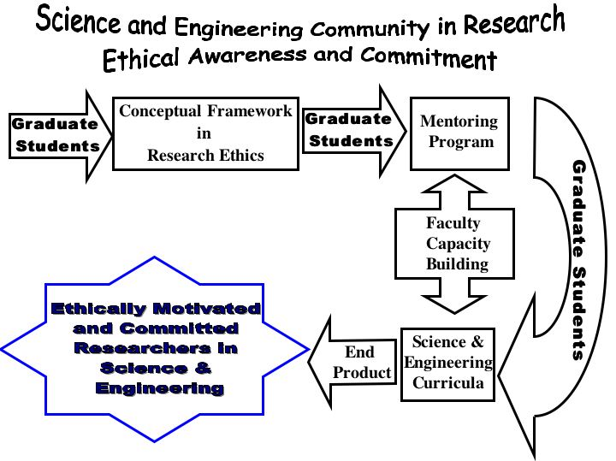
NSF-0629377: GERESE

Slide 9
GERESE Activities
Graduate Awareness Workshop
“double axiological axis” = issues in research ethics
SE faculty identify issues in workshop
Moral Deliberation Workshop:
moral complexity can be eliminated by achieving a moral point of view
Case Analysis Workshop:
Introduces moral complexity through “layered” cases and “Rashomon” dramatic rehearsals
Research Ethics Banquet
Students prepared case study posters

Slide 10
Plagiarism 50
Scientific Rigor 45
Authorship 32
Record Keeping 25
Misrepresenting Expertise/Competence 24
Power Disparity 21
Stealing Ideas (Robo de Ideas) 20
Amiguismo (Showing undue partiality to friends) 17

Slide 11
a double axiological axis helps identify key issues
Axis of Truth | Axis of Social Responsibility
Academic Integrity (Epistemic Research Values) | Responsibility Issues | Research Environment Issues
Confidentiality Integrity Intellectual Property Authorship Copyright Patents Trade marks and trade secrets Fabrication Falsification Plagiarism | Research with human subjects and human cells Vulnerable populations Informed consent Use of animals in research Public policy Commitment and relationship to industry Environmental protection | Mentorship Peer review Conflict of commitment Conflict of interest Responsible scientific record keeping
GERESE – Faculty Retreat on Research Ethics - 2009

Slide 12


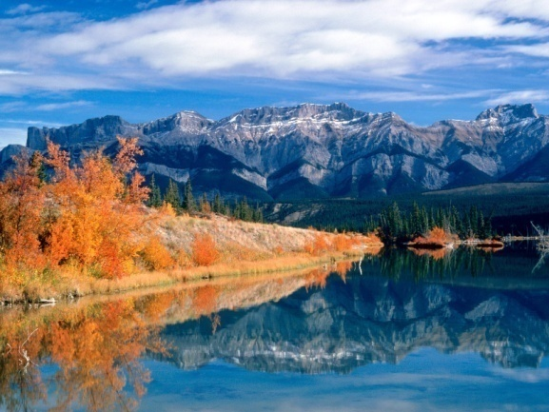
ANALISIS ETICA EN LA INVESTIGACION –
CASO: pH en Lagos (“pHish Tale”)
Rafael Tomas Victoria Bournigal, Juan Balbuena Merle
University of Puerto Rico at Mayagüez, Department of Engineering and Surveying
Presentación de Hechos
Consecuencias / Valores
El número de peces en ciertos lagos ha ido disminuyendo.
La EPA impulsa un estudio auspiciado por el gobierno, en el cual participa el Dr. Tom.
El estudio indico que el pH de los lagos ha disminuido considerablemente.
El pH bajo es mortal para ciertas especies de peces.
Tom sospecha que la causa del problema son las plantas eléctricas en el área adyacente a los lagos, pero los resultados del estudio no son suficientes para probarlo.
Se planifica otro estudio de cinco años, pero en este periodo la mayoría de los peces habrán desaparecido.
Tom tiene conexiones en un grupo ambientalista que promueve la relocalización de las plantas eléctricas.
Tom posee dudas sobre involucrarse con los ambientalistas sin tener pruebas concretas de la causa del problema.
Para los cursos de acción a y b:
Tom está cumpliendo con su deber de ser objetivo al no dar declaraciones sin fundamentos y mantenerse neutral.
Intenta cumplir con su deber de proteger el medio ambiente sin comprometer su integridad profesional.
Para curso de acción c:
La reputación de Tom puede perjudicarse ante la comunidad científica.
Para curso de acción d:
La reputación de Tom se perjudicara por no mantener una posición neutral.
Situación adicional del caso
Cursos de acción recomendados
Posibles cursos de acción.
“Suponga que Tom habló con Susan y ella le dice que el público no entiende las sutilezas de la investigación científica. Ella dice que para tener un impacto, Tom tendrá que presentar los resultados del estudio preliminar en los términos más amplios posibles y suavizar las incertidumbres. Tom no se siente cómodo con ese lenguaje tan definitivo, pero Susan insiste en esa postura. ¿Qué debe hacer Tom?”
Recomendamos que Tom tome los cursos de acción a y b ya que en estos logra mantener su integridad profesional y a la misma vez está tratando de proteger el medio ambiente y la economía local del área de los lagos.
Buscar resultados de estudios similares para intentar proveer una solución temporal, hasta tener los resultados del estudio propuesto sobre la causa.
Ver si hay disponibilidad de recursos para disminuir el tiempo del estudio, en caso de no haber fondos buscar auspicios.
Involucrarse con los ambientalistas, abogando en contra de las plantas eléctricas.
Involucrarse con los ambientalistas dando su opinión profesional sobre las causa del problema en los lagos, especificando que no hay pruebas concretas.
Si Susan insiste en mantener esta postura creemos que Tom no debería involucrarse con este grupo ya que su deber como investigador no le permite tener una posición definitiva sin tener pruebas contundentes. Debería presentar a Susan la opción de dar su opinión profesional sobre la posible causa de la disminución de pH, especificando que se basa en sus años de experiencia y no en los resultados del estudio.

Slide 13
Presentations at UPRM, UPR-Ponce, and Inter American Summer Camps
Visits to public and private schools in Western Puerto Rico (50 minute sessions)

Slide 14



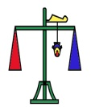



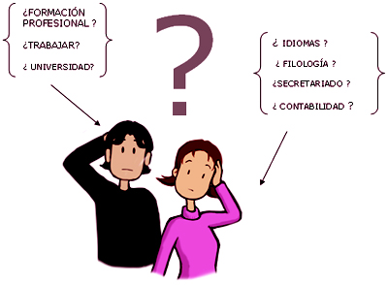
DILEMAS
¿ Qué quieres ser en un futuro?
¿ Qué quieres estudiar?
Hay diferentes tipos de dilemas
http://www.discapnet.es/guias/fichasdidacticas/html_orientacion_vocacional/images/grafico09.jpg
Notes:
Dilemma = situation that calls for deliberation. It is not a forced choice between two alternatives.

Slide 15






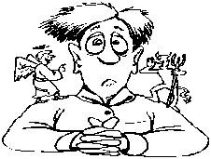
La Libertad
Ante los Dilemas, ¿Tenemos la libertad de tomar por varios caminos?
¿Los científicos e Ingenieros tendrán dilemas?
¿Son ellos libres de tomar decisiones antes sus dilemas?
http://antesdelfin.com/fotografias/etica.JPG
Notes:
Libertad is translated as freedom but the two notions have significant differences that can be approached through Berlin’s distinction in Two Concepts of Liberty between a positive sense of freedom (freedom to) and a negative sense (freedom from). The positive sense is better captured in Spanish with “autonomia.” “Libertad” corresponds better with the negative sense of freedom or freedom from. The dilemma posed from the slide is something like the following: given that there is nothing opposing your choosing your career and life plans (or that opposition can be overcome), how do you exercise this choice and freedom? Given our experience, there seem to be good and bad ways of exercising this choice.

Slide 16
Moving Gray World into University
Pre University
Graduate Students and Faculty
Ethics empowers responsible career choice
Introduce ethical concepts with examples
Delay introduction of moral complexity
Informal mentoring
Ethical awareness emphasized over analysis (no tests or theories)
Research ethics tied to RCR (responsible conduct of research)
Define ethical concepts
Introduce moral complexity early with layered case
Multi-perspective discussion of mentoring
Ethics tests (reversibility, harm, publicity)

Slide 17
Transition to the Gray World
Layered cases start with a black and white core scenario and introduce moral complexity by layering in complexity, conflict, plurality and constraint.

Slide 18


Reflexionemos sobre lo siguiente…
http://www.free-extras.com/search/1/graduation.htm, and http://www.maine.gov/dps/fmo/MainesReducedIgnitionPropensityCigaretteLawNEW.htm. 4 de sept. de 2011

Slide 19
FUMAMAS
Maria has just discovered a new, bioactive agent from a plant found in South America capable of eliminating dependency on cigarettes. When she is about to publish her findings, a tobacco company, FUMAMAS, offers her two million dollars and a promise of continued financial support for her research project of discovering substitutes for nicotine in exchange for her promise not to publish her recent discovery

Slide 20
Alternatives
If you were Maria should you…
Accept this offer
Reject this offer?
Accept under certain conditions? _____
Ask for more time?

Slide 21
Circumstances “Layered In”
Her thesis advisor tells her that if she publishes, this will conclude her thesis work, and she will be able to graduate at the end of the current semester.
At the same time she receives the FUMAMAS offer, her thesis advisor tells her that she has to publish immediately or she will not graduate
At the same time that she receives the FUMAMAS offer, her mother and father have an automobile accident and need expensive surgery.

Slide 22
Circumstances move students to the Gray world
Core Scenario
Layers
Imperative that scientists share their research results
vs.
Lure of private, financial gain
Add career development to core conflict
Core conflict “sharpened” by “now or never” ultimatum
Family emergency adds layer of complexity

Slide 23
Rashomon Cases
Case built out of multi-perspective exploration of a situation

Slide 24
Alyssa, after Dr. Swift’s negative evaluation of her work, decides to work with another research group. But she leaves her notebook and data summaries which are quickly integrated into the projects of other graduate students working under Dr. Swift’s supervision. This material is synthesized into a publication authored by Dr. Swift and these other graduate students. Alyssa finds out and asks why she is not included as coauthor. Upon receiving an unsatisfactory reply, she files a formal complaint that triggers an investigation during which several stakeholders testify
“To Be or Not to Be Included” (APPE; NSF SBR 9421879) Reworked by University of Oklahoma Center for Applied Social Research

Slide 25
Participatory Perspectives
Alyssa
Dr. Swift
Michael (a grad student working in Dr. Swift’s lab group)
Rachael (Alyssa’s roommate)
a representative of the University’s Research Ethics Committee

Slide 26
a Rashomon case explores an ethical issue using several participatory perspectives instead of one master narrative.
students are divided into groups
each analyzes and dramatizes their participant perspective

Slide 27
Just as a historian examines, compares, and criticizes conflicting witness perspectives and evidence, so do students compare and criticize the different, conflicting participatory perspectives

Slide 28
Video vignettes
Undergraduate students acted out the scenarios
Themes:
plagiarism, fabrication, falsification, mentoring, environmental protection, conflict of interest
Short Duration with Black and White portrayal of issues
Purpose: provide clear-cut instance of the moral concept under examination

Slide 29


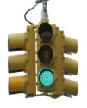



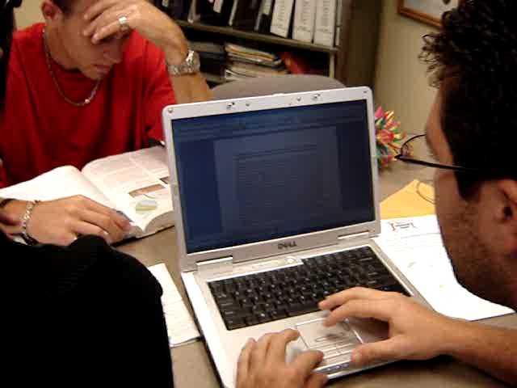
Problemáticas en Integridad Académica: Plagio
Video o caso 1:

Slide 30
Assessment Strategy and Results

Slide 31
Questions on student perception
True/false questions used to identify how students perceive ethical issues
“Ethics and morality are the same.”
“Having a tattoo is contrary to ethics.”
“Ethics is completely relative.”
Tested before and after activity to detect short term changes in student perception.
Notes:
Perception refers to general awareness and ordinary understanding of general matters pertaining to ethics. Are ethical concepts and principles absolute or relative? Is ethics as the systematic study of moral practices identical to morality or distinguished in some way? How does ethics stand in relation to areas with which it is often confused such as religion, law, and matters of custom?

Slide 32
Questions concerning knowledge of research ethics issues
Multiple choice questions on basic concepts in research ethics
Inventing results in an exercise is an example of…
a. plagiarism
b. falsification
c. fabrication
d. conflict of interest
e. don’t know
Students answered questions before and after to detect indicate short term changes
Notes:
These matters are more specific to the field of research ethics. They would include understanding research misconduct (plagiarism, falsification, and fabrication) as well as issues pertain to Ferrer’s “double cauce” i.e., epistemic issues that pertain to the acquisition and dissemination of scientific truth and issues of responsibility such as informed consent, treatment of humans and animals in research experiment design and execution, and issues pertain to the research environment.

Slide 33
Defining
Open-ended question: What is ethics?
Rubric
Student covers all three dimensions—3 points
Students gets two of three dimensions—2 points
Student gets one of three dimensions—1 point
Dimensions | Level | Scale
a. Student explains that ethics is reflection on conduct | 1 Poor | 33%
b. Student explains that ethics is used in decision making | 2 Good | 66%
c. Student explains that ethics demonstrates the route to true wellbeing | 3 Excellent | 100%

Slide 34
Case Analysis
Open-ended question on complex, gray case
Student responses assessed on basis of rubric
Makes decision, provides argument, identifies problem--3 points
Makes Decision and provides argument--2 points
Makes Decision--1 point
Dimensions | Level | Scale
a. Makes a decision but does not provide supporting argument | 1 Poor | 33%
b. Makes a decision and provides justifying argument | 2 Good | 66%
c. Identifies ethical problem presented in the case | 3 Excellent | 100%

Slide 35
Questions sorted into Bloom rubric
Associates concept of freedom with a key characteristic of the human being (Questions 3 and 4)
Distinguishes the ethical from the moral (Questions 1 and 10)
Defines ethics and describes its importance (Questions 5, 6, 11)
Identifies cases where ethics is relative or absolute
Defines the significance of plagiarism, falsification, fabrication and identifies the situation in which each of these concepts arises (Questions 12-15)
Defines conflict of interest, peer review, and mentoring (Questions 8 and 16)
Associates ethics with the protection of the natural environment and the use of humans and animals in research (Question 7)

Slide 36
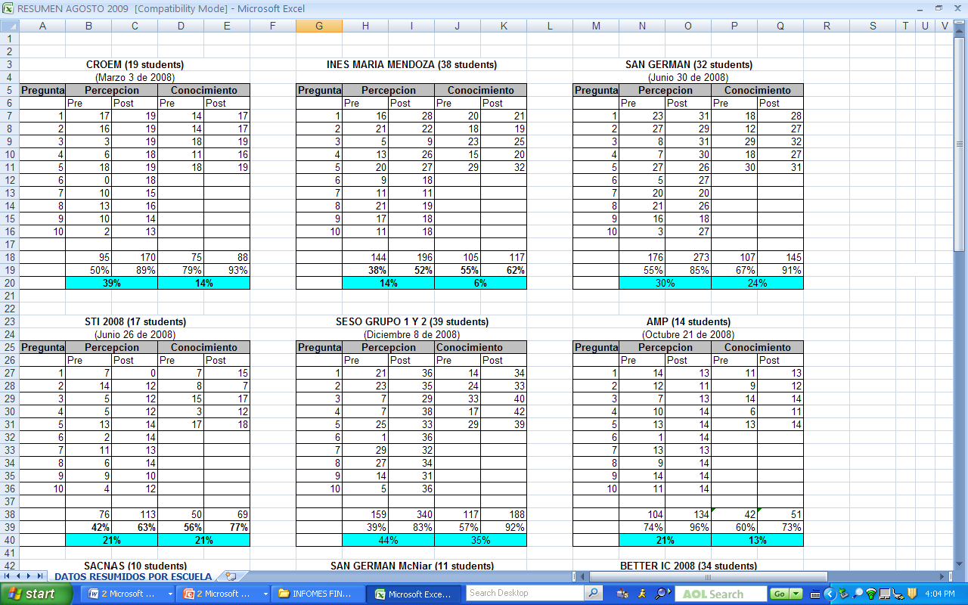

Slide 37
Nombre de la Escuela | Fecha | Núm. part. | Conocimientos | Percepción | Análisis Caso | Concepto Ética | Video | Eval. General del taller
STI-2007 | Junio 27 2007 | 16 | 26% | 19% | NA | NA |  | NA
UBSM-Ponce | Junio 28 2007 | 27 | 26% | 16% | NA | NA |  | NA
CROEM | Marzo 3 2008 | 19 | 14% | 39% | 0.47-1.18 | 1.5-2.05 |  | 90.4%
UBSM-S.Germán 2008 | Junio 30 2008 | 32 | 24% | 30% | 0.59-1.45 | 1.63-1.72 |  | 94.7%
STI-2008 | Junio 26 2008 | 18 | 21% | 21% | 2.22-2.44 | 0.23-1.31 |  | 90.3%
UBSM-Ponce yB | Junio 17 2008 | 41 | 20% | 33% | 0.56-1.89 | 1.22-2.17 |  | 94.33%
BETTeR-IC 2008 | Julio 19 2008 | 32 | 18% | 29% | 1.11-1.21 | 2.42-2.54 |  | 83.33%
SESO 2008 | Diciembre 8 2008 | 18 | 35% | 44% | 1.5-2.78 1.9-2.33 | 0.67-1.78 0.76-1.33 |  | 78%
Inés María Mendoza | Diciembre 10 2008 | 38 | 6% | 14% | NA | NA |  | 48.3%
SACNAS | Marzo 25 2008 | 10 | 12% | 27% | NA | NA |  | 85%
PR-LS-AMP | Octubre 21 2008 | 15 | 13% | 21% | 2.43-2.93 | 1.18-1.91
Mc Nair | Noviembre 12 2008 | 11 | 13% | 25% | 2.27-2.45 | 0.75-1.75
UBSM- Ponce 2009 | Julio 2009 | 25 | 13% | 24% | 0.63-1.5 | 1-1.32 | Plagio, falsificación | 86.3%
STI 2009 | Julio 3 2009 | 18 | 7% | 25% | 2.17-2.61 | 0.86-1.21 |  | 90%
BETTER-IC | Julio 2009 | 32 | 26% | 30% | 0.57-1.33 | 1.3-1.8 | Plagio, conflicto de interés | 87.3%
 |  | 352

Slide 38
Disseminating this and other projects through the EAC Toolkit
Online module for outreach effort

Slide 39
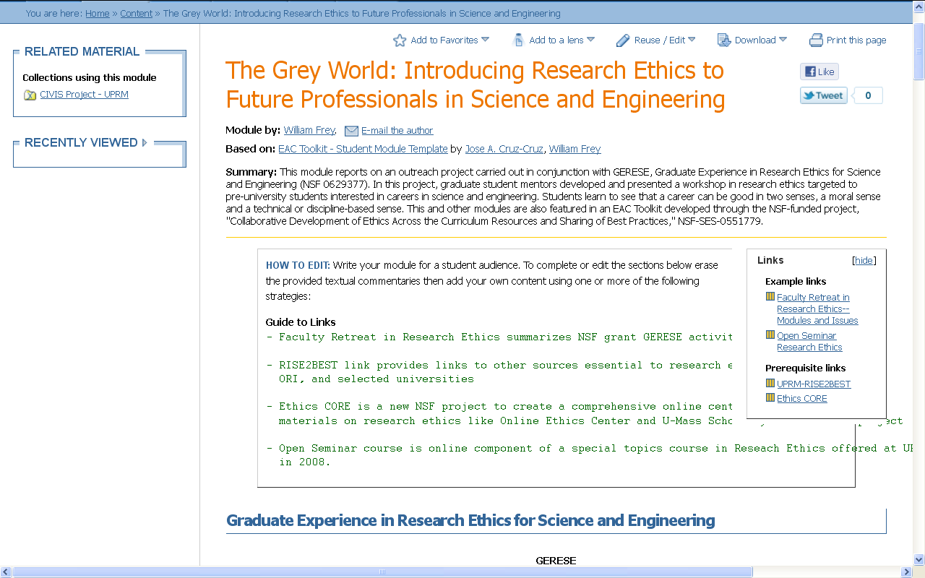
http://cnx.org/content/m37142/1.5/

Slide 40
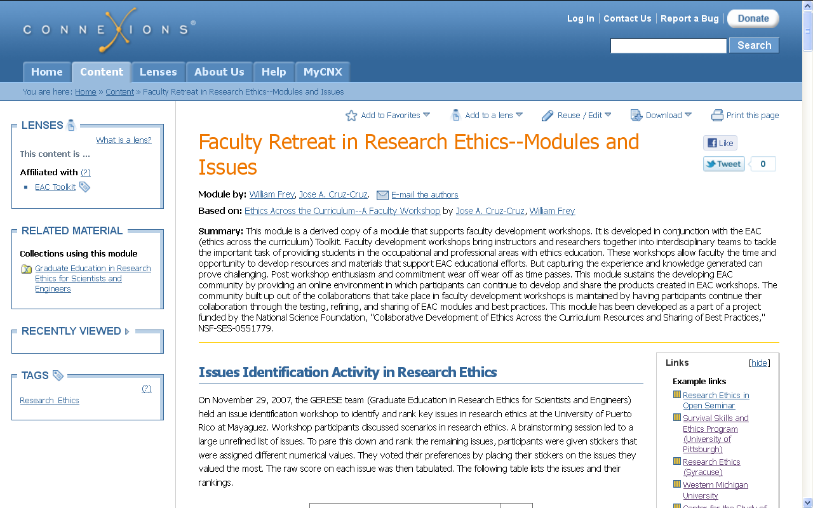
http://cnx.org/content/m32949/1.3/

Slide 41
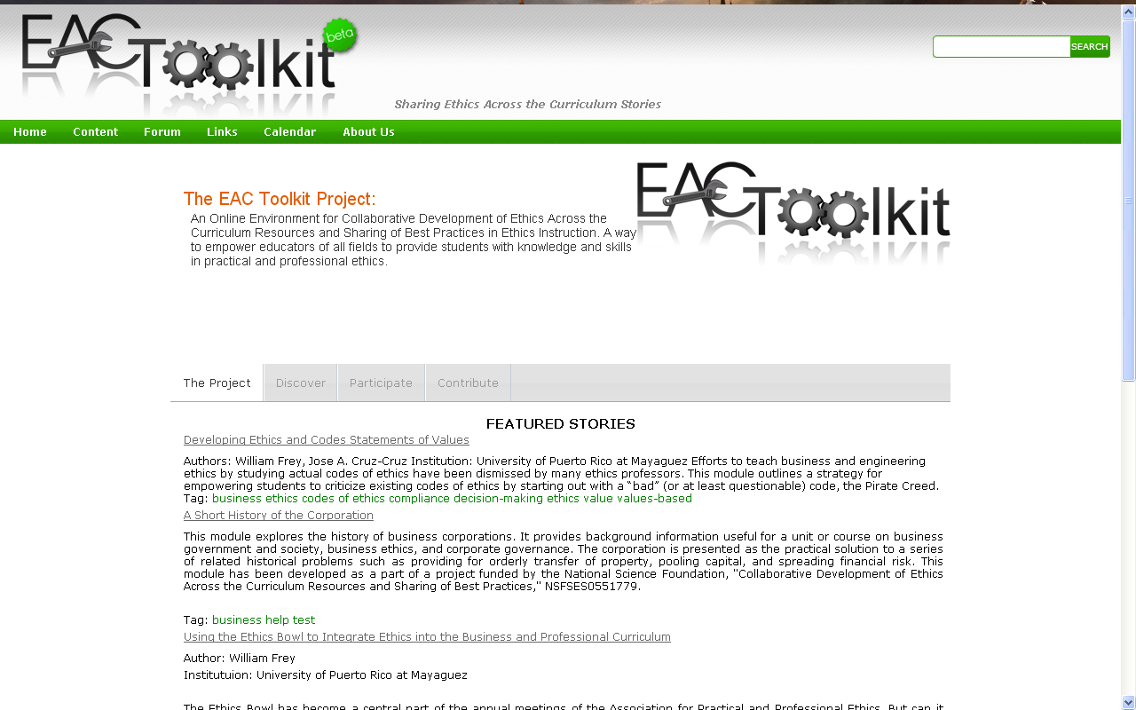

Slide 42
Conclusion
General overview of GERESE project in research ethics
With a concentration on an interesting outreach project
Graduate students developing an activity to introduce pre-university students to ethics and research ethics
Outlining the high points of the presentation
Describing an innovative approach to assessment
Online toolkit for disseminating and sharing pedagogical best practices

Slide 43
Thank-you
William Frey
College of Business Administration
UPRM
Williamjoseph.frey@upr.edu

Slide 44
Appendix

Slide 45
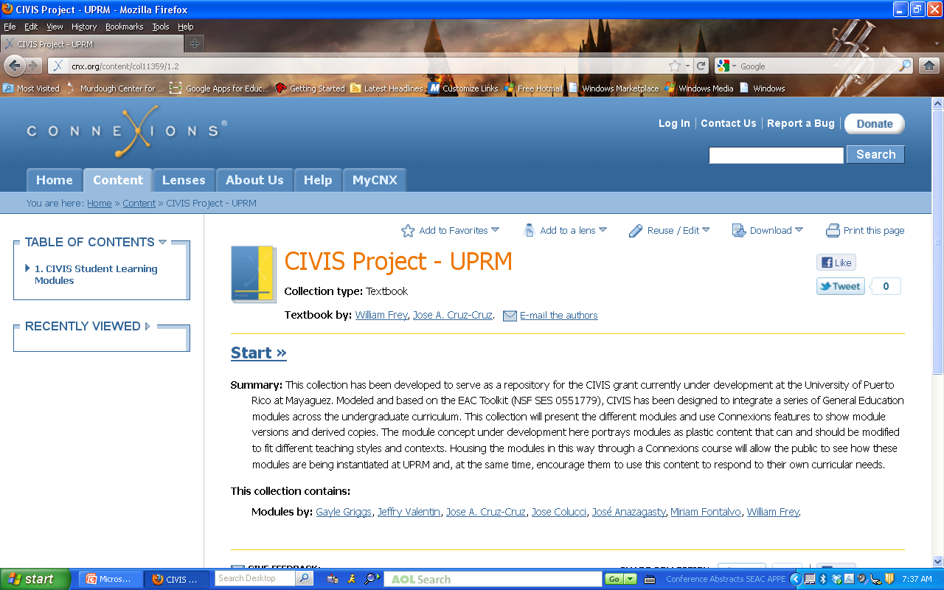
CIVIS
http://cnx.org/content/col11359/latest
Center for Resources in General Education
Areas: Professional Ethics, Information Literacy, Sustainability, Writing in the Disciplines, Social Impact / Global Issues, World Cultures, and Financial Literacy
17 modules so far published in Connexions

Slide 46
General Strategy
Reinforce general study by developing modules…
mico-insertions in mainstream, discipline-specific courses
train-the-trainers
Interdisciplinary between general studies and agriculture, business, engineering, and science specialists

Slide 47
“Gray World” turns train-the-trainer model on its head
Trainee needs to train the trainer
Biologist (Rios) trains ethicist (Frey) to teach module directed to particulars of research in microbiology
f
To systematically and critically examine this practice, one must first become aware of it

Slide 48
Trainer learns to listen
Active Listening that attends to …
vocabulary shifts
Includes suspending criticism to gain understanding
Requires building a “Trading Zone” that includes…
a common vocabulary and shared understandings
Experiment:
Rios develops a discipline-specific module in RE
Trains Frey to teach module in ADEM

Slide 49
Pedagogical Experiments
Graphics Design engineering ethics module
Micro ethics insertion
Assessment driven; overcrowded with content
Pedagogical Experiments
Inverted classroom permits more integration of content
Ethicist teaches module in different ways to demonstrate different ways of covering material

Slide 50
Issues requiring active listening and bridge building
Different vocabulary and different ways of conceptualizing
“Dilemma” = situation that calls for deliberation, not a forced choice between two alternatives.
“Libertad”
Translated as “freedom” but “liberty” is better (Freedom from)
Positive concept of freedom, freedom to, is translated by “autonomia”
Distinction between knowledge and perception in assessment
“Perception” = knowledge of basic moral issues
“Knowledge” = knowledge of issues specific to research ethics

Slide 51
More on grant components
Graduate Awareness Workshop
http://fie-conference.org/fie2008/papers/1233.pdf
Moral Deliberation Workshop
http://fie-conference.org/fie2008/papers/1713.pdf
Case Analysis Workshop
http://soa.asee.org/paper/conference/paper-view.cfm?id=12137
Current situation in research ethics for engineering
http://www.laccei.org/LACCEI2009-Venezuela/Papers/TS199_Valdes.pdf
In Spanish and delivered at Latin American and Caribbean for Engineering and Technology (LACET)

