Slide 1
Preparing a Statement of Values
The UPRM/ADEM Experience
William Frey

Slide 2
Changing the paradigm: Value-Realization
From 2004-2006, ADEM carried out a process of value realization and developed a Statement of Values
We discovered that this process reflects value realization in software development
We discovered, after the fact, how the practical informs the ethical
Three stages of value realization:
discovery, translation, verification
Mary Flanagan, Daniel Howe, and Helen Nissenbaum. “Embodying Values in Technology: Theory and Practice.” Information Technology and Moral Philosophy. Editors: Jeroen van den Hoven and John Weckert. Cambridge University Press, 2008; 322-353

Slide 3
Value Realization is Interdisciplinary
Interdisciplinary “Stew”
Technical (‘mechanisms’ for realizing value)
Philosophical (finding and clarifying the values to be realized)
Empirical (establishing the success of efforts to realize values)

Slide 4
Feenberg and Bakardieva
“Identification with symbols and ritual practices”
“Acceptance of common rules”
“Mutual aid”
“Mutual respect”
“Authentic communication”

Slide 5
Etzioni on Community
“Communities are social entities that have two elements.
a web of affect-laden relationships among a group of individuals….
a measure of commitment to a set of shared values, norms, and meanings, and a shared history and identity—in short, to a particular culture.”
From Feenberg et al, Community in the Digital Age, 225
See also Built to Last: Successful Habits of Visionary Companies (Harper Business Essentials) by Jim Collins and Jerry I. Porras

Slide 6
Stage One
Discovery

Slide 7
In Software Engineering…
“‘discover’ the values that are relevant to, inspire, or inform a given design project” (Flanagan et. al., 334)
In Community Development…
discover values that influence and motivate a community
those active in day-to-day activities
those to which a community aspires

Slide 8
Discovery—Workshop held April 2004
Objective: Write a draft of a stakeholder code
Relation between stakeholders
Built around a good or value
And obligations arise (expressed in rules) that protect that value
Results
28 provisions applied to Faculty
15 provisions were oriented toward students
10 provisions targeted administration and support staff
38 provisions in all
Some applied to more than one stakeholder

Slide 9
Results: Prescriptions and Proscriptions
Evitar la divulgación de información preferencial y confidencial tanto interna como externa / Maintain confidences
El profesor mantendrá un alto nivel de confidencialidad en toda la información que reciba de los estudiantes, profesores y administradores
Evitar cometer actos de plagio / Avoid plagiarism
Honestidad académica de los estudiantes y profesores
Integrity within instructional and research endeavors
Evaluar el desempeño del estudiante de forma imparcial
No favoritism or discrimination in the evaluation of students
No discrimination or nepotism in the hiring and evaluation of fellow faculty members
Notes:
EXAMPLES FROM 2004

Slide 10
Results: Prescriptions and Proscriptions
Los estudiantes asumen la responsabilidad por la parte que le corresponde en los trabajos en grupo / Responsibility in work teams
Delegar tareas a otros profesores o personas responsablemente y al la vez asumir sus responsabilidades
El profesor deberá cumplir con las responsabilidades afines a su nombramiento / Professors carry out job responsibilities
Demonstrate at least minimum competence in your field
Respetar los derechos de propiedad intelectual / Respect intellectual property rights
Relaciones de trabajo en equipo respetando la diversidad de ideas
Fomentar un ambiente de respeto modelando un comportamiento de aprecio a la diversidad de ideas
Notes:
EXAMPLES FROM 2004

Slide 11
Expanded view of codes
Codes fulfill (at least) 5 functions
Educate
Inspire
Promote Dialogue
Empower and Protect
Discipline
The first four contribute to what Lynn Sharp Paine terms an “Integrity Approach”
“being good is more than just not being bad”

Slide 12
Boeing Taught us values-based decision-making
Values provide effective guidance when rules cannot be extended to cover new situations
Values-Based decision making shifts responsibility away from the organization (which makes up the rules) to the individual (why, after all, acts on his or her core beliefs or aspirations)
Charles Ruthford, “Role of Management in Ethics and Business Conduct.” Presentation at UPRM, April 13, 2005

Slide 13
Rethinking Code Theory: Compliance to Integrity
Compliance:
“establish compliance standards and procedures…
take reasonable steps to achieve compliance through audits [and] monitoring processes…
consistently enforce standards through appropriate disciplinary measures” (109)
Integrity
“define companies’ guiding values, aspirations, and patterns of thought and conduct” “ethical values shape the search for opportunities, the design of organizational systems, and the decision-making process used by individuals and groups”
“Organizational ethics helps define what a company is and what it stands for” (107-111)
Paine, “Managing for Organizational Integrity, HBR, 1994: 105-117

Slide 14
Two Triads…
Compliance
Rules
Monitoring Procedures
Punishments
Integrity
Values or aspirations
Support systems
Using assessment to chart and document continuing improvement

Slide 15
synergies between compliance and integrity (Treveño and Weaver)
Studies in effectiveness of corporate codes
Seven criteria
Reducing unethical behaviors
Encouraging ethical advice-seeking
Increasing awareness of ethical issues
Producing perceptions of better decision-making
Solidifying commitment to organization
Building employee integrity
Increasing willingness to deliver bad news
Compliance codes produce improvements in 1-4
But values codes produce greater improvements in 1-4
Values codes improve areas 5-7
Optimal choice: integrate compliance and values/integrity modes

Slide 16
November 2005: Workshop to discover ADEM Values
Discuss Pirate “Articles of Agreement”
To reach a critical frame of mind
Identify values embedded in existing codes
To see how other codes embody values
Revisit rules and identify values they embody
Brainstorm list of ADEM shared values
Reduce list through championing, debating, and prioritizing

Slide 17
Result
Justice/Fairness
Responsibility
Respect
Trust
Integrity

Slide 18
Stage 2
Translation

Slide 19
In software engineering…
“embodying or expressing…values in system design. Translation is further divided into operationalization, which involves defining or articulating values in concrete terms, and implementation which involves specifying corresponding design features.” (Flanagan et. al., 339)
In community development…
Values are operationalized by developing value profiles
Description
Characteristics
Thresholds
Aspirations or challenges
Values are implemented by writing and adopting a Statement of Values
Rewriting philosophical profiles in community language that expresses shared understandings
Formally adopt through community-wide vote

Slide 20
Operationalization
Value Profiles written by outside advisor (To avoid groupthink)
Description
Pretentious and technical
Characteristics
To recapture values eliminated by prioritization activity
Rules
To revisit and summarize stakeholder code workshop
Ideals
To stretch values to cover higher moral spaces than just the “minimally moral”

Slide 21
Value Description
The root meaning of responsibility emerges when the word is broken down into its constituents, “response” + “able”. Responsibility becomes “response-ableness,” that is, the ability to identify the morally salient features of a situation and develop actions and attitudes that “answer” to these features by bringing into play moral and professional values. Responsibility includes several senses, three of which deserve special mention. First, individuals are responsible in that they are answerable for what they do. If they fail to answer adequately for actions that fall short of minimal moral standards, they are liable to sanction, discipline, or punishment. Second, individuals make commitments to social or professional roles. Out of these commitments arise special role-based moral obligations. For example, teachers are (role) responsible for carrying out continued research to bring their teaching up to date. Finally, responsibility refers to the manner in which one executes these role-based tasks. Those who do only the minimum exhibit a low level of responsibility while those who execute with excellence exhibit a high level of responsibility.

Slide 22
Value Characteristics (Respect)
Among the basic rights recognized and respected by the students, faculty, and administration of the College of Business Administration are…
Intellectual property in the form of copyrights, trade secrets, and patents
Privacy, especially maintaining confidential the sensitive information generated through transactions with students, faculty, staff, and administration
Free speech which includes academic freedom.
Due process which guarantees to faculty, students, staff, and administration the right to a serious and timely grievance procedure when subjected to decisions contrary to their person and interests
Free and informed consent which includes the right to participate fully and meaningfully in collective decisions that have an impact on their persons and work to a degree commensurate with this impact.

Slide 23
Value Rules
Bring back rules from
Stakeholder code
Students shall assume responsibility for their assigned tasks in group work.
Administrators shall delegate tasks to professors, students, and non-teaching personnel in a responsible way while, at the same time, conscientiously carrying out their own responsibilities.
Professors shall carry out the responsibilities designated in their job description.
Professors shall demonstrate at the very least minimum competence in their field.

Slide 24
Value Challenges
Hone in on the
aspirational
Respect:
Administrators, faculty, and students shall identify, examine, and assess existing due process procedures in terms of the ethical values expressed in this code. They will then revise these procedures should this value audit require it.
Responsibility:
Faculty [should] develop frameworks and activities to help students practice and reflect upon moral tasks or role responsibilities that arise in cooperative group activity.

Slide 25
Translation: Implementation
Committee of stakeholders wrote statement of values
Drafts circulated between committee and community at large
Profiles rewritten to incorporate community language
Profiles reconceptualized to reflect shared community understandings
Formally approved in May 2006

Slide 26
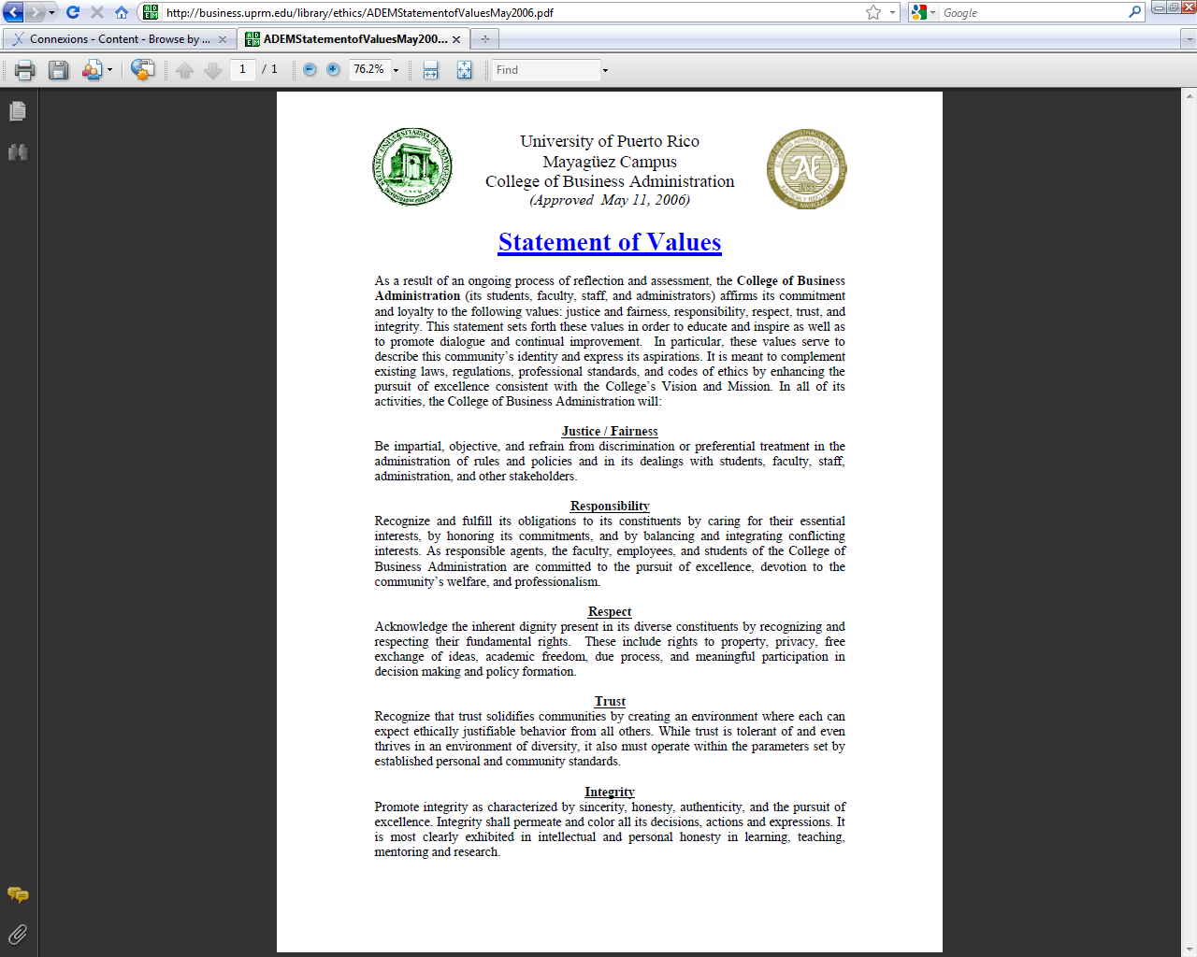

Slide 27
Stage 3
Verification

Slide 28
In software engineering…
“designers assess to what extent they have implemented target values in a given system…. [M]ay include internal testing among the design team, user testing in controlled environments, formal and informal interviews and surveys, the use of prototypes, traditional quality assurance measures such as automated and regression-oriented testing, and more.” (Flanagan et. al., 344-5)
In community development…
designers assess to what extent they have implemented target values in community decision-making, policies, and practices

Slide 29
Modes of verification
Can the SOV guide curricular development?
by generating new educational modules
Can the SOV be strengthened through challenges?
translate into Spanish
draw sharper distinction between values

Slide 30
Modules
Value-Based Decision Making in Gilbane Gold
Students use values as specifications for designing solutions to ethical and business problems
http://cnx.org/content/m15783/1.4/
Ethics of Team Work
Student groups set value goals that they work to realize during the semester
http://cnx.org/content/m13760/1.13/

Slide 31
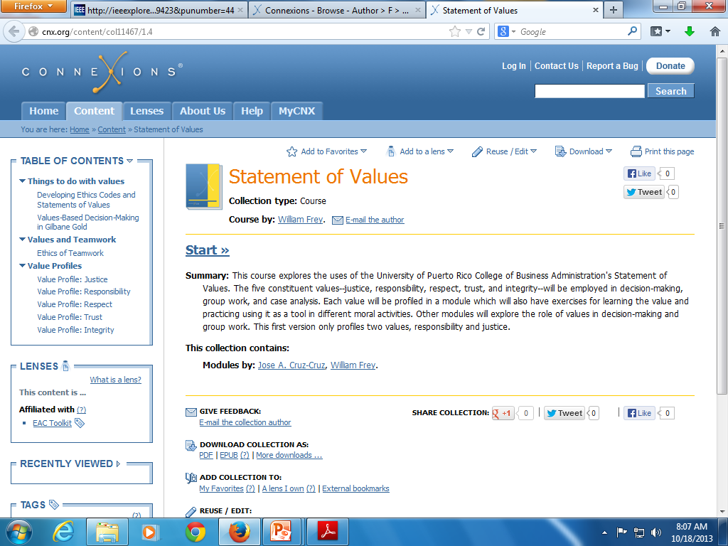

Slide 32
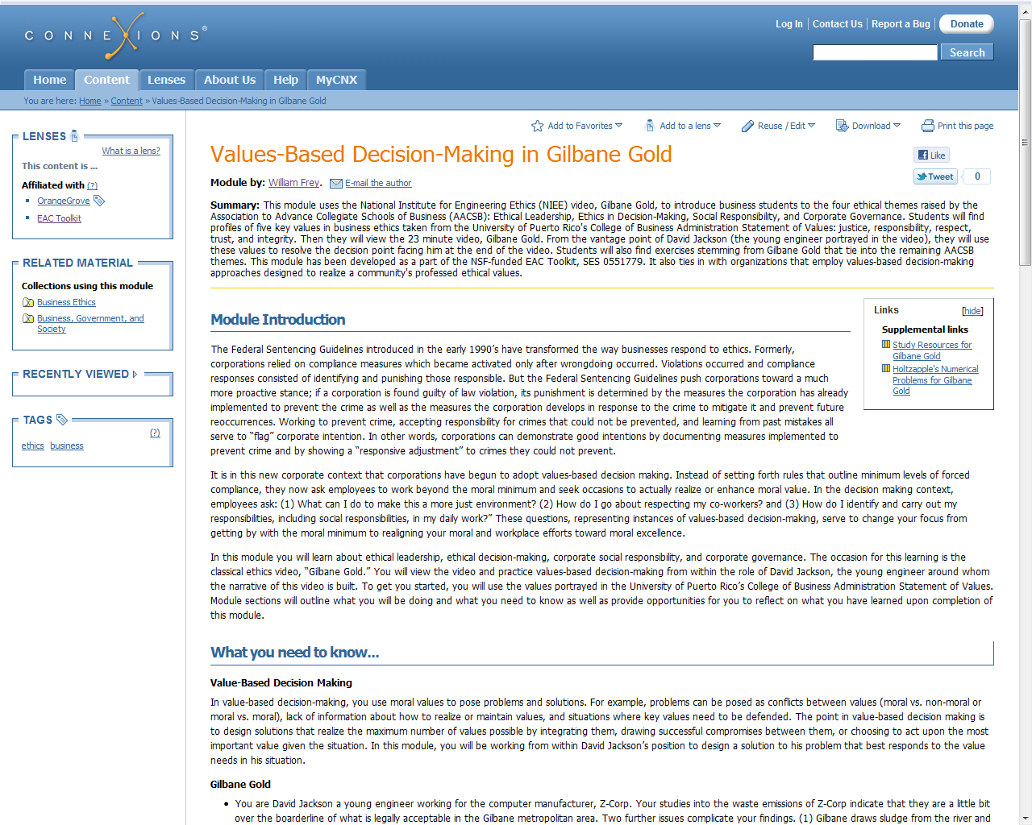
http://cnx.org/content/m15783/1.4/

Slide 33
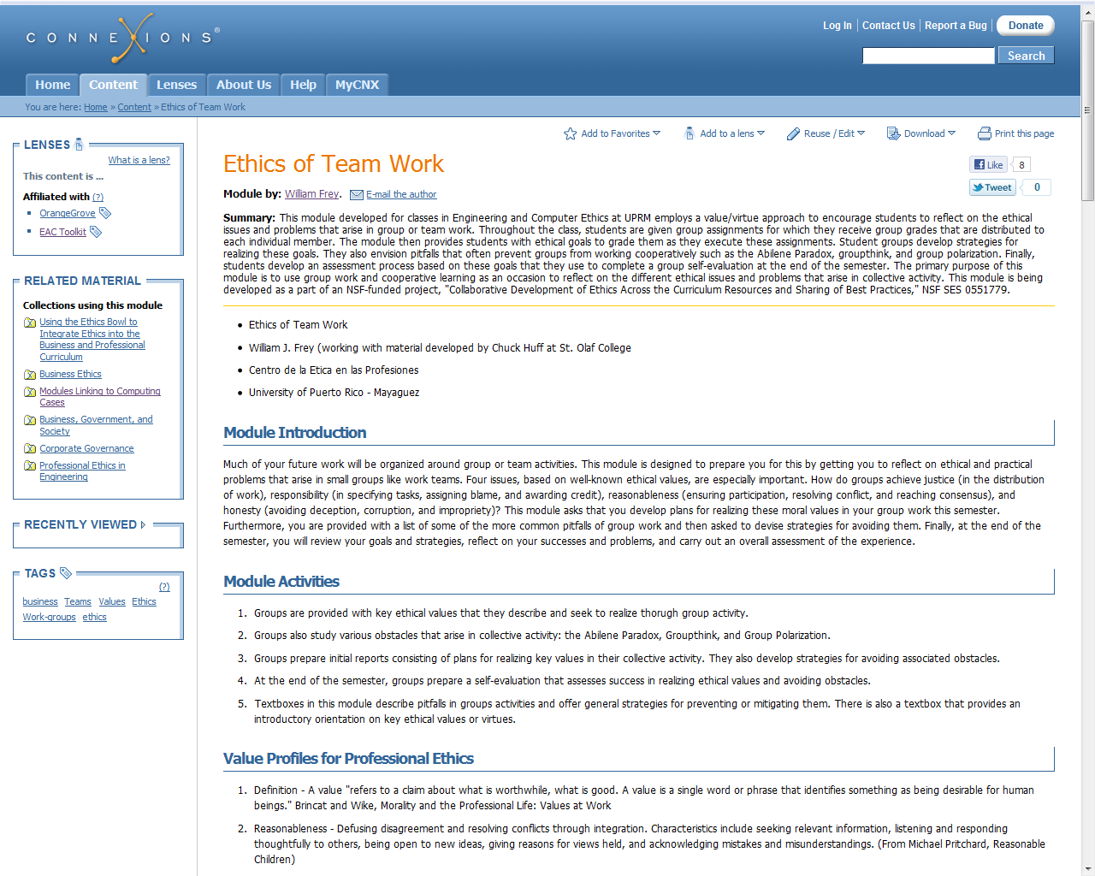
http://cnx.org/content/m13760/1.13/

Slide 34
SOV Challenge: Translate into Spanish
Students translate values in small groups
Translations lead to productive dialogue and conceptual challenges
Student Translations brought to other stakeholder groups
Administration, support staff, and faculty discuss and re-translate SOV into Spanish. Results published on ADEM webpage

Slide 35
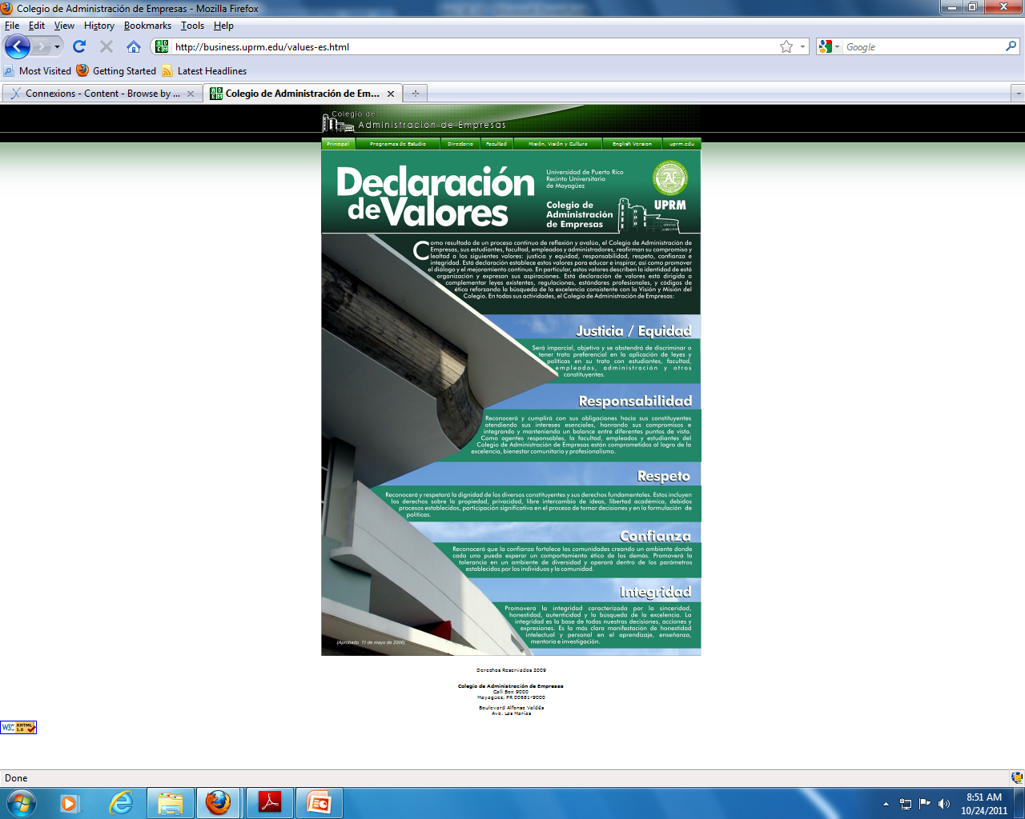

Slide 36
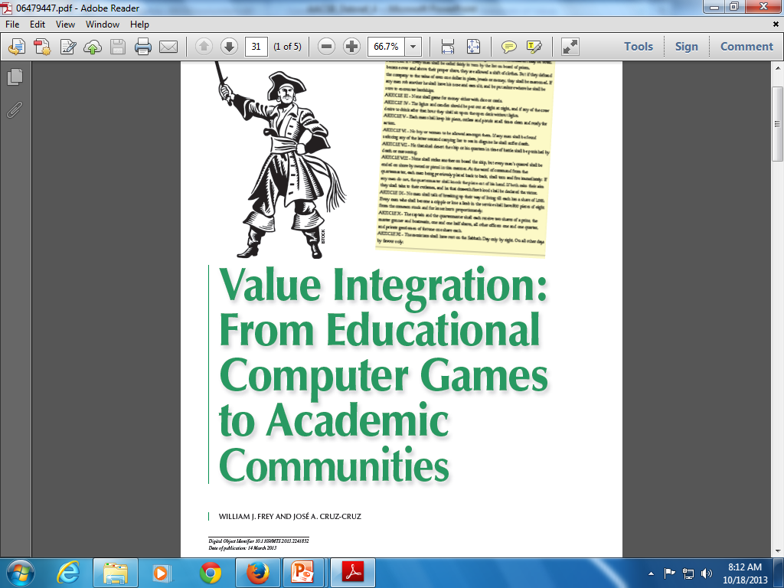

Slide 37
SOV Challenge: Clarify integrity, trust, and respect
Students confuse values on exams: integrity, trust, and respect
Student committee decides to rewrite descriptions to distinguish more clearly
Student conceptual challenge to SOV brought to other stakeholder groups
Administration, support staff, and faculty will discuss and react to student conceptual challenges on integrity, trust, and respect

Slide 38
Conclusion?
No challenges since 2009
Failure to use SOV in ADEM assessment
Falling short of culture of excellence?
Tear up SOV and substitute a strict compliance code armed with sanctions and punishments

Slide 39
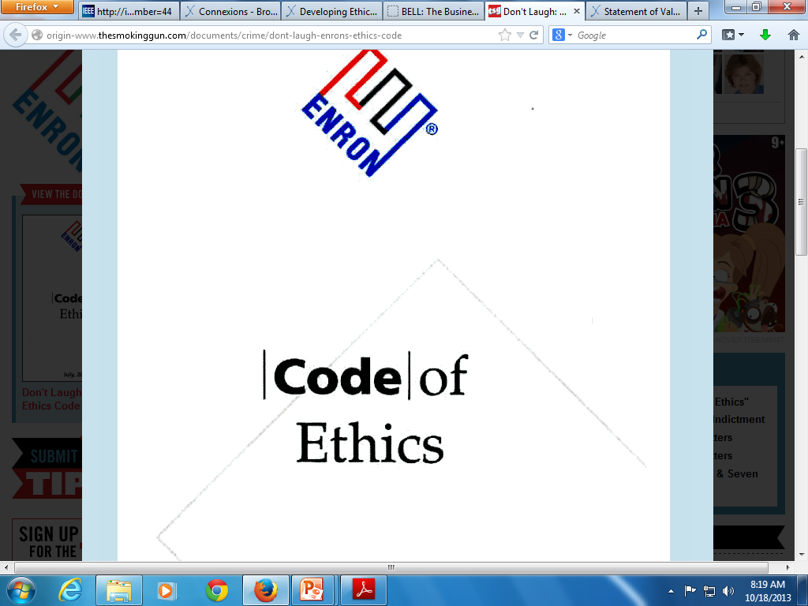

Slide 40
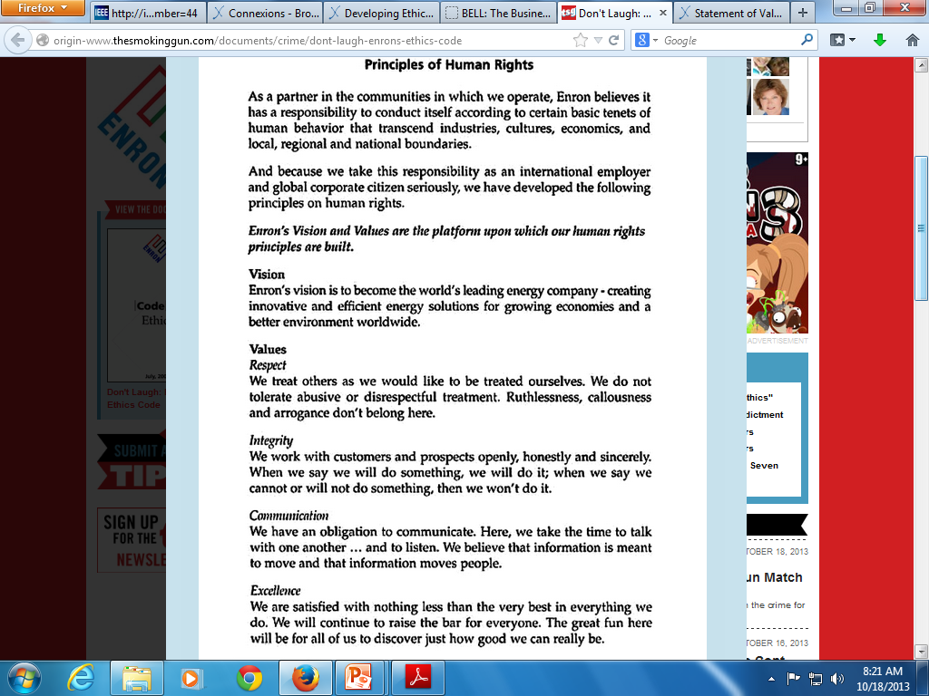

Slide 41
These sources reinforce the importance of value approaches
Ken Blanchard and Michael O’Conner. (1997) Managing by Values: How to Put Your Values Into Action for Extraordinary Results. Berrit Koehler Publishers.
Cynthia Brincat and Victoria Wike. (1999). Morality and the Professional Life: Values at Work. Prentice-Hall
Jim Collins and Jerry Porras. (1997). Built to Last: Successful Habits of Visionary Companies. Harper.
Stanford Encyclopedia of Philosophy. (See articles on Moral Responsibility, Respect, Property, Trust, and Integrity)
Robert Solomon and Fernando Flores. (2003). Building Trust: In Business, Politics, Relationships, and Life. Oxford.
The list used to identify embedded values in the stakeholder code draft came from values identified during a workshop led by Victoria Wike.

Slide 42
More resources
Feenberg, A & Bakardjieva, M. (2004). “Consumer or Citizens? The Online Community Debate.” In Feenberg, A. & Barney, D. (eds.), Community in the Digital Age: Philosophy and Practice. New York: Rowman & Littlefield Publishers, Inc. 5, 225.
Rest, J., Narváez, D., Bebeau, M.J. & Thoma, S.J. (1999). Postconventional Moral Thinking: A Neo-Kohlbergian Approach. Mahwah, NJ: Lawrence Erlbaum Associates, Publishers.
Callahan, Daniel. (1980). “Goals for the Teaching of Ethics.” In Callahan, D and Bok, S (eds.) Ethics Teaching in Higher Education. New York: Plenum Press, 1980: 61-94
Pritchard, M. (1996). Reasonable Children: Moral Education and Moral Learning. Lawrence, KS: University of Kansas Press.

Slide 43
More Resources
Huff, C & Frey, W. (2005). “Moral Pedagogy and Practical Ethics.” Science and Engineering Ethics, 11: 389-408.
Cruz, J. & Frey, W. (2003). “An Effective Strategy for Integrating Ethics Across the Curriculum in Engineering: An ABET 2000 Challenge.” Science and Engineering Ethics, 9: 543-568.
Cruz-Cruz, J., Curbelo, A., & Frey, W. (2010). “Doing Ethics Across the Curriculum: The EAC Toolkit.” Teaching Ethics, 10(2): 47-69.
Frey, W. (2010). “Teaching Virtue: Pedagogical Implications of Moral Psychology.” Science and Engineering Ethics, Vol 16: 611-628.

Slide 44
Acknowledgments
Based on “Business Ethics Across the Curriculum: Constructing the Foundation and Assessing the Results” presented by William Frey at AACSB Associate Deans Conference, November 15, 2011 in Tampa, Florida
“Value Integration: From Educational Computer Games to Academic Communities”
Authors: William J. Frey and Jose A. Cruz-Cruz
Technology and Society Magazine, IEEE, 13(1)

