Slide 1
Teaching Engineering Ethics to Professional Engineers in Puerto Rico
William J. Frey and Efrain O’Neill-Carillo
University of Puerto Rico at Mayaguez
Frontiers in Education, October 23, 2008

Slide 2
Continuing Education in Ethics in PR
Office of Government Ethics
Continuing Education in ethics to combat corruption
Puerto Rico State Society of Professional Engineers and Land Surveyors (CIAPR)
Continuing Education in ethics helps bring about compliance with code of ethics

Slide 3
PR Moral Ecologies in Engineering
Moral Ecology
Analogically extending “ecology” to cover the occupational and professional organizational contexts in which engineering is practiced
Engineers play different roles in these moral ecologies
Moral ecologies influence and constrain (but do not determine) what practicing engineers do

Slide 4
Professional moral ecologies in PR
Professional
CIAPR establishes standards of engineering practice
Licensing requires being “colegiado” (Member of CIAPR)
Ethical standards set through a professional ethics code
So, you want to get sued: Being licensed to practice engineering and belonging to the CIAPR brings advantages to individual engineers. But it also makes it possible to hold an engineer accountable for sub-standard practice. Many who have graduated from accredited engineering programs in PR choose not to become licensed because of professional society dues and because of the potential of legal liability. Does this position engineers to be the scapegoats of administrative and managerial incompetence and natural disaster?

Slide 5
Corrpution moral ecology
Corruption
Government Corruption scandals in PR
Compliance response to corruption
Establish and disseminate rules of compliance
Monitor compliance
Punish non-compliance
All in all, a negative, retroactive orientation
Town Z Case: A recent graduate from UPRM (Pedro) is trying to start up a new engineering firm specializing in construction. Town Z opens the bidding on a lucrative construction project. When he mentions to a friend (Marta) that he is thinking of submitting a bid, she tells him that it will not be successful unless he makes a hefty campaign contribution to the mayor's reelection bid. Marta suggests that Pedro inflate his bid to include the campaign contribution and hide this by padding other budget items. What should Pedro do?

Slide 6
Social justice moral ecology
PR Engineers fight social injustice by…
using engineering expertise to frame injustice, and…
becoming social activists to redress injustice
Copper Mining : From the 1950’s to the mid 1990’s, international mining concerns have solicited government licenses to mine copper and gold ore bodies located in the mountainous regions of central Puerto Rico. Engineers led grass roots opposition to a mining proposal in 1993. Due to these efforts, one of the principle mining sites, Cala Abajo, has been set aside as a nature preserve.

Slide 7
Engineer as craftsperson
Engineers integrate technical and ethical skills in problem solving
Engineers build value into designs
Case: Computer ethics students specified laptop computer disposal as an ethical and social problem. They discovered how developed nations export harm by sending their spent laptop components to developing nations who carelessly dump the components in landfills and irrigation canals. The students recommended designing safe disposal and recycling into future laptops. They also recommended recycling programs run by government and private industry funded by a fee placed on new laptops at the moment of purchase. These students have rethought the design process by integrating ethical and social value, not as marginal constraints, but as central and constitutive specifications.

Slide 8
These distinct but overlapping moral ecologies provide a context for understanding engineering ethics in Puerto Rico

Slide 9
A workshop was developed to help Puerto Rican engineers maintain ethical careers within these different moral ecologies

Slide 10
Workshop (November 15, 2007)
Activity | Goals | Duration
CIAPR Code and Professional Ethics Issues | Describe professional context of engineering ethics and cover compliance issues | 30 minutes
Values-based vs. compliance approaches Socio-Technical Systems | Create the moral space within engineering to advocate the pursuit of excellence as well as exceeding the moral minimum | 15 minutes 15 minutes
Break |  | 15 minutes
Decision-Making Overview (problem solving frameworks and ethics tests) | Explore analogy between design and ethics problems | 15 minutes
“Incident at Morales” (36 minute video) | Present a realistic situation in which to practice frameworks | 36 minutes
Decision Making Activity: 6 decision points | Practice decision making in engineering ethics | 40 minutes
Conclusion and evaluation | Assess workshop | 15 minutes

Slide 11
EAC Toolkit and Connexions®
A Student Module was created for this workshop and published in Connexions®
http://cnx.org/content/m15501/latest/
Module provides background material and links to help participants explore workshop themes.
Module also presents the six decision points taken from “Incident at Morales”
Participants can download workshop presentation, and interested browsers can view workshop assessments.

Slide 12
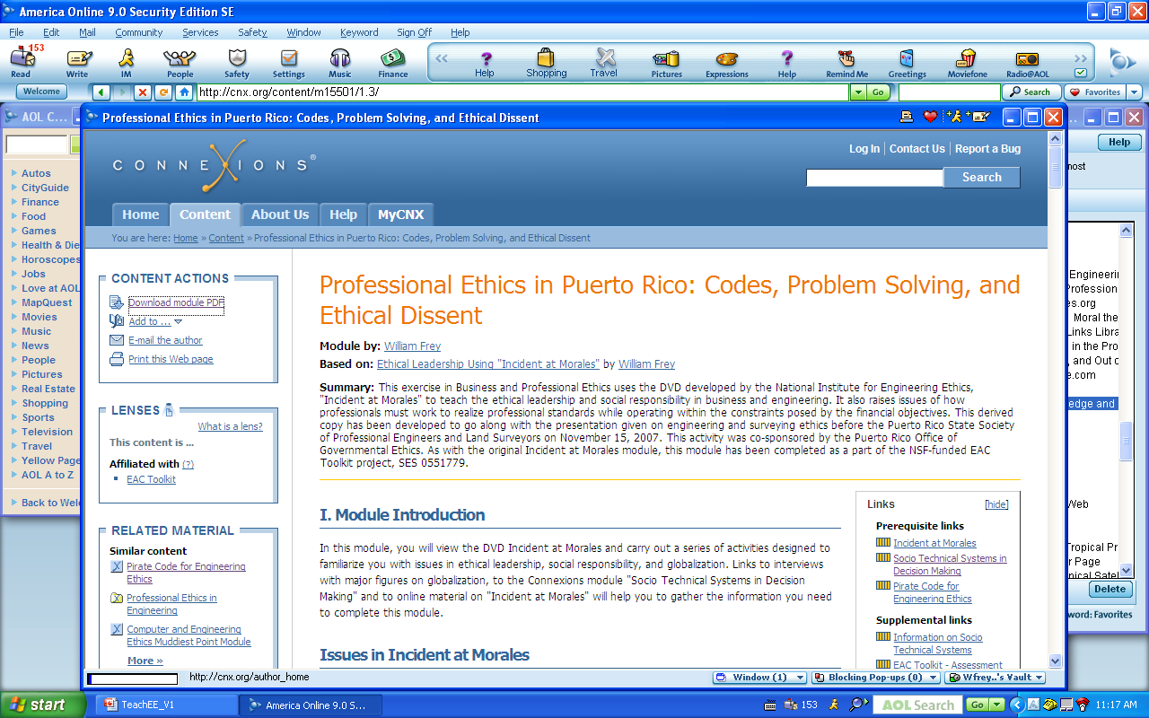

Slide 13
Conclusion: Four future engineering ethics challenges

Slide 14
Four future engineering ethics challenges
1. Reorient engineering ethics toward the aspirational
As Puerto Rico successfully deals with corruption issues, more time needs to be spent helping engineers to uncover opportunities for realizing ethical values through engineering design. Future workshops should use virtue ethics to steer participants toward excellence in engineering practice.

Slide 15
Four future engineering ethics challenges
2. Support engineers who would be ethical
Future workshops should encourage professionals to identify the different ways in which their societies can enable and support ethical—even exemplary—behavior.

Slide 16
Four future engineering ethics challenges
3. Bring together engineering ethics pedagogy and practice
Workshop participants, as practicing engineers, have experience that should be integrated into engineering ethics education. This requires a two-way process: (a) participants learn from engineering ethics initiatives, but (b) engineering ethics initiatives need to be informed with practical experience. Future workshops need to find ways to draw in practitioners as contributors to engineering ethics education.

Slide 17
Four future engineering ethics challenges
4. Highlight macro-ethical issues in Puerto Rico
Much work has been done to call the attention of engineers to macro-ethical issues. The danger in Puerto Rico is that many now think that engineering only contributes to creating macro-ethical problems while adding nothing to their solution. Future workshops can engage the community of engineers in a dialogue where participants imagine positive contributions that engineering can make to solving macro-ethical problems.

Slide 18

Thank You!
Please complete the evaluation form
Contact us
oneill@ece.uprm.edu
frey.william@adem.uprm.edu

