Slide 1
Northwestern University Fintech - Project 2 OPTIMAL ASSET FORECASTING
By: Drew Marnell, Yoko Yamamoto, Apexa Patel, Matt Epler

Slide 2
SUMMARY
Motivation: Test various machine learning models on two sets of asset buckets.
Which models best fit time series data type?
Which model predicts the most accurate prices?
How to evaluate accuracy matrix across different models?

Slide 3


THE TWO BUCKETS
Source: Alpaca API
Google, Amazon, Microsoft
Source: CoinAPI
Bitcoin, Litecoin, Ethereum
STOCKS:
GOOGL,
AMZN,
MSFT
CRYPTO:
BTC,
LTC,
ETH

Slide 4
PREDICTIVE MODELS FOR TIME SERIES DATA
Time series data is a sequence where data is recorded over a constant regular time intervals.
Recurrent Neural Network
Autoregressive Integrated Moving Average (ARIMA)
3. eXtreme Gradient Boosting (XGBoost)
2. Long Short-Term Memory Networks (LSTM)
Regression Model
Boosting

Slide 5
ARIMA Model
It can be used for any nonseasonal series of numbers that exhibits patterns and is not a series of random events.
The model can be created by combining any of these three logics:
AR: Autoregression
Predicts future values based on its own prior or lagged values
p: number of autoregressive terms
I : Integrated
Achieves stationary data that is not subject to seasonality
d: number of nonseasonal differences needed for stationarity
MA: Moving Average
Predicts future values using past errors plus current errors
q: number of lagged forecast errors in the prediction equation

Slide 6
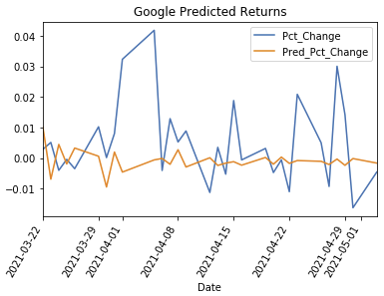
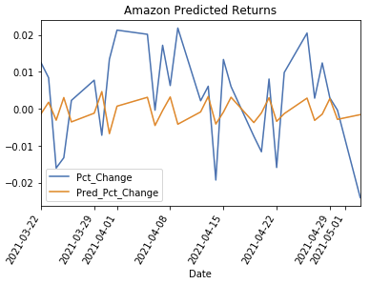
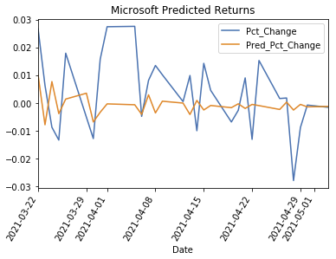
ARIMA– STOCKS

Slide 7
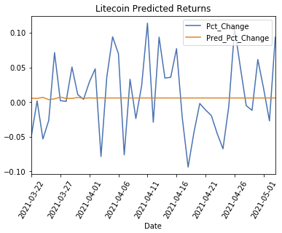
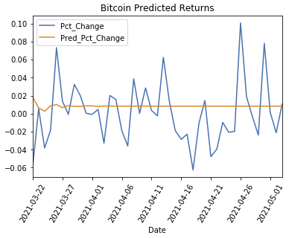
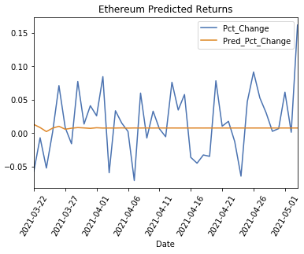
ARIMA– CRYPTO

Slide 8
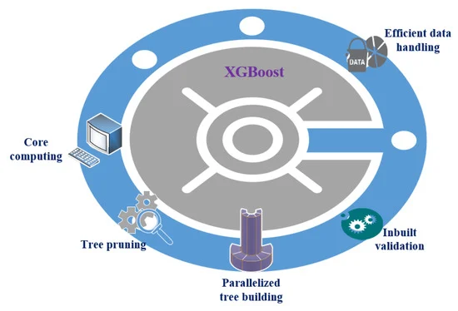
XGBoost Model
XGBoost is a decision-tree-based ensemble Machine Learning algorithm that uses a gradient boosting model framework of boosting weak learners.
XGBoost improves upon the base GBM framework through systems optimization and algorithmic enhancements.
Think of it as gradient boosting with ‘steroids’.

Slide 9
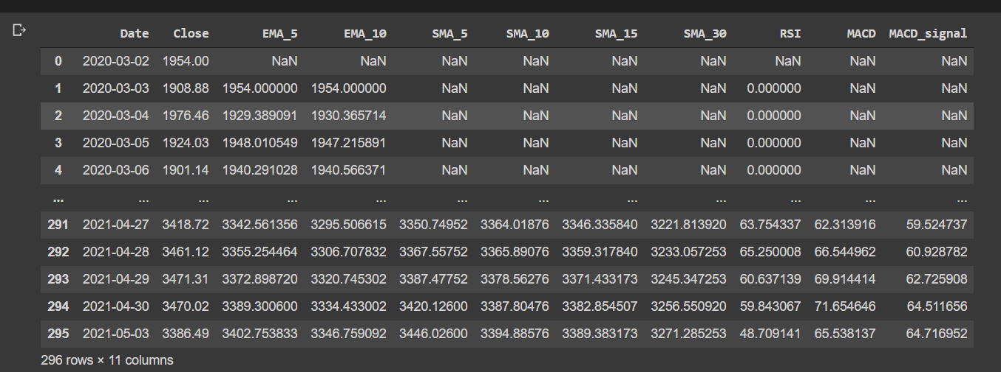
XGBoost Indicators

Slide 10
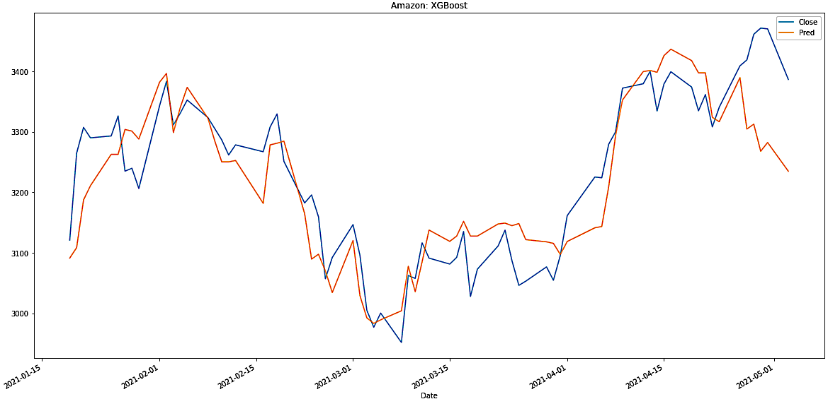
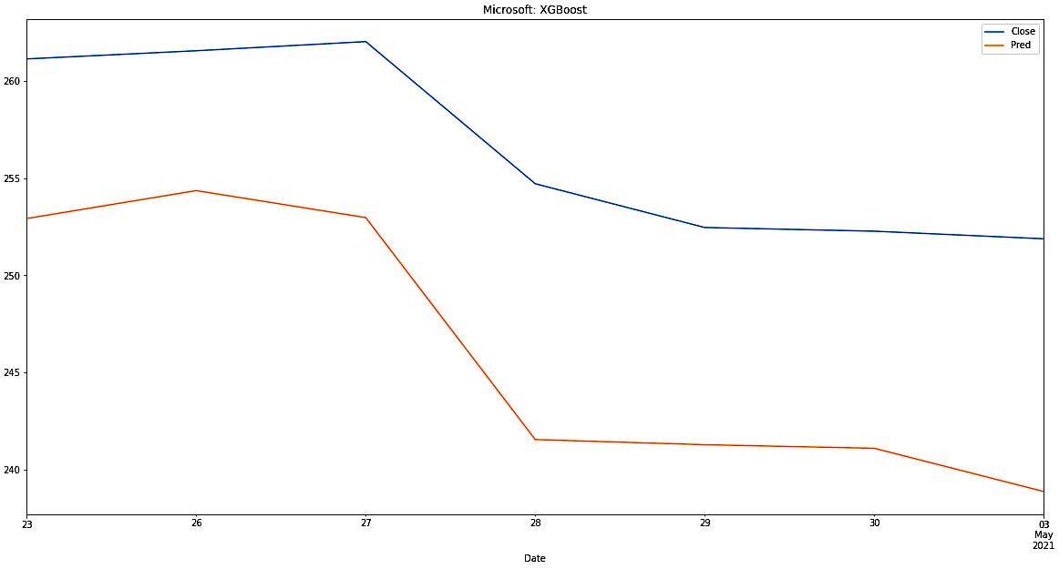
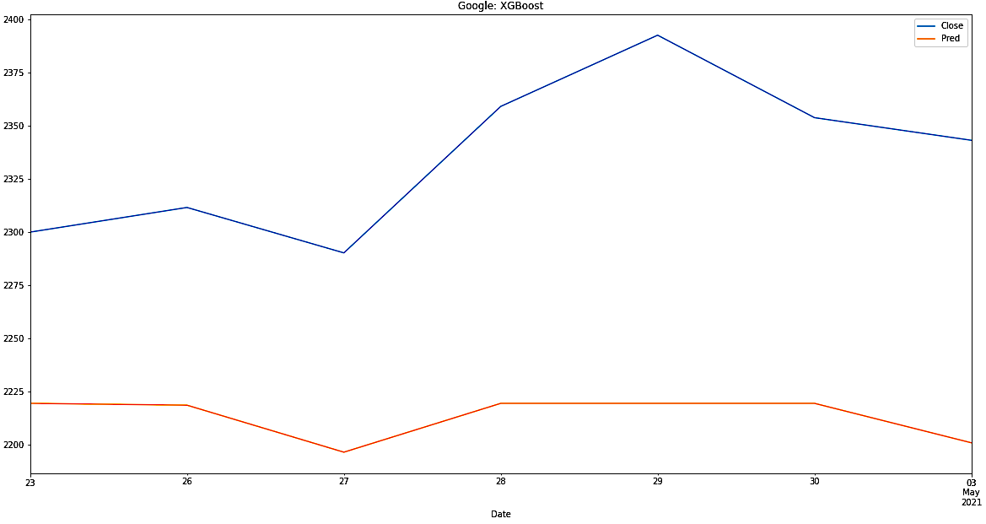
XGBoost – STOCKS

Slide 11
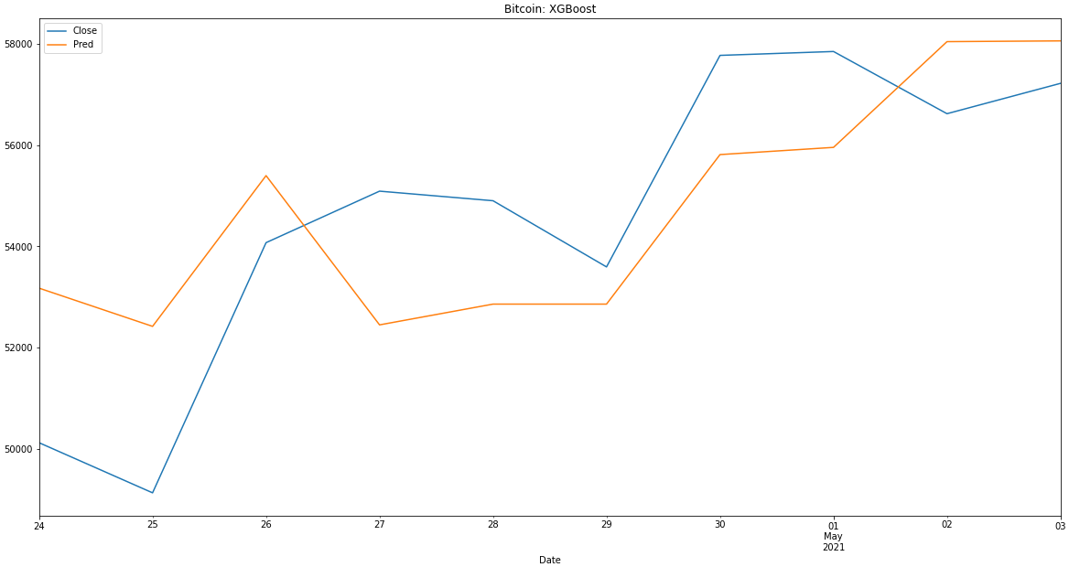
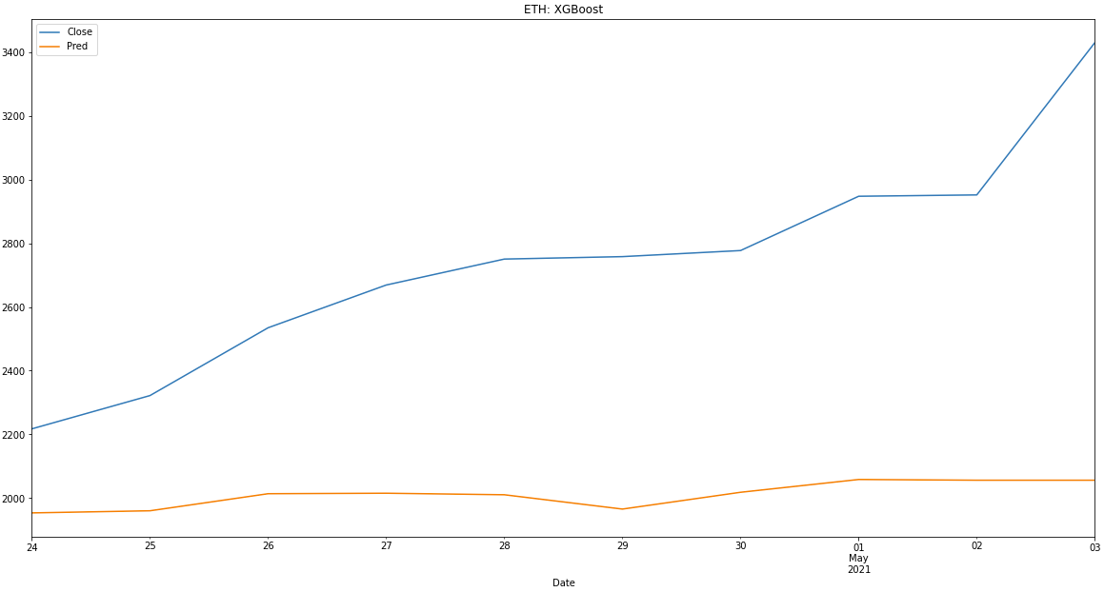
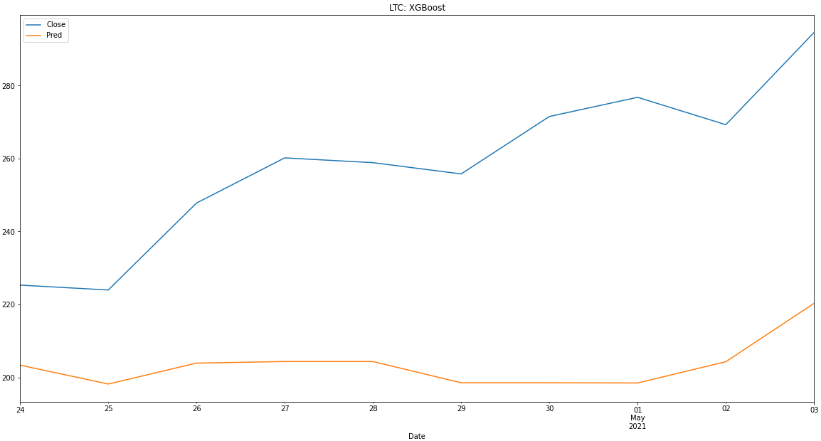
XGBoost - CRYPTO

Slide 12
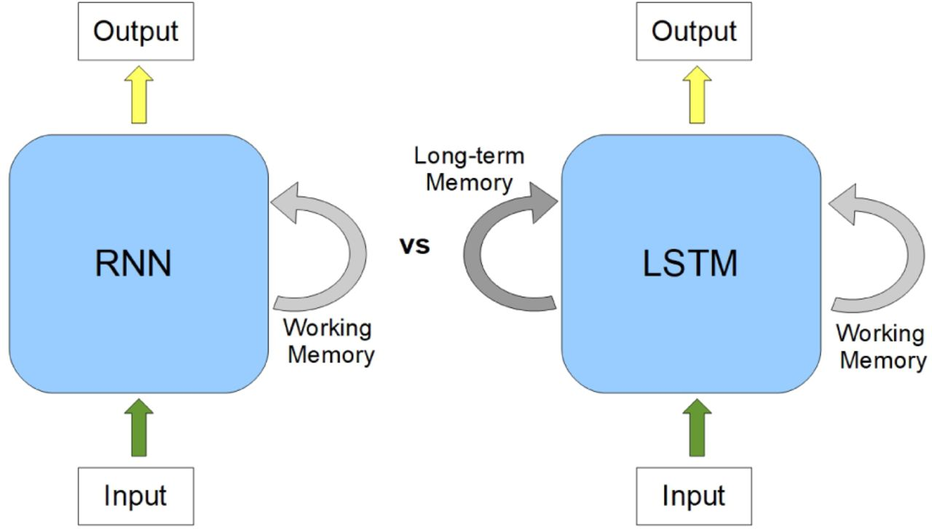
LSTM Model
RNNs are good at modeling time series data due to its sequential memory.
Traditional RNNs remember the most recent part of the sequence.
LSTM are special kind of RNN capable of remembering long-term dependencies.

Slide 13
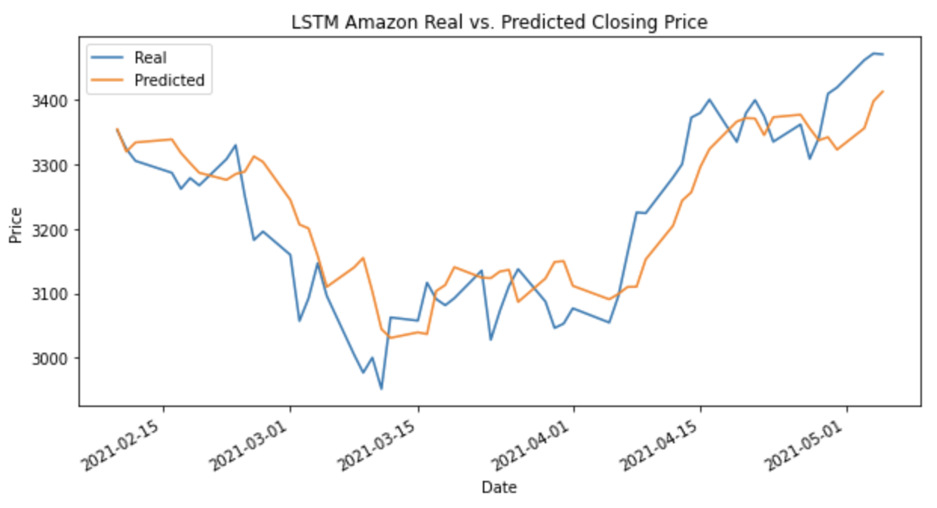
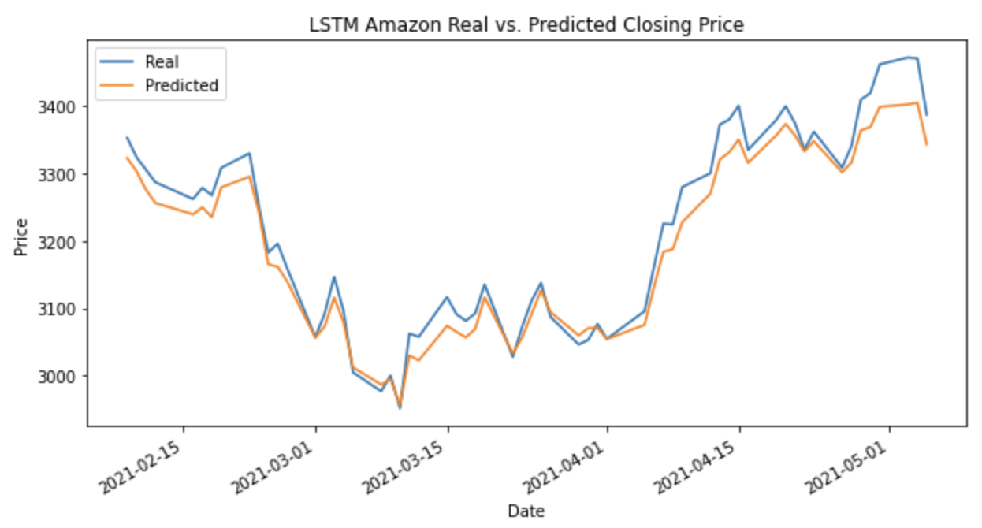
LSTM Model - Amazon
LSTM with Rolling Window Data
LSTM with Multivariate Data

Slide 14
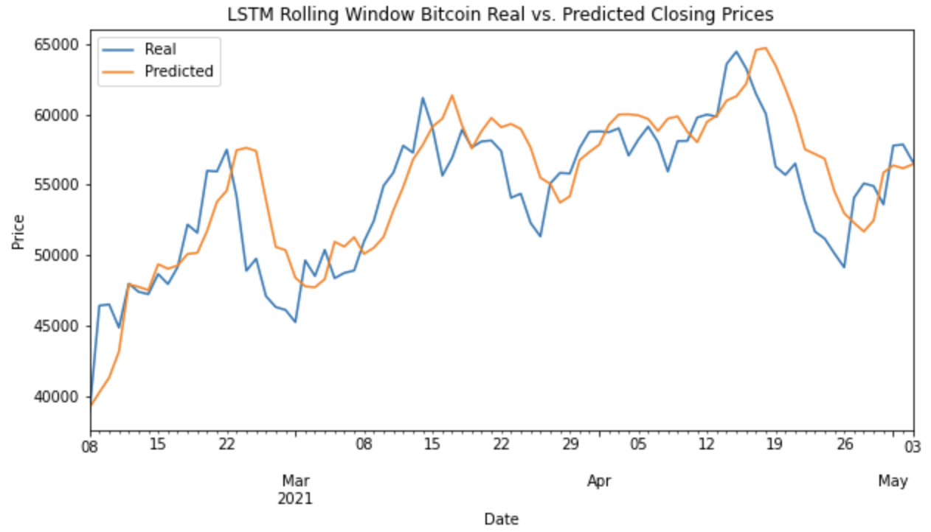
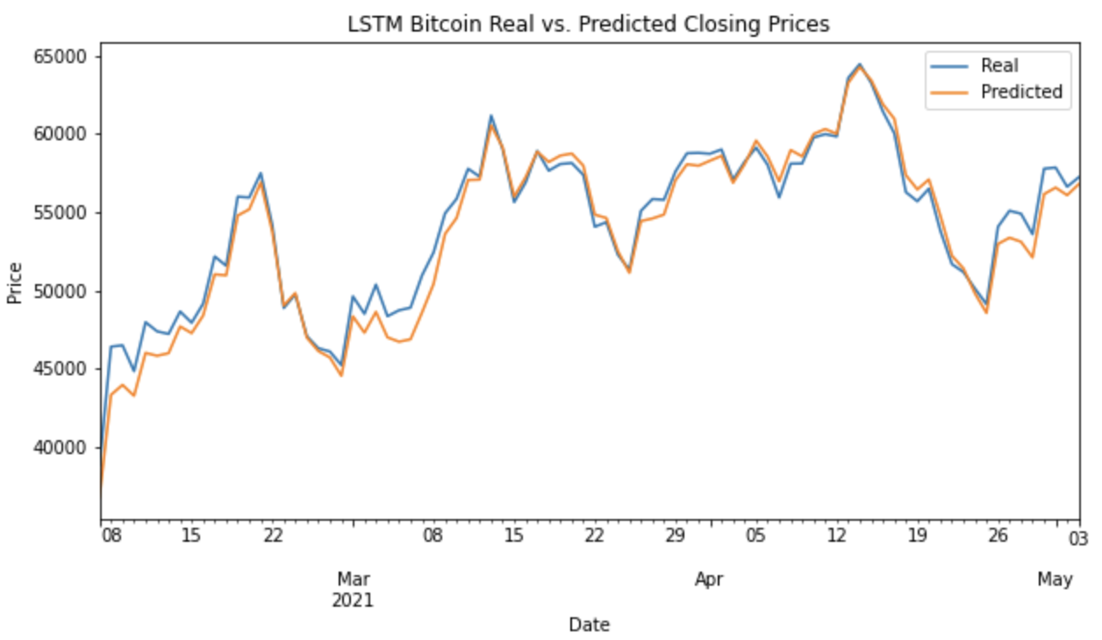
LSTM Model - Bitcoin
LSTM with Rolling Window Data
LSTM with Multivariate Data

Slide 15
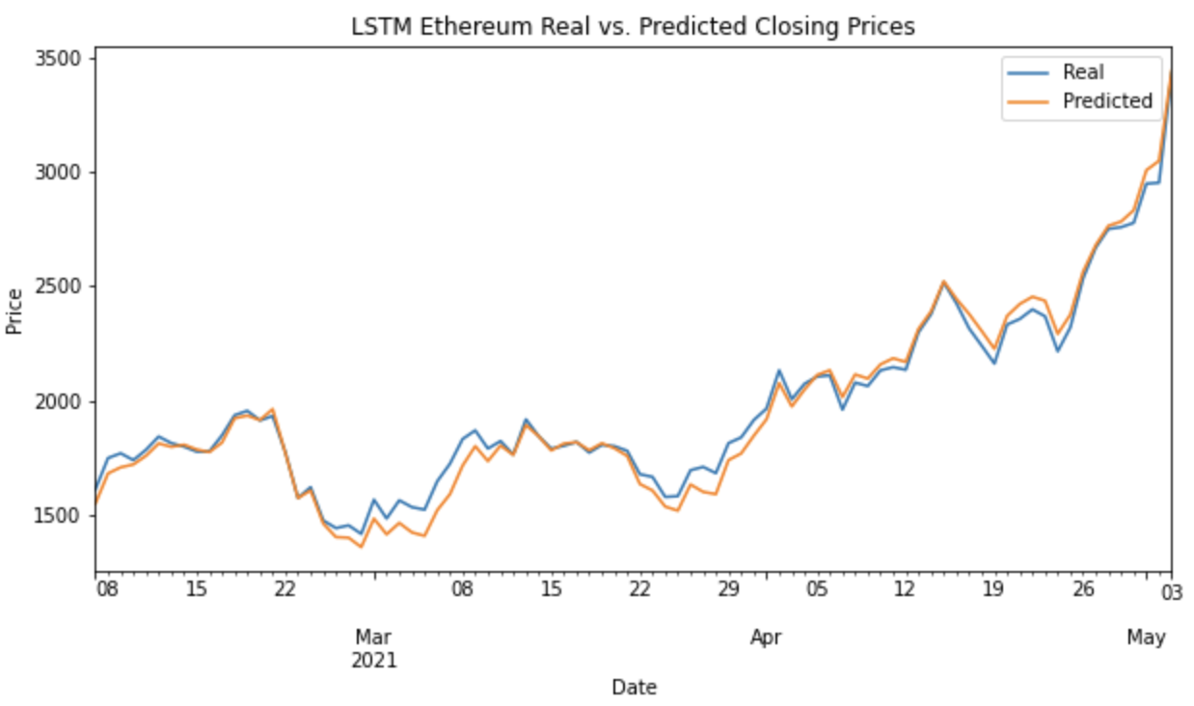
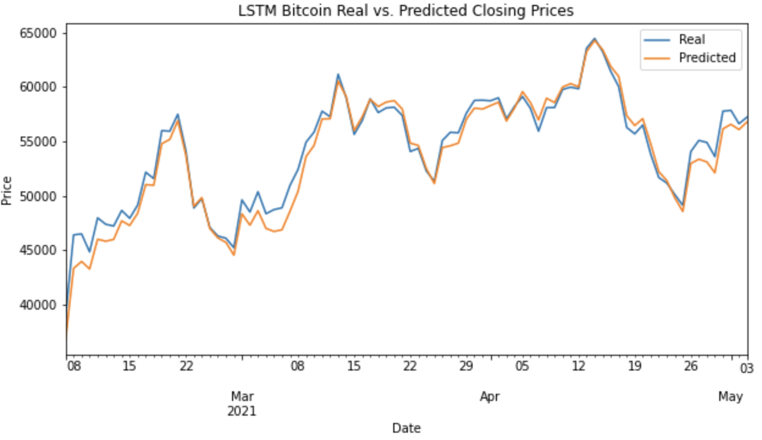
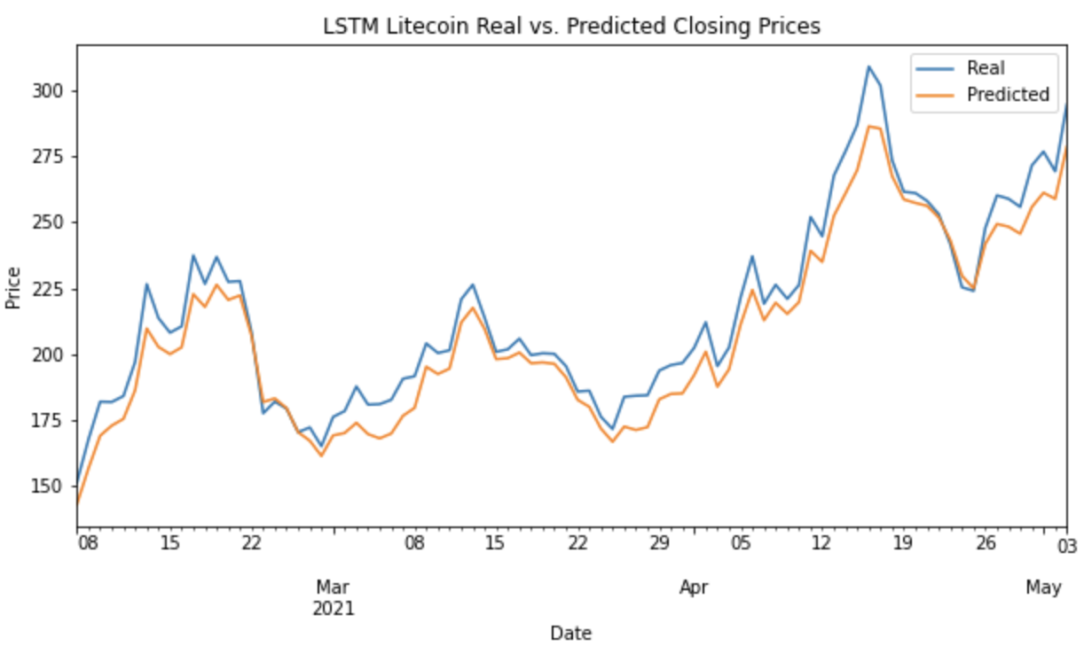
LSTM– STOCKS

Slide 16
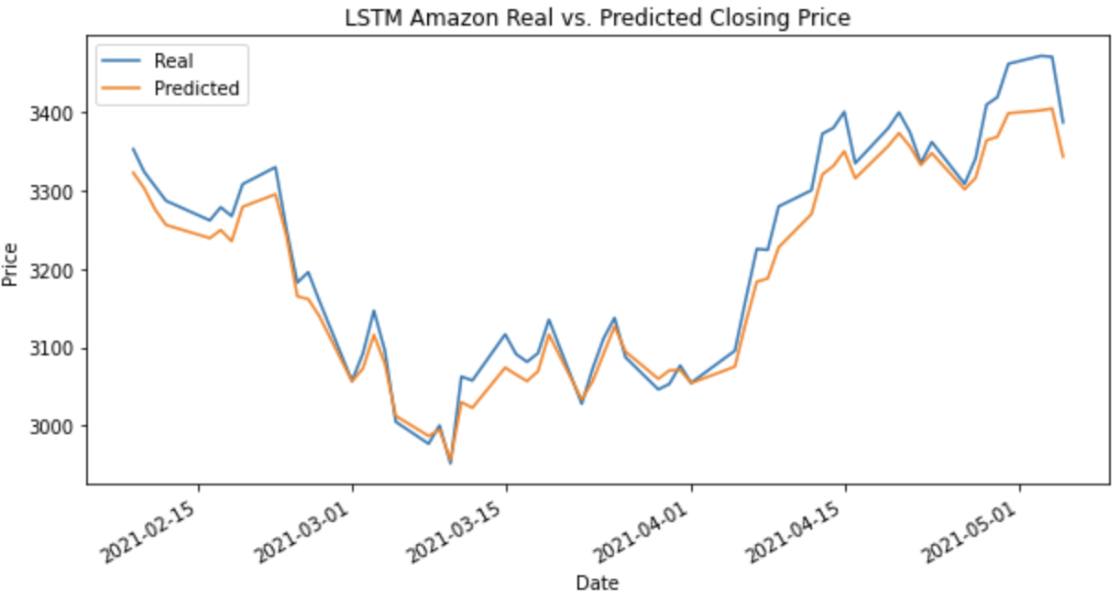
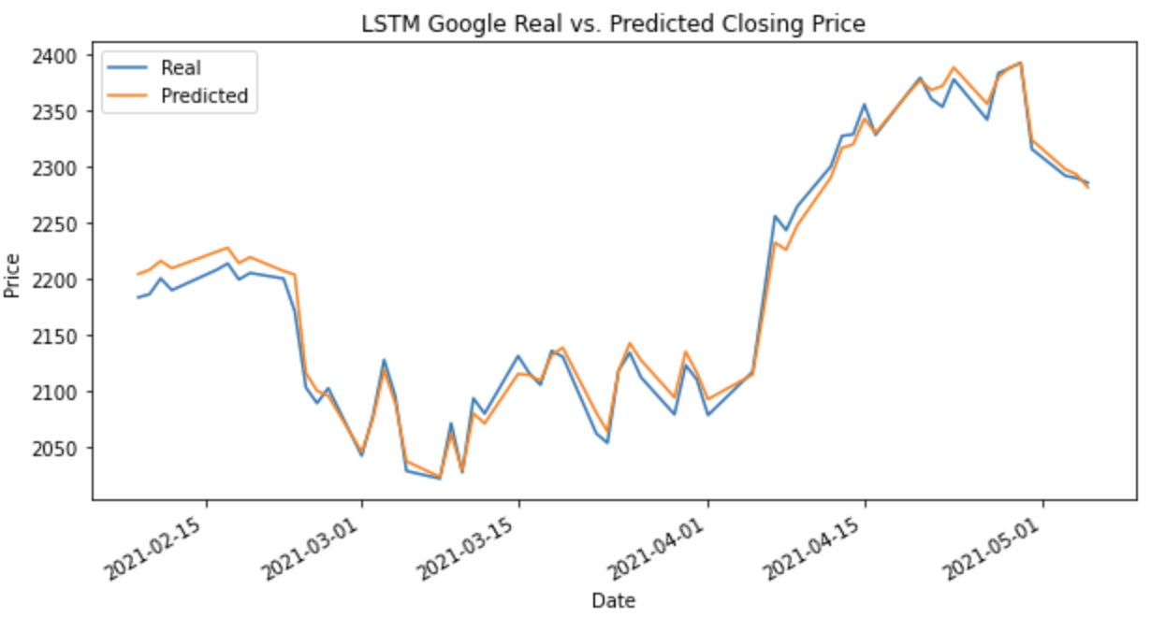
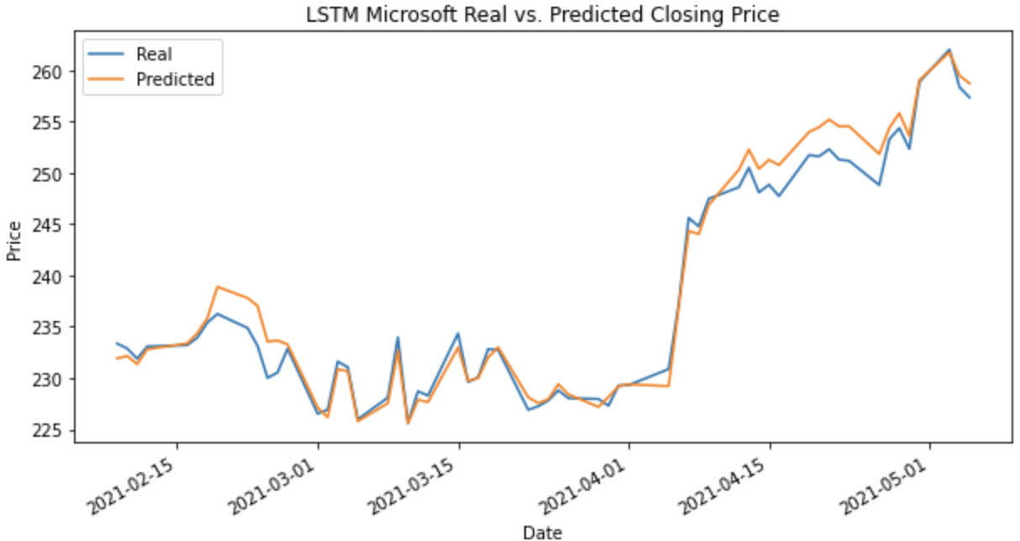
LSTM– CRYPTO

Slide 17
EVALUATION - STOCKS
Mean Square Error
Mean Closing Prices
Asset | ARIMA | LSTM | XGBOOST
AMZN | 61,985 | 949 | 4,575
MSFT | 388 | 3 | 113
GOOGL | 56,403 | 147 | 15,941
Asset | ARIMA | LSTM | XGBOOST
AMZN | 3,084.85 | 3,193.03 | 3,209.56
MSFT | 234.44 | 238.74 | 256.57
GOOGL | 2016.89 | 2,196.79 | 2,335.72
Root Mean Square Error
Root Mean Square to Mean Closing Price
Asset | ARIMA | LSTM | XGBOOST
AMZN | 248 | 31 | 68
MSFT | 19 | 2 | 11
GOOGL | 237 | 13 | 126
Asset | ARIMA | LSTM | XGBOOST
AMZN | 8.04% | 0.97% | 2.11%
MSFT | 8.10% | 0.68% | 4.15%
GOOGL | 11.75% | 0.55% | 5.41%

Slide 18
EVALUATION - CRYPTO
Mean Square Error
Mean Closing Prices
Asset | ARIMA | LSTM | XGBOOST
BTC | 136,590,222 | 1,117,080 | 4,378,945
ETH | 98,132 | 2,874 | 613,235
LTC | 1,217 | 94 | 3,366
Asset | ARIMA | LSTM | XGBOOST
BTC | 65,399.12 | 53,705.04 | 54,638.03
ETH | 2,006.18 | 1,961.74 | 2,735.78
LTC | 211.75 | 207.64 | 258.41
Root Mean Square Error
Root Mean Square to Mean Closing Price
Asset | ARIMA | LSTM | XGBOOST
BTC | 11,687 | 1057 | 2,093
ETH | 313 | 54 | 783
LTC | 34 | 10 | 58
Asset | ARIMA | LSTM | XGBOOST
BTC | 17.87% | 1.97% | 3.83%
ETH | 15.60% | 2.73% | 28.62%
LTC | 16.06% | 4.68% | 22.45%

Slide 19
CHALLENGES
Data range: Initially started with 5 years of data but had to change the range to past 15 months due to volatile market after Covid-19 shock.
Optimization: Each model for each asset had to be optimized to achieve best predictions. No happy medium across all assets.
Evaluation: Different evaluation metrics summary for all models.
Features: Traditional stocks feature used in XGBoost model (EMA & SMA), might not ideally optimize crypto asset models.

Slide 20
PROJECT EXTENSION
Forecasting using multivariate method by adding more features:
Sentiment analysis on news articles and social media posts
Number of articles/posts per day
Interest rates
Trading volume
SMA/EMA
Sharpe Ratios
Relative strength index
Rolling standard deviation
2. Classification and multiclass classification using LSTM

Slide 21


