Slide 1

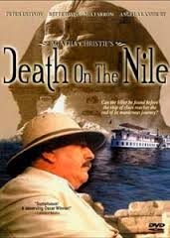
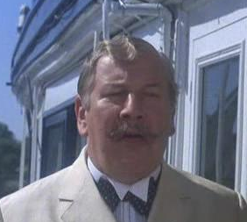

Slide 2
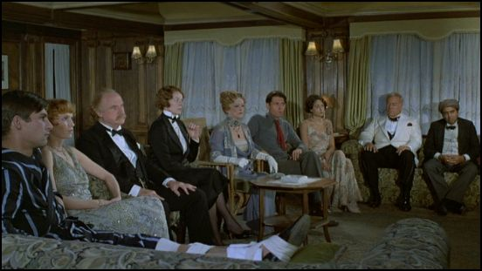

Slide 3

Directed by: John Guillermin
Written by: Agatha Christie (Novel)
Anthony Shaffer （Screenplay）
Produced by: John Brabourne, Richard B. Goodwin
Genre: Crime | Mystery | Suspense
Release Date: 29 September 1978
Cast:
  *Peter Ustinov (Hercule Poirot)
  *Jane Birkin (Louise Bourget)
  *Lois Chiles (Linnet Ridgeway)
  *Bette Davis (Mrs. Van Schuyler)
  *Mia Farrow (Jacqueline De Bellefort)

Slide 4

During a luxurious pleasure cruise down the Nile aboard a lavish vessel populated with wealthy passengers, widely despised heiress and home wrecker Linnet Ridgeway (Lois Chiles) is murdered. Almost everyone aboard seems to have a reason to want to do away with the heiress. Then the famed Belgian detective Poirot (Peter Ustinov), together with his taciturn traveling companion, Colonel Race, undertakes an investigation into Ridgeway's killing...

Slide 5

 Death on the Nile is a major contender for second place, a grand evocation of a type of mystery and a period now long gone.
AudioVideoRevolution.com
Death on the Nile is a clever, witty, well-plotted, beautifully-produced and splendidly acted screen version of Agatha Christie's mystery.
Variety.com

Slide 6
 A fine Agatha Christie adaptation, made more watchable because of its all-star cast
Bob Bloom Journal and Courier
The cast are, generally, on top-form.
Homecinema.com
Christie's excellent writing coupled with beautiful scenery and great performances put in by the stellar cast are what make this witty, fast-paced, laugh out loud film so good.
Almost Fabulous Movie

Slide 7
Watching Poirot untangle the mystery, involving all sorts of bizarre characters, is deliciously exciting.
At-a-glance film Reviews
It’s Ustinov’s first movie as the detective and he’s excellent; the stars are also amusing.
The MovieHamlet

Slide 8
 Director John Guillermin handles the ensemble well, never forcing scenes just for “screen time” yet still giving each performer a moment to shine.
FRANKSMOVIELOG.COM
Death on the Nile is a fine entertainment that is lovely to look at and easy to enjoy…Director John Guillermin makes the most of the exotic Egyptian settings and uses a repetitive flashback technique to create possible variations on how the crime took place. The surprise ending is well worth the wait.
Spiritualaity&practice

Slide 9
Director of Photography on this film was the legendary Jack Cardiff, and the results are naturally incredible. Cardiff manages to make even the most ordinary shot look great, and when he has material like the pyramids and ancient temples of Egypt to work with his artistry really shines.
Dvdverdict.com

Slide 10
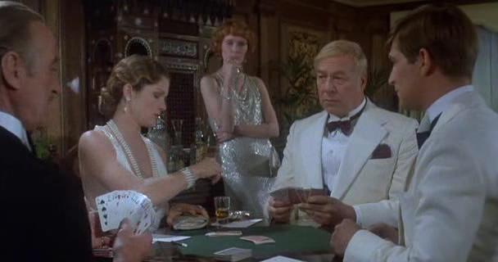

Slide 11

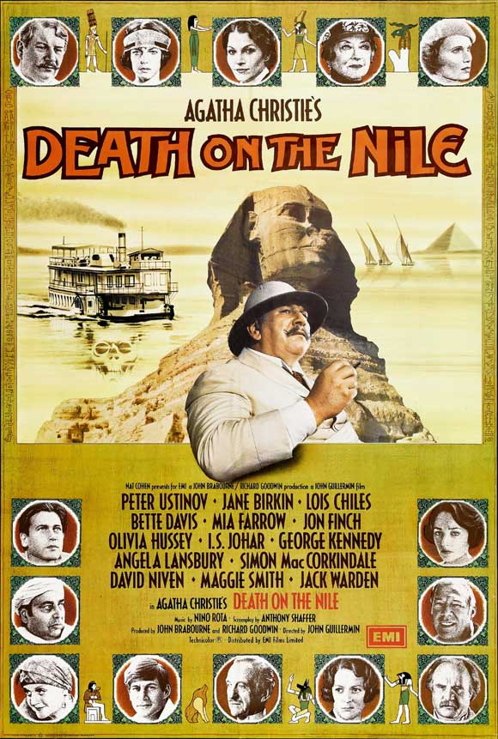
1. Match the characters in the left column with their identities in the right column. Some are done for you.

Slide 12






______ Rosalie G Tim __Andrew Pennington _____ Louise Bourget ___ Cornelia Robson E Miss Bowers ______ Mr. Ferguson I _ Signor Richetti C James Fanthorp ______ Dr. Bessner | an outspoken Communist Linnet's French maid a young attorney with Linnet's British solicitors, who sent him to spy on Pennington an Austrian physician Miss Van Schuyler's nurse the daughter of sex novelist Salome Otterbourne a jewel thief who stole Linnet’s pearls, the son of Mrs. Allerton the younger cousin of American socialite Marie Van Schuyler an Archaeologist J. Linnet's American trustee

Slide 13
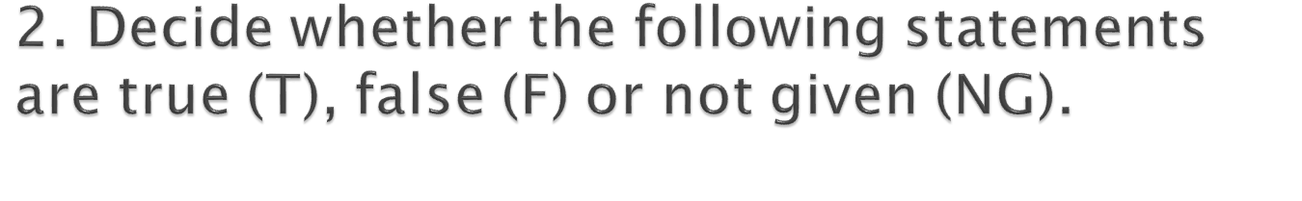





The shot fired by Jacqueline was an alibi （借口）for Simon to cover his murder of Linnet.
Linnet was shot by Jacqueline.
Jacqueline shot four people to death.
What invited Louise Bourget’s death was her greedy bidding for hush money
Detective Hercule Poirot concluded that Simon and Jacqueline were still lovers.

Slide 14
3. Refer to detective Hercule Poirot’s narrative of the crime committed by Jacqueline and Simon and rearrange the sequence of the crime.
A. Simon asked to see Jacqueline and told her of the new danger.
B. Robson and Fanthorp believed Jacqueline was so crazy about Simon’s betrayal that she shot him. They went out with her; Robson was to be with Jacqueline and Fanthorp was to send for Dr Bessner.
Ｃ. Otterbourne saw Jacqueline go into Louise's cabin. She was excited to tell who was the murder but was shot by Jacqueline.

Slide 15
Ｄ. Jacqueline pretended to fired at Simon (the bullet actually went into the table); Robson and Fanthorp heard the shot and found Simon with a red-stained handkerchief clasped to his leg.
Ｅ. Louise saw Simon run along to his wife's cabin and come back. She figured out what had happened so she asked for hush money.
F. Simon ran back, muffled a stole round the pistol and fired a bullet into his leg.
G. Jacqueline stole Bessner's scalpel, entered Louise’s cabin, pretended to give her money, and finally stabbed her to death with the scalpel while she was counting the money.
H. Simon slipped out of his shoes, ran silently, entered his wife Linnet's cabin, and shot her through the head while she was asleep.
D Ｂ Ｈ Ｆ Ｅ Ａ Ｇ C

Slide 16
4. Answer the following questions.
E.R. Punshon of The Guardian reviewed, "To decide whether a writer of fiction possesses the true novelist's gift it is often a good plan to consider whether the minor characters in his or her book, those to whose creation the author has probably given little thought, stand out in the narrative in their own right as living personalities. This test is one Mrs. Christie always passes successfully, and never more so than in her new book." Do you agree? Why or why not?

Slide 17

“当然罗。另一半的凶手。希蒙·道尔的不在场证明是什么？贾克琳·杜贝尔弗开的一枪。贾克琳的不在场证明呢？在希蒙·道尔的坚持下，她整晚由护士陪伴。在他们两人之中，可以找到行凶的一切必备条件——贾克琳·杜贝尔弗有冷静、机智和有条理的头脑；希蒙·道尔则有高度敏捷和计算准确的身手。”

Slide 18
“从正确的角度来看，每一个问题都可以找到答案。希蒙·道尔跟贾克琳·杜贝尔弗是爱侣。弄清楚他俩仍然相爱，事情就很清楚了。希蒙干掉富有的太太，继承巨额遗产，在适当的时候再娶旧爱人。真是天衣无缝！贾克琳对道尔夫人的恐吓，全是计划的一部分。希蒙的假装愤怒……不过——总是有漏洞的。他曾经向我讲到具有占有欲的女人——表示出极度的厌恶。我应该想到他是在说自己的太太——而不是贾克琳。然后是他在公共场合对太太的态度。一个平凡、不善辞令的英国人——正如希蒙·道尔，是不惯于流露感情的。希蒙不是个好演员，他对太太的爱慕显然太做作。还有，我跟杜贝尔弗小姐在亚思温谈话，她假装说有人在偷听。其实一个人也没有！但这在事后就变成混淆视听的要素了。

Slide 19
