Slide 1

Courtesy of KlingStubbins
Code Coverage Introduction
Randy Gong
Image courtesy of Mammoth-WEBCO, Inc.
Image courtesy of ADEPT Airmotive (Pty) Ltd.

Slide 2
Agenda
Purpose
Basic Process
Test Lister
Coverage Analyzer
Coverage Analysis for Test Events
Application In Other Products
Appendix
Notes:
Image what if we don’t have code coverage and what if we have code coverage.

Slide 3
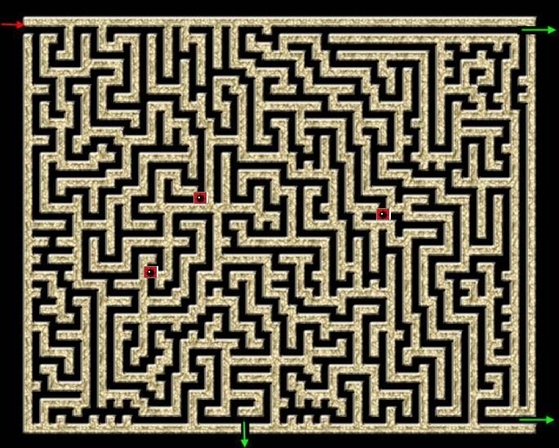

Purpose
We Test Software By
Manual test
Automation test
But…
How about test effectiveness?
Anything never tested?
Solution: Code Coverage
?
Program
?
?
Notes:
Image what if we don’t have code coverage and what if we have code coverage.
Code coverage can only tell you which area are not tested, but can’t tell you if there are bugs in non-tested area.

Slide 4
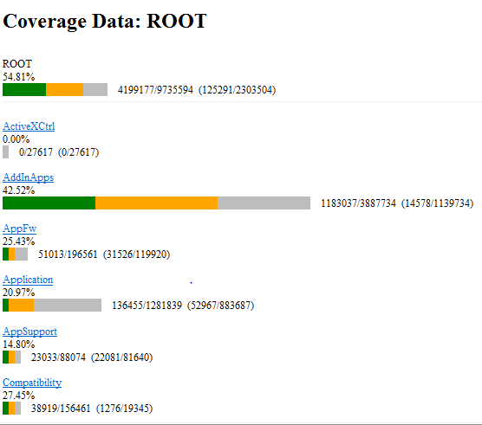
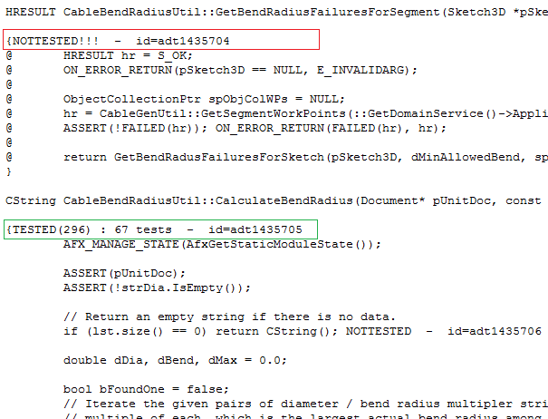
Basic Process
A Sample Report
Notes:
Image what if we don’t have code coverage and what if we have code coverage.

Slide 5
Basic Process
Instrument&Build
Run Tests
Source Tree Annotation
Post Coverage Trees
Instrumented application
Code coverage capability
Manual test or automation test
Get raw coverage data
Calculated coverage info based on source tree
Formatted coverage data for further analysis
Centralized coverage data for geo sites

Slide 6
Test Lister
Catch Regression as Early as Possible
Somehow blindness
With Test Lister(tl)
More targeted
Improved productivity
Code changes
Run smoke tests
Submit into code base
Peer review
Triage failures and fix
Code changes
Run smoke tests from tl
Submit into code base
Peer review
Triage failures and fix
Notes:
Inventor now has hundreds of thousands test cases
With test lister
Precision-guided missiles
Save time

Slide 7
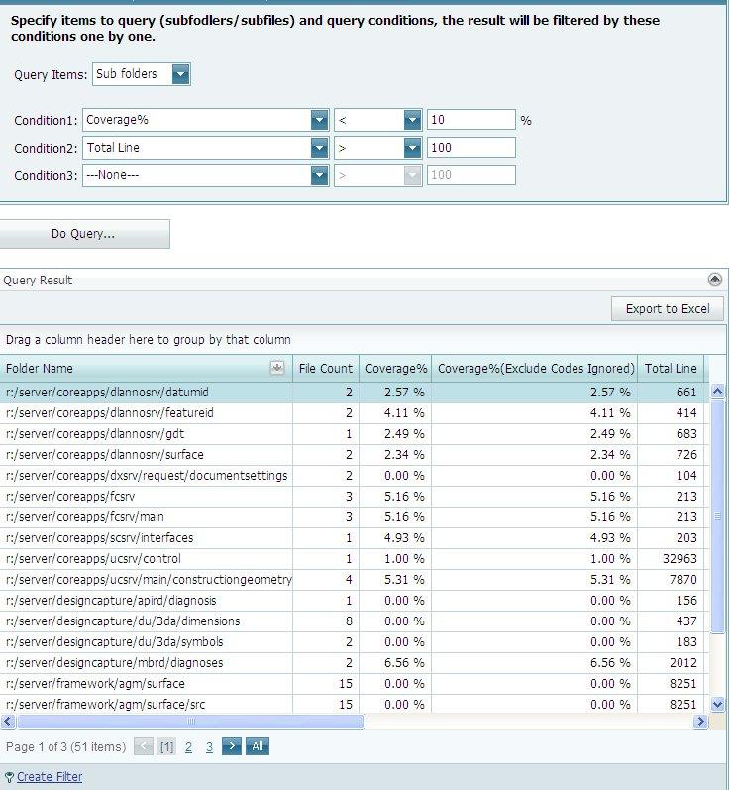
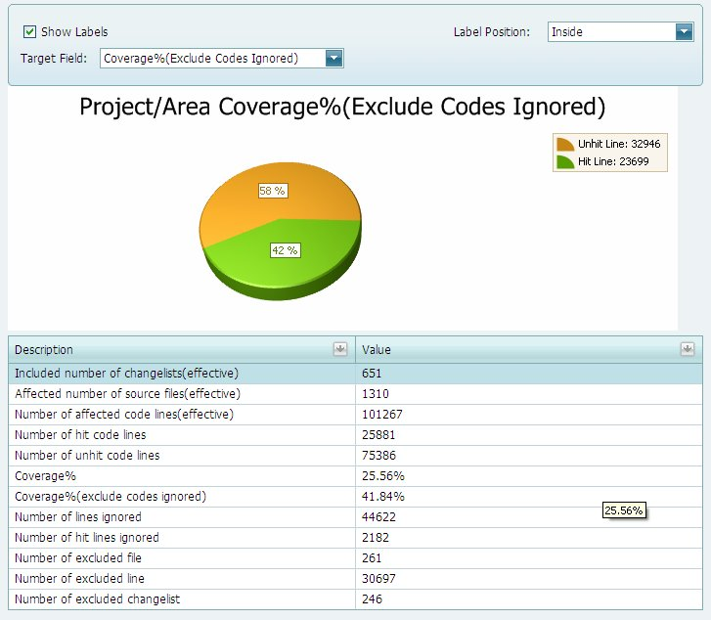
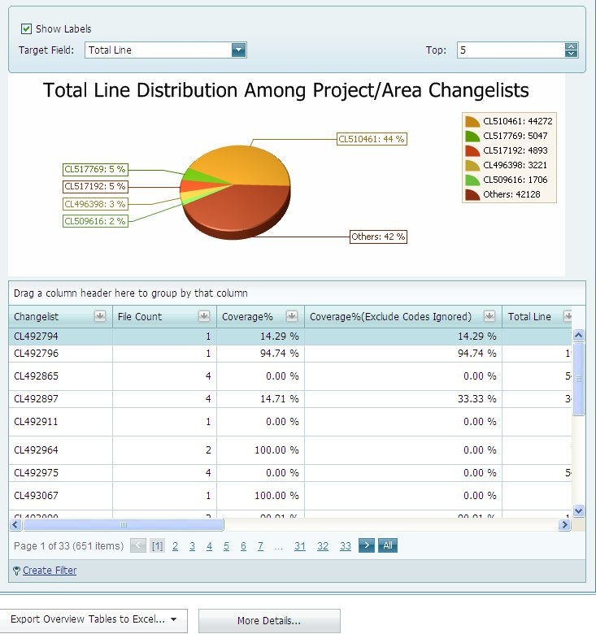
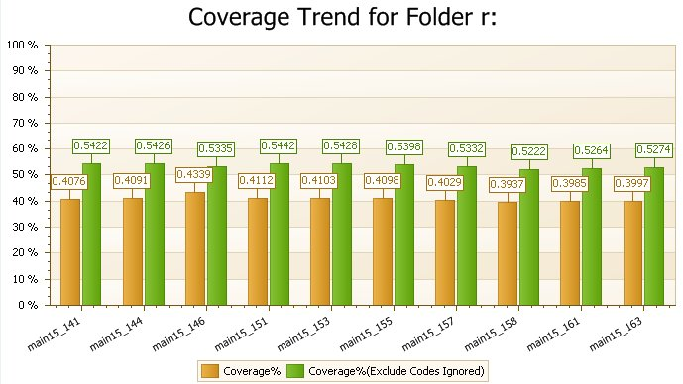
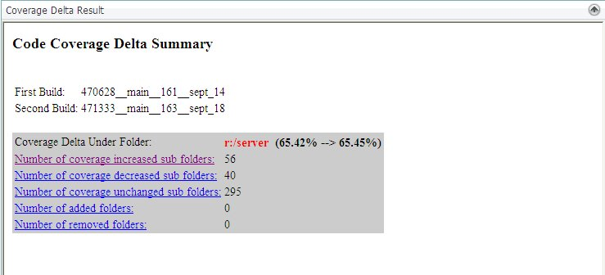
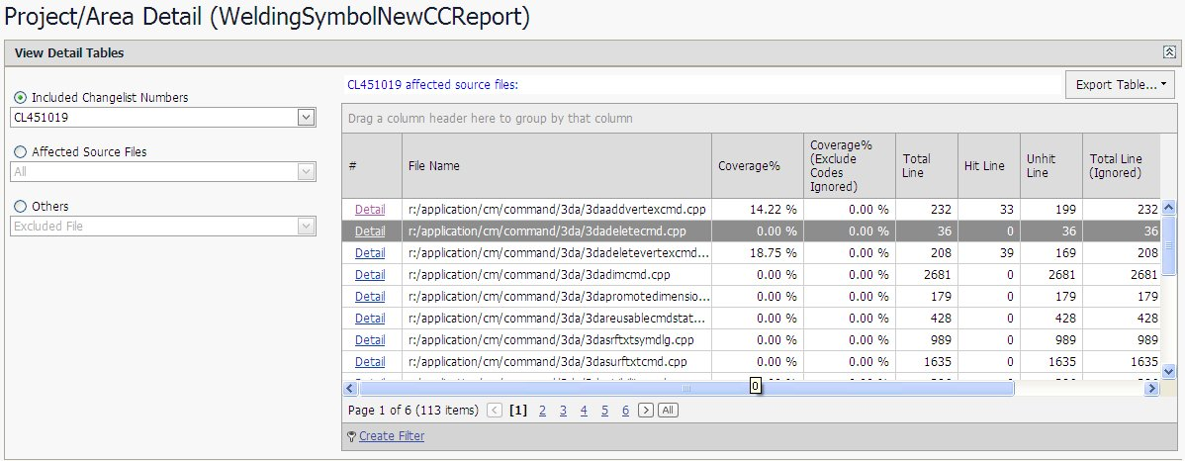
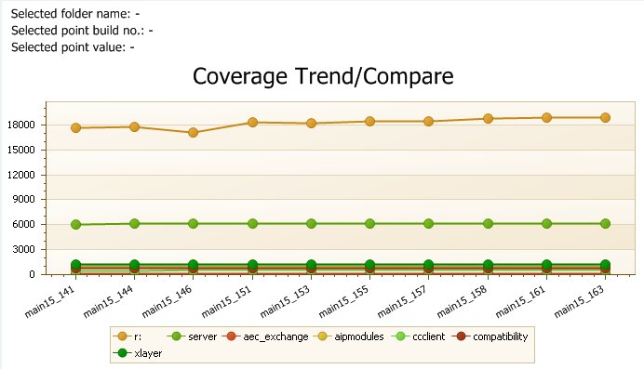
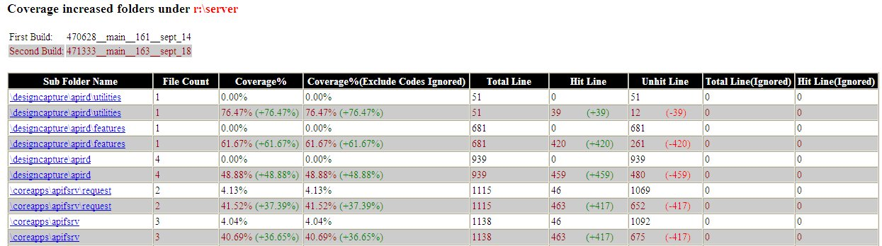
Coverage Analyzer
Coverage info from different perspective
Stand-alone vs thin-client
It can do…
Coverage Query
Coverage Delta
Coverage Trend
CL Based Coverage

Slide 8
Coverage Analysis for Test Events
Process
Install IC Build
CodeCov Team – IC Build
Test
QA
Collect Data
CodeCov Team – Coverage Data Collector
Analysis
Code Cov Team – Html Report, Feature Coverage Report
QA – View Result
QA – Request or Use Regular Build
QA – Install & Run
Test Event
Post-Process

Slide 9
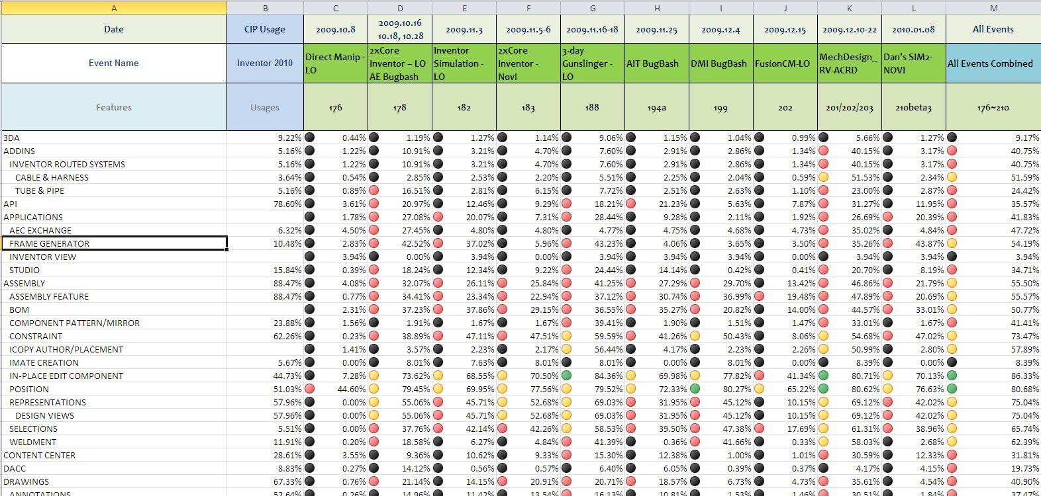
Coverage Analysis for Test Events
Combined Coverage
Total Coverage spanning multiple test events

Slide 10
Application In Other Products
EVO
Publisher
Factory
Algor

Slide 11
Appendix
Supported Languages
C, C++
C#
VB.Net
Supported Build Tool
Visual studio 2003, 2005, 2008, 2010
Site Link:
Code Coverage Sharepoit
https://share.autodesk.com/sites/msd_codecoverage/default.aspx
Coverage Analyzer Thin-client
http://shapdvsrv1/codecoverage/
Contact: inventor.code.coverage@autodesk

