Slide 1

Javascript v8 engine
Randy Gong
Sr. Software Engineer

Slide 2
What’s v8 engine
An FAST JavaScript Engine
build Javascript to machine code directly
C++ and Javascript call each other
Can be involved into existing C++ projects
Open-source and high performance

Slide 3
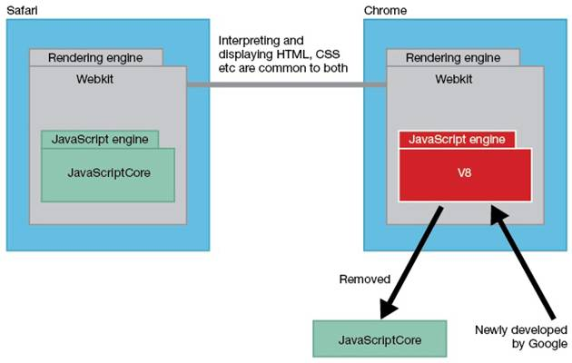
History
1. Google Chrome
2. Node.js
A server side solution for Javascript developers

Slide 4
Web version VCS
ForceEffectMotion Web
Mock-up
C++ VCS source code
Javascript source code
Web Browser
C++ VCS library
Javascript wrapper
Web Browser
Emscripten tool
Android Application Java Code
v8 engine

Slide 5
Build and configure v8
Find v8 in http://code.google.com/p/v8/
Get v8 codes in http://github.com/v8/v8-git-mirror
Get gyp using:
svn co http://gyp.googlecode.com/svn/trunk build/gyp --revision 1831
(Why not Cmake!!!)
Generate project using: build/gyp_v8

Slide 6
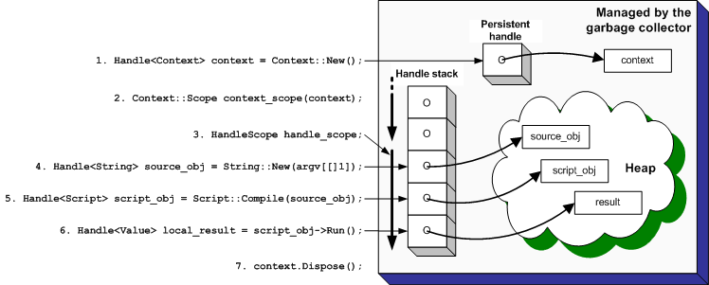
v8 concept

Slide 7
Object, handle, Scope, Context
Object always in heap
Handle is the pointer to v8 object
Persistent handle in heap
Local handle in stack
Scope is the container of local handles
Context is the running environment for a Javascript instance

Slide 8
Hello World
// Compile the source code.
Handle<Script> script = Script::Compile(source);
// Run the script to get the result.
Handle<Value> result = script->Run();
// Release context.
context.Dispose();
// Convert the result to an ASCII string and print it.
String::AsciiValue ascii(result);
printf("%s\n", *ascii);
return 0;
}
Result:
Hello World!
#include <v8.h>
using namespace v8;
Int main(int argc, char* argv[]) {
// Create a stack-allocated handle scope.
HandleScope handle_scope;
// Create a new context.
Handle<Context> context = Context::New();
// Enter the created context for compiling Context::Scope context_scope(context);
// Create a string containing the JavaScript source code.
Handle<String> source = String::New("'Hello' + ', World!'");

Slide 9
v8 data
C++
string
int
v8
v8::String
v8::Integer
Function
Function template
Object template
Object
Javascript
String
Int
Function
Object
double
v8::Double
Double

Slide 10
Accessors to data
Accessor callbacks are invoked when a specific object property is accessed by a script
static char sname[512] = {0};
static Handle<Value> NameGetter(Local<String> name, const AccessorInfo& info) {
return String::New((char*)&sname,strlen((char*)&sname));
}
static void NameSetter(Local<String> name, Local<Value> value, const AccessorInfo& info) {
Local<String> str = value->ToString();
str->WriteAscii((char*)&sname);
}

Slide 11
Access C++ data in Javascript
// Create a template for the global object.
Handle<ObjectTemplate> global = ObjectTemplate::New();
//public the name variable to script
global->SetAccessor(String::New("name"), NameGetter, NameSetter);
//set sname to "cpp" in cpp program
strncpy(sname, "cpp", sizeof(sname));
//access data in Javascript then change it
print(name);
//set the variable `name` to "js"
name='js';
print(name);
Result:
cpp
js

Slide 12
Define C++ function wrapper
Handle<Value> Add(const Arguments& args){
int a = args[0]->Uint32Value();
int b = args[1]->Uint32Value();
return Integer::New(a+b);
}
Handle<Value> Print(const Arguments& args) {
bool first = true;
for (int i = 0; i < args.Length(); i++) {
HandleScope handle_scope;
if (first) {
first = false;
} else {
printf(" ");
}
String::Utf8Value str(args[i]);
const char* cstr = ToCString(str);
printf("%s", cstr);
}
return Undefined();
}

Slide 13
Access C++ function in Javascript
var x = (function(a, b){
return a + b;
})(12, 7);
print(x);
//invoke function add defined in cpp
var y = add(43, 9);
print(y);
Result:
cpp
js

Slide 14
Define C++ class
class Person {
private:
unsigned int age;
char name[512];
public:
Person(unsigned int age, char *name) {
this->age = age;
strncpy(this->name, name, sizeof(this->name));
}
unsigned int getAge() { return this->age; }
void setAge(unsigned int nage) { this->age = nage; }
char *getName() { return this->name; }
void setName(char *nname) {
strncpy(this->name, nname, sizeof(this->name));
}
};

Slide 15
Accessors to class member
Handle<Value> PersonGetAge(const Arguments& args){
Local<Object> self = args.Holder();
Local<External> wrap = Local<External>::Cast(self->GetInternalField(0));
void *ptr = wrap->Value();
return Integer::New(static_cast<Person*>(ptr)->getAge());
}
Handle<Value> PersonSetAge(const Arguments& args) {
Local<Object> self = args.Holder();
Local<External> wrap = Local<External>::Cast(self->GetInternalField(0));
void* ptr = wrap->Value();
static_cast<Person*>(ptr)->setAge(args[0]->Uint32Value());
return Undefined();
}

Slide 16
Access C++ class in Javascript
//global function to print out detail info of person
function printPerson(person){
print(person.getAge()+":"+person.getName());
}
//new a person object in Javascript and print
var person = new Person(25, “Jack");
printPerson(person);
//set new value and print
person.setAge(30);
person.setName(“White");
printPerson(person);
Result:
25:Jack
30:White

