Slide 1

Learning Days’ Topic Concurrency With Multithreading
Fuming Dai
April 8 – 19, 2013

Slide 2
Learning Goals
Get a comprehensive view of new C++11/boost multithreading models/mechanisms, common concurrency patterns and concurrency libraries.

Slide 3
Learning Coverage
Basic concepts of multithreading concurrency
Basic tools of Multithreading
Common issues with Multithreading
Common multithreading concurrency patterns
Concurrency library: TBB

Slide 4
Basic concepts
Threads and multithreading concurrency
1) A thread is an execution path within a process.
Execution path is usually a function (or a callable object).
2) Multiple threads within a process share the same virtual memory
of the process
3) The execution and interaction of multiple threads
within an application give rise to multithreading
concurrency.

Slide 5
Basic concepts
Single Thread VS Multiple Thread
sum = func1() + func2
Single Thread |  | Multiple Thread
Sequential execution steps | Time | Thread Execution Steps | Time
Func1() (2) Func2() (3) Sum = func1()+func2() | T1 = 20 s T2 = 30 s T3 = 1 s | Thread1: func1() Thread2: func2() Main Thread: sum = func1()+func2() | T1 = 20 s T2 = 30 s T3 = 1 s
Total time = T1+T2+T3 = 51 s |  | Total time = max(T1, T2) + T3 = 31 s

Slide 6
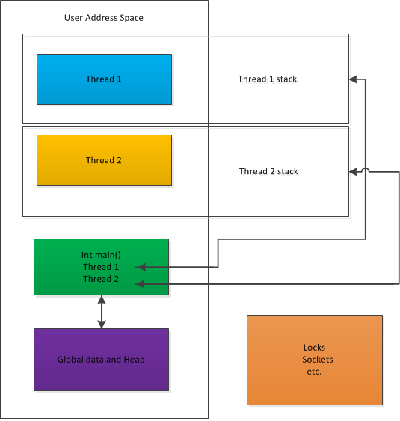
Basic concepts
Simplified Thread Model

Slide 7
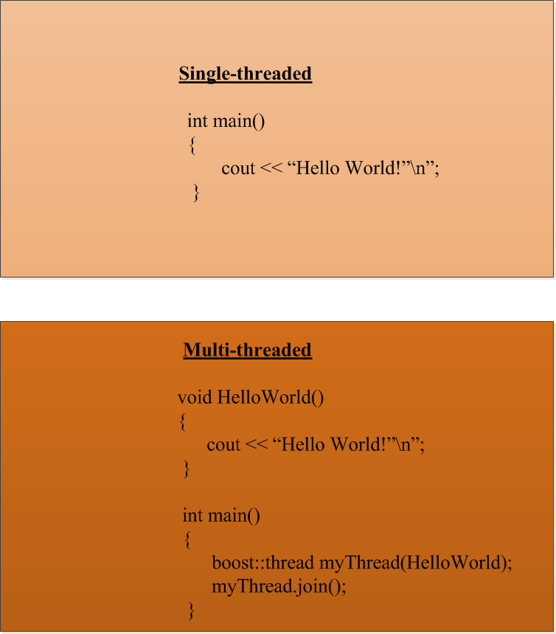

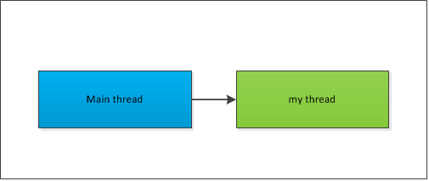
Basic concepts
A simple example of “Hello World”

Slide 8
Basic Tools
Thread Management
- Thread Creation (launching)
- Thread join and detach
- wait for thread to finish
-Thread Break and Interrupt
- thread queries
Thread Synchronization Primitives
- mutexes and locks
- condition variable
- future/promise
- atomics

Slide 9
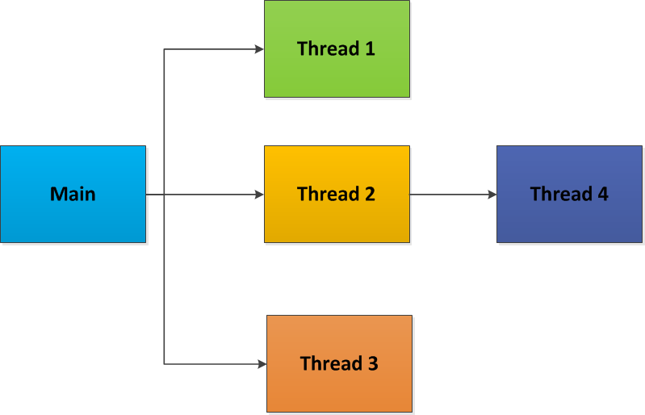
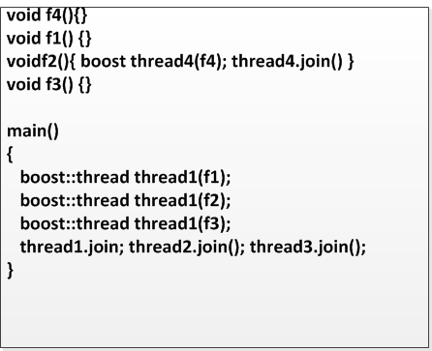
Basic Tools -Thread Management
Thread Creation

Slide 10
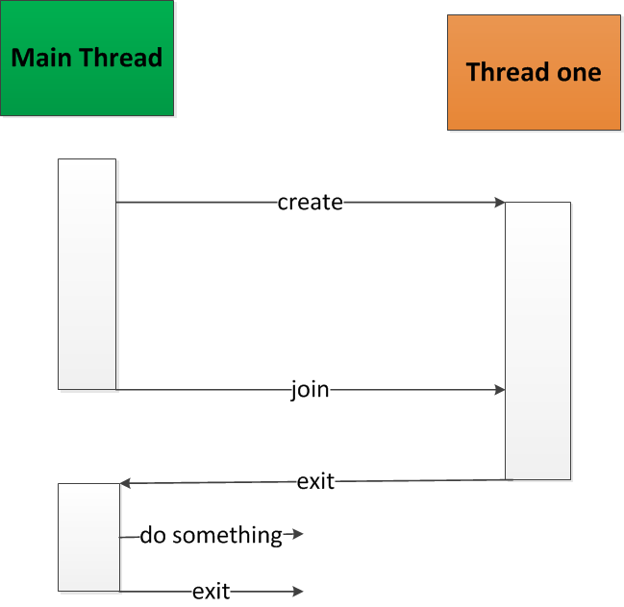
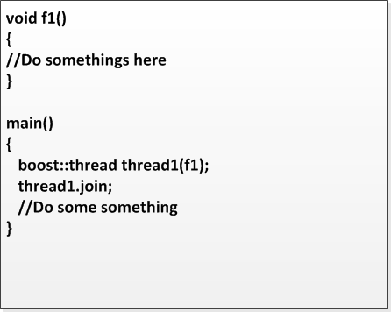
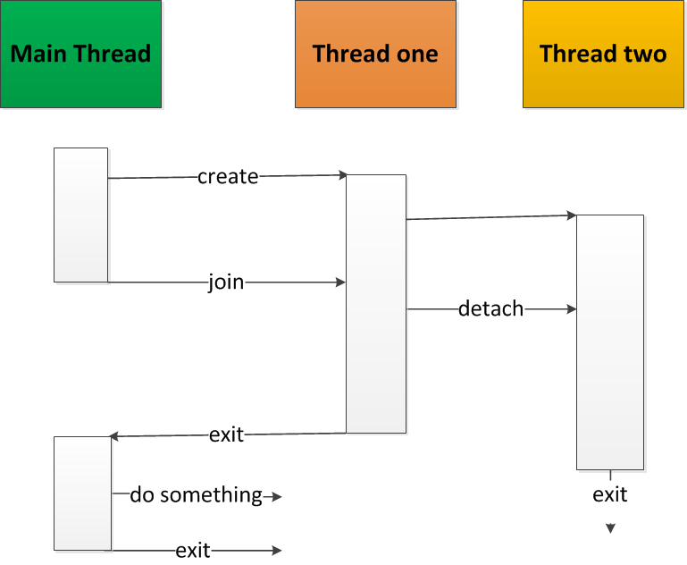
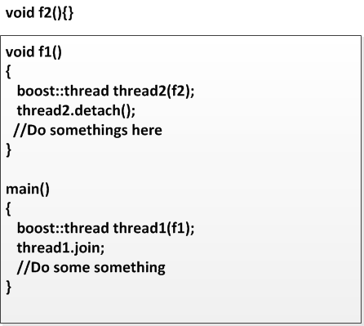
Basic Tools -Thread Management
Thread life time - join and detach

Slide 11
Basic Tools -Thread Management
Thread Block(Wait) and Interrupt
- interrupt: myThead.interrupt()
- sleep: myThread.sleep(time)
- yield: myThread.yield()
Thread Queries
- thread id: myThread.get_id()
- thread join: myThread.joinable()
- available hardware threads:
boost:thread:hardware_concurreny()

Slide 12
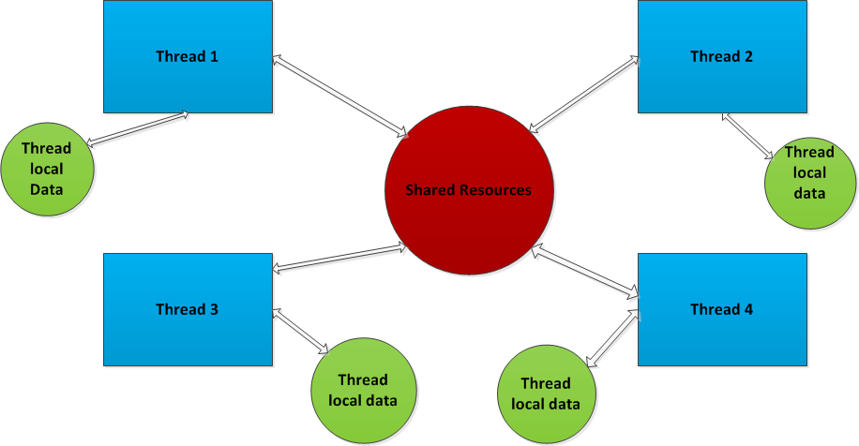
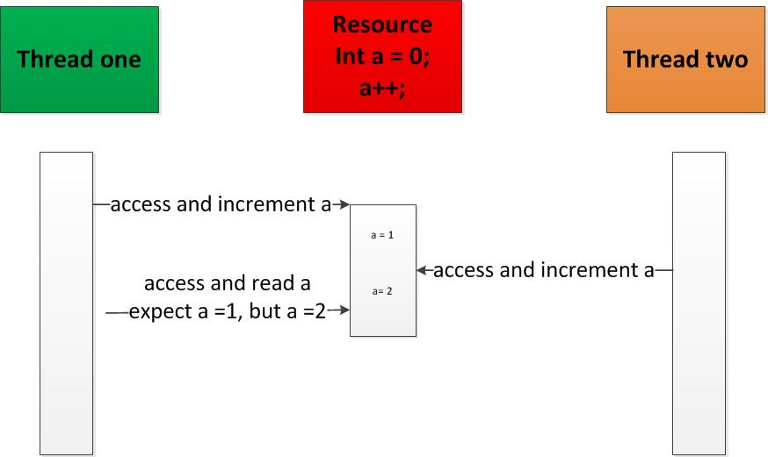
Basic Tools – Sync Primitives
Thread Synchronization
A set of threads interacts with one another in terms of resource sharing.
Static View Dynamic View

Slide 13
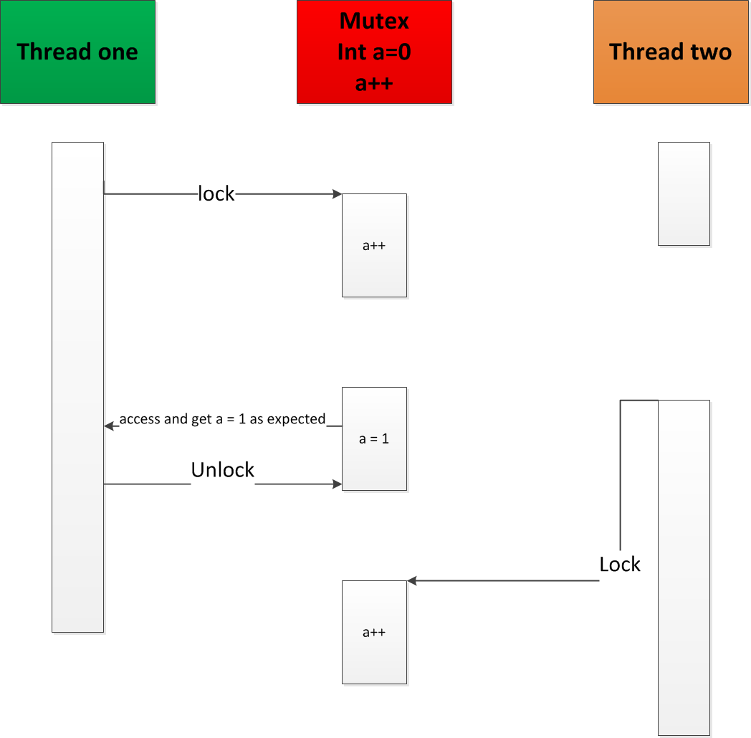
Basic Tools – Sync Primitives
Mutexes and locks
- Ensure a section of code to be executed only by one thread at a time.
- Two main states: lock and unlock
- Two main types: simple mutex and recursive mutex.
- Two common lock objects: lock_guard and unique_lock

Slide 14
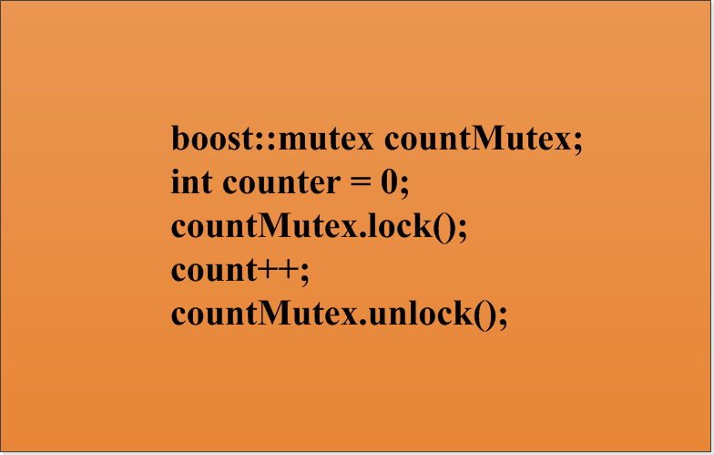
Basic Tools – Sync Primitives
Mutexes and locks

Slide 15
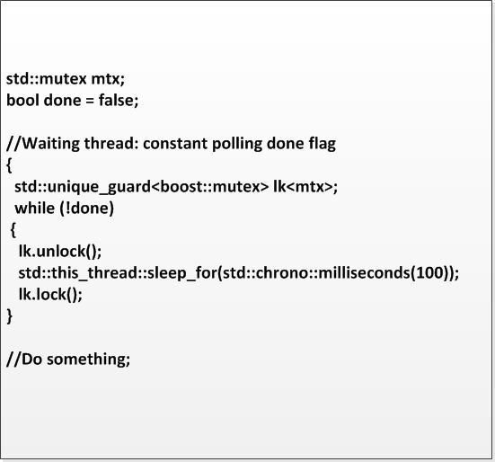
Basic Tools – Sync Primitives
Condition variable
- Provides a way for threads to communicate with each
other with some condition triggers, rather than constant polling
.

Slide 16
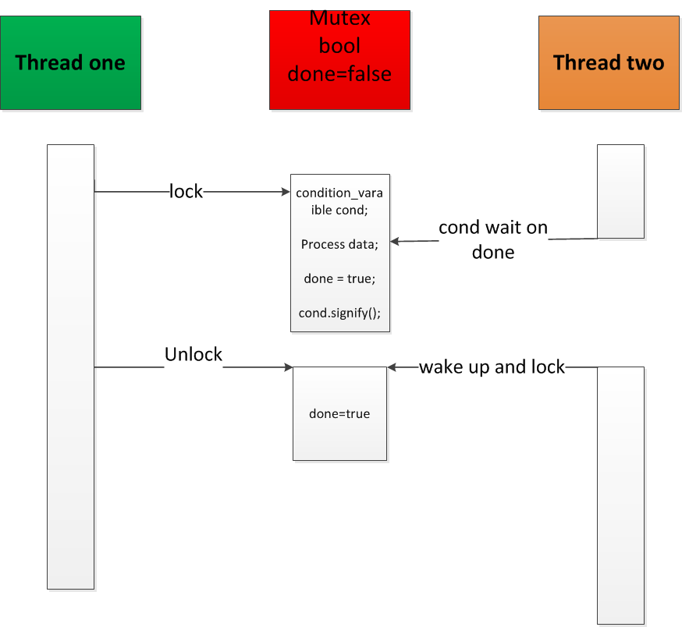
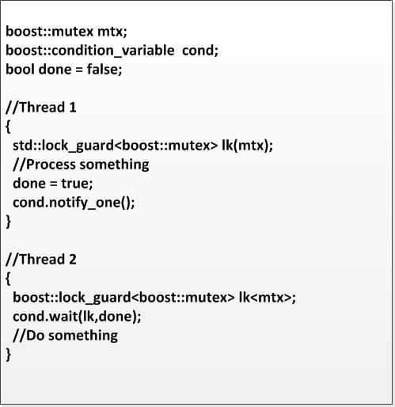
Basic Tools – Sync Primitives
Condition variable
- Two components
- always used with mutex locks
- Signify/Wait pair

Slide 17
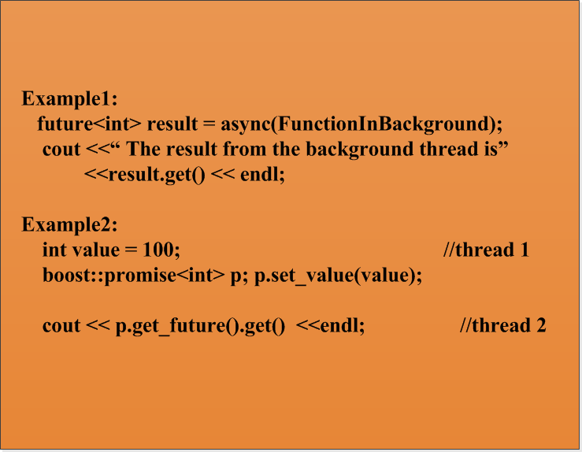
Basic Tools – Sync Primitives
Future/promise
- provide a means for the asynchronous communications between
threads. Unlike condition variable, value is set/returned on once.
- used in some concurrent patterns (e.g. active object pattern)

Slide 18
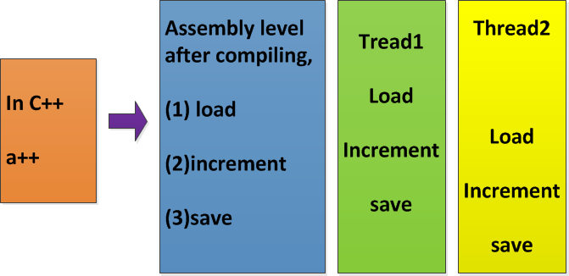
Basic Tools – Sync Primitives
Atomics:
C++ operations are not atomic in concurrent context

Slide 19
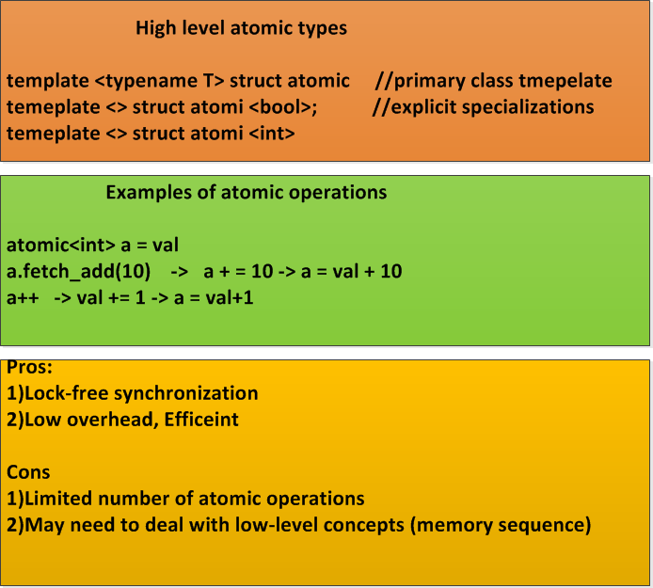
Basic Tools – Sync Primitives
Atomics:

Slide 20
Common Issues with Multithreading
Race Condition
Deadlock
Divide Work For Concurrency
Performance
Exception Handling

Slide 21
Common Issues with Multithreading
Race Condition
- Occurs when multiple threads try to access the same resource.
- Possible solutions
1) lock with mutex
2) atomic operations
3) Concurrent objects (Java, and TBB etc.)
4)Concurrent Patterns (e.g. Monitor Object pattern)
5)Follow best practice, e.g. never return pointer of the protected data.

Slide 22
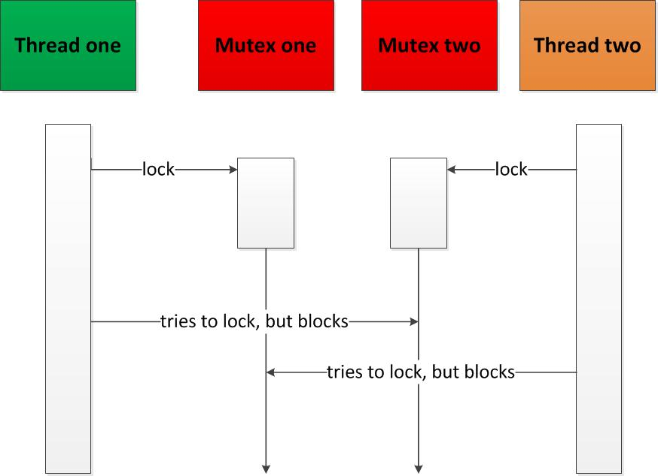
Common Issues with Multithreading
Deadlock
- Occurs where one or more threads wait for resources that never become
available.
- Self-lock: a simple mutex is locked more than once
- solution:
1) avoid one lock per thread – design issue
2) consistent lock order for more than one resources
3) Avoid calling member functions from another member function.

Slide 23
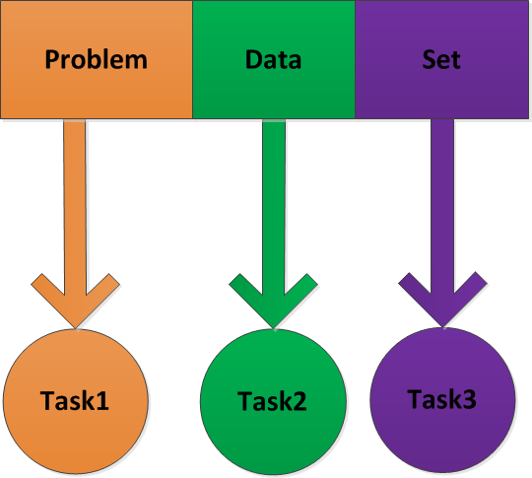
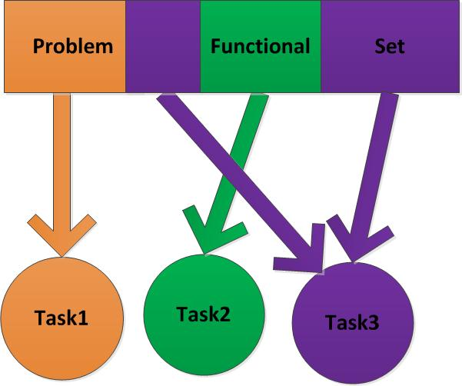
Common Issues with Multithreading
Divide Work For Concurrency
Data Parallelism Algorithm Parallelism
- Data parallelism is usually favored for scalability.
- Granularity and dependency
- Solutions
-Concurrency patterns: loop parallelism pattern and thread pool pattern.
-Concurrency libraries implementing concurrency patterns

Slide 24
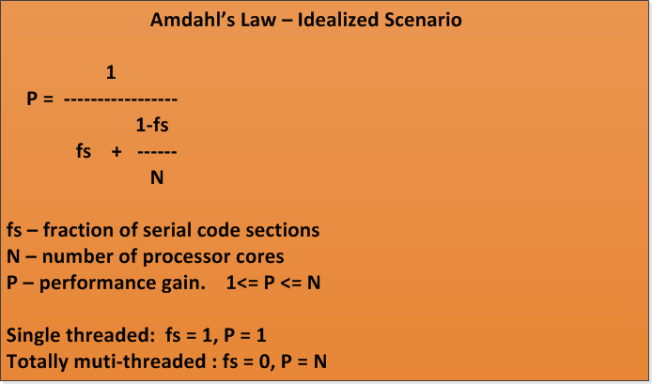
Common Issues with Multithreading
Performance
Number of cores (N) | Fraction of serial code section (fs) | Performance gain
4 | 1 | 1
 | .5 | 1.6
 | 0 | 4
8 | 1 | 1
 | .5 | 1.67
 | 0 | 8

Slide 25
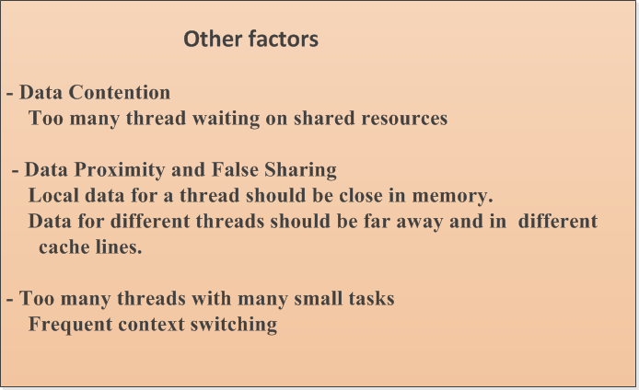
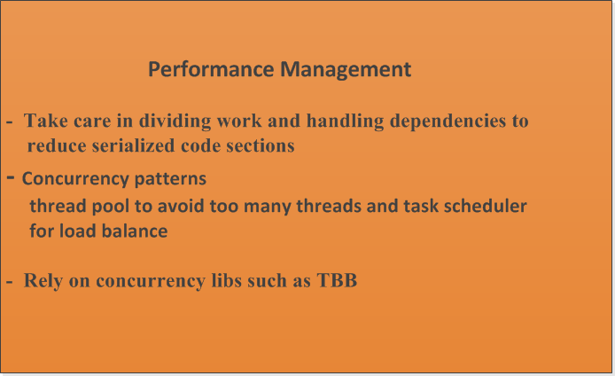
Common Issues with Multithreading
Performance

Slide 26
Common Issues with Multithreading
Exception Handling
- Regarding the correctness of concurrent coding when an exception is
thrown
- Propagate exception beyond thread boundaries
- Exception Management For Exception Safety
1) try/catch block
2) Concurrency patterns: scoped lock pattern, scoped threads etc.

Slide 27
Common Concurrency Patterns
Leaning Motivations
1) General: patterns provide template solutions to recurring design
problems at higher level than classes, entailing more cohesive
design and reusable components.
2) More specifically, concurrency patterns manage common threads
and concurrent issues at a high level. Some language (Java) and
many concurrency libraries (TBB and PPL etc.) are built on top of
concurrency patterns.
3) Concurrency patterns can be further leveraged with general patterns, for
example, strategy pattern can be used for different types of locks. Command
pattern can be used in connection with Active Object Pattern etc.

Slide 28
Common Concurrency Patterns
Scoped Lock Pattern
Read/Write Lock Pattern
Monitor Object Pattern
Producer Consumer Pattern
Parallel Loop Pattern
Active Object Pattern
Thread Pool Pattern
Task Scheduler Pattern

Slide 29
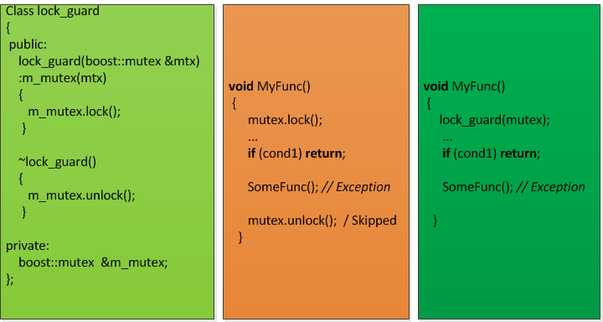
Common Concurrency Patterns
Scoped Lock pattern
-Provides exit/exception safe locks, conforming to RAII principle
(Resource Acquisition Is Initialization)
- Examples of scoped lock pattern: lock_guard and unique lock in
C++11/boost library

Slide 30
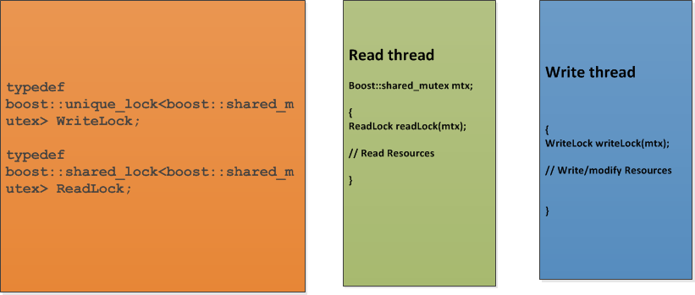
Common Concurrency Patterns
Read/Write Lock
- decouples the lock for resource acquisition(read) and resource
update(write)

Slide 31
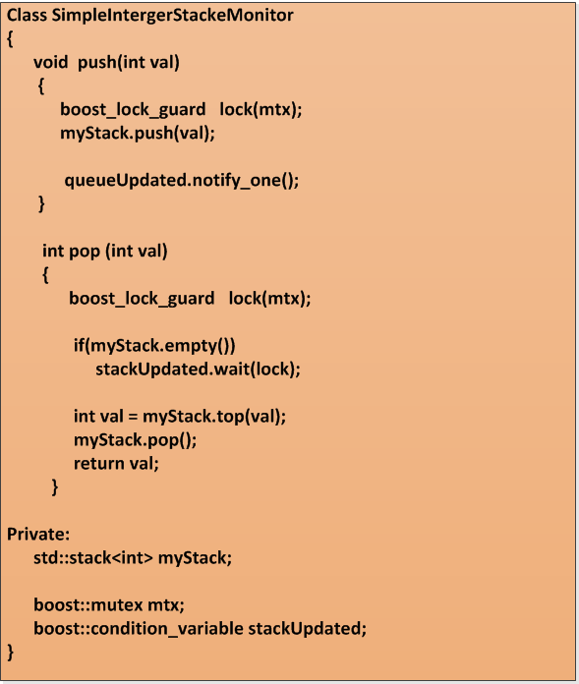
Common Concurrency Patterns
Monitor Object Pattern
- Encapsulates an object’s synchronization policy to provide mutex-free interfaces.
.
- Java objects, TBB concurrent containers.

Slide 32
Common Concurrency Patterns
Producer Consumer Pattern
- Decouples the shared data creation and receiving between different
threads, enabling synchronous/asynchronous data creation and data
receiving.

Slide 33
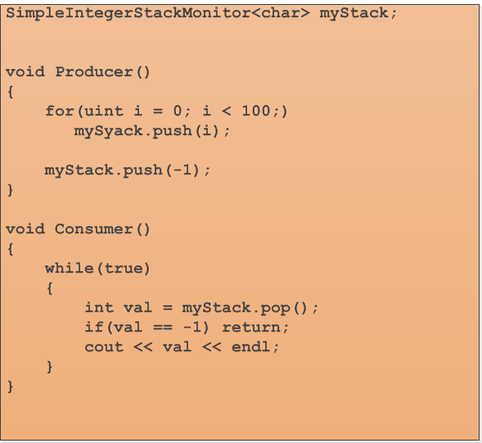
Common Concurrency Patterns
Producer Consumer Pattern

Slide 34
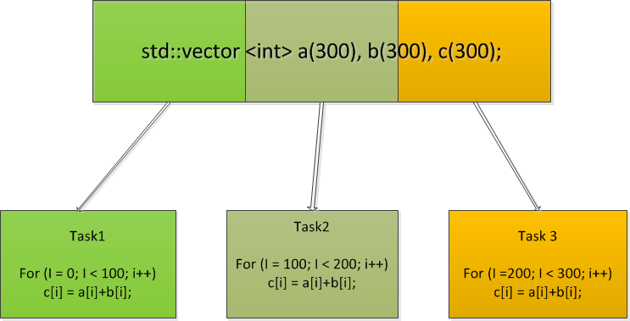
Common Concurrency Patterns
Parallel Loop Pattern
- Main components: loop range, loop body and, partition
policy; Scalable but the execution order is not guaranteed.
- parallel_for and parallel_for_each from TBB and PPL.

Slide 35
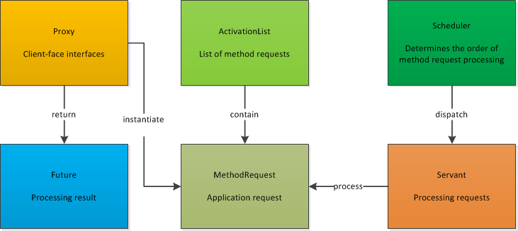
Common Concurrency Patterns
Active Object
- Provides a mechanism for asynchronous method calls by decoupling
method invocation and method execution.
- Main components

Slide 36
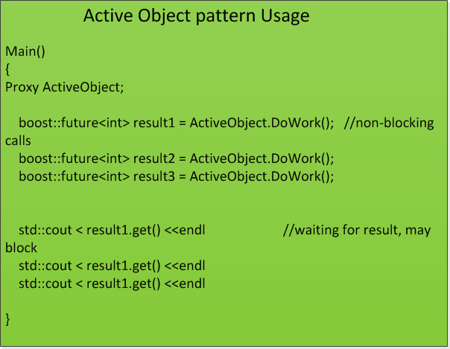
Common Concurrency Patterns
Active Object
- Used in a client-server scenario
- Clients send processing requests to the server
- The requests are queued, waiting to be processed
- While the server processes requests, the clients should not be blocked.

Slide 37
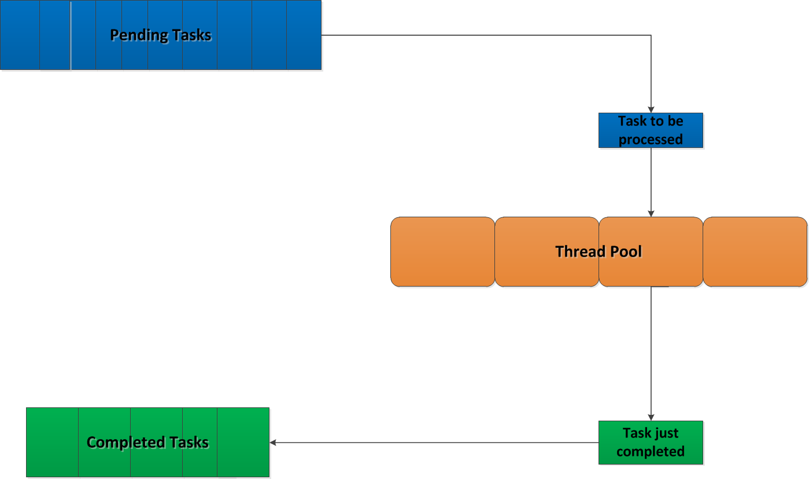
Common Concurrency Patterns
Thread Pool Pattern
- Provides a mechanism for asynchronous executing a set of pending tasks (N) with a pool of worker threads (M).
Usually, N >> M.
- Main components
- a pool of threads
- a queue of pending tasking
- local queue of pending tasks
- Examples
java util.concurrent.ThreadPoolExecutor class. TBB task scheduler

Slide 38
Common Concurrency Patterns
Task Scheduler Pattern
- Provides a mechanism to encapsulate following thread
management techniques
- Lower level schedule policy, such as FIFO(first-in first-out),
RR(round-robin) and others
- Load balancing techniques (e.g. work/task stealing)
- Used with Thread Pool Pattern for high-level optimized thread
management.
- Examples: TBB and PPL tack scheduler.

Slide 39
Concurrency Library: TBB
Concurrency libraries at a glance
- Platform specific libs: Pthread APIs on POSIX, Windows
Thread APIs
- platform independent: boost/C++/Java 11 thread APIs
- Cross-platform, highly portable, high-level libs:TBB, PPL and
OpenMP

Slide 40
Concurrency Library: TBB
Threading Building Blocks - TBB
- What is TBB?
- Main components of TBB
- Major Benefits of TBB
- Simple Usage
- Some Takeaways

Slide 41
Concurrency Library: TBB
What is TBB
- In short, the Threading Building Blocks(TBB) is a C++ template run-time
library for creating high performance, scalable parallel applications.
- More specifically,
- Specify logical parallel structure instead of Threads
- Emphasize data parallel programming
- Take advantage of concurrent collections and parallel algorithms

Slide 42
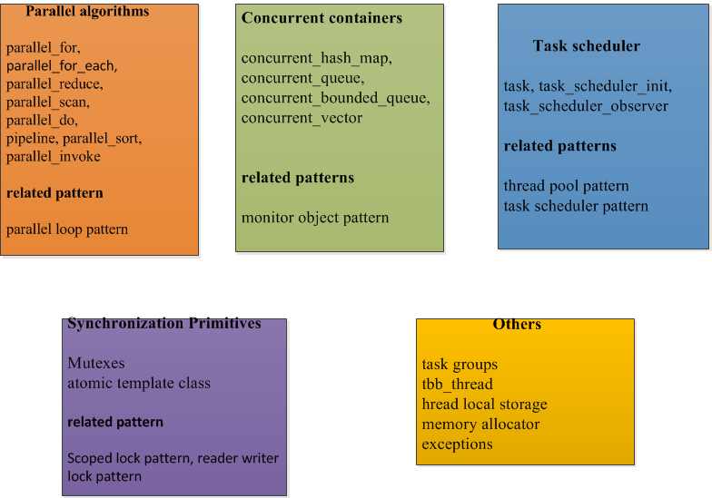
Concurrency Library: TBB
Main Components

Slide 43
Concurrency Library: TBB
Major Benefits of TBB
- Enables you to specify logical parallelism instead of threads
- Targets threading for performance
- Is compatible with other threading libraries
- Emphasizes scalable, data parallel programming
- Relies on generic programming

Slide 44
Concurrency Library: TBB
Simple Usage
- task scheduler initilization
new tbb::task_scheduler_init(tbb::task_scheduler_init::automatic);
new tbb::task_scheduler_init(nThreads);
- Parallel Loop
void DoSomething();
tbb::parallel_for(0, 100, DoSomething);
- task group
task_group tasks;
for (int i = 0; i < 100; ++i)
tasks.run(DoSomething);

Slide 45
Concurrency Library: TBB
Some Takeaways
- How many threads?
TBB’s answer is “Do ask, don’t specify”. Simply call,
tbb::task_scheduler_init(tbb::task_scheduler_init::automatic);
- Underneath the TBB task scheduler is optimized thread pool pattern and task scheduler pattern
- specifying the number of threads may not improve performance,
but degrade memory usage.
- Pick the right tools
Sometimes, when one is faced with many small tasks and has to choose
to between parallel algorithms or task_groups. parallel algorithms is more scalable.
- Know the limitation
TBB is mainly used for parallel performance and scalability. So it’s
optimized for that purpose. For other more specific workflows, such as
asynchronous thread communications, one can make use of Active Object
pattern and other threads libraries. TBB is well suited for mixing up with
other thread libraries such as boost, pthreads.

Slide 46

Main Reference sources
C++ Concurrency in Action
a book by Anthony Williams in Feb., 2012
Effective Concurrency
series articles on concurrency by Herb Sutter,
http://herbsutter.com/2010/07/12/effec
concurrency-prefer-using-active-objects-
Instead-of-naked-threads/
Boost library docs
http://www.boost.org/
TBB Reference Manual
http://threadingbuildingblocks.org/docs/help/index.htm#reference/introducing.htm
http://en.wikipedia.org/wiki/Concurrency_pattern

Slide 47
Q&A

