Slide 1
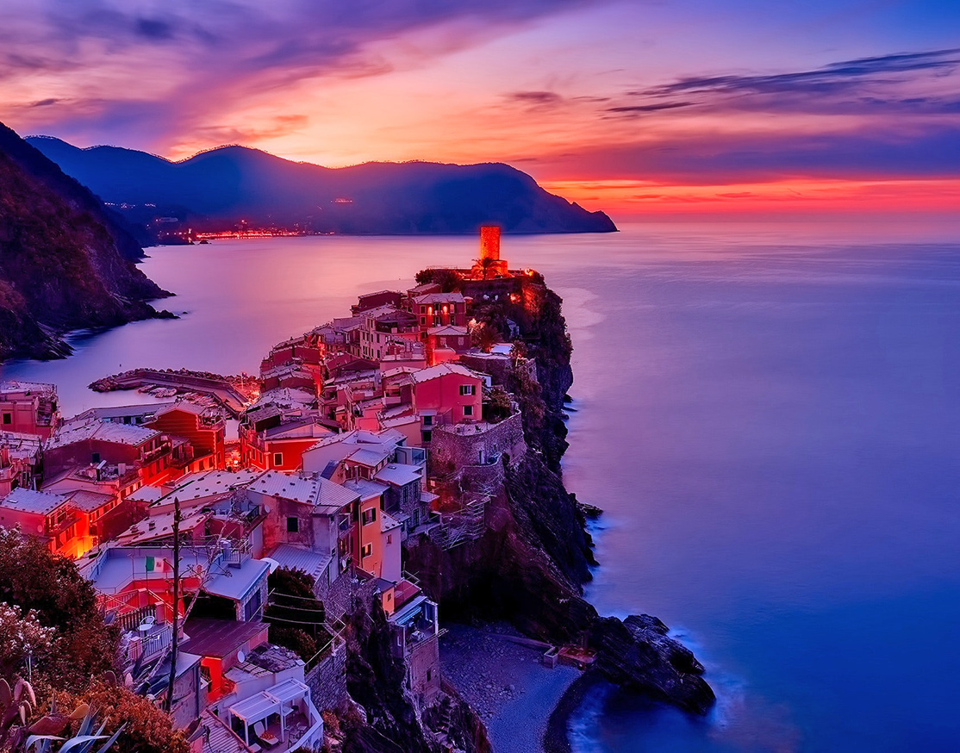
T raloda www.traloda.com
Travel. Love. Date
A Date to Remember!

Slide 2
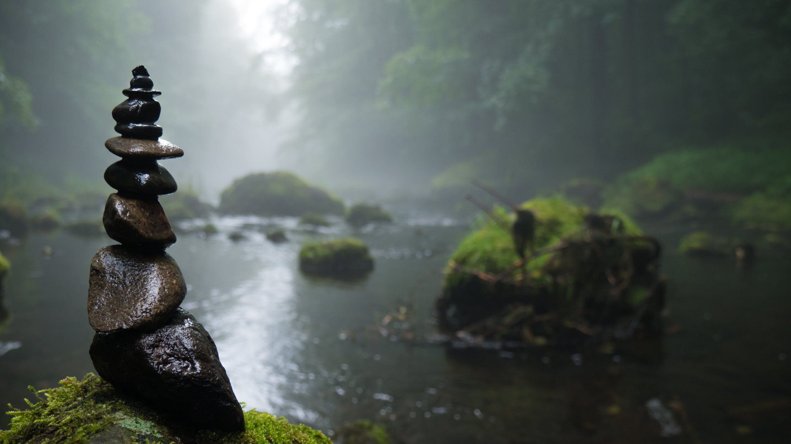
About Us
Going on a Date? Break away from the Clichés!
We are a bunch of Travel Enthusiasts, always on the lookout to explore, travel & soak in the different experiences that each place has to offer.
We are obsessed with the idea to empower couples/to be couples to travel to exotic locations & create the setting for the perfect first, second, third or fiftieth date.
At Traloda, we promise to curate experiences for you & your loved one that will stay etched on to your memories forever.
And as they rightly say, Let us find you a beautiful place to get Lost! (Not literally though)

Slide 3
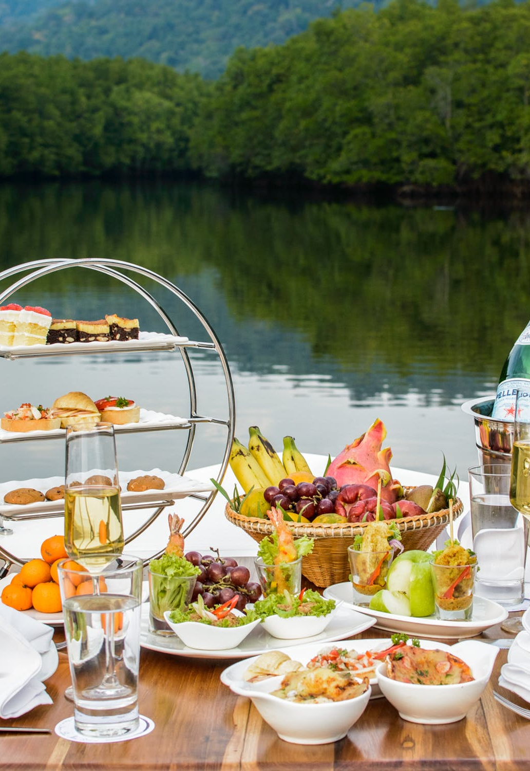
Begin with a memory
Have you begin to like someone? Want to know him/her better? Thinking to start with a date?
Go on a date with someone you like to know about
Traloda helps you find a romantic place nearby where you can spend a quality time.
Imagine you both sitting for a candle light dinner outside.
Talk in the serenity of the divine nature.
Start your relationship with ….(up to your imagination)

Slide 4
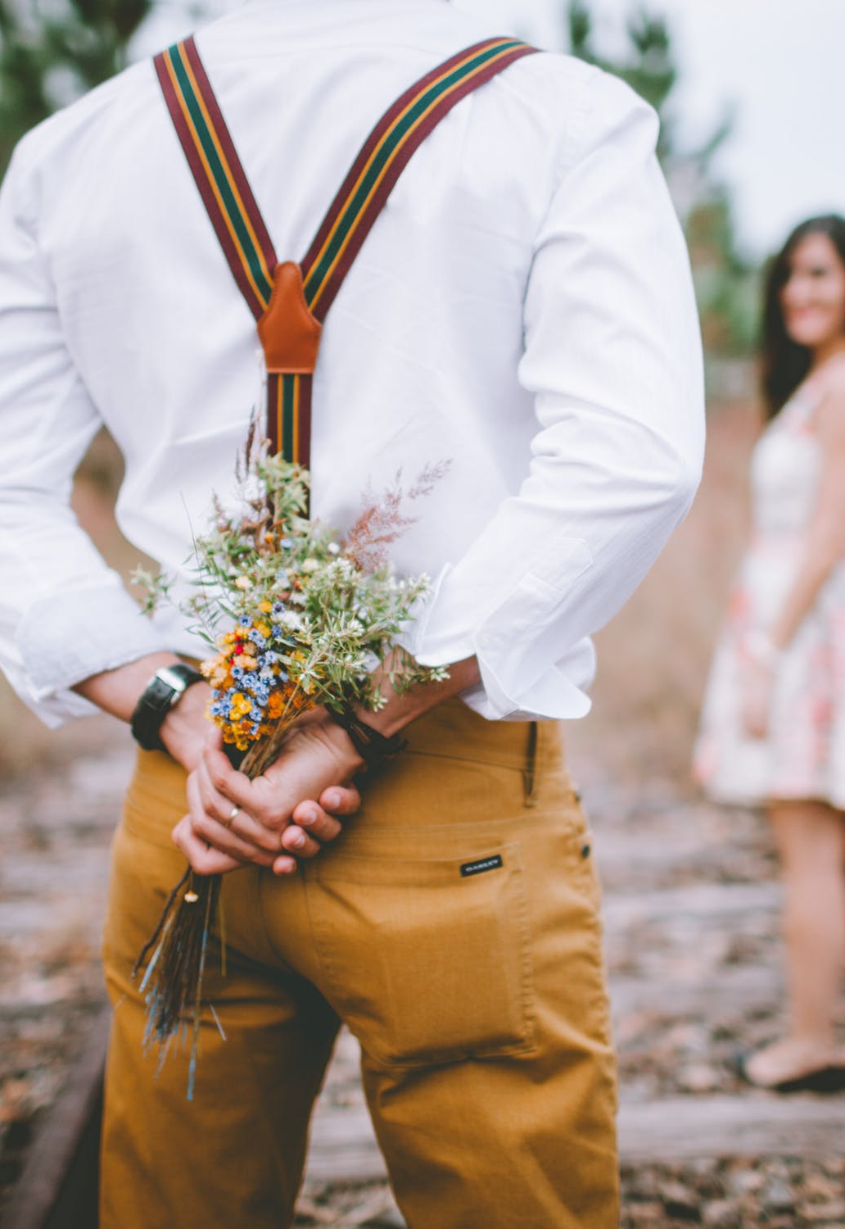
Propose thy partner
Want to marry your love? Want her/him to say “Yes,I do”? Got the ring?
Take your love to an exotic place
We help you create the most romantic setup
We will be ready when you propose, to say – Lights, Camera and Action
Make your loved one be the spotlight of the evening
Feel awesome to see the smile at her/his face
Relish the 5 course multi-cuisine meals of your choice along with the Chardonnay

Slide 5
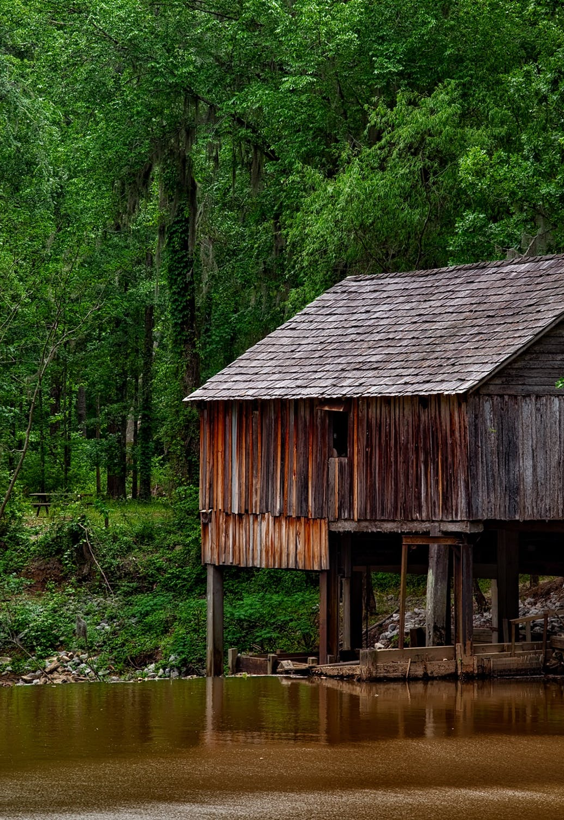
Know Your Fiancé
Are you engaged? Few months to your wedding? Want to reaffirm the intimacy with your partner?
Traloda offers you a highly customized romantic date through our exclusive consulting service.
Spend time with your partner at a choice of your destination ranging from the realms of the mighty Himalayas to the backwater of blissful Kerala.
Enjoy the live music, standup comedy, photoshoot at your service.
Relish the 5 course multi-cuisine meals of your choice along with the Chardonnay

Slide 6
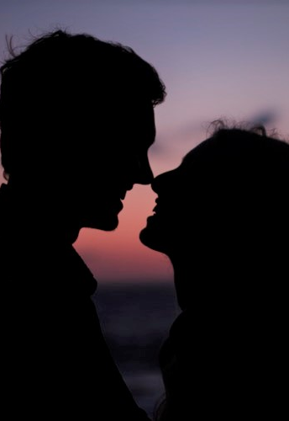
Keep the Spark on
Are you married? Want to fire up the passion & intimacy with your partner?
Traloda offers you a highly customized romantic date through our exclusive consulting service.
Spend time with your partner at a choice of your destination ranging from the realms of the mighty Himalayas to the backwater of blissful Kerala.
Enjoy the live music, standup comedy, photoshoot at your service.
Experiment with cooking and don’t worry we have it covered in case anything goes wrong ☺

Slide 7
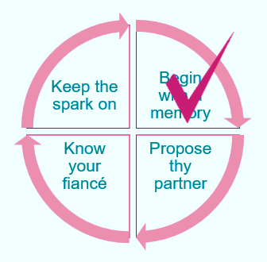




How It Works?
Share your preference with us
Our Designer will reach out to you
We will create the perfect experience for you
Dress up, travel, relax & enjoy the beautiful dating experience at an exotic location

Slide 8
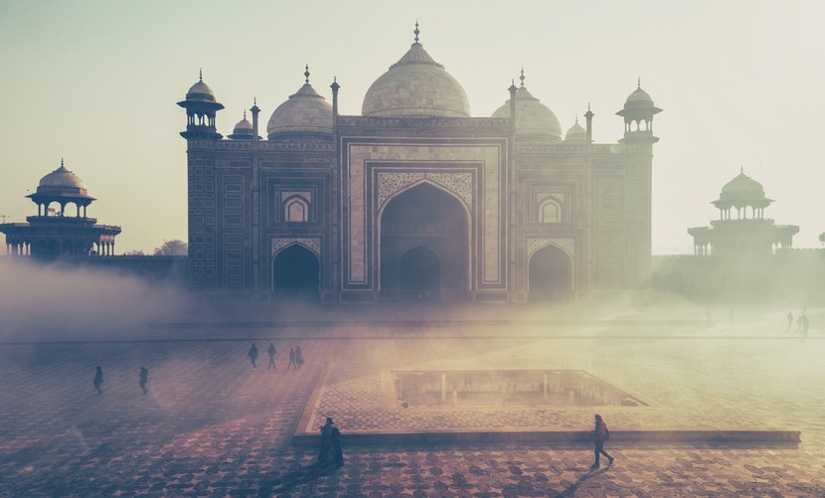
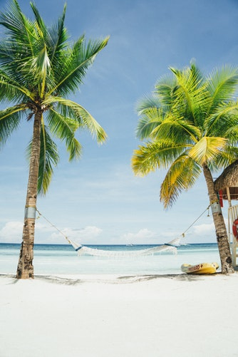
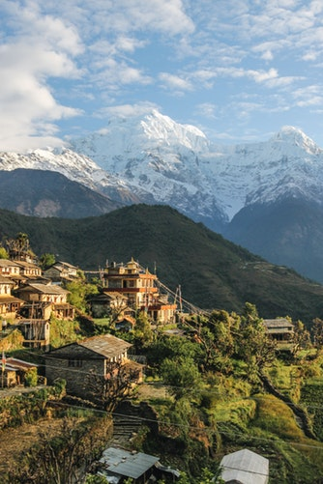
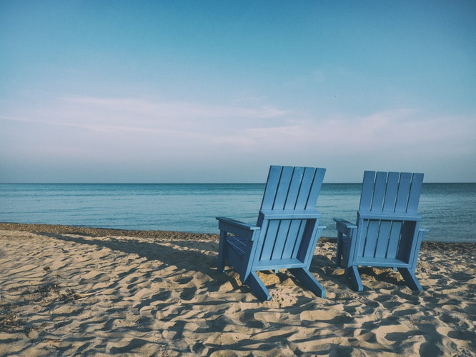
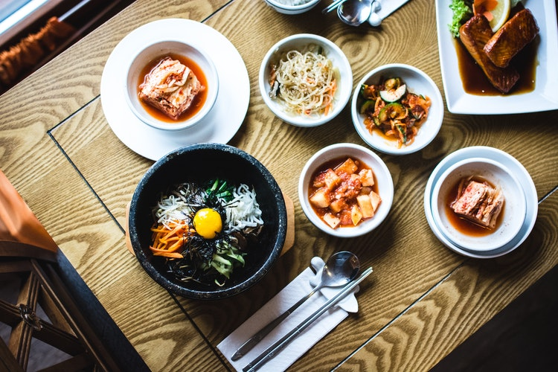
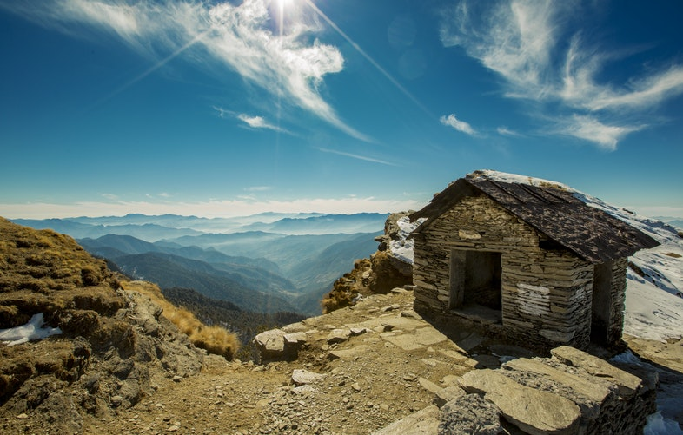

Slide 9

‘What we find in a Soulmate is not something Wild to Tame. But something Wild to run with!’

Slide 10
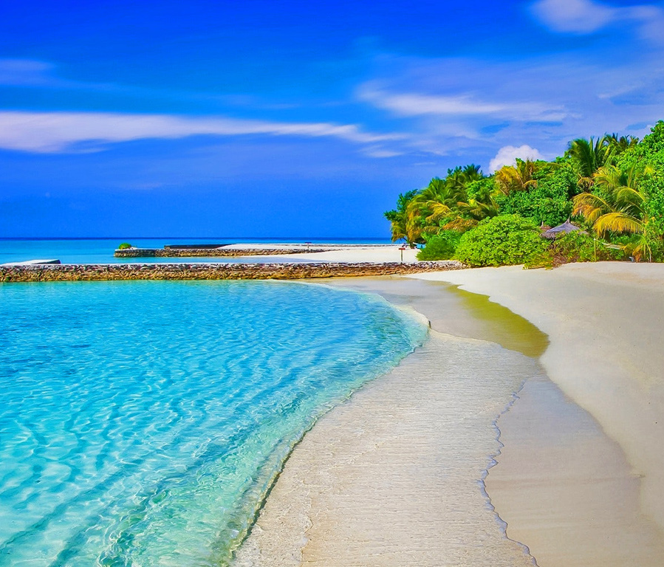
THANK YOU!
Ambareesh
Phone:
+91-9840781026
Email:
Ambareesh@traloda.com

