Slide 1
Forecasting monthly jobs growth
MSCA31006 Time Series Analysis and Forecasting
Instructor : Arnab Bose, Ph.D.
Group 10 : Ross Cole, Connor O’Brien, Zakir Bekenov

Slide 2
Grading Rubric & Project Description
The purpose of the project is to test the students’ ability to apply the time series methodologies and tools presented in the class to diverse practical problems and interpret the results.
For the class project, students are graded on 8 criteria outlined below. Each criterion is 5 points for a total of 40 points.
The criteria are:
Presentation
Problem statement
Assumptions/Hypotheses about data and/or modeling
Data properties (stationarity, correlations, data distribution) and Exploratory data analysis
Data processing (anomaly detection, cleansing and imputations) and transformations
Feature engineering
Proposed approaches (models) with selected model – justification and trade-offs, if any
Results (accuracy) and future work
The class project covers:
Choose a real-world time series data problem and a forecasting objective
Procure and analyze the time series data
Develop at a minimum 3 (if group = 3 students) or 4 (if group = 4 students) forecasting models
Select final model based on selection criteria
Evaluate forecasting metrics and accuracy
Determine how the model forecasting can be improved
Effectively communicate analytical work

Slide 3
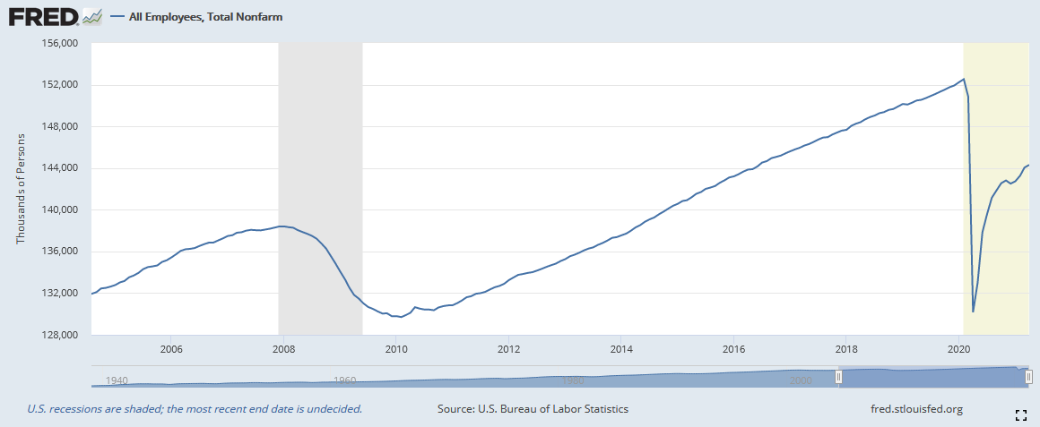
Problem statement
We test three separate models and assess how each performs historically (i.e., pre-pandemic) and currently
Statistical model:
Curve-fitting model:
Deep learning model:
On the first Friday of each month, the Bureau of Labor Statistics (BLS) releases employment, or jobs numbers, for the previous month
These numbers are critical in assessing the state of the economy and researchers often try to forecast what the job numbers will be in the future.
Such information is used by policy makers in assessing where the economy will be, and by other entities such as hedge funds and other financial institutions in trading.
This problem has been further complicated by the pandemic – the lowest jobs growth since the great depression

Slide 4

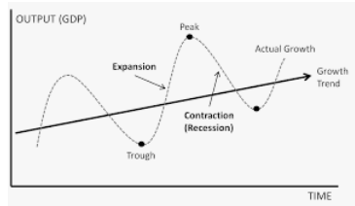
Assumptions & Hypotheses about Data
Many factors determine employment in a given month
One of the most important is where we are in the business cycle (i.e., are we in a recession?)
  Recessions are cyclical, but don’t have a specific periodicity
Thus, a curve fitting model might be most suitable – STL – where every cycle may not have the same period.

Slide 5

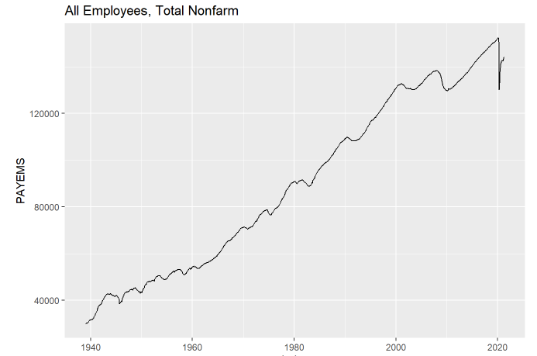
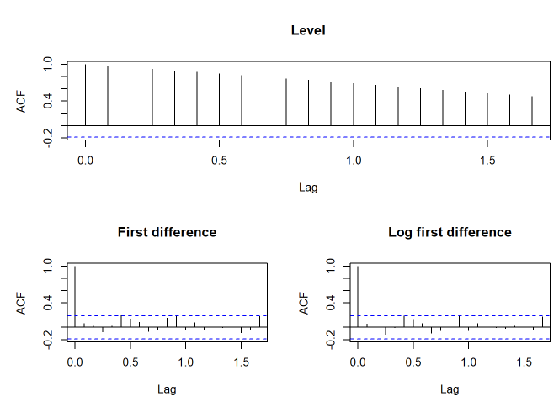
Data properties, processing & Feature engineering
We pull all of the necessary data from FRED
  The Federal Reserve Bank of St. Louis’ widely used data base and API
The level of employment is clearly non-stationary
  Strong upward drift
  Seasonal component
  Cyclical component – where cycles are of undefined periodicity
But the first difference & log first difference are stationary

Slide 6
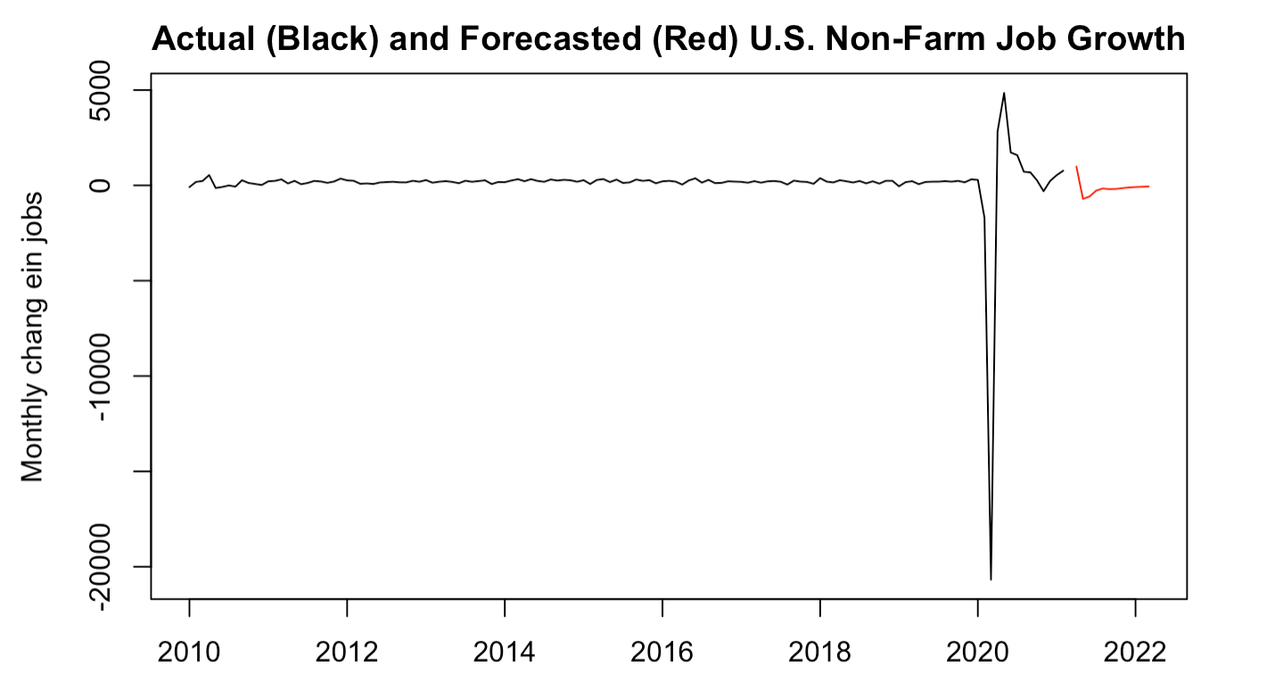
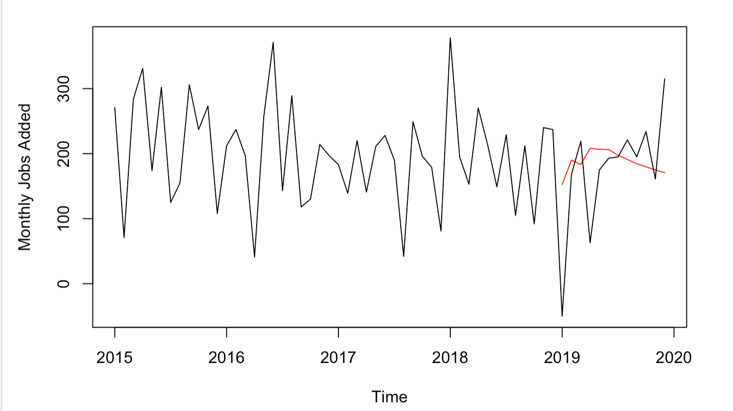
Statistical model
We use a VAR(2) of employment, the Chicago Fed Financial Conditions Index, Industrial Production, Population, the ten-year Treasury yield, the 2-10 yield spread, the price level, and a binary recession indicator.
Back-testing this method, we find it is relatively accurate. It projected 2.2 million jobs added in 2019, compared to the actual 1.8.
However, the forward-looking forecasts projects the economy to lose 1.6 million jobs over the next year, which is extremely unlikely.
Here we see the shock of COVID making this a poor model.
Vs. Back-tested:

Slide 7
Curve fitting model
Seasonal Trend decomposition using Loess (STL)
  Employment depends on many factors, one being business cycles/recessions
  Not all have the same period/seasonal component fluctuates over time
  Makes this a good candidate
  ADD INFO ON CURVE FITTING MODEL

Slide 8
Deep learning model
ADD INFO ON DEEP LEARNING MODEL

Slide 9
Selected model
Of the models we tested, the… performed best
ADD SOMEWHAT MORE DETAILED NOTES ON BEST PERFORMING MODEL

Slide 10
Results and future work
For this exercise, we decided not to use additional covariates for simplicity.
Clearly, incorporating such information would prove useful in our projections
An ensemble model might be useful in stabilizing the model since the pandemic
Alternatively, we could apply some sort of pulse function – to capture the temporary, albeit enormous, impact of Covid-19, which has been breaking a lot of models that are used to describe employment and the broader macroeconomy.
Did any of our models perform “well”?
  Clear that Covid-19 has changed things
  Pure statistical models out (under) perform both curve fitting and deep learning models pre-pandemic.
  ADD / EDIT THIS

Slide 11
Thank you!
Questions?

