Slide 1
AXL Workflow
Route for Reagents from Arktik-80oC Ultra Low Storage
ARKTIK
(1of)
Connect (1of)
Centrifuge (2of)
XL200** LiHa
(1of)
LN2
Connect (1of)
ARKTIK
(1of)
Route for Reagents from -20oC Ultra Low Storage
MAP (reagents in/out)
DFSA STX-280
XL200** thawer
(1of)
Centrifuge (2of)
Peeler
(2of)
XL200** LiHa
(1of)
LN2
DFSA STX-280
Route for Reagents from SpectroQ
SpectroQ
(3of)
Centrifuge* (2of)
Peeler*
(2of)
XL200** LiHa
(1of)
Sealer/Capper
(2of)
SpectroQ (3of)
Route for Mosquito Source Plates
Linked devices
Mosquito Xtal3
(1of)
BenchCel (1of)
Plate labeler
(1of)
XL200** LiHa
(1of)
Sealer
(2of)
Centrifuge* (2of)
Peeler
(2of)
Mosquito LCP
(1of)
Waste
batch mode
MAP (plates in/out)
Route for Crystal Plates
Linked devices
Mosquito Xtal3
(1of)
SpectroQ
X-ACT
(6of)
Sealer
(2of)
SpectroQ
(3of)
BenchCel (1of)
Plate labeler
(1of)
XL200** LiHa
(1of)
Mosquito LCP
(1of)
Sealer
(2of)
Centrifuge* (2of)
SpectroQ
(3of)
Peeler
(2of)
Echo
(2of)
Sealer
(2of)
Pre-Soak Imaging
Incubation
Post Soak Imaging
Peeler
(2of)
Route for Compound Plates
DC2SA – N2G
(1of)
Centrifuge* (2of)
Peeler
(2of)
Echo
(2of)
PlateLoc -Ar2G
(2of)
DC2SA – N2G
(1of)
Route for Pins
Key
X-ACT
(6of)
Vitrification
Puck Storage
MAP (pucks in/out)
Time spent at device is project-specific, requires characterization and is determined on a per-project basis
Route for Plates
X-ACT
(6of)
Sealer
(2of)
SpectroQ
(3of)
Fixed timings
Route for Seed Tubes
Reformatting Points – reagents change labware type
X-ACT
(6of)
XL200
Centrifuge* (2of)
XL200
SpectroQ (3 of)
Manual Access Points required
Vitrification
Arktik (1 of)
DFSA (1 of)
Optional: for leftover reagents
Convergence points
Crystallisation Setup – generates crystal plates in batches, active at during shutdowns and runs. Scheduling of reagents to XL200 needs to be ad-hoc as it is project/reagent-dependent due to stability/temperature/thawing requirements etc. None of which affect the workflow structure and will be handled by software/science schedule
Soaking workflows (x2) – post growth plates enter two workflows at 15 min intervals (imaging bottleneck), workflows are offset by 7m30s, active during runs
Seed stock generation – likely happens during shutdowns when soaking workflow is inactive.

Slide 2
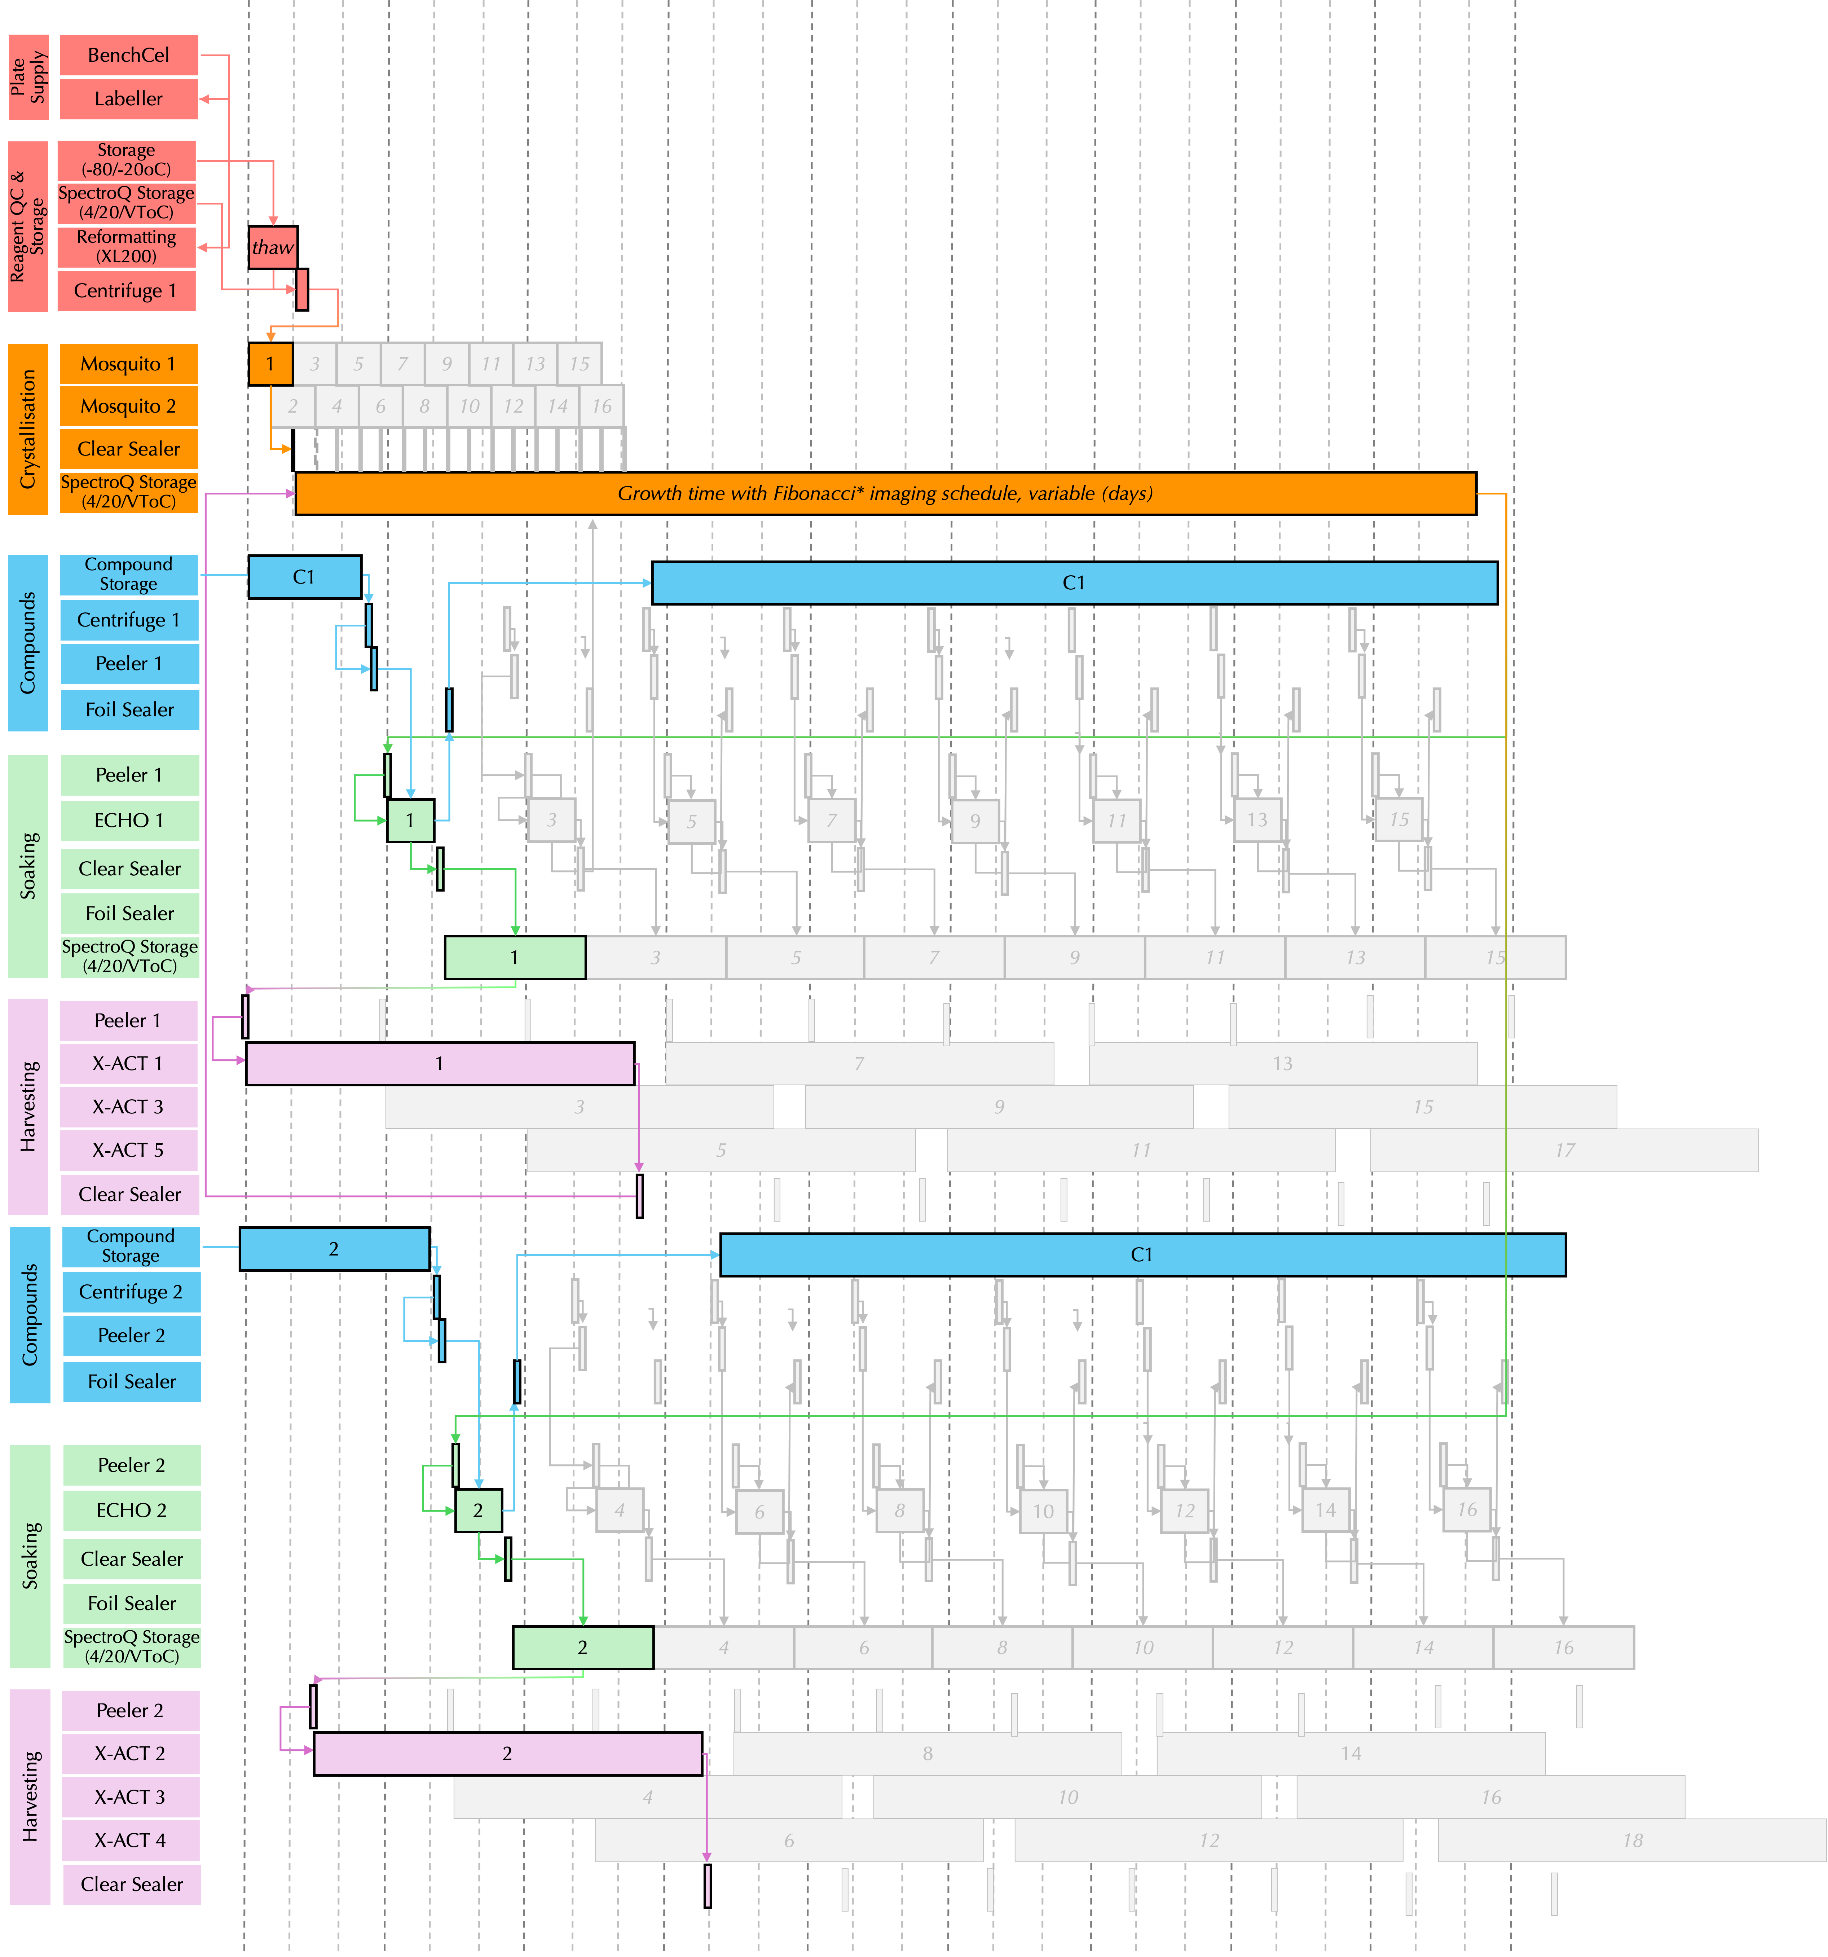
Daily Schedule
Crystallisation Setup & Growth
(days-weeks)
2 Soaking Workflows

Slide 3
Device List, Throughputs, Scheduled purchase dates, site requirements & services
Line No. | Device |  |  |  | Schedule |  | Device Dimensions |  |  |  | Services
 | Item Name | Item Function/Description | QTY | Max Active Device Time | Phase | Purchase Date | Width (mm) | Depth (mm) | Height (mm) | Mass (kg) | Power | Network | Compressed Air | Vacuum | Gas | Benchtop/Floor-Standing
1 | XPEEL | Plate Peeler (1 of 2) | 1 | 18sec | 1 | Mar-25 | 374 | 638 | 374 | 35 | 1 | 1 | 0 | 0 | 0 | Benchtop
2 | VSpin | Plate Centrifuge (1 of 2) | 1 | 2min | 1 | Mar-25 | 328 | 714 | 248 | 35 | 1 | 1 | 1 | 0 | 0 | Benchtop
3 | PlateLoc | Compound Plate Sealer (1 of 2) | 1 | 8sec | 1 | Mar-25 | 216 | 399 | 584 | 20 | 1 | 1 | 1 | 0 | 1 | Benchtop
5 | X-ACT | Prototype (1 of 6) | 1 | 41mins | 2 | Jul-26 – Oct27 | 1000 | 750 | 900 | 0 | 1 | 1 | 0 | 0 | 0 | Benchtop
6 | Mosquito LCP | Crystallisation Plate Setup (1 of 2) | 1 | 5mins | 2 | Jul-26 – Oct27 | 390 | 470 | 690 | 34 | 1 | 1 | 0 | 0 | 0 | Benchtop
7 | SpectroQ STX-500 | Storage & imaging, 20oC(P2) --> 4oC(P4) (1 of 3) | 1 | 25sec | 2 | Jul-26 – Oct27 | 744 | 716 | 1940 | 282 | 0 | 0 | 0 | 0 | 0 | Stand Alone
8 | BenchCel | Plate Supply (1 of 1) | 1 | 20sec | 2 | Jul-26 – Oct27 | 1147 | 622 | 1311 | 49 | 0 | 0 | 0 | 0 | 0 | Stand Alone
9 | Labeller | Plate Labeller (1 of 1) | 1 |  | 2 | Jul-26 – Oct27 | 287 | 622 | 351 | 21 | 0 | 0 | 0 | 0 | 0 | Benchtop
10 | DC2SA STX-500 | Compound Storage (1 of 1) | 1 | 25sec | 2 | Jul-26 – Oct27 | 789 | 728 | 1940 | 282 | 1 | 1 | 0 | 0 | 1 | Stand Alone
11 | Echo 650T | Compound dispensing (1 of 2) | 1 | 7mins | 2 | Jul-26 – Oct27 | 538 | 746 | 925 | 142 | 1 | 2 | 1 | 1 | 0 | Benchtop
12 | A4S | Crystal plate sealer (1 of 2) | 1 | 10sec | 2 | Jul-26 – Oct27 | 230 | 507 | 276 | 27 | 1 | 1 | 0 | 0 | 0 | Benchtop
13 | X-ACT | Crystal Harvester (2 of 6) | 2 | 41 mins | 3 | Oct-27 – Jan-29 | 2000 | 1500 | 1800 | 0 | 2 | 2 | 0 | 0 | 0 | Benchtop
14 | Cobot Arm - TBC | Cobot Arm | 1 | TBC | 3 | Oct-27 – Jan-29 | 201 | 235 | 1439 | 35 | 1 | 1 | 0 | 0 | 0 | Stand Alone
15 | Cobot Rail - TBC | Cobot Rail | 1 | TBC | 3 | Oct-27 – Jan-29 | 201 | 235 | 1000 | 30 | 0 | 0 | 0 | 0 | 0 | Stand Alone
16 | XL200 | Reformatter (1 of 1) | 1 | batch | 3 | Oct-27 – Jan-29 | 1330 | 820 | 890 | 90 | 1 | 1 | 0 | 0 | 0 | Benchtop
17 | DFSA STX-280 | -20oC deep freeze storage (1 of 1) | 1 | 25sec | 4 | Jan-29 – Mar 30 | 744 | 716 | 1203 | 183 | 1 | 1 | 0 | 0 | 0 | Stand Alone
18 | SpectroQ STX-200 | 200 plate Storage & imaging, VT (2 of 3) | 1 | 25sec | 4 | Jan-29 – Mar 30 | 744 | 716 | 1190 | 183 | 0 | 0 | 0 | 0 | 0 | Stand Alone
19 | SpectroQ STX-1000 | 1000 plate 20oC Storage | 1 | 25sec | 4 | Jan-29 – Mar 30 | 1280 | 766 | 1988 | 565 | 1 | 1 | 0 | 0 | 0 | Stand Alone
20 | Echo 650T | Relocate Existing XChem Asset/Redundancy Item | 0 | 7mins | 4 | Jan-29 – Mar 30 | 0 | 0 | 0 | 0 | 0 | 0 | 0 | 0 | 0 | Benchtop
21 | X-ACT | Redundancy Crystal harvester (3-6 of 6) | 3 | 41 mins | 4 | Jan-29 – Mar 30 | 3000 | 2250 | 2700 | 0 | 3 | 3 | 0 | 0 | 0 | Benchtop
22 | Mosquito xtal3 | Redundancy Crystallisation Setup (2 of 2) | 1 | 5mins | 4 | Jan-29 – Mar 30 | 790 | 470 | 690 | 34 | 1 | 1 | 0 | 0 | 0 | Benchtop
23 | Vspin | Redundancy Centrifuge (2 of 2) | 1 | 2mins | 4 | Jan-29 – Mar 30 | 328 | 714 | 248 | 35 | 1 | 1 | 1 | 0 | 0 | Benchtop
24 | PlateLoc | Redundancy Compound Sealer (2 of 2) | 2 | 8sec | 4 | Jan-29 – Mar 30 | 432 | 798 | 1168 | 40 | 2 | 2 | 2 | 0 | 2 | Benchtop
25 | A4S | Redundancy Crystal Sealer (2 of 2) | 1 | 10sec | 4 | Jan-29 – Mar 30 | 230 | 507 | 276 | 27 | 1 | 1 | 0 | 0 | 0 | Benchtop
26 | XPEEL | Redundancy Plate Peeler (2 of 2) | 1 | 18sec | 4 | Jan-29 – Mar 30 | 374 | 638 | 374 | 35 | 1 | 1 | 0 | 0 | 0 | Benchtop
27 | Cobot Arm | Cobots (2-5 of 5) | 2-5-TBC | TBC | 4 | Jan-29 – Mar 30 | 804 | 940 | 5756 | 140 | 4 | 4 | 0 | 0 | 0 | Stand Alone
28 | Cobot Rail | Cobots (2-5 of 5) | 2-5-TBC | TBC | 4 | Jan-29 – Mar 30 | 804 | 940 | 4000 | 120 | 0 | 0 | 0 | 0 | 0 | Stand Alone
29 | Arktik | -80oC (protein) storage (1 of 1) | 1 | 15 sec | 4 | Nov-29 – Mar 30 | 1400 | 800 | 1980 | 720 | 1 | 1 | 1 | 0 | 0 | Stand Alone
30 | Connect | Benchtop access for Arktik (1 of 1) | 1 |  | 4 | Dec-29 – Mar 30 | 710 | 765 | 785 | 100 | 1 | 1 | 1 | 0 | 0 | Benchtop
Key
Phase 1 (complete)
Phase 2 (In progress – Codify Experiment, Sample Handling)
Phase 3 (Dark Period - Plate Handling & Transport)
Phase 4 (Post Dark – Duplicate workflow, scale throughput)

