Slide 1

✦ ENGLISH LANGUAGE SPECIALIZED MASTERCLASS • INTERACTIVE SERIES
Irregular Verbs for Kids
Visual Explanations, Dynamic Cartoons, and Native Fluency
INSTRUCTOR & PEDAGOGICAL LEAD / المُحاضر
MR. Mohamed Nasser Badawy | مستر محمد ناصر بدوي
English Language Teacher - معلم لغة إنجليزية

Slide 2
✦ MODULE ROADMAP
خريطة الدرس والمحاور الرئيسية
01
1. Visual Action Verbs
• Cartoon action scenarios
• Core meaning & prepositions
02
2. Time & Perspective
• Present Perfect vs Past Simple
• When to use each tense
03
3. Tense Matrix
• Side-by-side comparison
• Key time markers
04
4. Fluency Formula
• Step-by-step sentence building
• Common mistakes to avoid

Slide 3
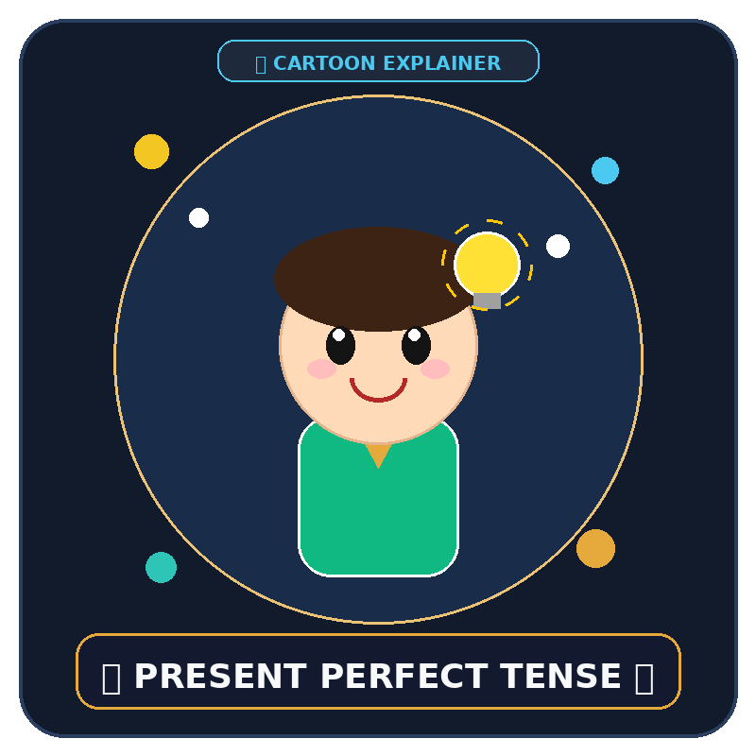
✦ CARTOON EXPLAINER • شرح مصور
Present Perfect Tense
🗣 /ˈprez.ənt ˈpɜː.fɪkt/ • (have / has + V3)
المعنى والقاعدة / Meaning & Rule:
Connects past actions directly to the present moment. We use it when the exact past time doesn't matter, but the result is visible NOW.
نقاط التركيز والاستخدام / Key Notes:
✔ Structure: Subject + have / has + Past Participle (V3).
✔ Keywords: already, just, yet, ever, never, recently, since, for.
✔ Focuses on life experiences and ongoing states.
💡 مثال عملي / Practical Example:
“ “ I have already finished my assignment, so I can relax! ” ”
🎨 Visual Explainer • رسم توضيحي كارتوني

Slide 4
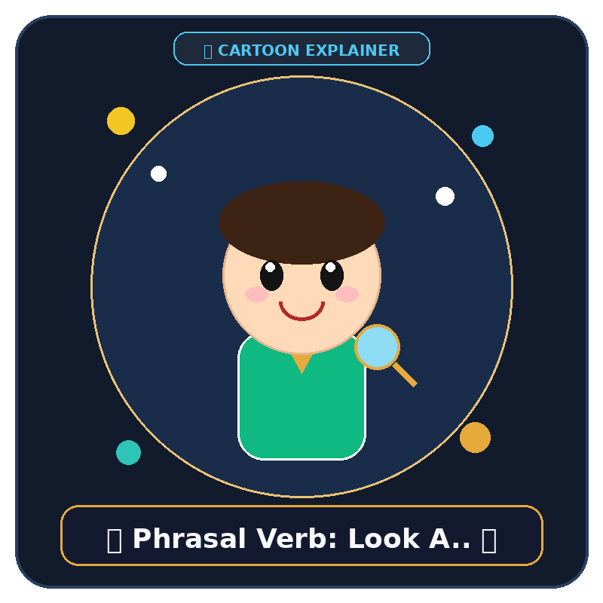
✦ CARTOON EXPLAINER • شرح مصور
Phrasal Verb: Look After
🗣 /lʊk ˈɑːf.tər/ • Verb + Preposition
المعنى والقاعدة / Meaning & Rule:
Means to take care of someone or something, providing attention, food, or safety.
نقاط التركيز والاستخدام / Key Notes:
✔ Synonyms: Care for, nurse, protect, attend to.
✔ Common collocations: look after children, look after pets, look after yourself.
✔ Inseparable verb: the object comes right after the preposition.
💡 مثال عملي / Practical Example:
“ “ Can you please look after my cat while I am traveling? ” ”
🎨 Visual Explainer • رسم توضيحي كارتوني

Slide 5
✦ COMPARISON MATRIX
Tense Matrix: Present Perfect vs Past Simple
Grammar Dimension | Present Perfect (have + V3) | Past Simple (V2)
Time Connection | Connected to the present; result matters now | Finished action in a completed time period
Time Markers | Already, yet, ever, just, since, for | Yesterday, last year, in 2022, two days ago
Living in London | I have lived in London for 5 years (still there) | I lived in London in 2018 (not there anymore)

Slide 6
✦ STEP-BY-STEP FLOW
The 3-Step Native Sentence Builder
STEP 01
1. Pick the Perspective
Is the result active right now, or completely closed in the past?
💡 Current vs Finished
STEP 02
2. Select Auxiliary Verb
Use have/has for perfect, or drop directly to V2 for past.
💡 have/has + V3 vs V2
STEP 03
3. Add Time Polish
Use natural adverbs like 'already', 'recently', or 'yesterday'.
💡 Place adverb naturally

Slide 7
Thank You! | بالتوفيق والنجاح الدائم
"Every expert was once a beginner. Keep practicing, and never stop learning!"
«التعلم رحلة مستمرة.. استمر في التدريب والتطبيق دائماً»
للتواصل وحجز الحصص الخاصة والمتابعة الدورية / For Private Tutoring & Follow-up:
📱 WhatsApp & Phone / واتساب وهاتف
+201159330109
🌐 Facebook Profile / فيسبوك
Mohamed Nasser Badawy
MR. Mohamed Nasser Badawy • مستر محمد ناصر بدوي
English Language Teacher | معلم لغة إنجليزية

