Slide 1

✦ دورة اللغة الإنجليزية المتخصصة • شروحات تفاعلية واحترافية
Unit 3: Who's in My Family?
Primary 1 • First Term • English Language Masterclass | Mr. Mohamed Nasser Badawy
المُحاضر والمعلم المعتمد
مستر محمد ناصر بدوي
معلم لغة إنجليزية

Slide 2
✦ محاور الدرس
خريطة الدرس والمحاور الرئيسية
01
1. Meet My Family & Sara's Story
• Father, mother, parents, brother, sister
• Grandfather & grandmother
02
2. Question: "Who's this?"
• Daily conversational phrases
• Asking & answering about siblings
03
3. Phonics Adventure: Letters (Nn) & (Pp)
• Letter Nn (/n/): nose, nurse, net, neck
• Letter Pp (/p/): pizza, pencil, panda, parrot
04
4. Numbers (1 to 5) & Grammar Rule
• Singular "There is 1..." vs Plural "There are 4..."
• Counting books, flowers, apples & values

Slide 3
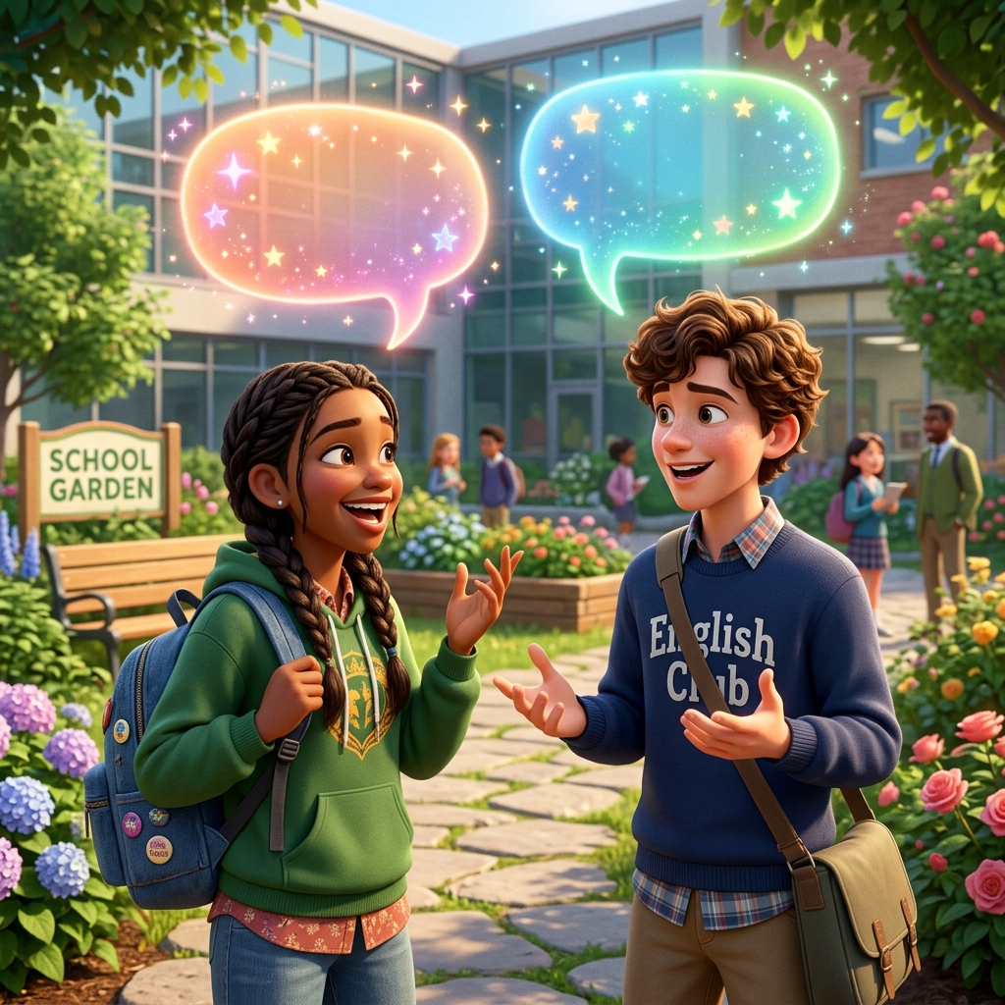
Meet My Family: Who's in My Family?
🗣 /ˈfæm.əl.i/ • Family Members • أفراد العائلة الكريمة
المعنى والقاعدة الأساسية:
Family is where our story begins! In Unit 3, we learn the names of our dear family members and how to introduce them with pride, love, and clear English pronunciation.
أهم نقاط التركيز والاستخدام:
✔ Parents (الوالدان): Father (أب) + Mother (أم) together are my parents.
✔ Siblings (الإخوة): Brother (أخ) and Sister (أخت) — 'I have 1 brother and 2 sisters!'
✔ Grandparents (الأجداد): Grandfather (جد) and Grandmother (جدة) who share wisdom and warmth.
💡 مثال عملي تطبيقي:
“ Maya: “Who is this?” ➔ Sara: “This is my father. And this is my mother. They are my parents! ”

Slide 4
Language Function: Asking "Who's this?"
🗣 /huːz ðɪs/ • Daily Question & Answer • السؤال والتعريف بالأشخاص
المعنى والقاعدة الأساسية:
Whenever you look at a photograph or introduce family members to friends, ask politely: 'Who's this?' and answer: 'This is my...'
أهم نقاط التركيز والاستخدام:
✔ Question Pattern: “Who's this?” (Who's is the short form of Who is).
✔ Answer Pattern: “This is my brother.” / “This is my grandmother.”
✔ Asking About Siblings: “Do you have any brothers?” ➔ “Yes! I have 1 brother.”
💡 مثال عملي تطبيقي:
“ Who's this? ➔ This is my grandfather. He loves reading books to us! ”

Slide 5
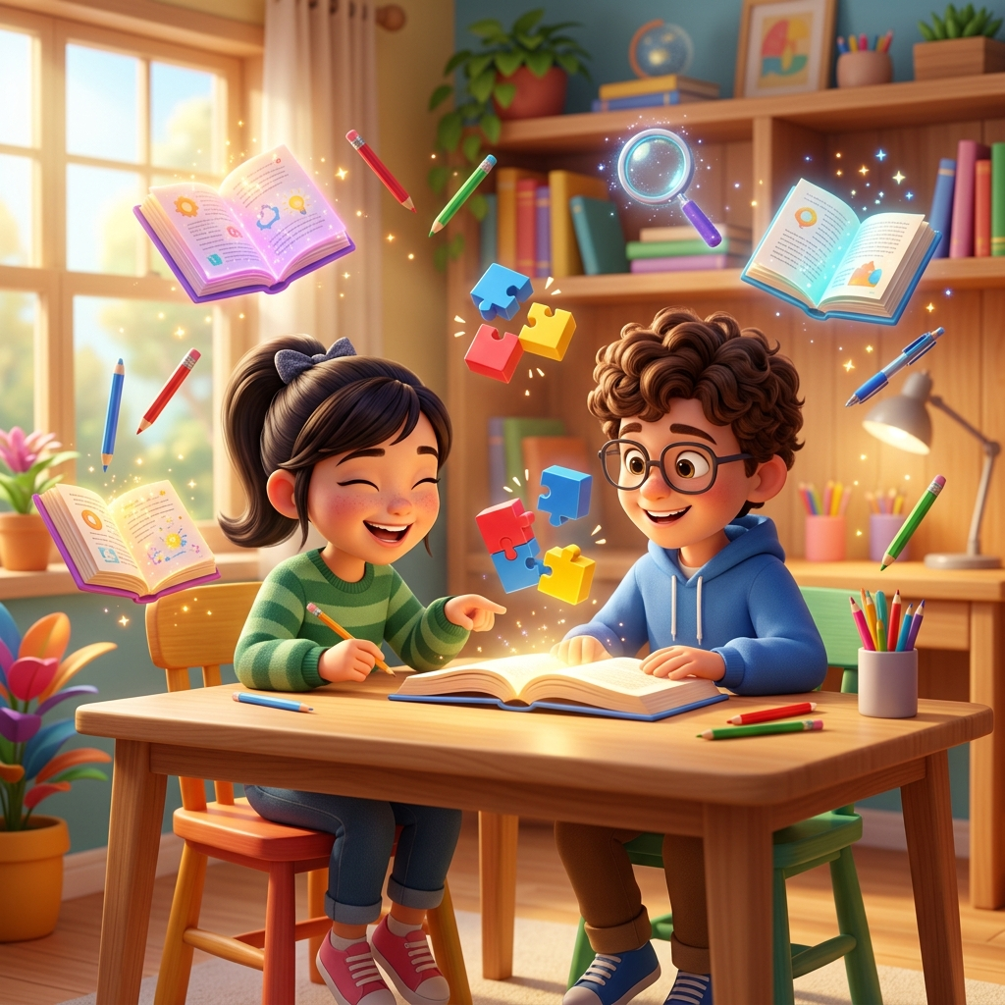
Lesson 2: Phonics Fun with Letter (Nn)
🗣 Letter Nn • Sound: /n/ • Uppercase 'N' & Lowercase 'n'
المعنى والقاعدة الأساسية:
Letter (Nn) makes the smooth nasal sound /n/! Touch the tip of your tongue gently behind your upper teeth and let the air resonate cleanly through your nose.
أهم نقاط التركيز والاستخدام:
✔ Nose /nəʊz/: Point to your nose with your finger! (أنف)
✔ Nurse /nɜːs/: A helpful, caring nurse in the clinic (ممرضة)
✔ Net /net/ & Neck /nek/: Fishing net (شبكة) and neck (رقبة)
💡 مثال عملي تطبيقي:
“ The caring nurse gently points to her nose with a bright smile! ”

Slide 6
Lesson 2: Phonics Fun with Letter (Pp)
🗣 Letter Pp • Sound: /p/ • Puffed-Air Sound • صوت الهواء الخفيف
المعنى والقاعدة الأساسية:
Letter (Pp) makes the sound /p/! Hold your palm in front of your lips: feel the gentle puff of air released when you say 'pizza' or 'pencil'!
أهم نقاط التركيز والاستخدام:
✔ Pizza /ˈpiːt.sə/: A delicious, warm slice of cheese pizza (بيتزا)
✔ Pencil /ˈpen.səl/: We write and color our English letters with it (قلم رصاص)
✔ Panda /ˈpæn.də/: A cute, fluffy black-and-white panda bear (باندا)
💡 مثال عملي تطبيقي:
“ I hold my pencil to draw a happy panda eating a slice of pizza! ”

Slide 7
✦ مصفوفة المقارنة
Phonics Mastery Matrix: Letter (Nn) vs. Letter (Pp)
Phonics Dimension | Letter Nn (/n/) | Letter Pp (/p/)
Sound Articulation | Smooth nasal sound /n/ (Air flows through nose) | Crisp puff of air /p/ (Air released from lips)
Primary 1 Vocabulary | Nose, Nurse, Net, Neck, Nail | Pizza, Pencil, Panda, Parrot, Potato
How to Trace | Straight line down, slant down, straight up (N) | Straight line down, round top loop on the right (P)
Classroom Example | “The nurse touches her nose.” | “I write with my pencil and eat pizza.”
Listening Discrimination | Starts with /n/ ➔ Letter N | Starts with /p/ ➔ Letter P

Slide 8
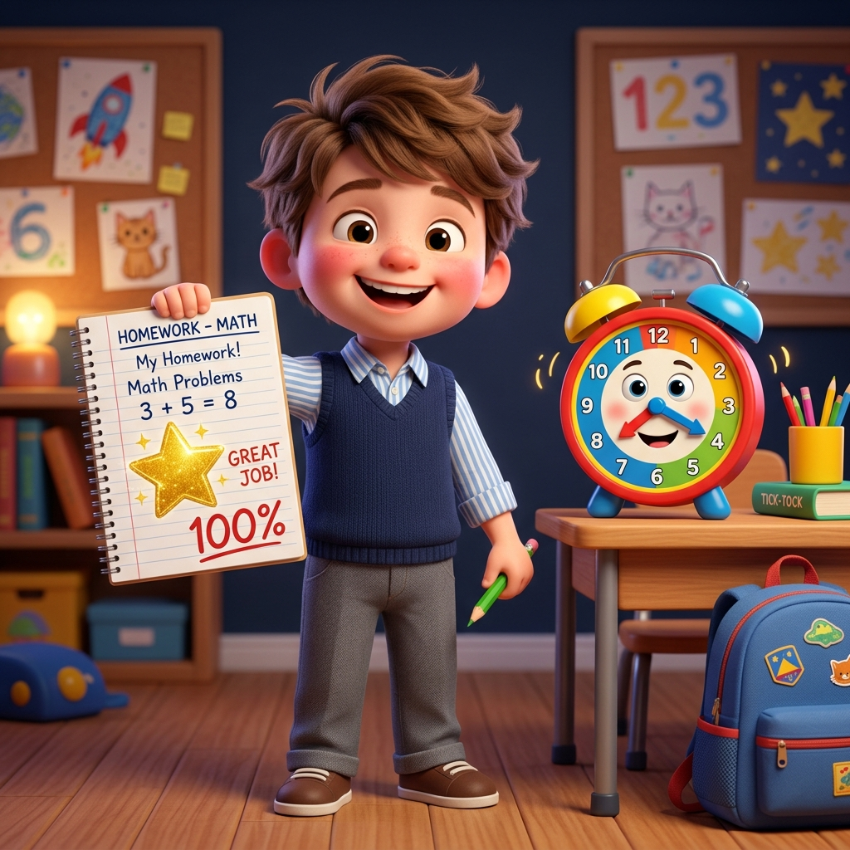
Lesson 3: Numbers 1 to 5 & Counting Fun
🗣 Numbers 1 – 5 • [ 1 • 2 • 3 • 4 • 5 ] • الأرقام والعد الجميل
المعنى والقاعدة الأساسية:
Numbers help us count objects in our world! Let's count from 1 to 5 with Omar and Aly in the classroom and the garden.
أهم نقاط التركيز والاستخدام:
✔ 1 (One): There is 1 sun in the sky • I have 1 apple.
✔ 2 (Two): I have 2 sisters • Look at 2 yellow pencils.
✔ 3 (Three): There are 3 books on the shelf.
💡 مثال عملي تطبيقي:
“ Omar: “How many books do you have?” ➔ Aly: “Let's see... 1, 2, 3. There are 3 books! ”

Slide 9
✦ مصفوفة المقارنة
Grammar Rule: Singular "There is 1..." vs. Plural "There are 2, 3, 4, 5..."
Grammar Rule | Singular (1 Item) • There IS | Plural (2+ Items) • There ARE
Quantity / Count | Exactly 1 item (مفرد واحد فقط) | 2, 3, 4, 5 or more items (جمع)
Sentence Pattern | There is 1 + singular noun | There are + number + plural noun (-s)
Classroom Objects | There is 1 bag on the desk. | There are 3 pencils in the pencil case.
Nature & Animals | There is 1 sun • There is 1 butterfly. | There are 4 flowers • I see 5 birds.
Having & Sharing | I have 1 brother • I have 1 apple. | I have 2 sisters • We have 5 apples.

Slide 10
✦ خطوات التطبيق
Classroom Activity & Values: Count, Match & Share
الخطوة 01
1. Family Detective
Look at the picture: “Who's this?” Choose: (father - mother) / (sister - brother) and say “This is my...”
💡 This is my mother!
الخطوة 02
2. Phonics Sound Hunt
Listen carefully: Does 'Nose' start with N or P? ➔ Letter Nn! Does 'Pencil' start with N or P? ➔ Letter Pp!
💡 Circle Nn or Pp
الخطوة 03
3. Count the Objects
Count how many pencils: “There are 2 pencils.” Count how many stars: “There are 5 bright stars!”
💡 Count: 1, 2, 3, 4, 5
الخطوة 04
4. Value of Sharing
Aly: “I have 5 apples. Do you want one?” ➔ Omar: “Yes, please! Thank you!” Kindness and sharing make us happy.
💡 Polite & Generous

Slide 11
🌟 بالتوفيق والنجاح الدائم
مع تمنياتي لكم بالتفوق والنجاح المستمر دائمًا
“Continuous effort and daily practice are the keys to true English fluency.”
«التعلم والممارسة اليومية المستمرة هما مفتاح طلاقة التحدث بالإنجليزية»
📱 واتساب الحصص والمتابعة المباشرة
+201159330109
للتواصل المباشر وحجز الدروس والمراجعات
🌐 الصفحة الرسمية للمتابعة
مستر محمد ناصر بدوي
تابع أحدث الشروحات والتدريبات اليومية
مستر محمد ناصر بدوي
معلم لغة إنجليزية

