Slide 1
AI Evals in Practice
Week 2
Design reliable automated evaluators
Instructor: Manjeet Singh

Slide 2
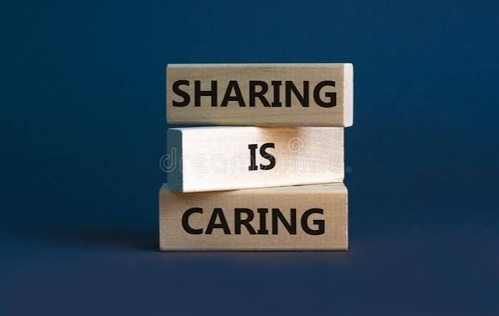
Show your work and Tag me on LinkedIn

Slide 3
Week1 Office Hours

Slide 4
Eval Driven Development: Live Demonstration
10 mins

Slide 5
What you'll learn in Week 2
How to decide how to evaluate a metric?
Learn to design your LLM as judge
Align your LLM judge with Human
How to evaluate multi turn conversation
See an end to end demo of Enterprise EVal
Notes:
Choose the right judge based on the task, including deterministic, human, and LLM-based judges.
Predict evaluation failures by looking at a skill md, prompt, workflow, or agent design.
Balance cost, quality, and speed when designing evals and making launch decisions.
Know when evals will lie to you, including bias, leakage, overfitting, reward hacking, distribution shift.
Continuously improve your evals learn from production failures, customer feedback signals

Slide 6
Today: turn failure codes into evaluators you can trust
1
Choose the right evaluation method
20 min
2
Design an LLM judge that applies your rubric
20 min
3
Validate your evaluator against human judgment
15 min
4
Beyond single answers: multi-turn, tool calls, A/B
20 min
5
Live build, enterprise demo, Project 2
40 min
120 min

Slide 7
TOOLING
Your eval stack: Braintrust
1
Free access for the course
complimentary Braintrust for the whole course — no API key to buy
2
Braintrust is our default
all exercises and demos run on it: datasets, scorers, experiments
3
Prefer another tool?
LangSmith or anything else is fine — the rubrics and the validation method transfer

Slide 8
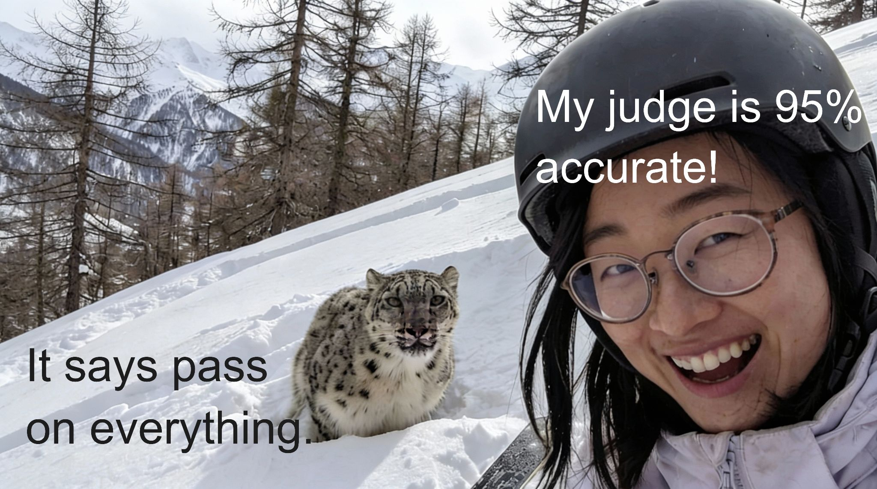
How evaluations can mislead you

Slide 9
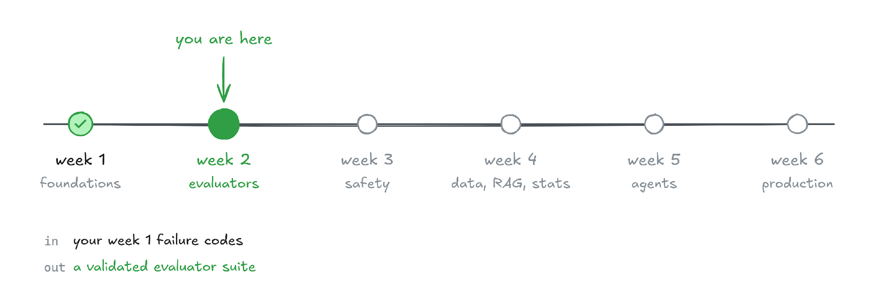
Where week 2 fits

Slide 10
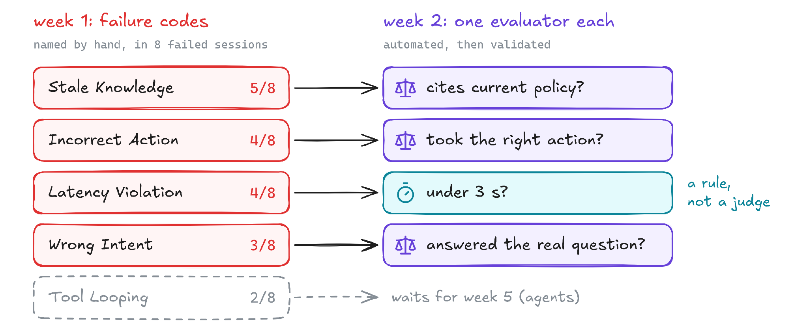
Turn failure codes into automated judges
You are not guessing what to measure. You are automating failures you already named

Slide 11
Choose the right evaluation method
PART 1

Slide 12
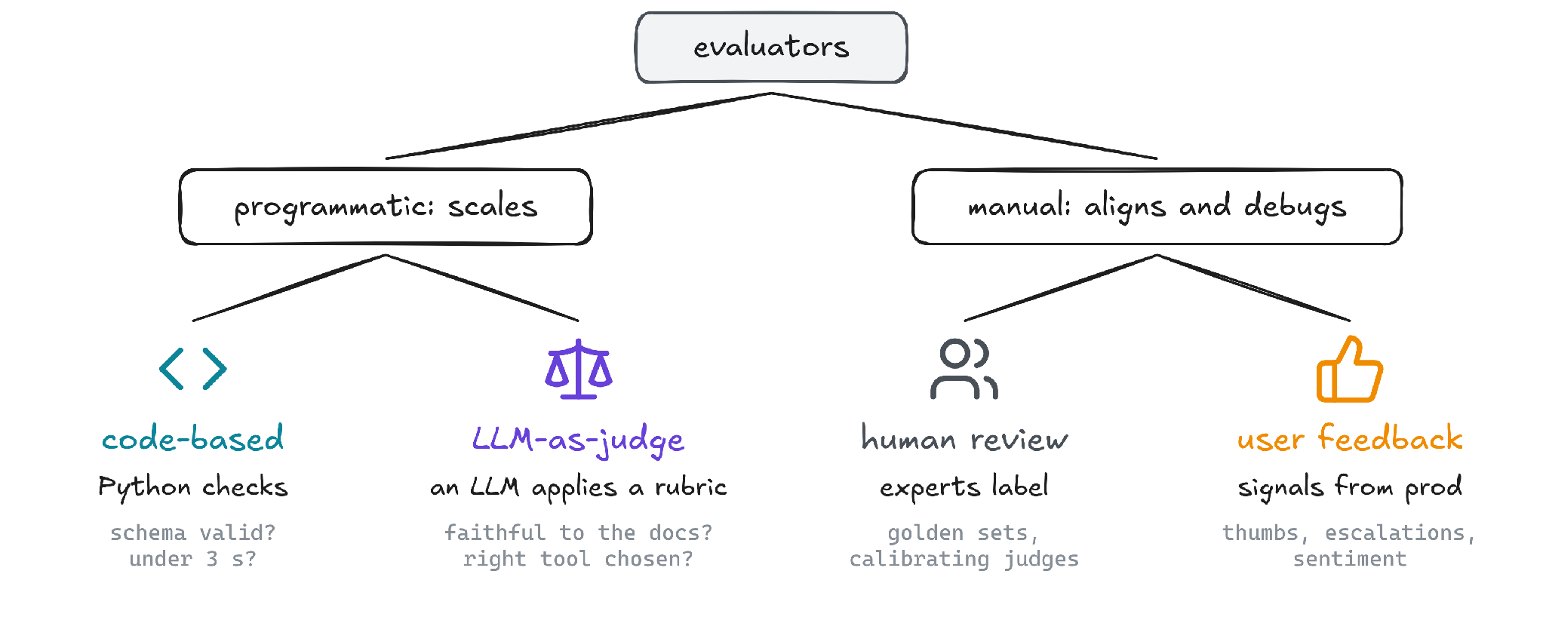
Four evaluator types and when to use them
A rule exists → code · it needs judgment → judge · ground truth → human

Slide 13
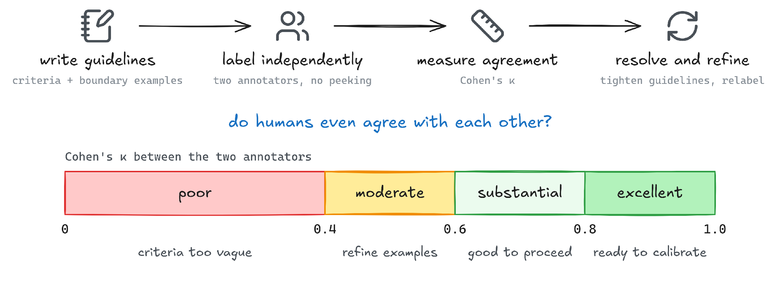
Human labels define the ground truth for validating a judge
Never trust a judge you have not checked against human labels

Slide 14
Why traditional metrics fail for LLM outputs
Metric | What it measures | Works for | Fails when
Exact match | output identical to reference | IDs, labels, classifications | any phrasing variation fails
F1 / precision / recall | token or span overlap | extraction, classification | ignores meaning and order
BLEU / ROUGE | n-gram overlap | translation, summarization | high score ≠ correct
BERTScore | embedding similarity | semantic closeness | misses factual errors

Slide 15
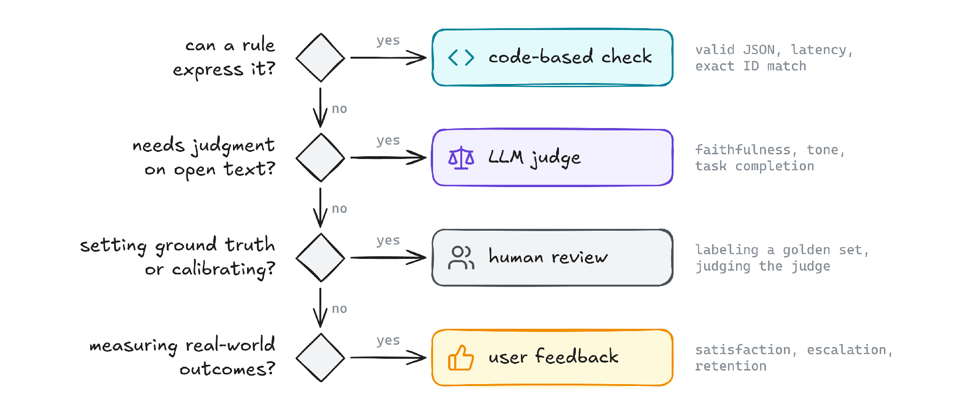
Choose the evaluator by what you are checking: a rule, a judgment, a ground truth

Slide 16
Design an LLM judge that applies your rubric
PART 2

Slide 17
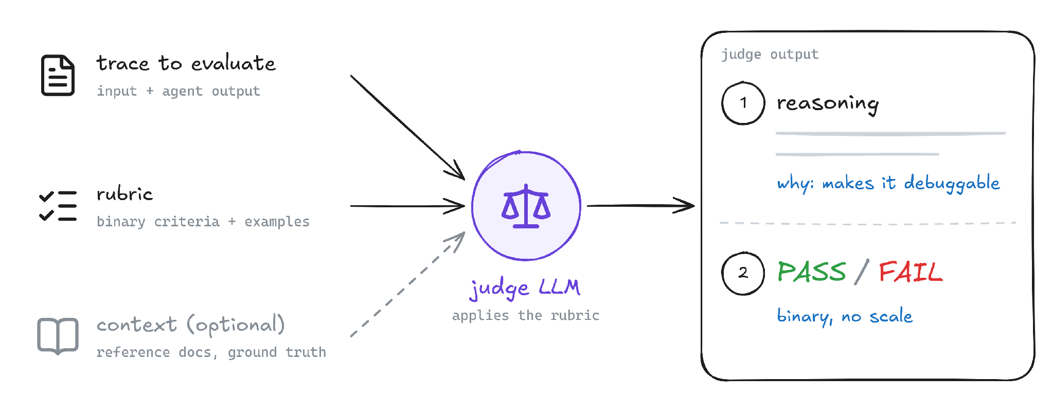
Components of a reliable LLM judge

Slide 18
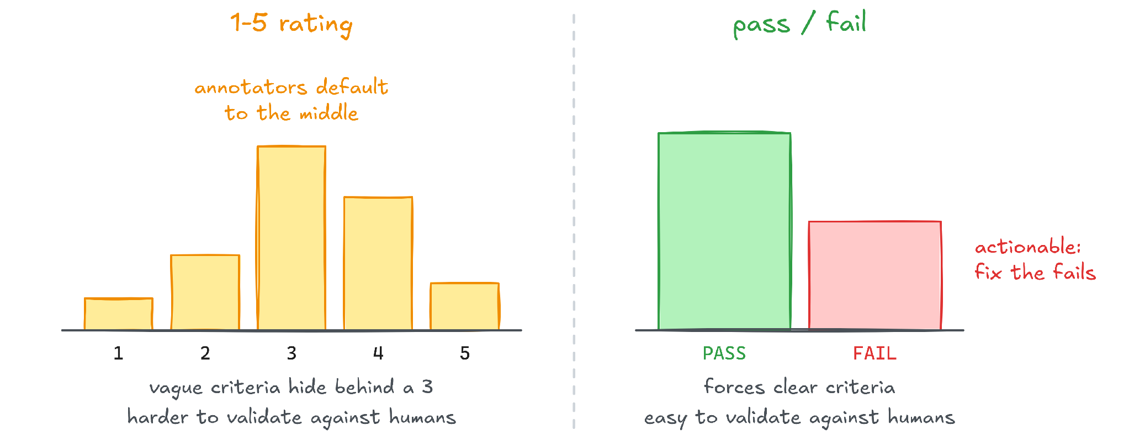
Why pass/fail rubrics are more reliable than 1-5 ratings
Need more detail? Split one 1-5 score into separate binary checks

Slide 19
Elements of a reliable LLM-judge prompt
1
Auditor role
“You are auditing a transcript between a user and a support agent.”
2
Single binary question
“Did every turn that needed a tool call get one?”
3
Concrete standard
PASS and FAIL each defined
4
Boundary example
“Fixing it after the user pushes back does NOT redeem the miss.”
5
Output format
“Reasoning in one or two sentences, then one word: PASS or FAIL.”
Each line comes from the judge prompt on the next slide

Slide 20
Example: a tool-call-or-prose judge prompt
judge prompt
ROLE: You are auditing a transcript between a user
and a support agent.
QUESTION: Did every turn that needed a tool call get one?
PASS: Every turn that needed a tool emitted the tool call.
Why and how questions answered in prose are fine.
FAIL: Any turn needed a tool but the agent replied
with prose only.
Fixing it after the user pushes back does NOT
redeem the miss.
OUTPUT: Reasoning in one or two sentences, then one word:
PASS or FAIL.
1 Auditor role
it evaluates, it does not help
2 Single binary question
one criterion: tool call or prose
3 Concrete standard
PASS and FAIL each defined
4 Boundary example
the edge case, spelled out
5 Output format
reasoning first, then the verdict

Slide 21
One judge, one binary criterion: make failures actionable
Anti-pattern: one prompt, three criteria
Fix: three judges, one question each
“Rate this response 1-5 on helpfulness, accuracy, and tone.”
Helpful? Accurate? Right tone? Each judge answers PASS or FAIL.
Three criteria bleed together: one score, three meanings
When it fails, you cannot tell which one triggered
One failure code per judge, each with its own rubric
Binary forces clarity and is easy to validate against human labels
Accuracy fails, tone passes: you know exactly what broke

Slide 22
Four judge types cover most failure codes
Judge type | What it checks | Example
Tone and style | clarity, verbosity, empathy | empathetic to a frustrated user?
Factual correctness | true, complete, consistent with the reference | hallucination detection
Instruction following | in scope, right structure, correct policy priority | safety-guideline adherence → week 3
Task completion | all steps done, tools and handoffs completed | orchestration correctness → week 5
From week 1: Stale Knowledge → factual correctness · Incorrect Action → task completion

Slide 23
Validate your evaluator against human judgment
PART 3

Slide 24
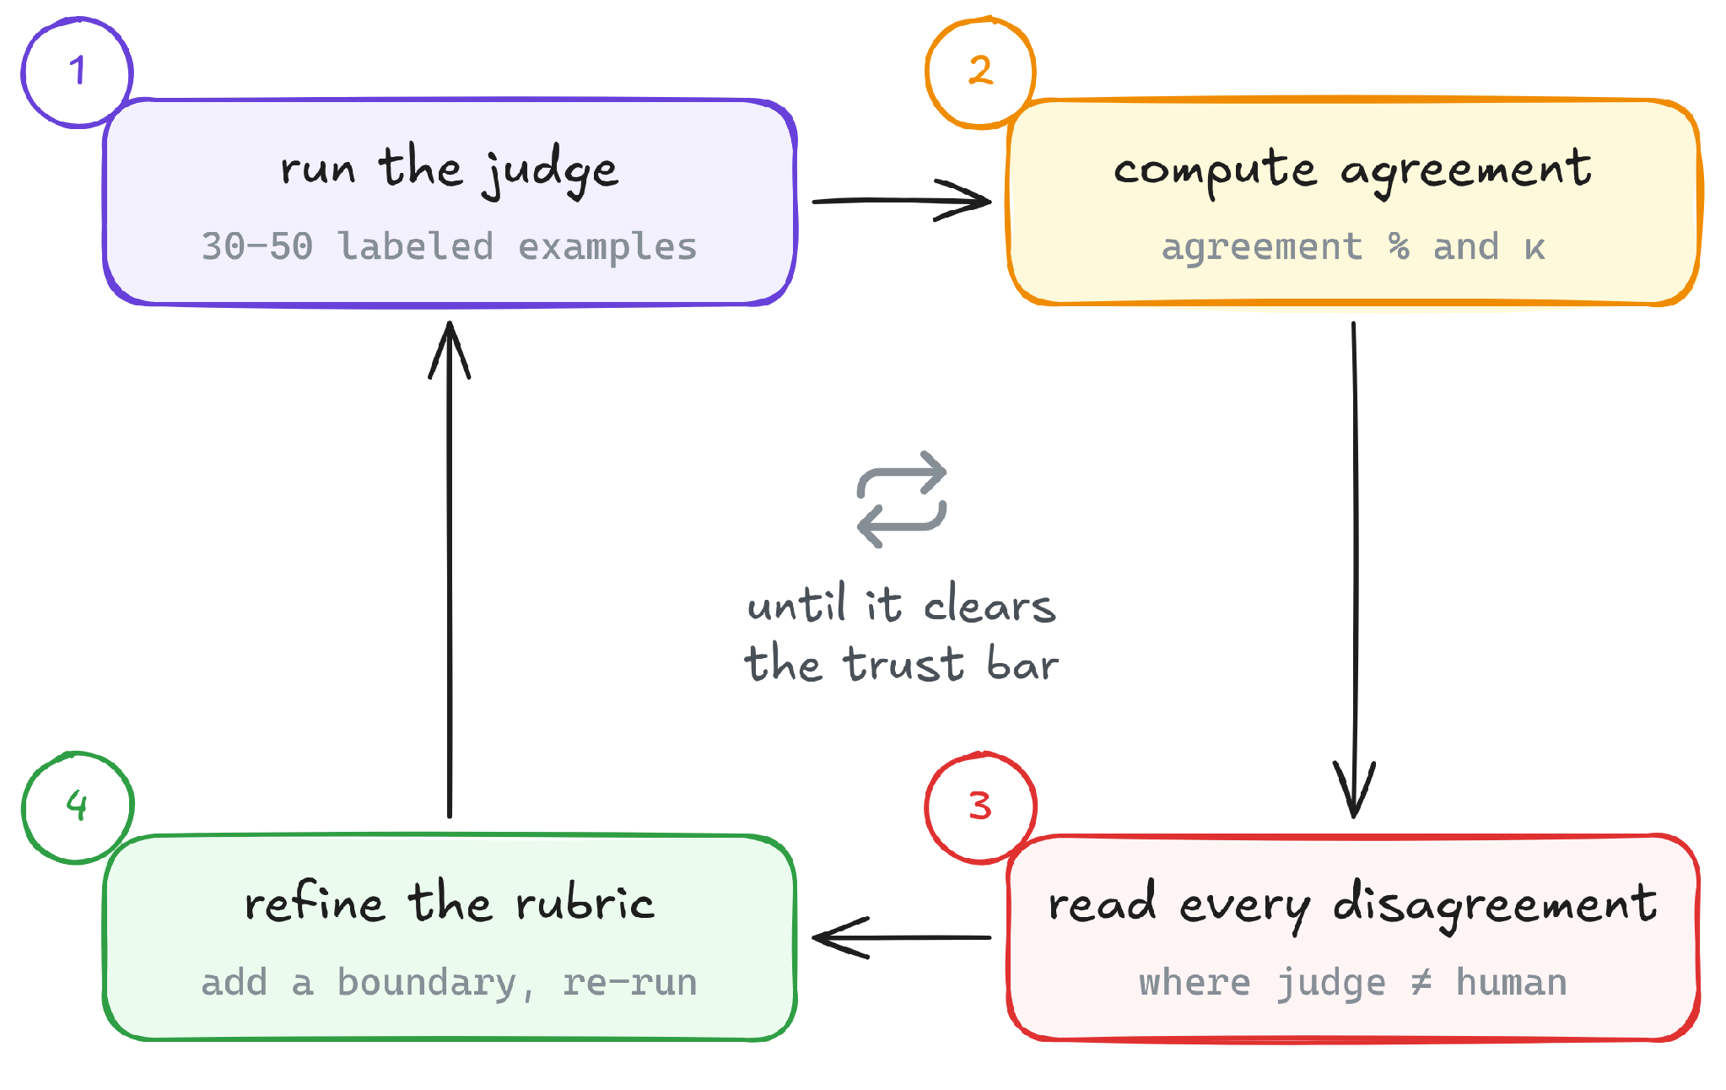
How to validate an LLM judge against human labels
Target: 85% agreement and κ of 0.6 or more, before the judge drives a ship decision
Errors in one direction are a fixable bias. Random errors mean a vague rubric
Keep a held-out set: tuning and testing on the same labels flatters the judge

Slide 25
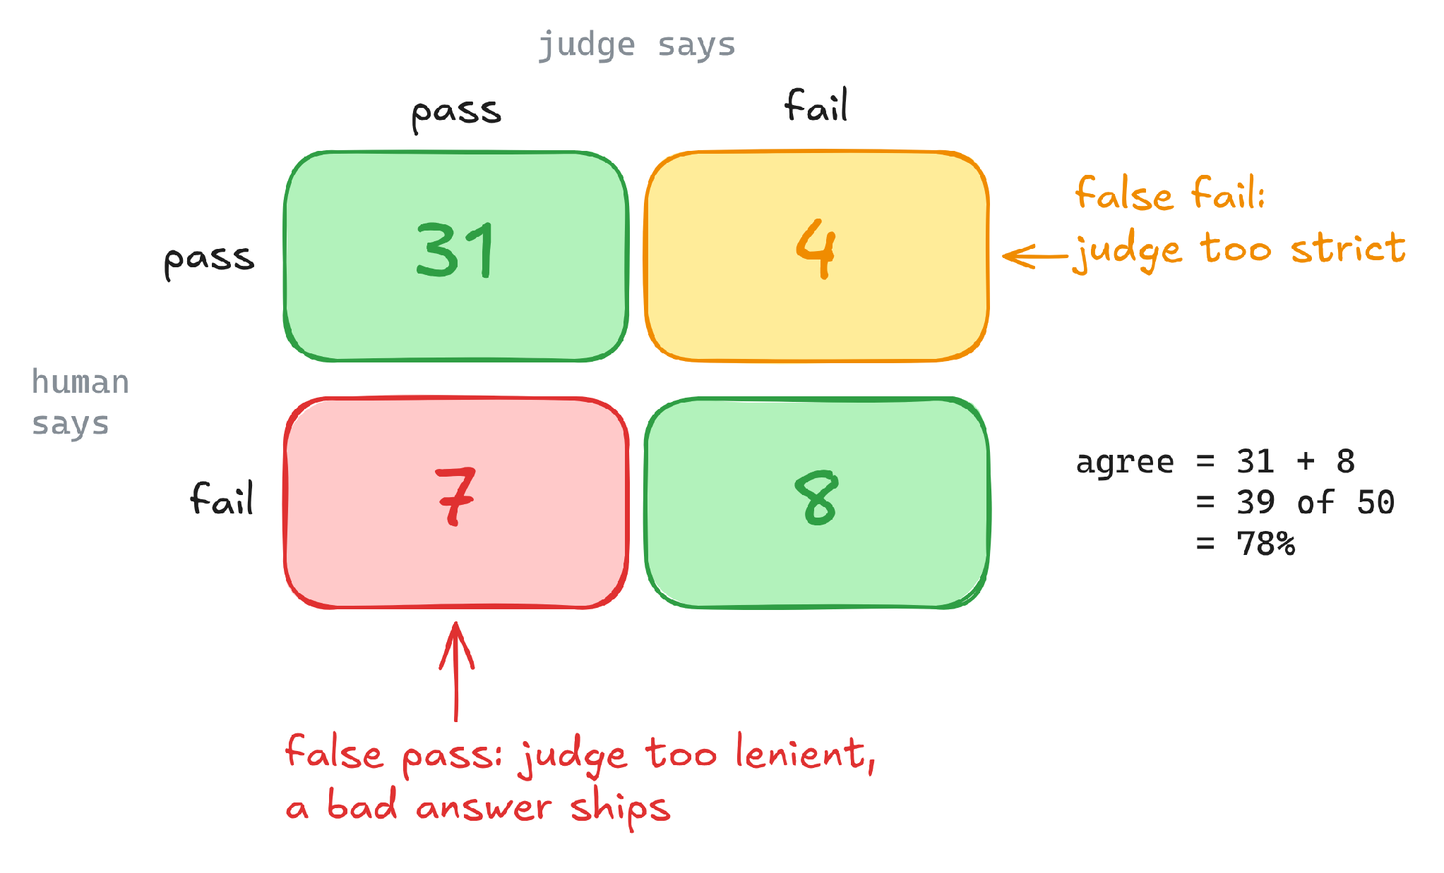
How to read a judge-vs-human agreement matrix
A faithfulness judge against 50 human labels
78% agreement: below the 85% bar
7 false passes: real failures the judge let through
Read those 7 together: 5 cite the wrong doc section, so one boundary rule fixes 5 of the 7 false passes
illustrative numbers
Notes:
Rows are the human label, columns are the judge verdict. Human pass: 31 + 4 = 35. Human fail: 7 + 8 = 15. Agreement = (31 + 8) / 50 = 78%.

Slide 26
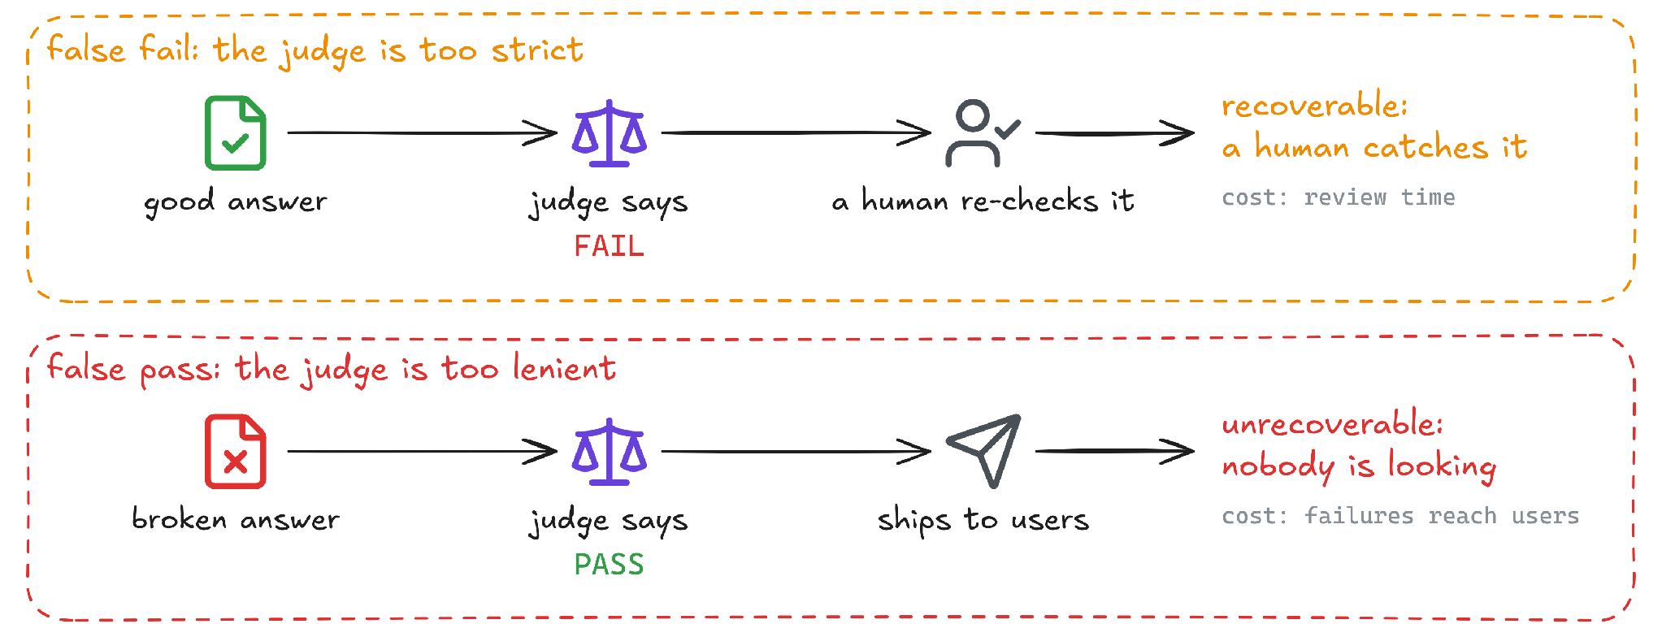
False passes: the most dangerous judge error
Read the false passes together, find the shared loophole, make it a FAIL boundary, re-run

Slide 27
Requirements before you trust and ship a judge
1
Agreement ≥ 85%
3
Few false passes, each one read
on 30-50 diverse human-labeled cases. Easy cases inflate it
the dangerous quadrant is small, and you know exactly what is in it
2
Cohen’s κ ≥ 0.6
4
Failures are explainable
chance-corrected, so a skewed set cannot fool it the way raw accuracy can
you can name why each disagreement happened, not just report a lucky number
Clear these four and you have earned the right to automate

Slide 28
Example: why this faithfulness judge is not ready to ship
The same 50 human labels, checked against the four requirements
Gate | Target | Result | Why | Verdict
1 Agreement | ≥ 85% | 78% | 31 + 8 = 39 of 50 match | FAIL
2 Cohen’s κ | ≥ 0.60 | 0.44 | moderate, not substantial | FAIL
3 False passes | few, each one read | 47% | 7 of the 15 real failures (7 + 8) passed | FAIL
4 Explainable | root cause found | yes | 5 of the 7 false passes cite the wrong doc section | PASS
Not ready. Gate 4 points to the fix: a boundary rule on the cited section
illustrative numbers
Notes:
Cohen's kappa for the matrix 31 / 4 / 7 / 8: observed agreement 0.78. Agreement by chance = (35 x 38 + 15 x 12) / 2500 = 0.604. Kappa = (0.78 - 0.604) / (1 - 0.604) = 0.44. False passes: 7 of the 15 cases the humans marked fail, 47%.

Slide 29
Beyond single answers: multi-turn, tool calls, A/B
PART 4

Slide 30
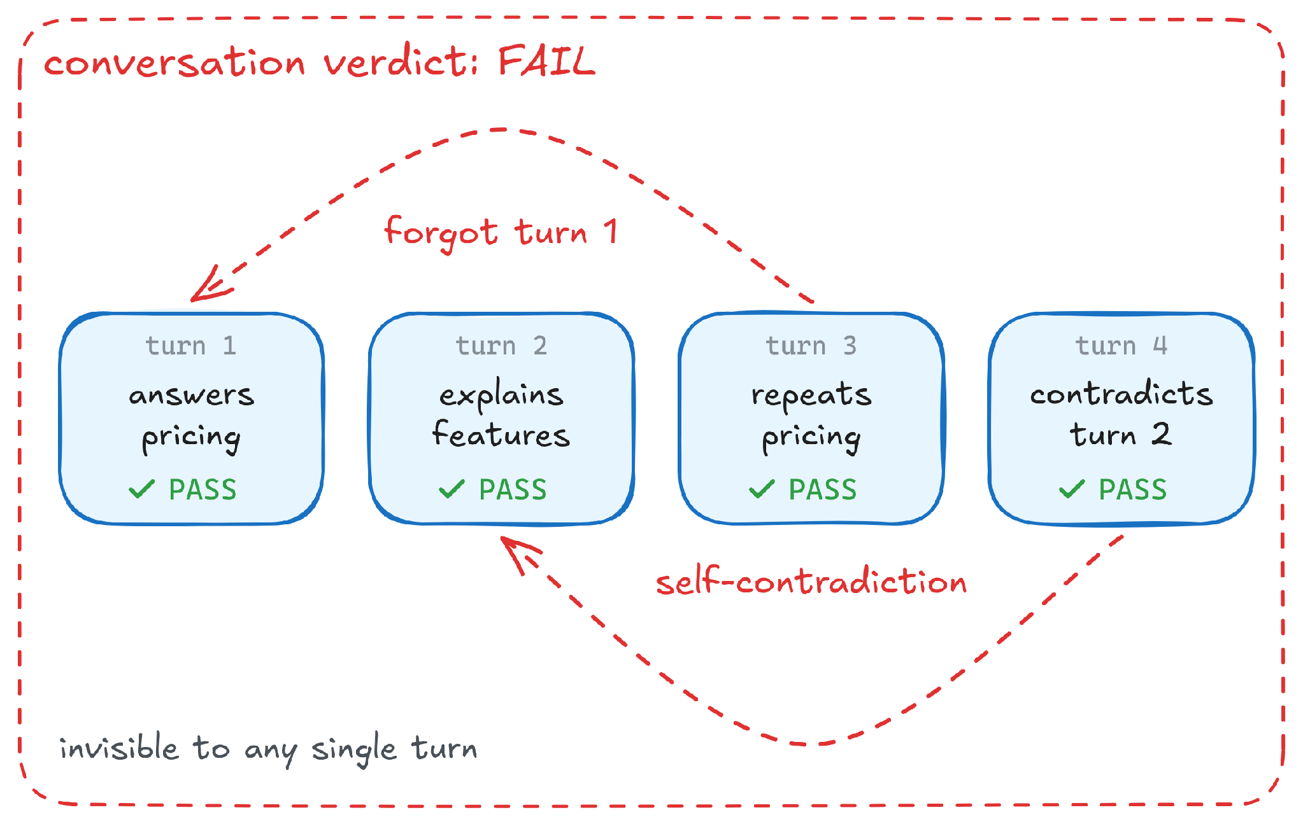
A conversation can fail even when every individual turn passes
Conversation-level checks
Context retention: does turn N remember turns 1 to N-1?
State accuracy: is the tracked state right (cart, preferences)?
Coherence: no contradictions across the session?

Slide 31
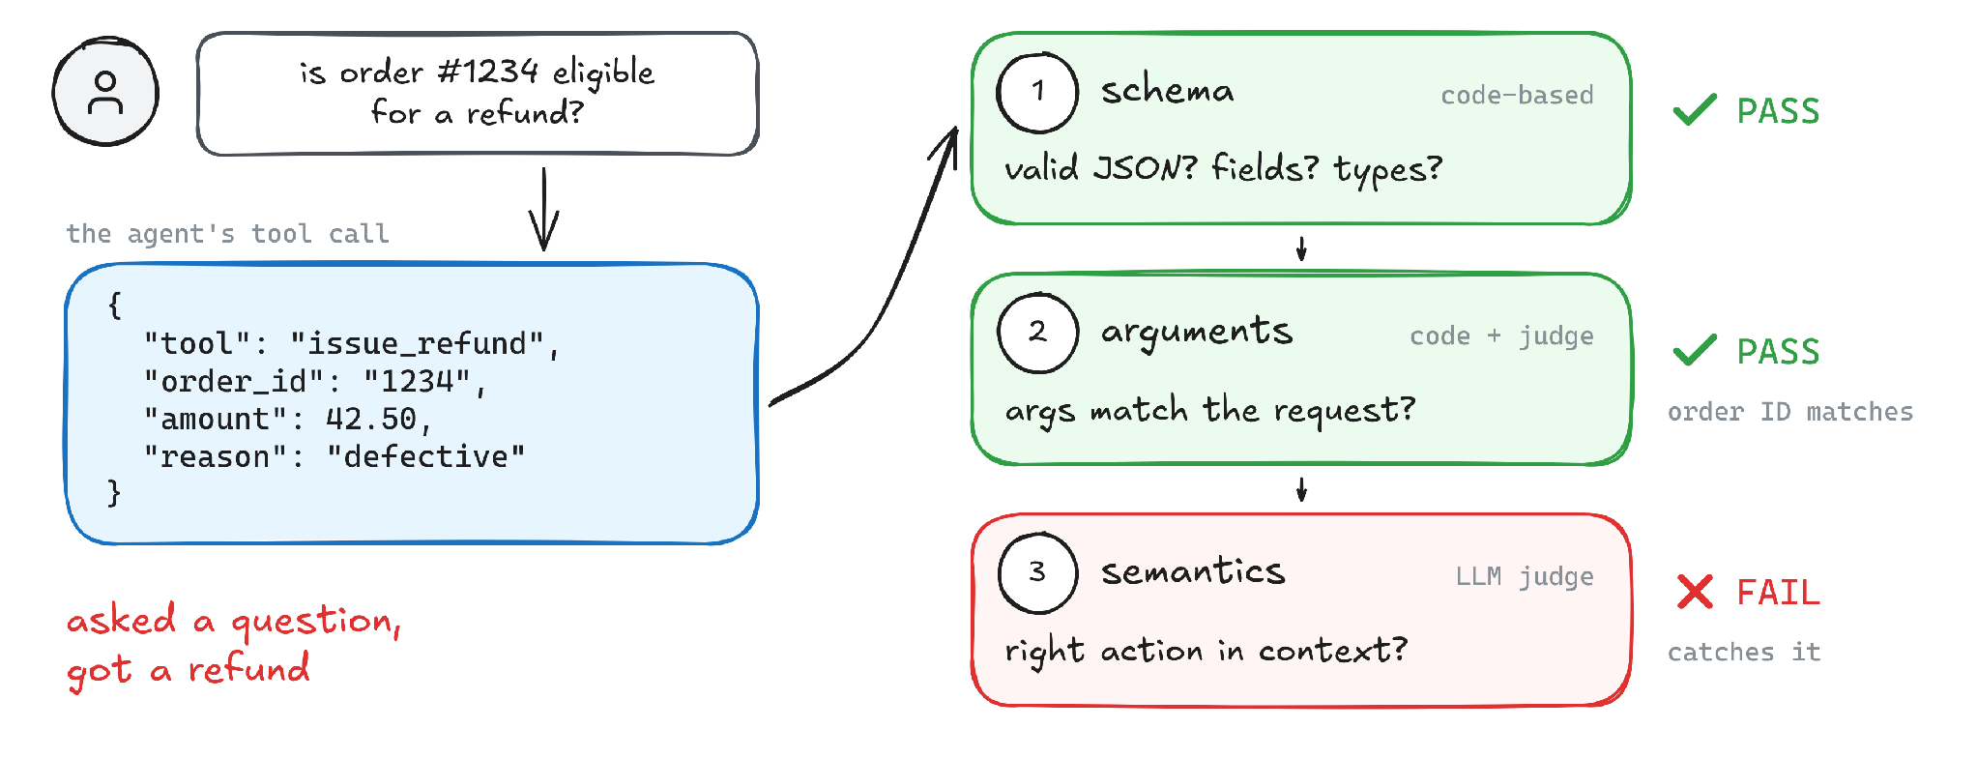
Evaluate tool calls in three layers: schema, arguments, semantics
Valid JSON and a matching order ID: only layer 3 sees a question, not a refund request

Slide 32
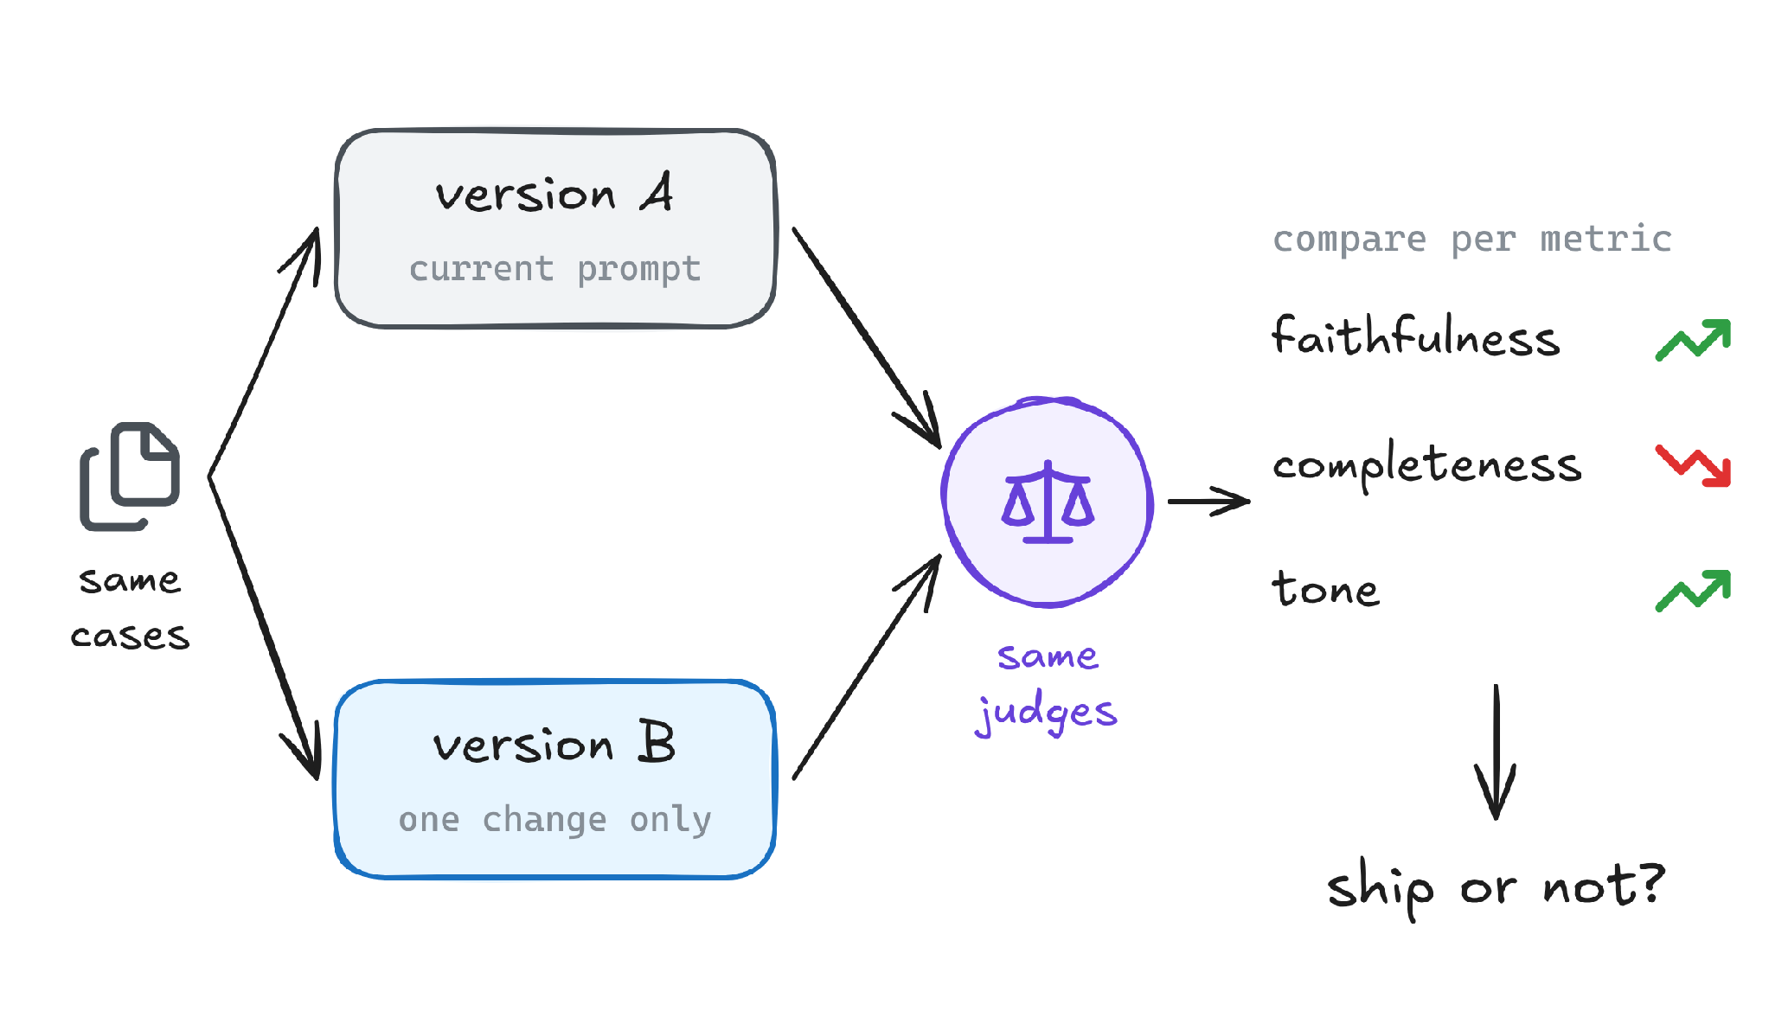
Use A/B evaluation to decide whether a prompt change is better
“I changed the prompt. Did it get better?”
Change one thing at a time: prompt and model together teach you nothing
Run the full suite: never eyeball a handful of examples
Read per-metric deltas: B can win on faithfulness and lose on completeness
offline A/B: same cases, two versions (not a live traffic test)

Slide 33
Live build: a faithfulness judge, validated
PART 5

Slide 34
A naive faithfulness judge scores 4.2 out of 5: what is wrong with it?
judge prompt · naive
4.2 / 5
Rate how faithful this answer is to
the retrieved docs on a scale of 1-5.
Consider accuracy and completeness.
Return a number.
average score
“Looks great, ship it”
illustrative numbers

Slide 35

Why a 1-5 faithfulness judge produces misleading results
Likert scale
scores cluster at 4-5 and mean little
Two criteria in one judge
accuracy AND completeness: which failed?
No concrete pass/fail standard
nothing says what passing actually is
No boundary examples
every ambiguous case is a coin flip

Slide 36
Rewrite the judge as a binary rubric, then test it with human labels
A new judge and a new labeled set of 40
judge prompt · v2
78%
ROLE: You audit a support answer against
its retrieved policy docs.
Q: Is EVERY factual claim supported by
the retrieved docs?
FAIL if: any claim is unsupported, OR it cites
a doc section not in context.
PASS if: fully grounded; minor phrasing
differences are fine.
OUTPUT: One sentence of reasoning, then PASS or FAIL.
31 of 40 agree with the human labels. The bar is 85%
The errors do not look random: something systematic is fixable
So we pull up the agreement matrix
illustrative numbers

Slide 37
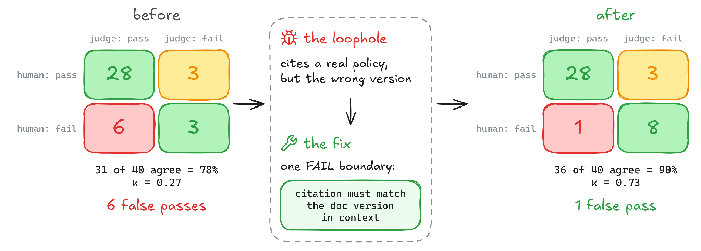
Use judge errors to find the loophole, improve the rubric, and re-test
The same 40 human labels, before and after the fix
One boundary rule: +12 points, 5 of 6 false passes gone
illustrative numbers
Notes:
The human labels do not change: 31 pass and 9 fail in both matrices. Before: (28 + 3) / 40 = 77.5%, shown as 78%, kappa 0.27. After: (28 + 8) / 40 = 90%, kappa 0.73. The fix moves 5 cases from false pass to correct fail.

Slide 38
Use per-metric A/B results to make a safer ship decision
Metric | A (current) | B (new prompt) | Change
Faithfulness | 82% | 91% | +9
Completeness | 88% | 85% | −3
Tone | 90% | 92% | +2
Blended average | 86.7% | 89.3% | +2.7
−3
on completeness. A blended score reads about +3 and hides it
Ship B? It depends on which failure hurts users more, and on whether −3 is real (week 4)
illustrative numbers
Notes:
Blended average: (82 + 88 + 90) / 3 = 86.7 for A and (91 + 85 + 92) / 3 = 89.3 for B, so +2.7, which reads as about +3.

Slide 39
HANDS-ON · 15 MIN
Judge Calibration Game
1
Label 24 Pronto responses
2
Write a judge prompt
pass or fail, in your browser — mock mode needs no API key
one binary question, then watch it grade your labels live
3
Read your agreement live
4
Check against the gold key
accuracy, precision/recall, F1, Cohen's κ as you label
see where your labels — and your judge — disagreed
5
Bring your own key (optional)
6
No setup, no installs
add an OpenAI or Anthropic key to grade with a real model
runs entirely in the browser — source lives in the repo
Play it here:
coachmanjeet.github.io/AI-Agent-Evals-Course/judge-calibration-game/

Slide 40
Project 2: build and validate judges for Pronto
PART 6

Slide 41
Project 2: build, validate, improve and compare three judges
1
Write 3 binary rubrics
4
Diagnose and fix
policy adherence, escalation correctness, tool-call accuracy
read the false passes; add a boundary; re-run
2
Implement as judges
5
Hit the trust bar
one per rubric, as Braintrust scorers (LangSmith or others fine too). Output: reasoning, then PASS or FAIL
85% agreement and κ ≥ 0.6 on your worst judge; read every false pass
3
Run against 40 labels
6
A/B two variants
label 40 Pronto outputs by hand; compute agreement and κ
compare prompt A and prompt B across all three judges
Submit: 3 judge prompts, validation metrics, error analysis, revised rubrics, per-metric A/B results, a ship or no-ship call

Slide 42

Project 2: definition of done
3 binary judges, each answering one question
no Likert, no multi-criteria prompts
Each judge run against the 40-label set
agreement and Cohen’s κ computed
My worst judge reaches 85% agreement and κ ≥ 0.6
after at least one diagnose-and-fix cycle
I can name each judge’s shared loophole
the pattern behind its false passes
A/B comparison reported per metric
deltas per judge, not one blended score
A ship or no-ship call with a reason
which regression I would accept, and why

Slide 43
Practice: why 94% agreement can still mean your judge is unreliable
The scenario
Two questions
Your teammate ships a new faithfulness judge
100 cases: 93 pass and 7 fail by human label. The agent is usually right
94% agreement between the judge and the human labels
The judge marks almost everything pass
Why is 94% agreement misleading here, and what would you check instead?
Which quadrant of the matrix would you look at first, and why that one?

Slide 44
Answer: check κ and the false passes, not agreement
 | Judge: pass | Judge: fail
Human: pass | 93 | 0
Human: fail | 6 | 1
0.24
Cohen’s κ. The bar is 0.6
1 of 7
agreement = (93 + 1) / 100 = 94%
real failures caught. The judge passed the other 6
Always saying pass scores 93% for free. 94% is one point better
Look at the false-pass quadrant first: that is where the dangerous errors hide
Notes:
Cells: 93 / 0 / 6 / 1 on 100 cases. The judge says pass 99 times. Agreement = 94 / 100. Agreement by chance = 0.93 x 0.99 + 0.07 x 0.01 = 0.921. Kappa = (0.94 - 0.921) / (1 - 0.921) = 0.24.

Slide 45
Week 2 takeaways: build judges you can trust
Four evaluator types
Validate every judge
rule → code · judgment → judge · ground truth → human · outcomes → user feedback
85% agreement, κ ≥ 0.6, every false pass read
Binary, single-question judges
The false pass is the danger
auditor role, concrete standard, boundary examples
a false fail wastes time, a false pass ships harm
Humans agree first
A/B per metric
if κ between annotators is low, no judge will agree either
same suite, one change, read each delta separately

Slide 46

Thank you!
Next steps: complete Project 2
and prepare for week 3

Slide 47
Show your work and Tag me on LinkedIn

